Slide 1

Understanding and Combatting CVD in the Fire Service
NYSPFFA
Health & Safety Conference
September 19, 2017

Slide 2
Denise L. Smith
Professor of Health and Exercise Sciences
Skidmore College, Saratoga Springs, NY
Research Scientist
University of Illinois Fire Service Institute
Firefighter Fatality Investigator
National Institute for Occupational Safety and Health

Slide 3
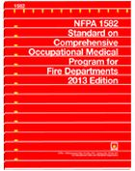
Disclosures
Expert Witness (cardiovascular events, heat stress)
Consultant
Member of NFPA Technical Committee on FS Occupational Safety and Health
Author

Slide 4
Combatting CVD
Section 1 – Health and Safety in the Fire Service
Section 2 – Cardiovascular Strain of Firefighting
Section 3 – Linking Cardiovascular Strain to Sudden Cardiac Death
Section 4 – Strategies to Combat CVD in the Fire Service

Slide 5


Section One Health and Safety in the FS
Firefighting Fatality Statistics
Research Findings

Slide 6
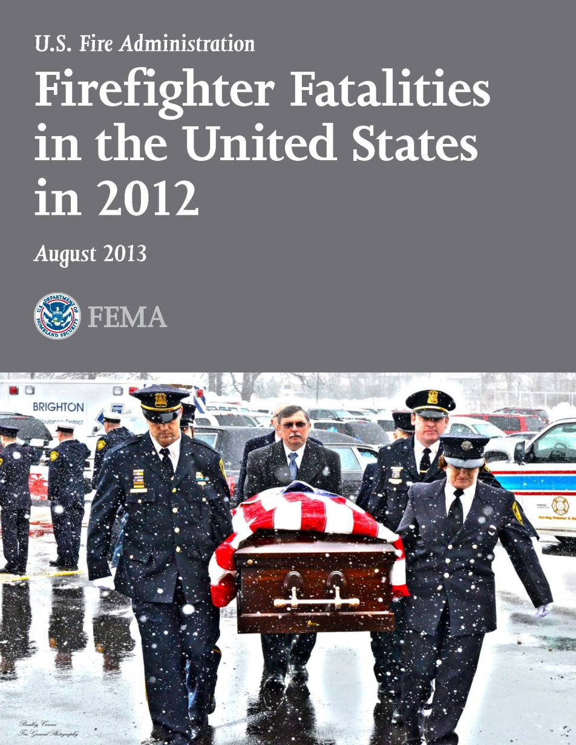
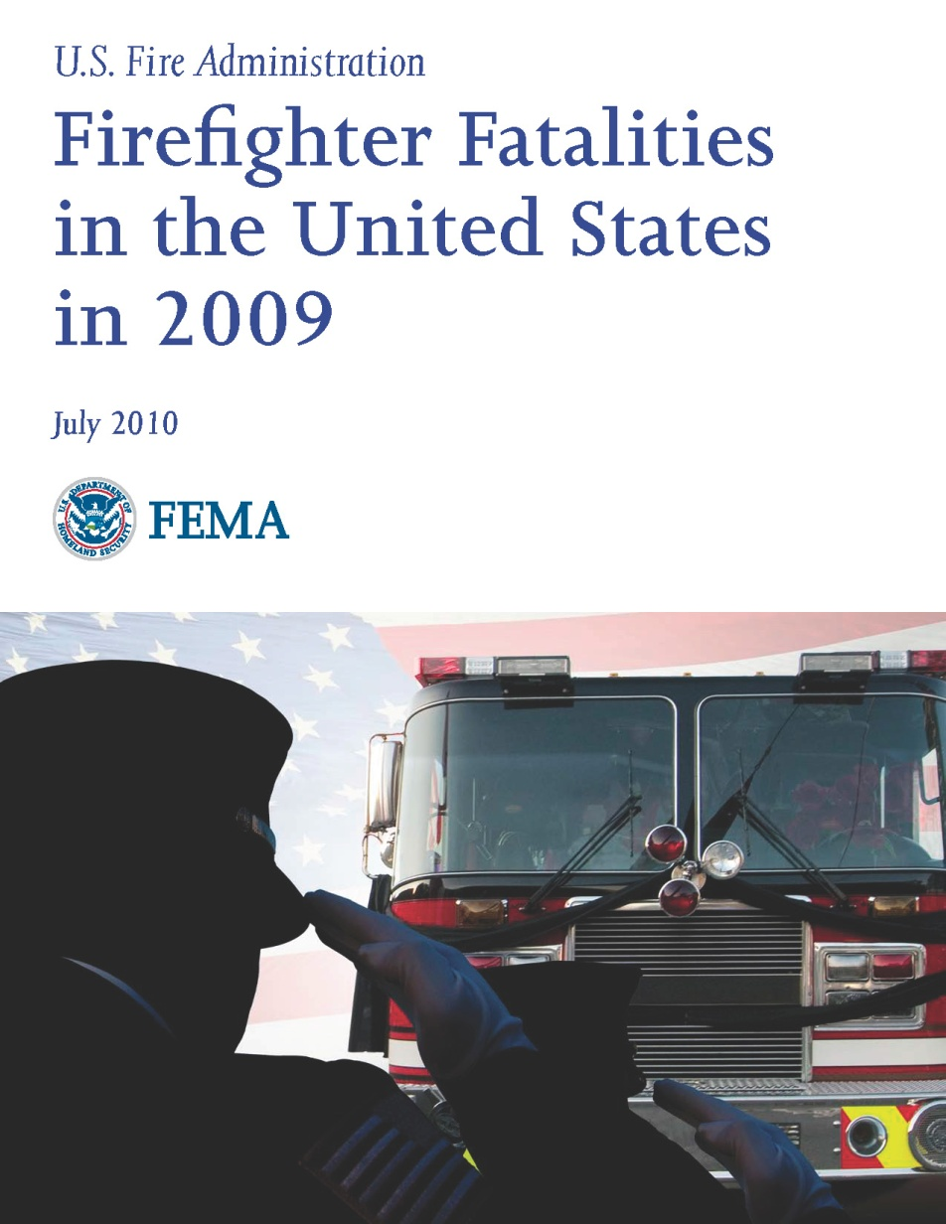
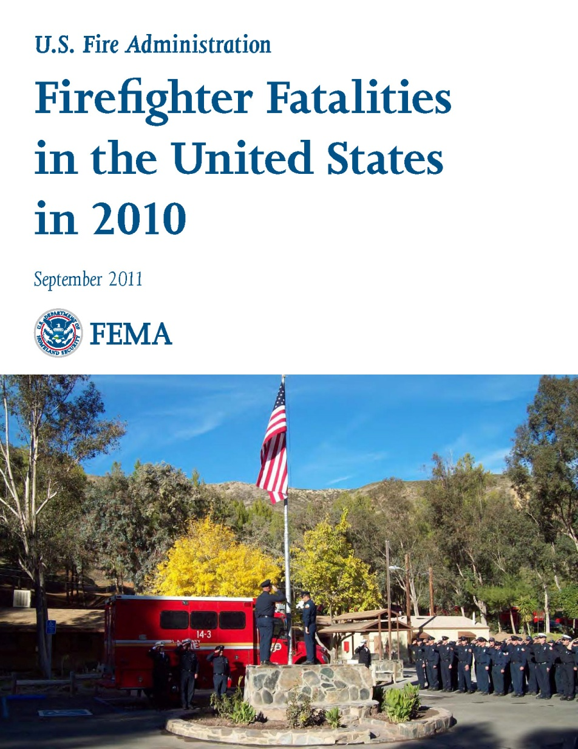
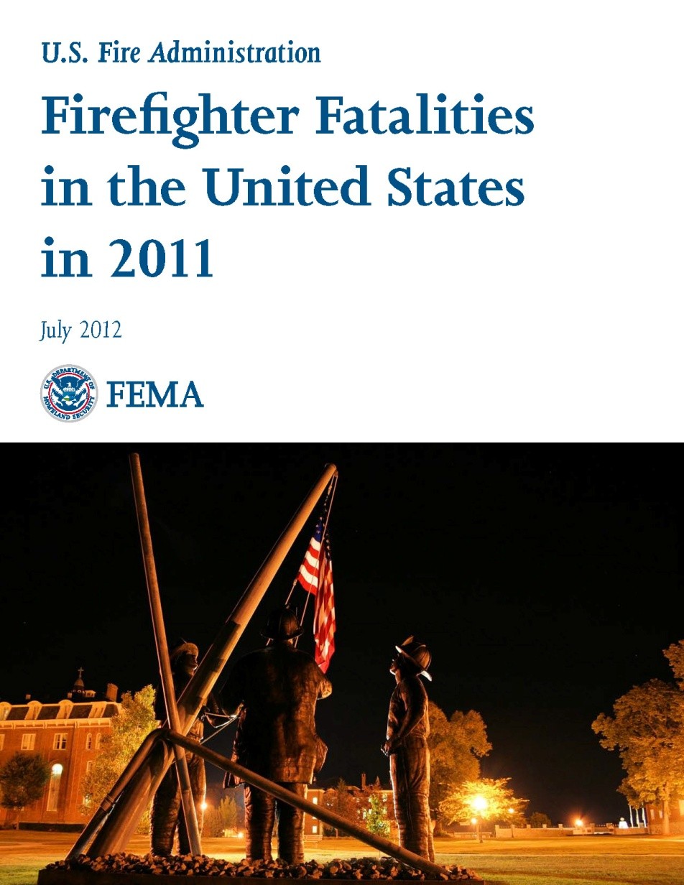
Firefighter Fatality Statistics
Firefighter Deaths
Firefighter Deaths − 2016
Fahy et al. 2017, NFPA.

Slide 7
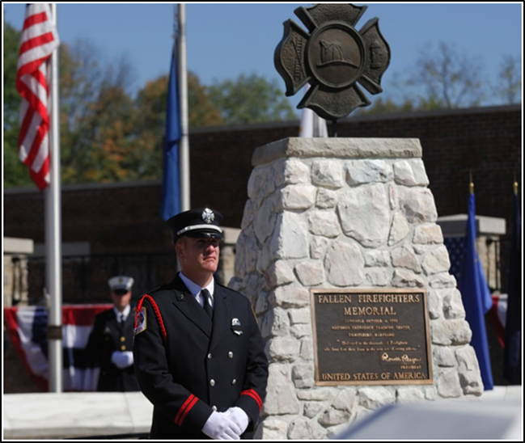
Firefighter Fatalities & Injuries
Fatalities
80–100 deaths per year
~50% of LODD due to SCE
1995–2015: 918 deaths due to overexertion & strain (cardiac, CVA, heat exhaustion)
Non-fatal CV events
700–1000 per year (reported)

Slide 8

Research Findings
Line of Duty Deaths - CHD related
N=449, 1994-2004
Kales et al. 2007
 | Time Spent (%)
Fire Suppression | 1%
Response to Alarm | 4%
Return from Alarm | 7%
Physical Training | 8%
Nonfire emergencies | 15%
Nonemergency duties | 65%
Fatalities (%)
32%
13%
17%
13%
9%
15%
Odds Ratio
136
14.1
10.5
6.6
2.6
1.0
Skidmore College
First Responder Health & Safety Lab

Slide 9
Health & Safety in the Fire Service
How do Health, Safety, & Wellness fit together?
Wellness:
Being in good physical and mental health
Safety:
Being free from harm
Health:
Being free from disease
01, 2013 By Ira OzerSep. "Safety and Wellness: The Critical Connection -- Occupational Health & Safety." Occupational Health & Safety. 1105 Media, Inc, 1 Sept. 2013. Web. 12 Oct. 2016.

Slide 10
Health
Safety
Health
Safety
Initiatives
Risks

Slide 11
Firefighter Fatality Statistics
Firefighter Fatalities
Fahy et al. 2017, NFPA.

Slide 12
Section Two Cardiovascular Strain of Firefighting
Physical Demands of Firefighting
Physiological Responses to Firefighting

Slide 13
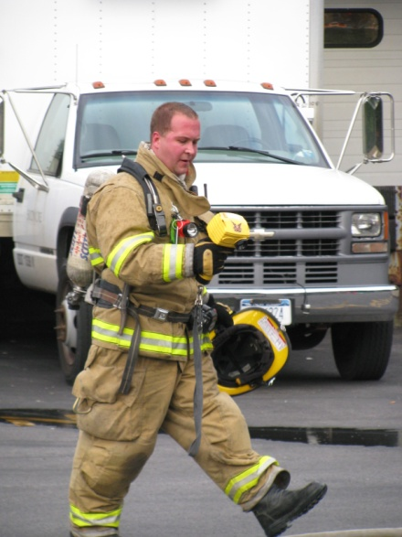
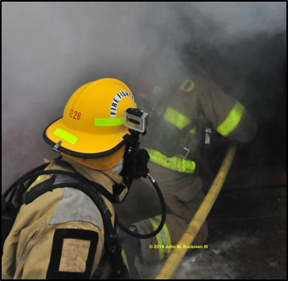
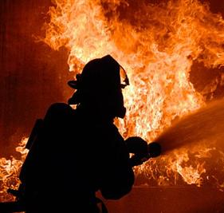
Physical Demands of Firefighting
Strenuous work
Climbing stairs
Forcible entry
Search and rescue
Heavy PPE
> 22 kg
↑ Metabolic work
↓ Heat dissipation
Restrictive
Hot and Dangerous Environment
Routinely over 100°C
Chaotic
Low visibility

Slide 14
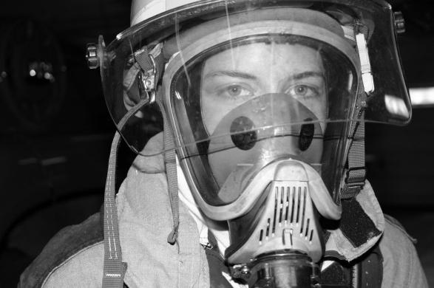
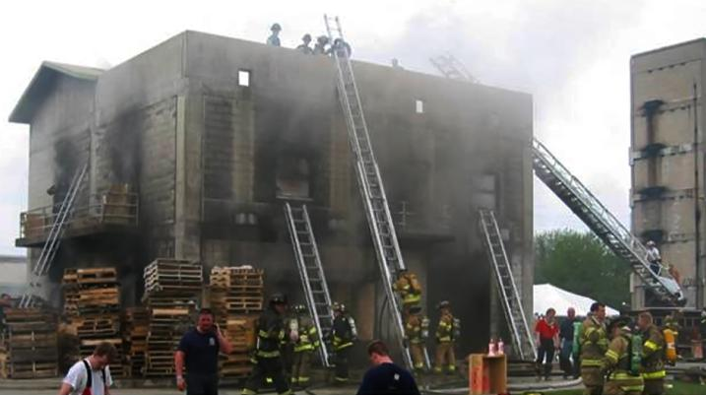
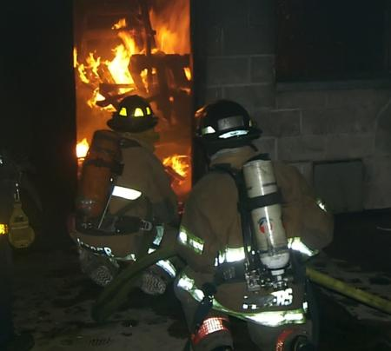
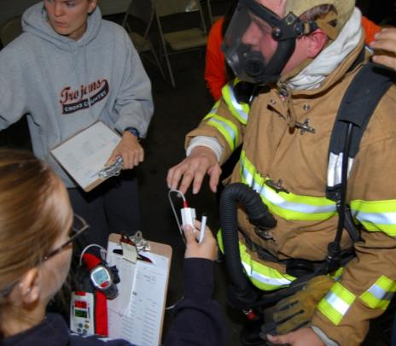
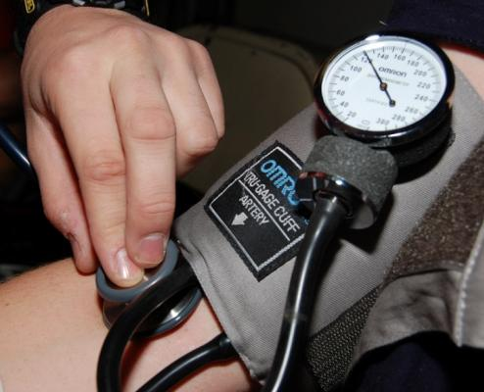
Physiological Strain of Firefighting

Slide 15
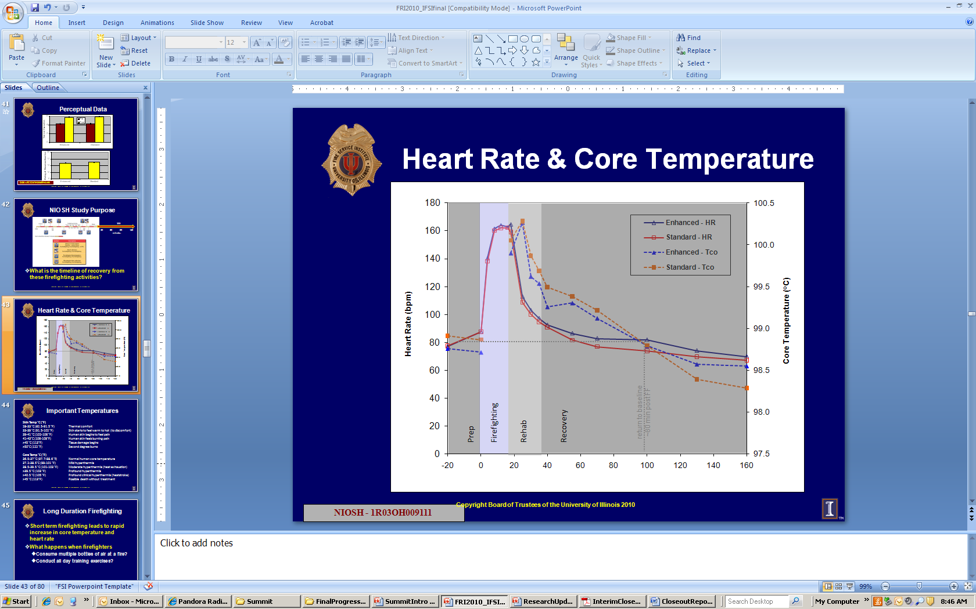

Documented Thermoregulatory Strain of Firefighting
Core Temperature
Hydration Status
↑ Core Temp
Time (min)
Skidmore College
First Responder Health & Safety Lab
Horn et al. 2011, Prehosp Emerg Care.

Slide 16
Documented Thermoregulatory Strain of Firefighting
Core Temperature
Hydration Status
↑ Core Temp
Skidmore College
First Responder Health & Safety Lab

Slide 17
Documented Thermoregulatory Strain of Firefighting
Core Temperature
Hydration Status
↑ Core Temp
Skidmore College
First Responder Health & Safety Lab

Slide 18
Documented Thermoregulatory Strain of Firefighting
Core Temperature
Hydration Status
↓ Body Weight
↓ Plasma Volume
ª
Smith et al. 2011, J Thermal Biology.
ª Significantly different (p<0.05) than immediately post
Skidmore College
First Responder Health & Safety Lab

Slide 19
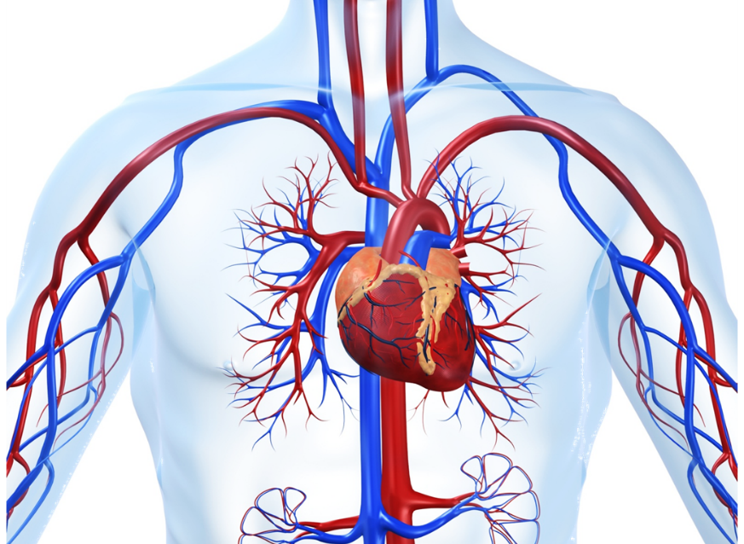
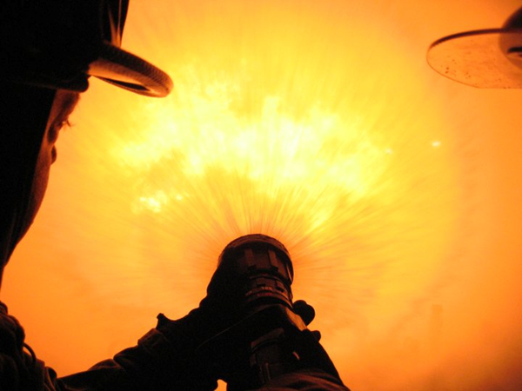
Documented Cardiovascular Strain of Firefighting
Cardiac
Vascular
Blood/Coagulatory
Skidmore College
First Responder Health & Safety Lab

Slide 20
Documented Cardiovascular Strain of Firefighting
Cardiac
Vascular
Blood/Coagulatory
↑ HR
↑ RPP
↓ SEVR
Time (min)
Skidmore College
First Responder Health & Safety Lab
Horn et al. 2011, Prehosp Emerg Care.

Slide 21
Documented Cardiovascular Strain of Firefighting
Cardiac
Vascular
Blood/Coagulatory
↑ HR
↑ RPP
↓ SEVR
Horn et al. 2011,
Prehosp Emerg Care.
Skidmore College
First Responder Health & Safety Lab

Slide 22
Documented Cardiovascular Strain of Firefighting
Cardiac
Vascular
Blood/Coagulatory
↑ HR
↑ RPP
↓ SEVR
Horn et al. 2011, Prehosp Emerg Care.
Skidmore College
First Responder Health & Safety Lab

Slide 23
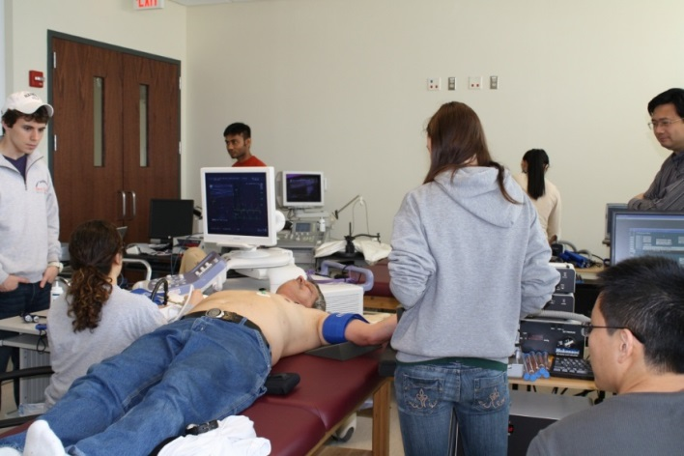
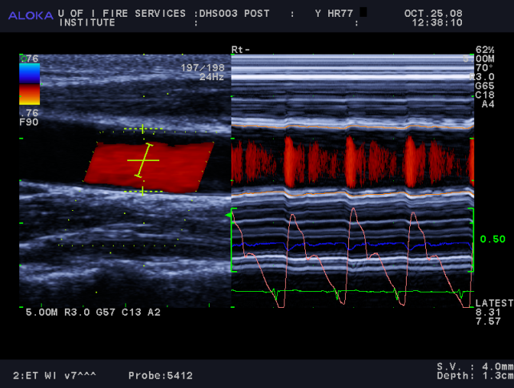
Documented Cardiovascular Strain of Firefighting
Cardiac
Vascular
Blood/Coagulatory
Arterial stiffness
Microvascular function
Blood flow
Yan et al. 2012, Eur J Appl Physiol;
Fahs et al., Vascular Medicine.
Skidmore College
First Responder Health & Safety Lab

Slide 24
Documented Cardiovascular Strain of Firefighting
Cardiac
Vascular
Blood/Coagulatory
↑ Platelet # / fxn
↓ Clotting time
Platelet Number
Aggregation Time
*
*
*Significantly different (p<0.05) from Pre
Skidmore College
First Responder Health & Safety Lab
Smith et al. 2011,Prehosp Emerg Care.

Slide 25
Documented Cardiovascular Strain of Firefighting
Cardiac
Vascular
Blood/Coagulatory
↑ Heart rate
Rate pressure product
↓ Subendocardial viability ratio
Arterial stiffness
Microvascular function
Blood flow
Plasma volume
Platelet number & function
↓ Clotting time
Skidmore College
First Responder Health & Safety Lab

Slide 26
Factors That Affect FF Responses
Work Performed
Gear
Thermal
Environment
Environmental
Factors
Physiological Responses to Firefighting
Personal
Factors
Health Status
Fitness
Hydration Level

Slide 27
Factors That Affect FF Responses
Work Performed
Gear
Thermal
Environment
Environmental
Factors
Physiological Responses to Firefighting
Personal
Factors
Health Status
Fitness
Hydration Level

Slide 28
Factors That Affect FF Responses
Stair Trial
Cardiac strain index = HR × duration (minutes)
Assignment Phase

Slide 29
Factors That Affect FF Responses
Work Performed
Gear
Thermal
Environment
Environmental
Factors
Physiological Responses to Firefighting
Personal
Factors
Health Status
Fitness
Hydration Level

Slide 30
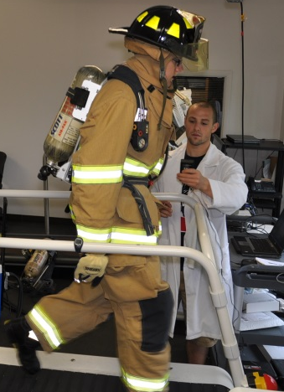
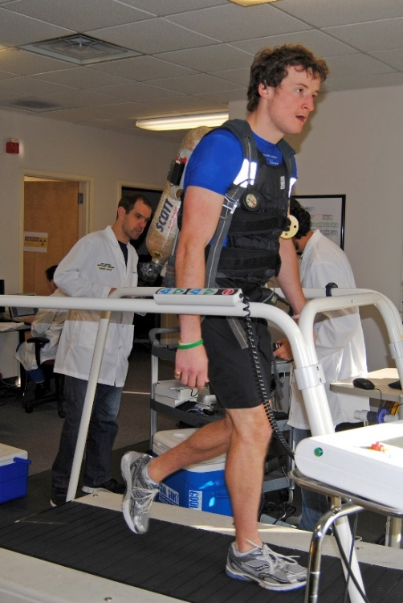

Heat Stress & Dehydration
Fehling et al. 2015, Occupational Medicine.

Slide 31
Section Three Linking CV Strain to SCE
Theoretical Models
Who is at Risk?

Slide 32
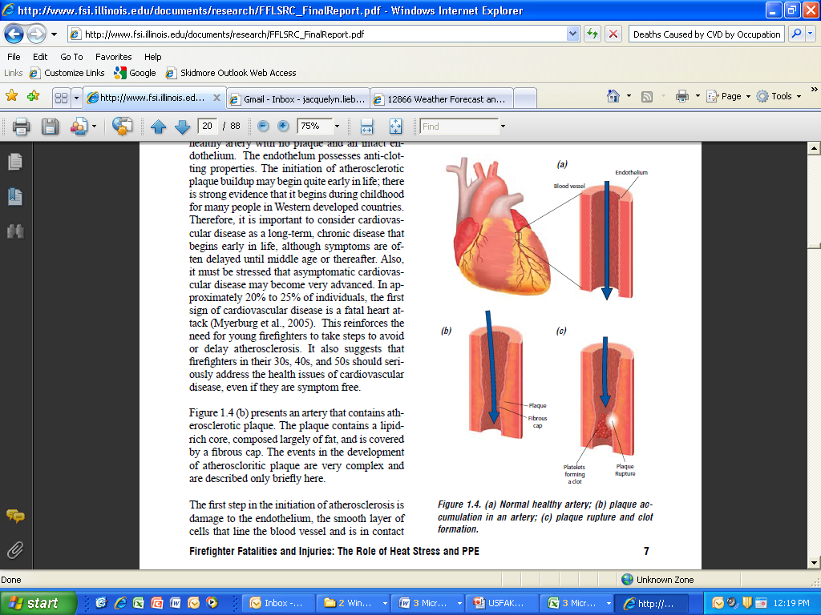
Model of Sudden Cardiac Event

Slide 33
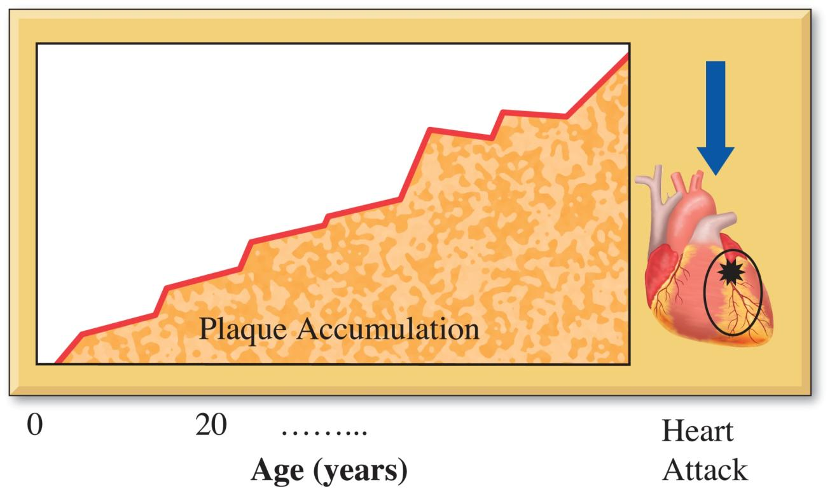
Model of Sudden Cardiac Event
Firefighting
Trigger

Slide 34
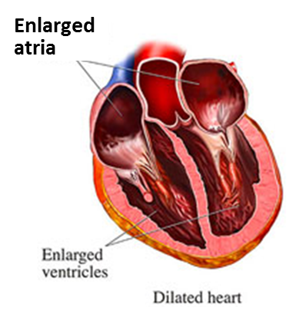
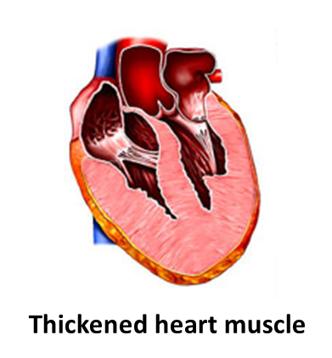
Structural Changes
Cardiomegaly – enlarged heart (>450 g)
Left ventricular hypertrophy (LVH) – thickened left ventricle (≥1.2 cm)
Enlarged
ventricles
Skidmore College
First Responder Health & Safety Lab

Slide 35

Cardiovascular Strain of Firefighting
Increased Cardiac Work/Shear Stress
Ischemia
Altered
Vascular Function
Enhanced
Coagulatory Potential
A)
Cardiomegaly/LVH,
and/or Underlying CHD
Underlying CHD
Plaque Rupture and Thrombus Formation
Arrhythmia
B)
SCD or
Other CVD Event
Smith et al. 2013.
Skidmore College
First Responder Health & Safety Lab

Slide 36
Model of CVE in the FS
Occupational
Tobacco
Alcohol
Poor Diet
Sedentary Behavior
Fire Smoke
Noise
Stress
Shift Work/
Sleep Deprivation
Triggers/
Strenuous Duties
Known
CHD or
Equivalent
Personal
Genetics
Baseline Habits
Initial Body Composition & Fitness Level
Medical
Hypertension
Dyslipidemia
Diabetes
Obesity
Death
Disease
Disability
Subclinical
Disease
+/- LVH
Behavioral
Regular Exercise
Physical Activity
Healthy Diet
Adequate Sleep
Moderate Alcohol
Tobacco Free
Acute
CVD
Events
Progression of Atherosclerosis or Structural Heart Changes
Adapted from Soteriades et al. 2011,
Cardiology in Review.

Slide 37
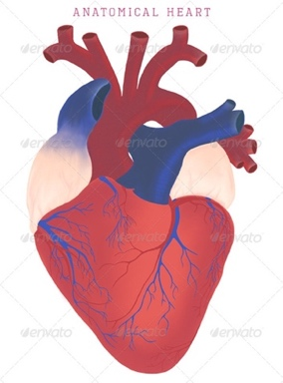
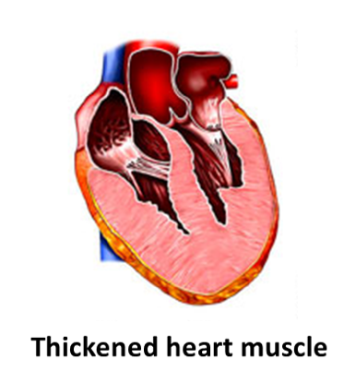
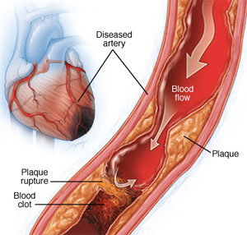
Structural HD
Coronary HD
Two types of heart disease
Structural Heart Disease
Structural HD - general term to describe structural changes to the heart. It includes:
Cardiomegaly –an enlarged heart
Left Ventricular Hypertrophy (LVH) – a thickening of the heart muscle (left ventricle)
Major Risk:
Increased susceptibility to arrhythmia
Can impede blood flow from the heart
Coronary Heart Disease (CHD)
CHD - narrowing of the blood vessels that supply blood and oxygen to the heart tissue
Major Risk:
Atherosclerotic plaque builds up in artery causing stenosis and ischemia
Plaque ruptures, causing formation of a blood clot, which causes a heart attack

Slide 39
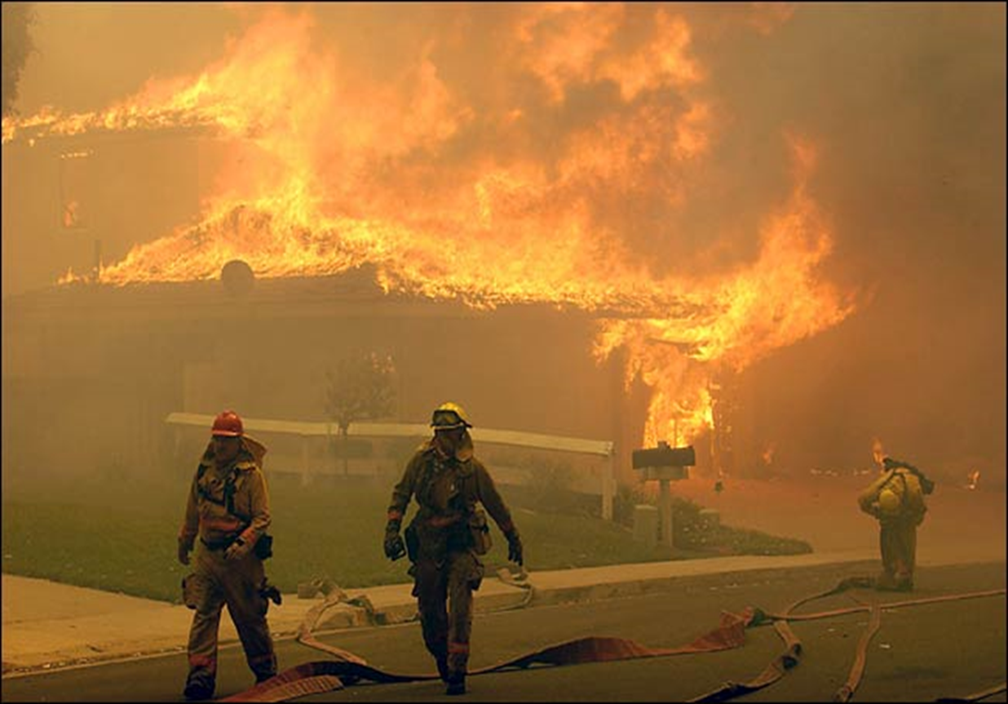
Who is at Risk?
Most firefighters recover from firefighting without cardiac issues.
How do we identify those who are at risk?

Slide 40
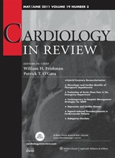
CVD Risk Factor Hazards
Relative Risk of On-duty CHD Death by Risk Factor
Risk Factor | On-duty CHD Fatalities
Age ≥ 45 years old | 18.0 (8.5−40)
Current Smoking | 8.6 (4.2−17)
Hypertension | 12.0 (5.8−25)
Obesity, BMI ≥ 30 kg∙m⁻² | 3.1 (1.5−6.6)
Cholesterol ≥ 5.18 mmol∙L⁻¹ | 4.4 (1.5−13)
Diabetes mellitus | 10.2 (3.7−28)
Prior diagnosis of CHD | 35.0 (9.5−128)
Source: Soteriades et al., Cardiovascular Disease in US Firefighters, Cardiology in Review, 2011.

Slide 41
Physical Fitness, Activity & CHD Risk
Persons in the ≥ 75th percentile of Fitness had ≥ 60% Lower Risk
Williams 2001, MSSE
Skidmore College
First Responder Health & Safety Lab

Slide 42
Fitness and Metabolic Syndrome
Fitness is a better predictor of
metabolic syndrome than age
Baur et al. 2012, JSCR
Skidmore College
First Responder Health & Safety Lab

Slide 43
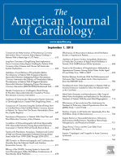
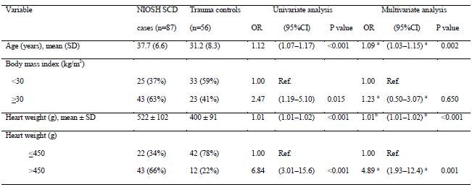
Who is at Risk
Sudden Cardiac Death Among Firefighters ≤ 45 Years of Age in the United States
Yang et al. 2011, Am J Cardiol
Skidmore College
First Responder Health & Safety Lab

Slide 44
Cardiovascular Strain of Firefighting
Increased Cardiac Work/Shear Stress
Ischemia
Altered
Vascular Function
Enhanced
Coagulatory Potential
A)
Cardiomegaly/LVH,
and/or Underlying CHD
Underlying CHD
Plaque Rupture and Thrombus Formation
Arrhythmia
B)
SCD or
Other CVD Event
Smith et al. 2013.
Skidmore College
First Responder Health & Safety Lab

Slide 45
Cardiovascular Disease Risk Factors Cholesterol BP Smoking Obesity Gluc/DM
Increased Cardiac Work/Shear Stress
Ischemia
Altered
Vascular Function
Enhanced
Coagulatory Potential
A)
Cardiomegaly/LVH,
and/or Underlying CHD
Underlying CHD
Plaque Rupture and Thrombus Formation
Arrhythmia
B)
SCD or
Other CVD Event
Smith et al. 2013.
Skidmore College
First Responder Health & Safety Lab

Slide 46
Fireground Exposures (Triggers) Exertion Heat/Dehydration SNS Smoke/PM
Increased Cardiac Work/Shear Stress
Ischemia
Altered
Vascular Function
Enhanced
Coagulatory Potential
A)
Cardiomegaly/LVH,
and/or Underlying CHD
Underlying CHD
Plaque Rupture and Thrombus Formation
Arrhythmia
B)
SCD or
Other CVD Event
Smith et al. 2013.
Skidmore College
First Responder Health & Safety Lab

Slide 47
Section Four Strategies to Combat CVD in the FS
Medical Evaluations
Adopt and Implement Comprehensive Wellness/Fitness Programs
Promote Smoking Cessation
Provide On-scene Medical Support and Incident Rehabilitation

Slide 48
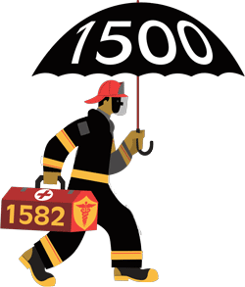
Medical Evaluations
NFPA 1582:
Comprehensive medical evaluation that assesses the ability of a firefighter to safely perform their job requirements, and addresses risk factors
NFPA 1582: Standard on Comprehensive Occupational Medical Program for Fire Departments. National Fire Protection Agency, 2016. Web. 12 Oct. 2016.

Slide 49
Comprehensive Occupational Health
Cancer screening and counseling
CVD screening and counseling
Sleep hygiene
Psychological health

Slide 50
Decreasing Death and Injury
Get NFPA 1582 Medical Evaluation by a Physician who understands the work you do and the environment in which you do it.
Get screened for CVD and Cancer Using the Best Available Guidelines and Technology USE THE INFORMATION

Slide 51
Decreasing Death and Injury
How many of you want better screening for CVD?
Why?

Slide 52
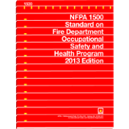
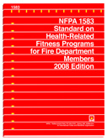
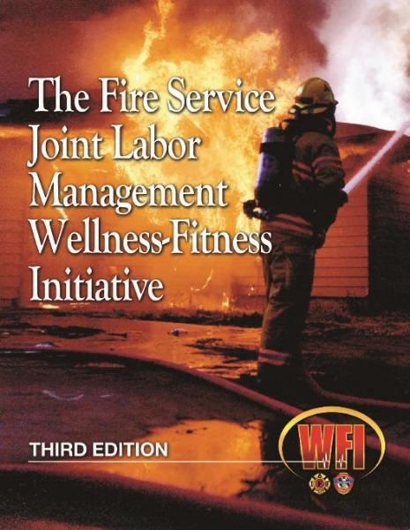
Wellness/Fitness Programs
Part of Comprehensive Medical Program
Guidance
Standards that recommend fitness programs
Resources Available

Slide 53
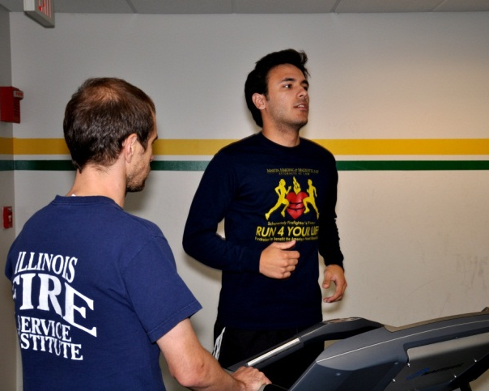
Benefits of Fitness
Aerobic Fitness:
↑Thermal Tolerance
↑ Plasma Volume
↑ Cardiac Efficiency
↑ Work Capacity
Improved Clotting Profile
Decreased Fatigue
Heart less vulnerable to ischemia
Decreased risk of CVD
Appropriate Body Size:
↑Thermal Tolerance
↓Thermal Strain
↑ Cardiac Efficiency
↑ Work Efficiency
Improved Clotting Profile
Decreased Risk of CVD
Skidmore College
First Responder Health & Safety Lab

Slide 54
Benefits of Fitness
Skidmore College
First Responder Health & Safety Lab

Slide 55
How many of you want to decrease risk of Cancer?

Slide 56
Cancer Risk Among Firefighters
Daniels et al. 2013, OEM.

Slide 57
Cancer Risk and Physical Activity
Based on data from Moore et al. 2016.

Slide 58
Promote Smoking Cessation
Rates of smoking among FF
14%career/17% volunteer (Haddock et al., 2011)
40-50%, CHD fatalities (Soteriades et al., 2011)
Independent risk factor for on-duty CHD event
8.6, relative risk of CHD fatality (Kales et al., 2003)

Slide 59
On-Scene Consideration
Adopt REHAB Policy
2015
Skidmore College
First Responder Health & Safety Lab

Slide 60
Incident Scene Rehabilitation
Rehab is an intervention to mitigate against the physical, physiological, and emotional stress of firefighting—in order to improve performance and decrease likelihood of on-scene injury or death
.
Smith and Haigh 2006, Fire Engineering
Smith, D.L., Haigh, C.. (2006) “Implementing effective on-scene rehabilitation” Fire Engineering. 159(4): 175-188.

Slide 61
Incident Scene Rehabilitation
Adopt Incident Rehabilitation Policies
Cool- “Aggressively”
Rehydrate
Provide rest and recovery
Monitor vitals
Ensure appropriate manpower is available
Staffing
Mutual aid
Copyright Board of Trustees of the University of Illinois 2011

Slide 62
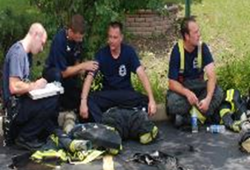
Benefits of Rehabilitation
Skidmore College
First Responder Health & Safety Lab

Slide 63
Ensure Proper Hydration
Many FF report to work in a dehydrated state
To improve thermoregulation and reduce CV strain:
Drink plenty (~2-3L/day) of water or other non-sugary, non-caffeinated fluid
Consume enough water to replace fluid lost during exercise
Avoid alcohol/diuretics the night before a shift or training drills
Monitor urine color to assess hydration levels

Slide 64
Ensure Proper Hydration
Increasing dehydration
+1 -1 -3 -5 -7
Well Hydrated
Minimal Dehydration
Significant Dehydration
Serious Dehydration
0.18-0.36 ºF increase in core temperature for every 1% BW lost
3-5 beats per minute increase in heart rate for every 1% BW lost
Adverse affects on performance
Heart rate, stroke volume, cardiac output, skin blood flow, core temp
Lower heat tolerance
Reduce work capacity
Increased perception of exercise difficulty
Increased risk of exertional heat stress
Reduced muscle endurance
Reduced maximal aerobic power

Slide 65
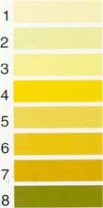
Dehydration
1 2 3 4 5 6 7 8
U_{col}
ACSM
Euhydrated
NATA
Well Hydrated
Minimal
Dehydration
Significant Dehydration
Serious Dehydration
1.000 1.010 1.020 1.030 1.040
U_{sg}
ACSM
Euhydrated
NATA
Well Hydrated
Minimal
Dehydration
Significant Dehydration
Serious Dehydration
200 400 600 800 1000 1200
U_{osm}
ACSM
Starting work in a dehydrated state puts a firefighter at increased risk for heat injuries and increased thermal and cardiovascular strain
Euhydrated
+1 -1 -3 -5 -7
%ΔBW
NATA
Well Hydrated
Minimal
Dehydration
Significant Dehydration
Serious Dehydration
Horn et al. 2012, Prehosp Emerg Care.

Slide 66
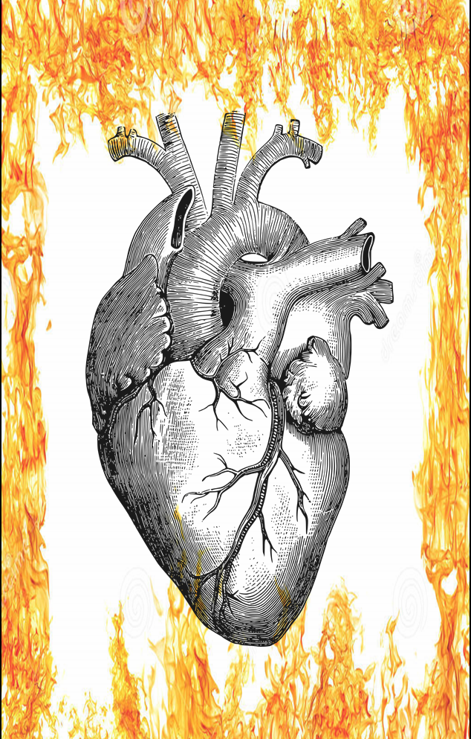
Promote Smoking Cessation
Heart Attack
Most common symptoms
Chest pain or discomfort
Upper body discomfort (back, shoulders, arm, neck, jaw)
Shortness of breath
Other common signs and symptoms
Cold sweat
Nausea/vomiting
Light-headedness/dizziness

Slide 67
SUMMARY
Far too many cardiac fatalities (and cancer cases)
Firefighting is strenuous work with multiple exposures
The most important things you can do to protect your health are:
GET A PROPER MEDICAL EVALUATION AND USE THE INFORMATION
INCREASE YOUR FITNESS LEVEL AND DECREASE YOUR BODY WEIGHT

Slide 68
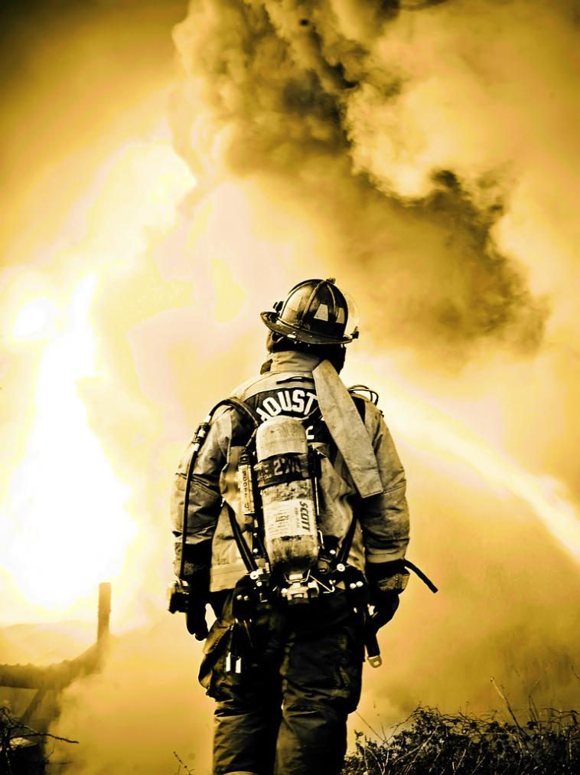
Thank You
www/fsi/research
www/skidmore/responder
Denise Smith
dsmith@skidmore.edu
(518) 580-5360

