Slide 1
The Integrated Campaign: Seizing Control On the Ground & In the Air Paul Larrabee, APR Managing Director

Slide 2

Corning Place Communications (CPC)
Team of Communications professionals specializing in:
Communications and Public Relations Strategies;
Media relations, Crisis response,
Organizational identity;
Social media; and
Framing and delivering the message.

Slide 3
CPC Partnership with NYSPFFA Began in 2012
Statewide Initiatives:
Showcase Organizational Strength:
Fire Fighter & Labor Solidarity.
Opposed: Efforts to Erode Binding Arbitration Rights.
Raised Public Awareness: Toxic Chemicals – Demonstrate Pod burns.
Legislative Victories: Presumed Exposures to Carcinogens; and Extended Filing Deadlines for Benefits (2-5 Years).
Packing a Political Punch: Vote No! Con-Con

Slide 4
Local Initiatives, Budgets, Trainings and Crisis:
City of Oswego Fire Fighters Association (#2707)
Albany Permanent Professional Fire Fighters Assoc. (#2007);
Rensselaer Prof. Fire Fighters Association (#2643);
Gloversville Prof. Firefighters Association (#719);
Johnson City Firefighters Association (#921);
Ithaca Professional Firefighters (#737);
And more…

Slide 5
No Campaign is the Same: But the Priorities are Constant
Ensuring for the Safety of Community You Serve;
Protecting and Preserving the Membership
(Wages, Benefits, Working Conditions); and
3. Providing for the Well-being of Those Who Rely on You.

Slide 6
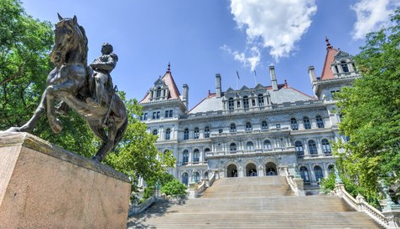
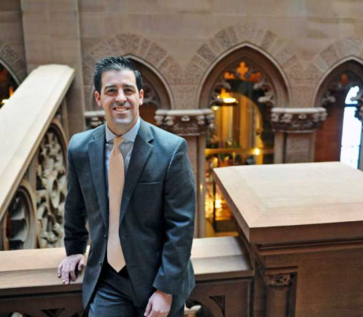
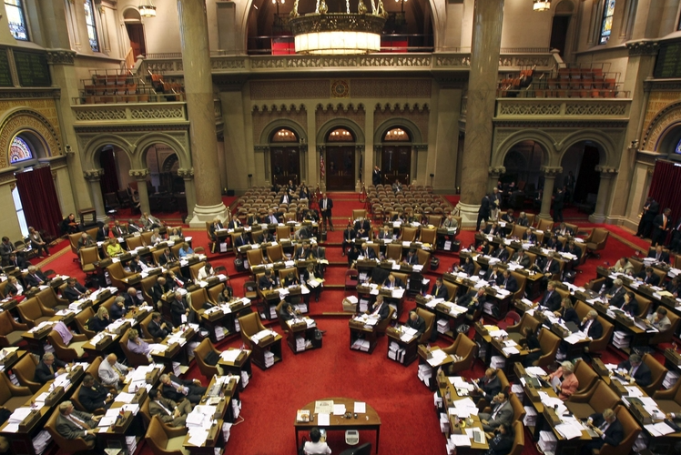
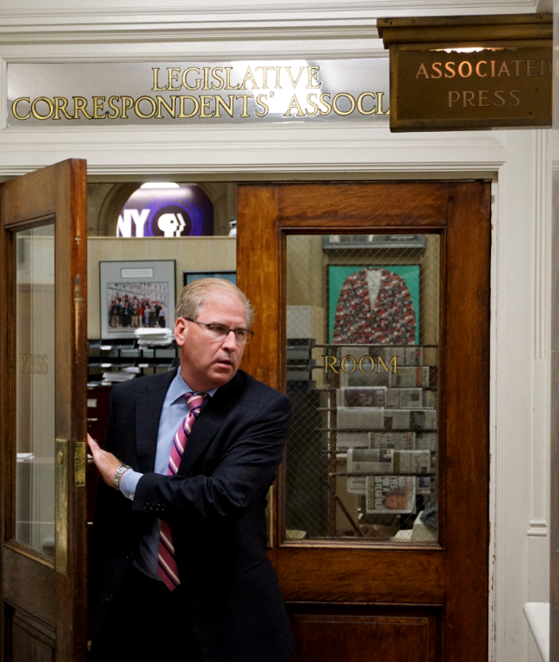
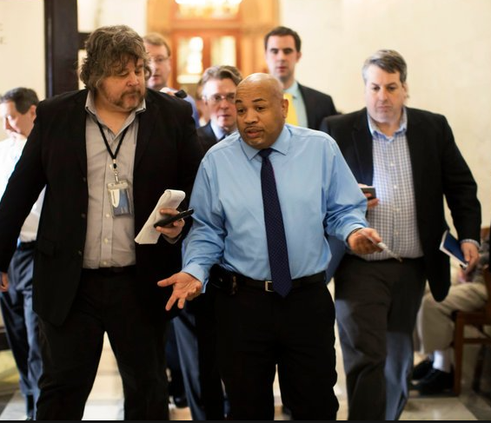
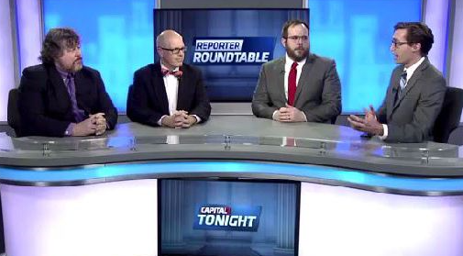
What is Integration; and Why is it Important?

Slide 7


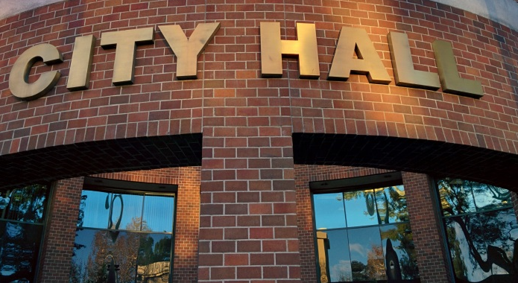
Plans for 2018
Combat Janus & Its Impact
(Friedrich Case 4-4)
Legislative Priorities
Maintain Incident Control for Career Fire Fighters
Statewide Clean-up of Discretionary Funding
Public Employee Discipline
Counter Local Budget Impacts,
Contract Disputes and Crisis.

Slide 8
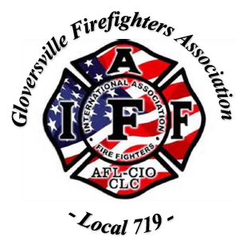
Protecting Fire Fighter Privacy
And Personnel Records
A CALL FOR PRIVACY IS BEING DISCUSSED ACROSS NEW YORK STATE
Allegations of Misconduct to be Heard in Johnstown Town Court
It is alleged, that more than 100 days ago, the members of the Gloversville Firefighters Association (GFFA) Local 719 suffered an invasion of privacy of their personnel files resulting in an ongoing legal action stemming from an investigation by the New York State Police and misconduct charges against City Mayor Dayton King.
Ed Martelle, President of GFFA said: “Last fall, many thought this incident was simply a matter of small town politics – but today, I can assure you that the right of privacy is not a notion that stops at the Gloversville City limits. And, for those who have been granted the extraordinary privilege to serve – they too must honor the law and the community they represent.”
Under New York State Civil Rights Law Section 50-a, personnel records are confidential and not subject to inspection or review without the express written consent of the individual or a court order.

Slide 9
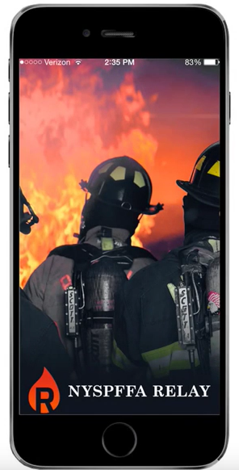


Mobile Device Communication The Relay App
Goal is to become as commonly used as Email, Facebook, Twitter and Instagram.
Launching a series of pilot projects to boost outreach to users.
Unveiling that project today.
Visit App Store:
New York State Professional Fire Fighters Association and Relay App

Slide 10
Questions?
Contact us…
Corning Place Communications * 518.432.9087
Paul Larrabee, APR plarrabee@corningplace.com
Sarah Ruane sruane@corningplace.com
www.corningplace.com – www.twitter.com/cpcalbany

