Slide 1

Building Union Power and Engaging Members in RTW/ Non-CB Environments
New York State Professional Fire Fighters Association Legal Conference
February 28, 2018
Dave Coker

Slide 2
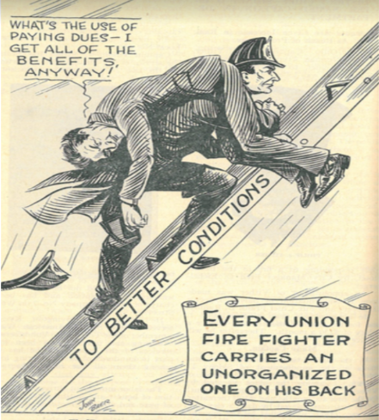
100 Years of Unionism

Slide 3
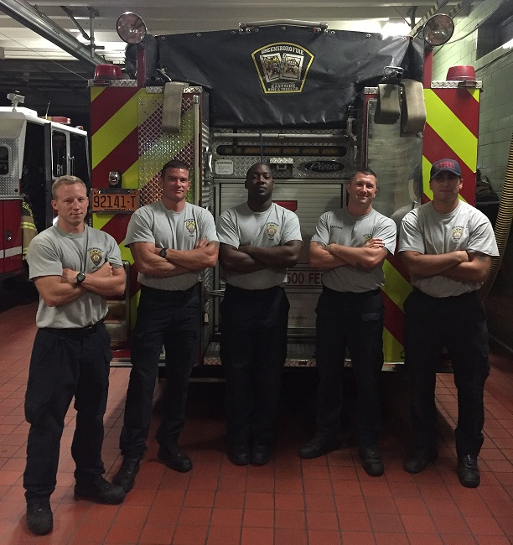
My Background
CWA Local 3607
PFFG Local 947
PEP Instructor
IAFF Service Rep

Slide 4
Right-To-Work…
…is likely your new normal
…represents challenges you haven’t faced
…will probably lead to lower membership
IS NOT THE END OF PUBLIC EMPLOYEE UNIONS

Slide 5
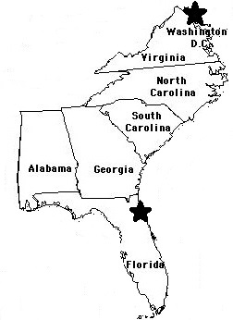
Our Landscape

Slide 6
Our Landscape
Low Union Density
Unfamiliar with Unionism

Slide 7
Our Landscape
Significant Legal/ Structural Challenges

Slide 8
NC Structural Challenges
No Collective Bargaining Rights For Public Employees

Slide 9
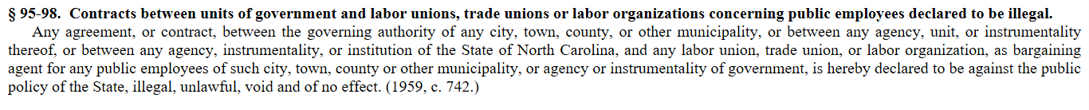
NC Structural Challenges

Slide 10
NC Structural Challenges
Right-to-Work for Private Sector

Slide 11
NC Structural Challenges
Lack of Civil Service Protections
(Local Option Only)

Slide 12
NC Structural Challenges
At-Will Employees

Slide 13
NC Structural Challenges
No Grievance Procedure
(Only an Appeals Process)

Slide 14
NC Structural Challenges
Lack of Union Dues Deduction
(Local Option Only)

Slide 15
NC Structural Challenges
Lack of Union Release Time

Slide 16
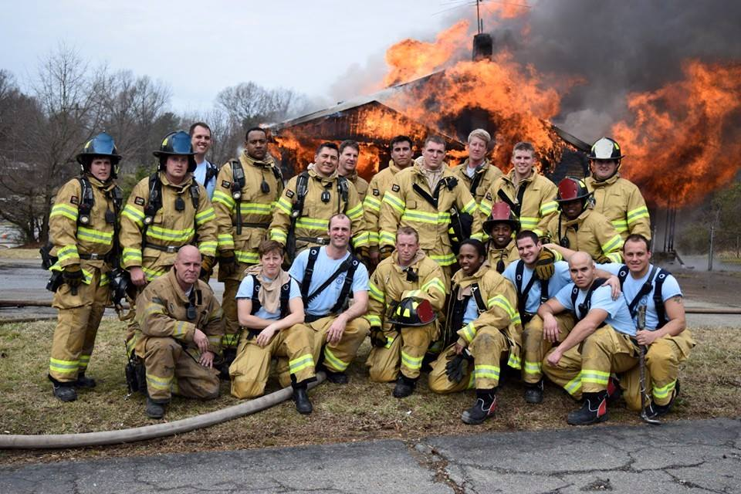
Local 947 Victories

Slide 17
Local 947 Victories
Increased Membership Density

Slide 18
Local 947 Victories
2005: 30% Density
2018: 88% Density
2017: 60 New Members
Surpassed 500 Members

Slide 19
Local 947 Victories
Collaborative Approach With Fire Admin

Slide 20
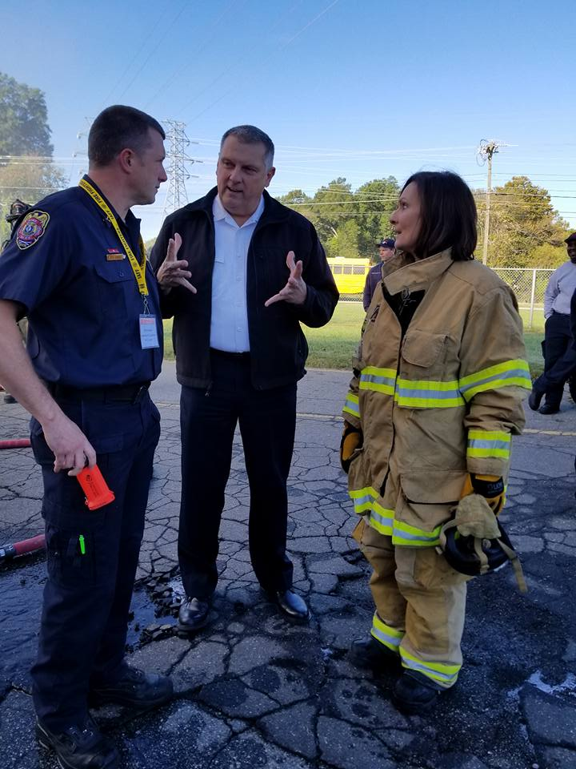
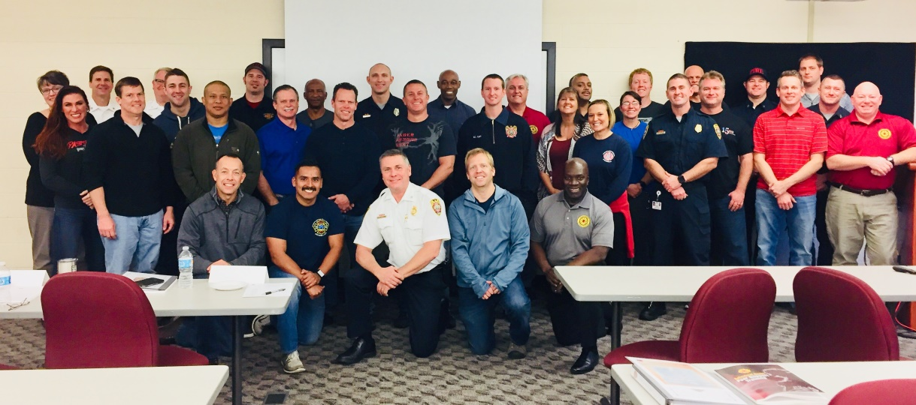
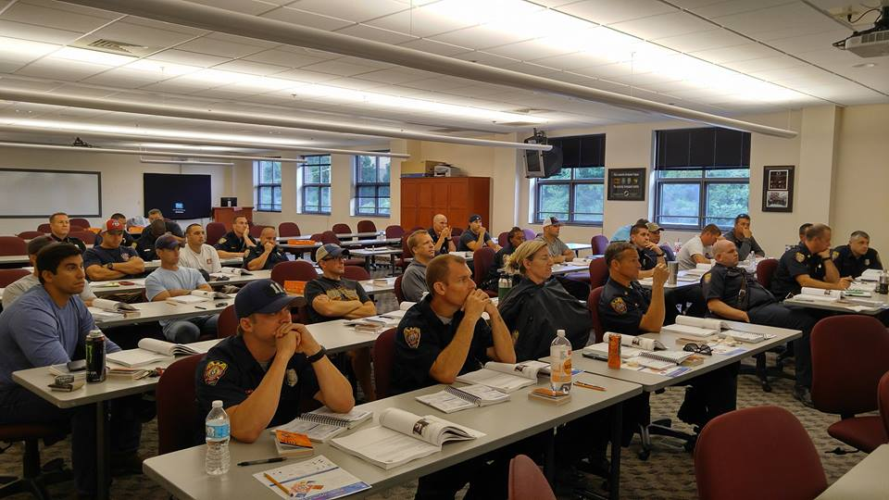
Local 947 Victories

Slide 21
Local 947 Victories
Heavily Engaged in Political Action

Slide 22
Local 947 Victories
2017 City Council Elections:
53 members
133 hours
21 polling locations

Slide 23
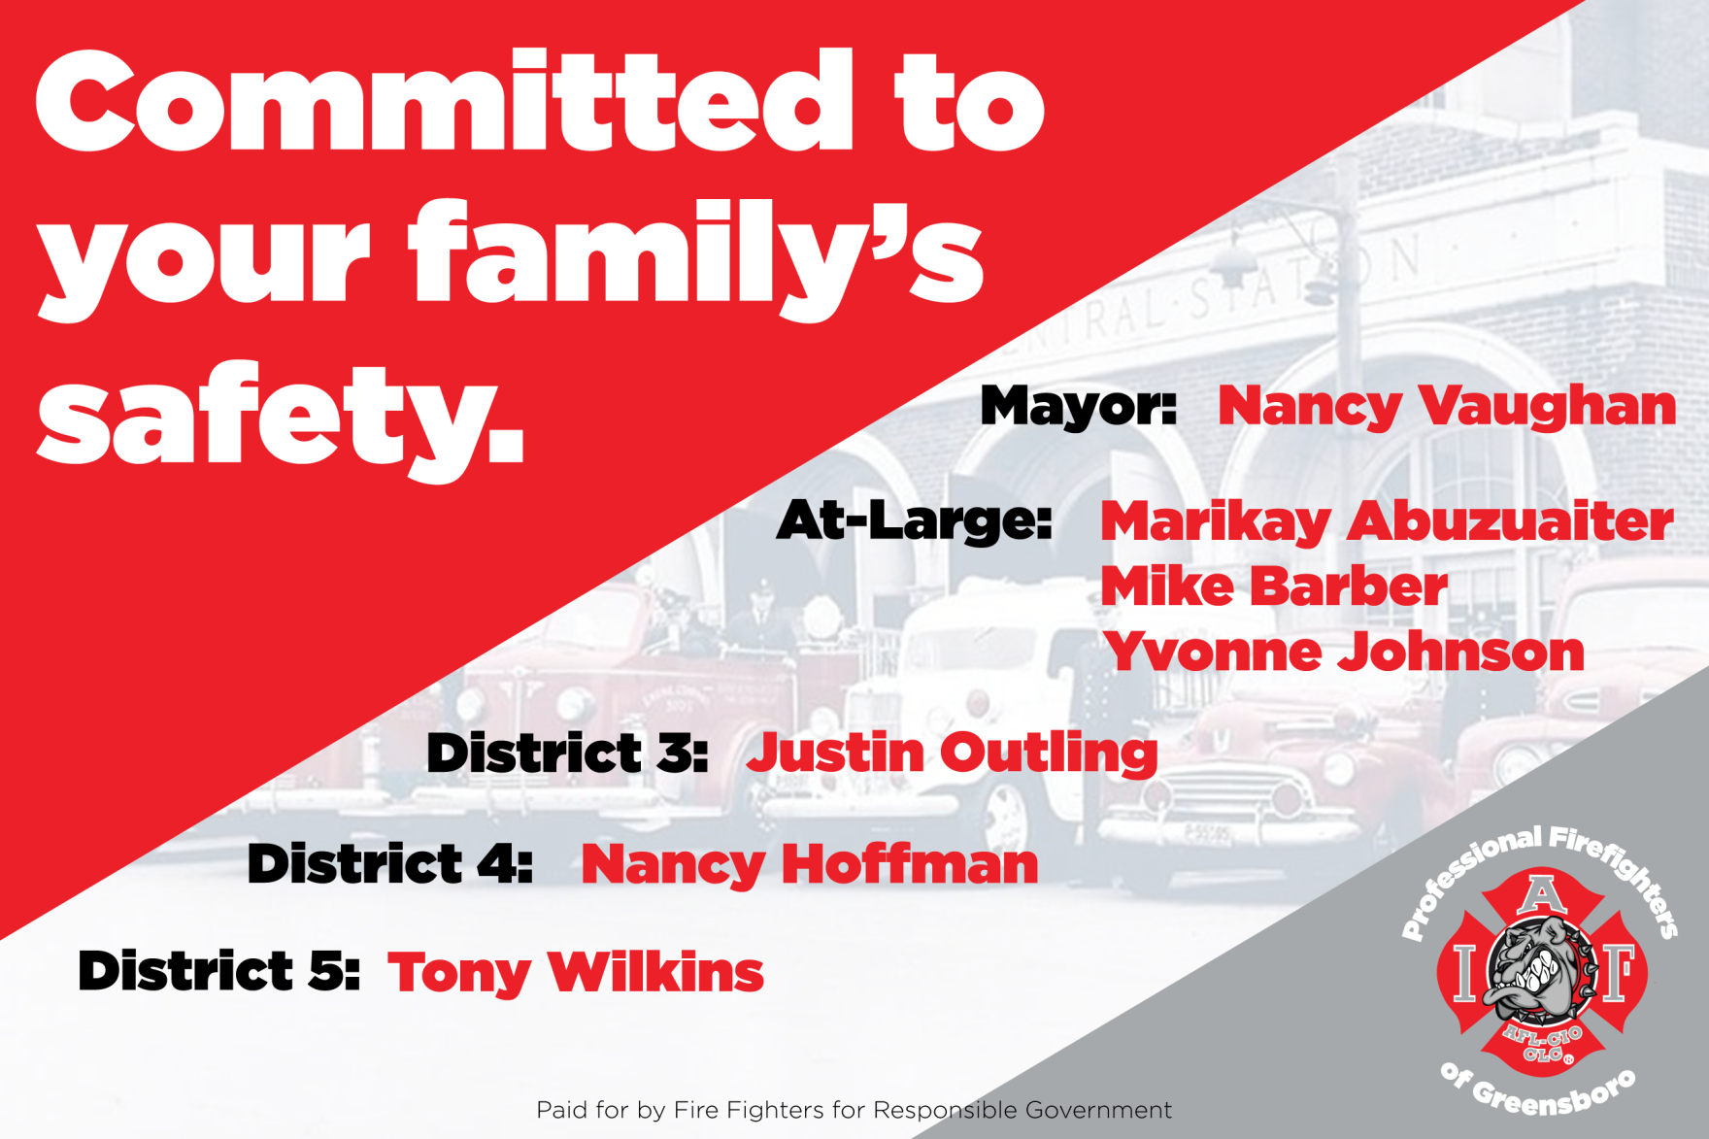
Local 947 Victories

Slide 24
Local 947 Victories
PAC Fund:
$3,635 Contributed
$3,195 Spent

Slide 25
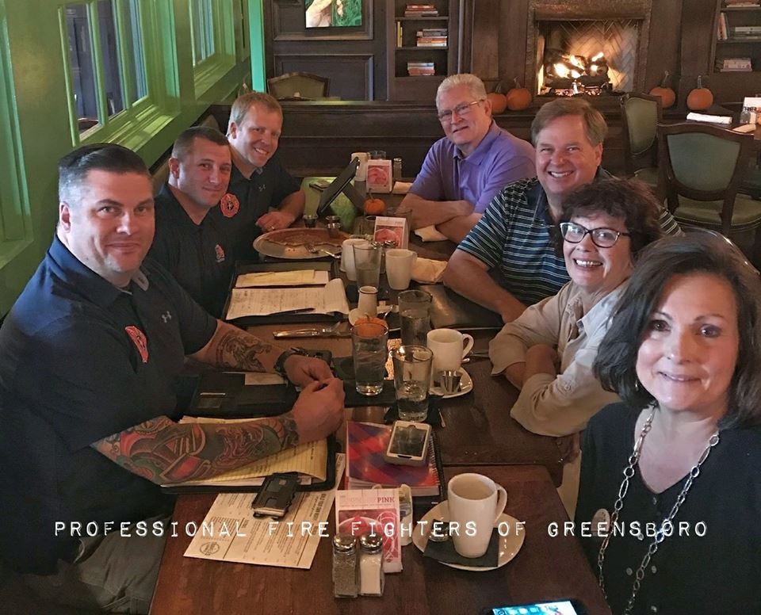
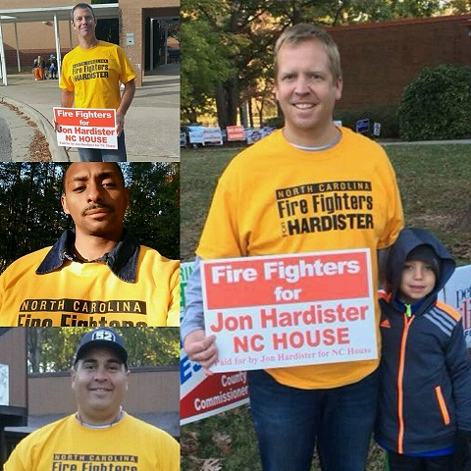
Local 947 Victories

Slide 26
Local 947 Victories
2011- Halted closing of Ladder company
2013- Council votes for FF Dues Deduction
2013- Stopped cuts to Worker’s comp
2014- Council votes to fund plan for 4-person ladder staffing
2015- Pay compression for BCs, FLSA-exempt 24/48 get Holiday $, $500k allocated for CoG Compression issues
2015- Council votes Presumptive Legislation as part of CoG Legislative Agenda
2017- Council approves 7.5% pay increase

Slide 27
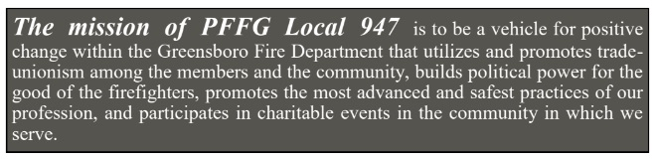
How Did We Get There?

Slide 28
Engaged in Strategic Planning
Identified Our Values and Mission
Created Short, Mid, Long Term Goals that REFLECTED Our Values & Mission
Attached Goals to Our Budget
WROTE IT DOWN!

Slide 29
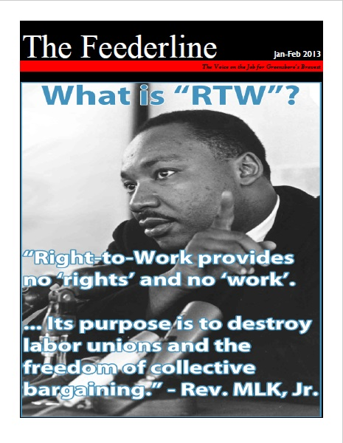
Planned to Communicate
Functioning Email List
Website
NEWSLETTER

Slide 30
Internal Organizing
“Stop Light Method” Using Your Duty Roster
Members are Green
Non-Members are Yellow
Known Anti-Union are Red

Slide 31
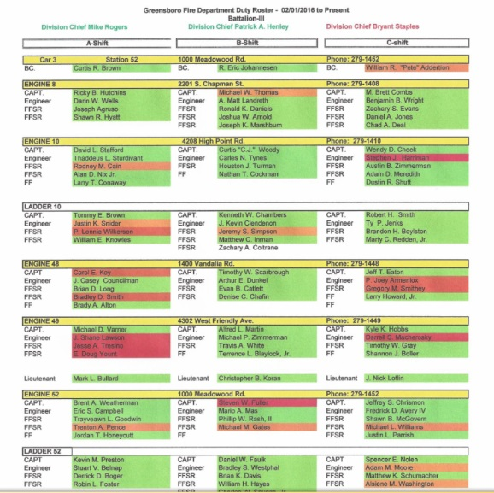
Internal Organizing

Slide 32
Internal Organizing
You Have To Go After Them
(Station Visits)

Slide 33
SMART Objectives
Specific
Measurable
Assignable
Realistic
Time-Based

Slide 34
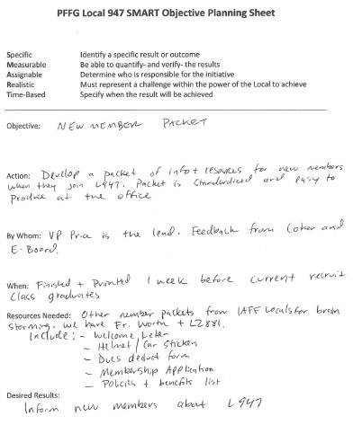

Slide 35
Engage & Empower Your Members
Committees/ Union Initiatives
Shop Steward/ Station/ Shift Reps
Community/ Charitable Work
Showcase Their Talent
Communicate Consistently

Slide 36
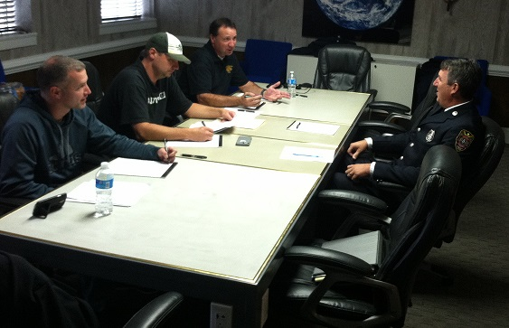
Programs That Engage
Company Officer Mock Assessments

Slide 37
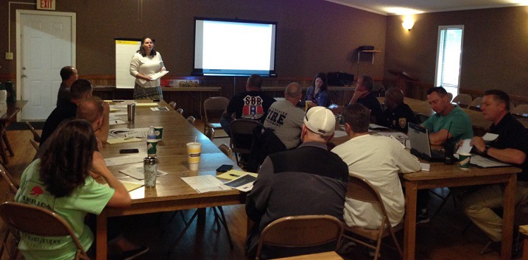
Programs That Engage
Retirement Benefit
Retirement Planning

Slide 38
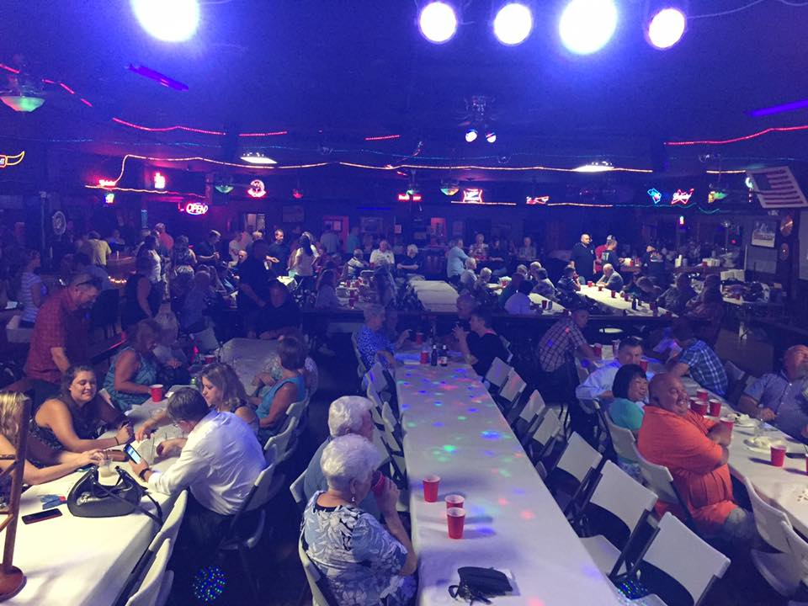
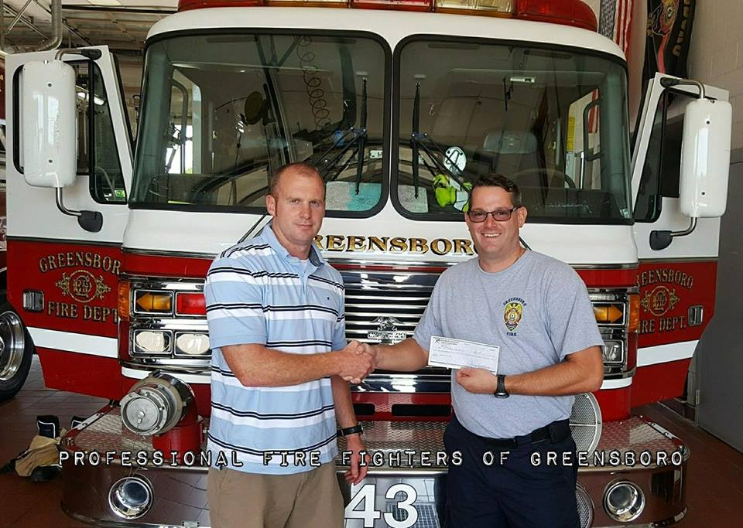
Programs That Engage
Emergency Benevolent Fund
Greensboro FF’s Charitable Fund
Reverse Raffle

Slide 39
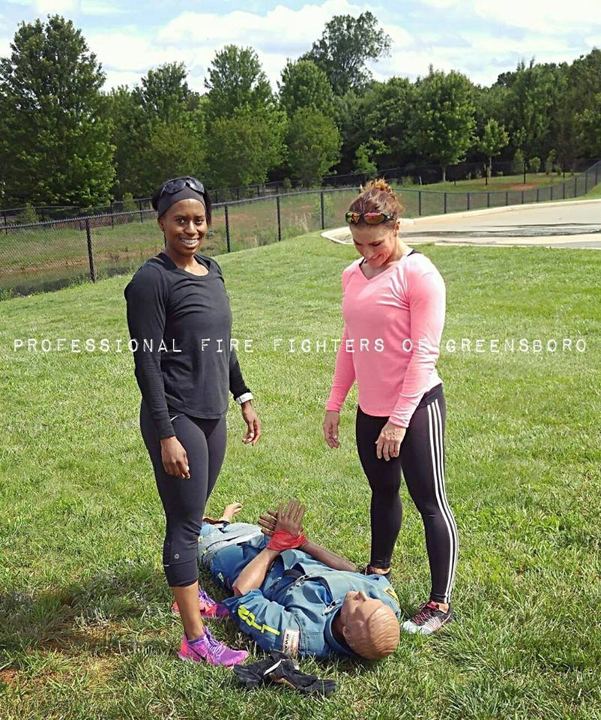
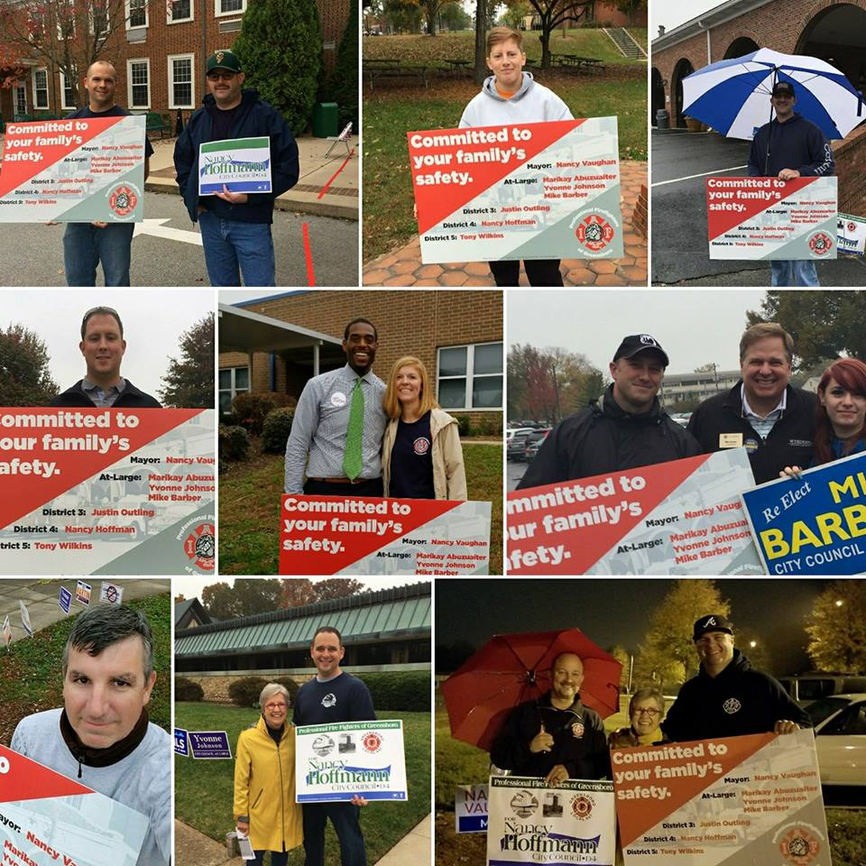
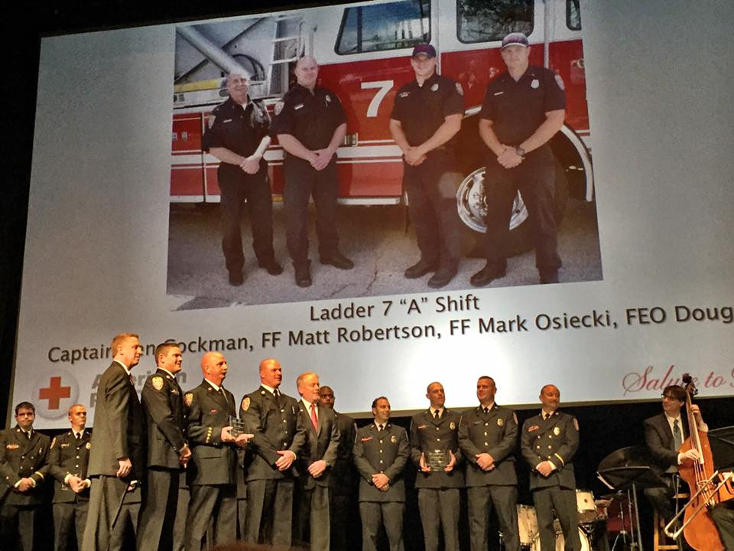
Membership Recognition

Slide 40

NOW WHAT?

Slide 41
What Does Janus Mean For You?
Decreased member density?

Slide 42
What Does Janus Mean For You?
Reduced dues revenue?

Slide 43
What Does Janus Mean For You?
Loss of political influence?

Slide 44
What Does Janus Mean For You?
Lack of power at the bargaining table?

Slide 45
What Does Janus Mean For You?
Obstacle or Opportunity?

Slide 46

Obstacle or Opportunity?

Slide 47
What Does Janus Mean For You?
A New Way to Engage Your Members?

Slide 48
What Does Janus Mean For You?
A Vision That Views Dues Payment as an Investment?

Slide 49
What Does Janus Mean For You?
A Greater Understanding of the Importance of Political Action?

Slide 50
What Does Janus Mean For You?
More Input and Engagement During Negotiations?

Slide 51
How Do Your Members View Their Union?
Transactional
Transformational
Members view their union as an insurance policy
Members don’t connect their lifestyle to their union
Dues purchase a product
Customers
Members view their union as an agent of change
Members know their lifestyle is because of their union
Dues are an investment
Union Activists

Slide 52
How Do Your Members View Their Union?
Are you just servicing the Contract or do you have a greater mission as a labor leader?

Slide 53
What Does Janus Mean For You?
YOU GET TO DECIDE

Slide 54
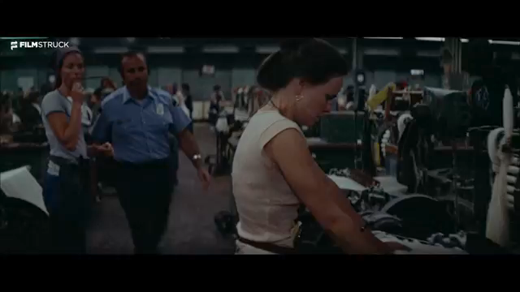
You Get To Decide

Slide 55
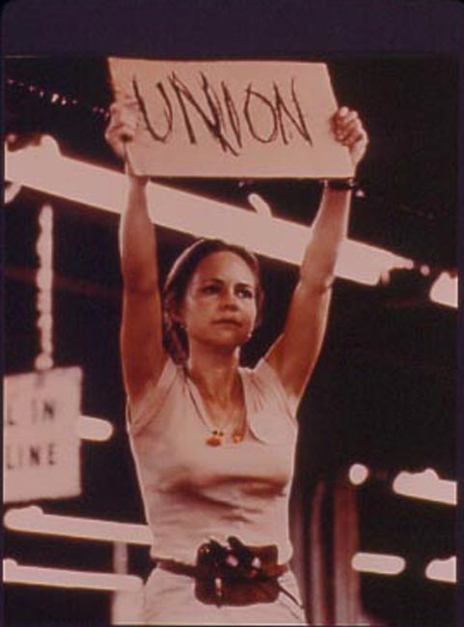
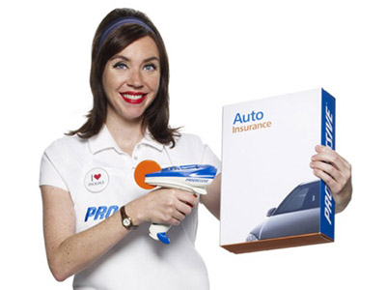
How Do Your Members View Their Union?

Slide 56
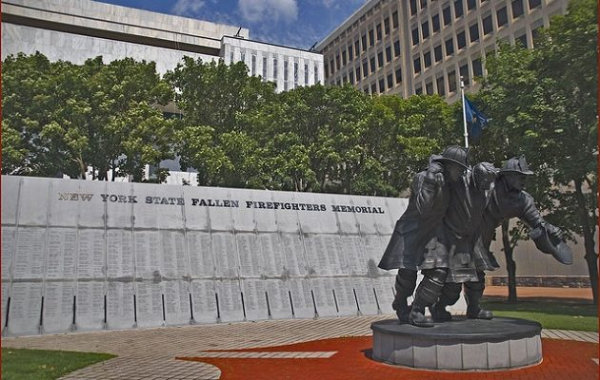
We Define Who We Are

Slide 57
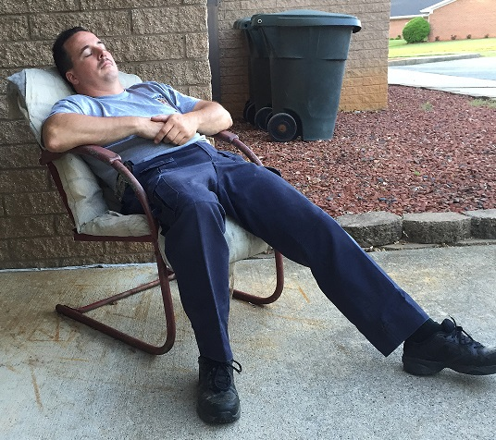
Thank You
dave.coker@pffg.org
@DaveCoker_PFFG
336-392-9742

