Slide 1
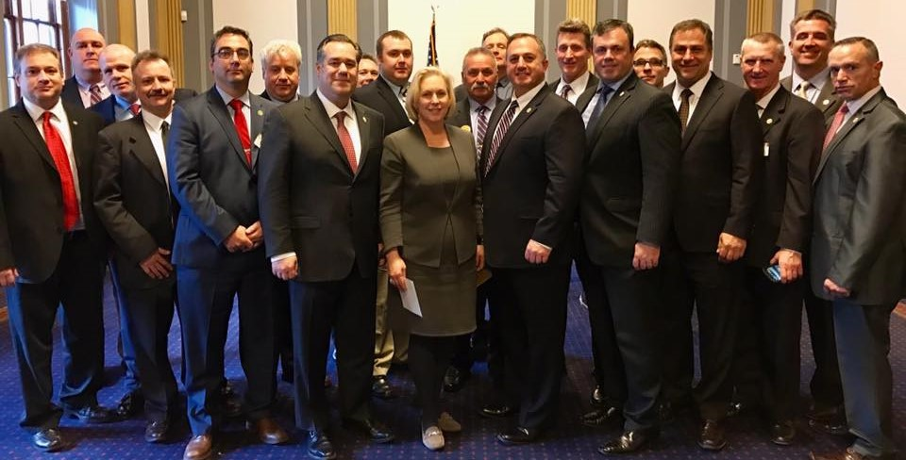
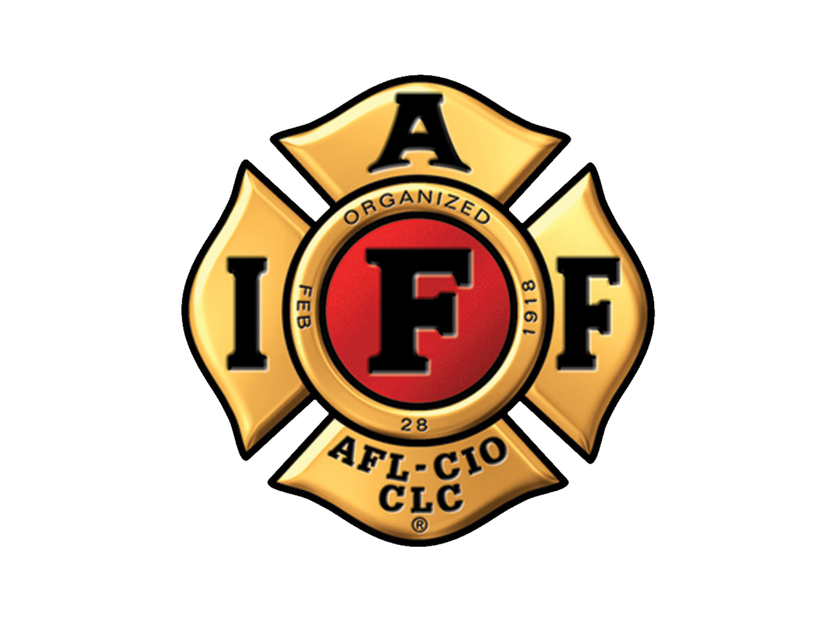
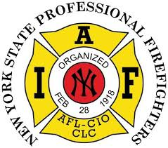
NEW YORK STATE PROFESSIONAL FIRE FIGHTERS ASSOCIATION
Overview of the IAFF & NYSPFFA and
Local Affiliate Member Services

Slide 2
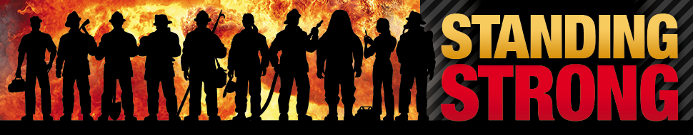
NEW YORK STATE PROFESSIONAL FIRE FIGHTERS ASSOCIATION
ABOUT THE IAFF
The IAFF is a 310,000 member trade union protecting and advancing the interests of career firefighters and fire-based paramedics in the United States and Canada
With over 3200 local affiliates, we represent over 85% of professional firefighters and fire-based paramedics
There are 107 IAFF locals in New York with 18,000 members and growing.

Slide 3
NEW YORK STATE PROFESSIONAL FIRE FIGHTERS ASSOCIATION
What are the goals of the IAFF?
Better our profession, promote a safer working environment, create reasonable working conditions and secure just compensation.
Why was the IAFF formed?
Address the working conditions of fire fighters in the early 20th century – 100 years later our IAFF is more than a union!
The IAFF addresses major issues including safety and health, research, wages, benefits, worker rights, working conditions, training, public relations, and political action.
Takes care of our members when they need it most.

Slide 4
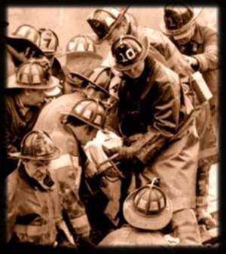
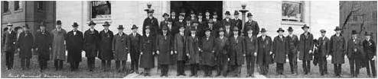
NEW YORK STATE PROFESSIONAL FIRE FIGHTERS ASSOCIATION
IAFF HISTORY
Established in 1918
Hours were long
Pay was low
Safety standards did not exist
No retirement benefits
The IAFF become the voice of, by, and for fire fighters, and remains so today

Slide 5
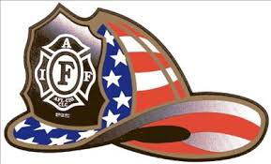
NEW YORK STATE PROFESSIONAL FIRE FIGHTERS ASSOCIATION
ACCOMPLISHMENTS (partial list)
The IAFF is responsible for most of the improvements in the fire service, including pay, benefits, safety, working conditions and service delivery
NFPA 1500 – Occupational Safety and Health Standards
NFPA 1710 – Staffing, Operations and Response
NIOSH Line of Duty Death Investigations
PSOB - $300k Death and Education Benefit for Spouses and Families
Health, Wellness and Fitness Programs
Improved Turnout Gear
FLSA Protections (overtime)
Reductions in Work Hours
Earlier Retirement Benefits

Slide 6
NEW YORK STATE PROFESSIONAL FIRE FIGHTERS ASSOCIATION
UNION GOVERNANCE
Our union is a direct-democracy
All representatives at the Local, District and International level are elected by the membership, not appointed.
Members in good standing are eligible to stand for office
Decisions are voted on and ratified by the members
IAFF leaders are accountable to the members, not elected officials or fire administration

Slide 7
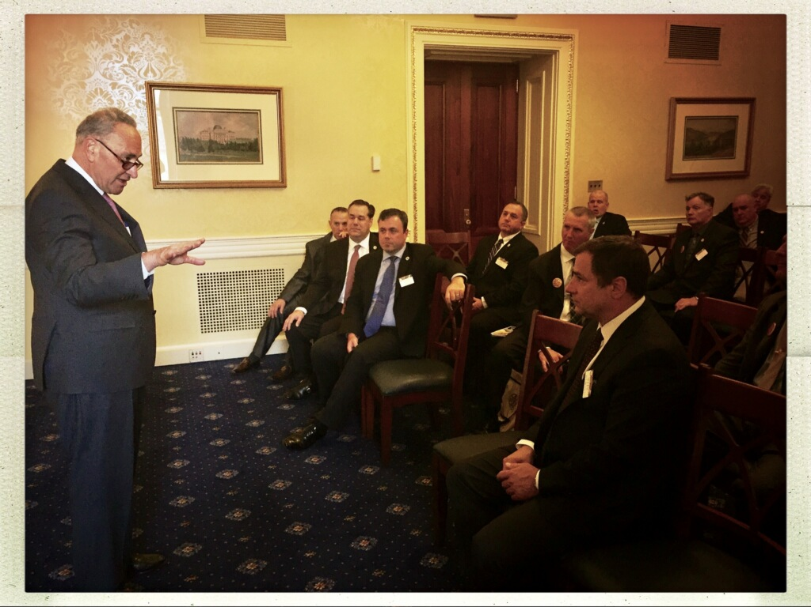
NEW YORK STATE PROFESSIONAL FIRE FIGHTERS ASSOCIATION
YOUR VOICE AT THE TABLE
Almost every decision that effects your career and livelihood is made by an elected official, who most often, does not have a background in emergency services
The IAFF serves as your voice when decisions on pay, benefits, staffing, working conditions and safety are being made.
If you’re not at the table, you’re on the menu!
Interests will not be represented
The fire chief is a political appointee
Senator Schumer with NYSPFFA Leadership

Slide 8
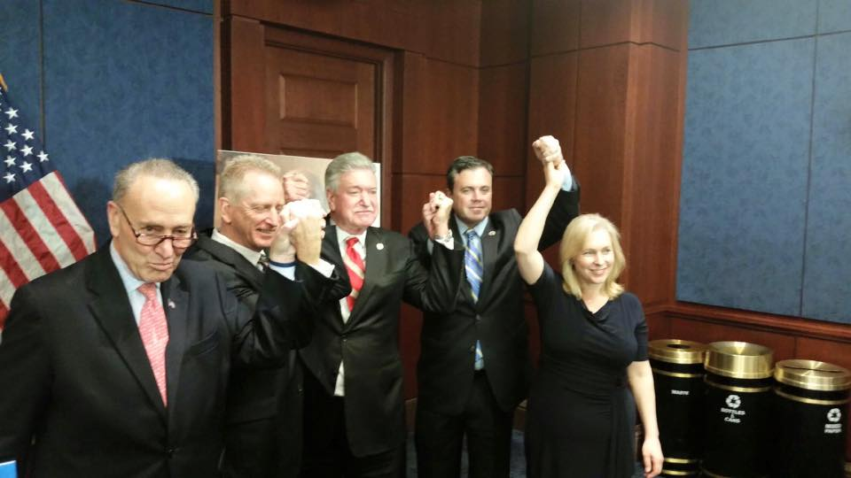
NEW YORK STATE PROFESSIONAL FIRE FIGHTERS ASSOCIATION
POLITICAL ACTION
The IAFF educates politicians on issues important to career firefighters, including compensation, benefits and working conditions as well as the resources we need to do our jobs.
We support candidates for elected office who support firefighters and our issues
FIREPAC, the IAFF political action committee is rated in the top 1% of the most influential PACs nationally
FIREPAC is bi-partisan and supports pro-firefighter candidates regardless of party

Slide 9
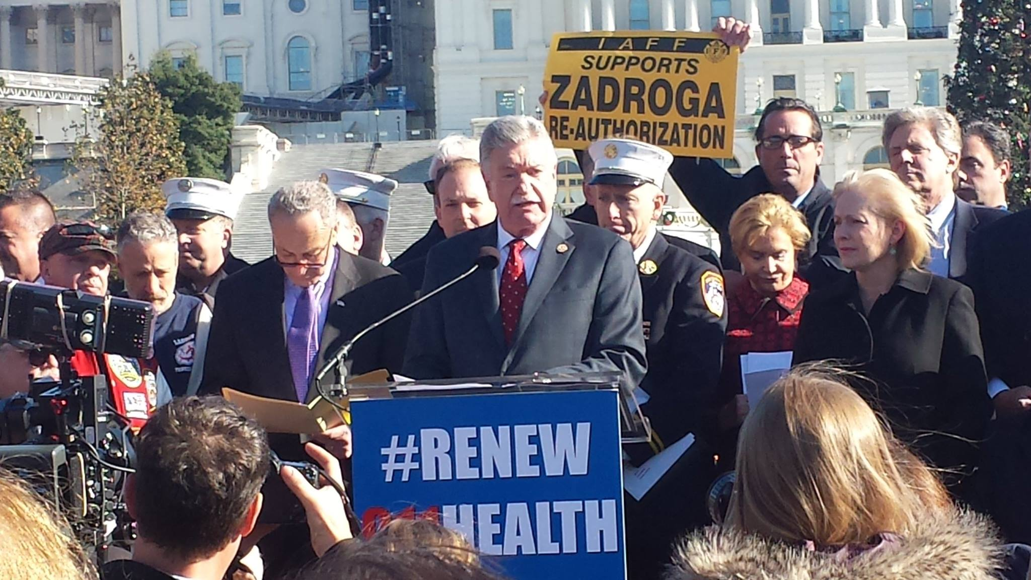
NEW YORK STATE PROFESSIONAL FIRE FIGHTERS ASSOCIATION
POLITICAL ACTION
Political wins come by passing legislation that is beneficial to members and by killing potential legislation that can harm our members.
Work to delay the Cadillac Tax
Zadroga Bill- Nationwide effort by IAFF members to reauthorize benefits for 9/11 responders
Stopping Senator Orrin Hatch bill to replace pensions with insurance company run annuities.
Cancer Registry bill

Slide 10
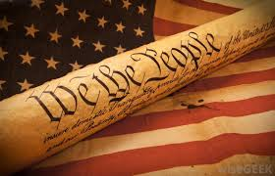
NEW YORK STATE PROFESSIONAL FIRE FIGHTERS ASSOCIATION
PROTECTING YOUR RIGHTS
Joining a union is a Constitutional Right protected by the First Amendment Right of Association
You have other workplace rights
The IAFF protects those rights
IAFF Legal Department
3 attorneys at IAFF Headquarters, reinforced by the D.C. firm of Woodley and McGillivray.
Guardian Policy
The IAFF staunchly defends its leaders when they are punished or retaliated against while fulfilling the duties of leading their union.

Slide 11
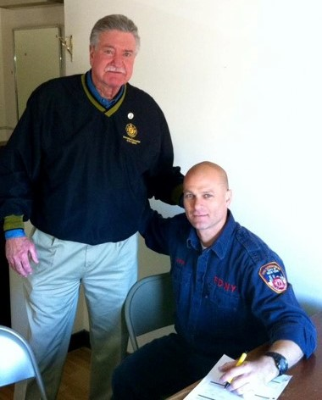
NEW YORK STATE PROFESSIONAL FIRE FIGHTERS ASSOCIATION
SERVICES PROVIDED TO LOCAL AFFILIATES AND DEPARTMENTS
Technical Assistance
Health and Safety
Political Assistance
Communications and Media
Education and Training
Financial Corp

Slide 12
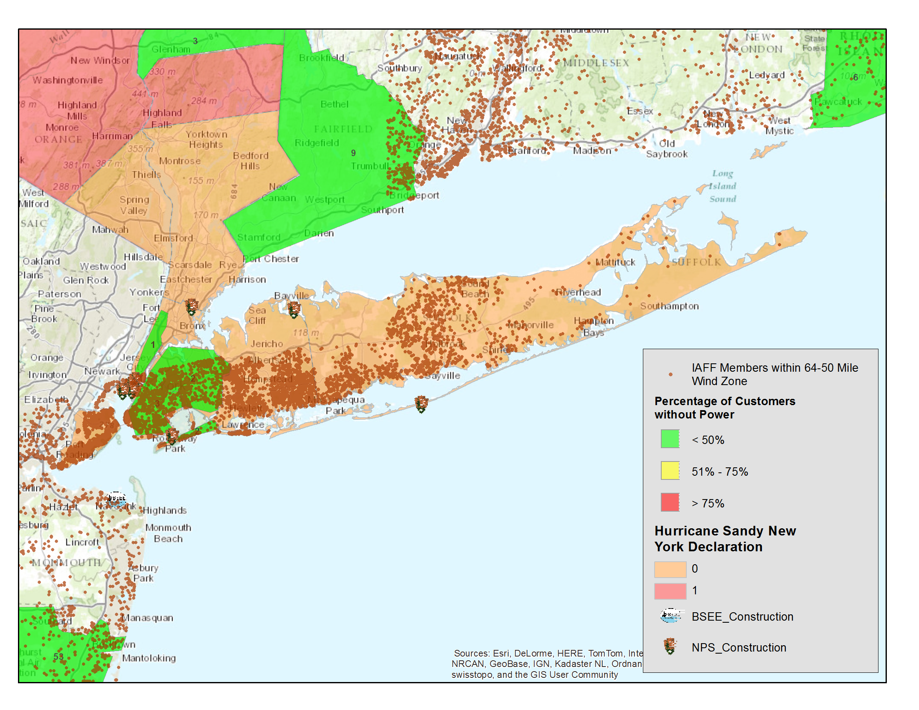
NEW YORK STATE PROFESSIONAL FIRE FIGHTERS ASSOCIATION
GEOGRAPHIC INFORMATION SYSTEM
The IAFF uses 21st Century GIS technology to plot the addresses of members that are in the direct path of a particular event, allowing for the deployment of immediate assistance and resources to affected members.
In addition, the IAFF also uses this GIS technology to assist with every day issues such as staffing deployment, station changes, and other initiatives that improve the safety and working conditions of its members.
GIS can pinpoint IAFF members living the path of a deadly storm
Superstorm Sandy 2012

Slide 13
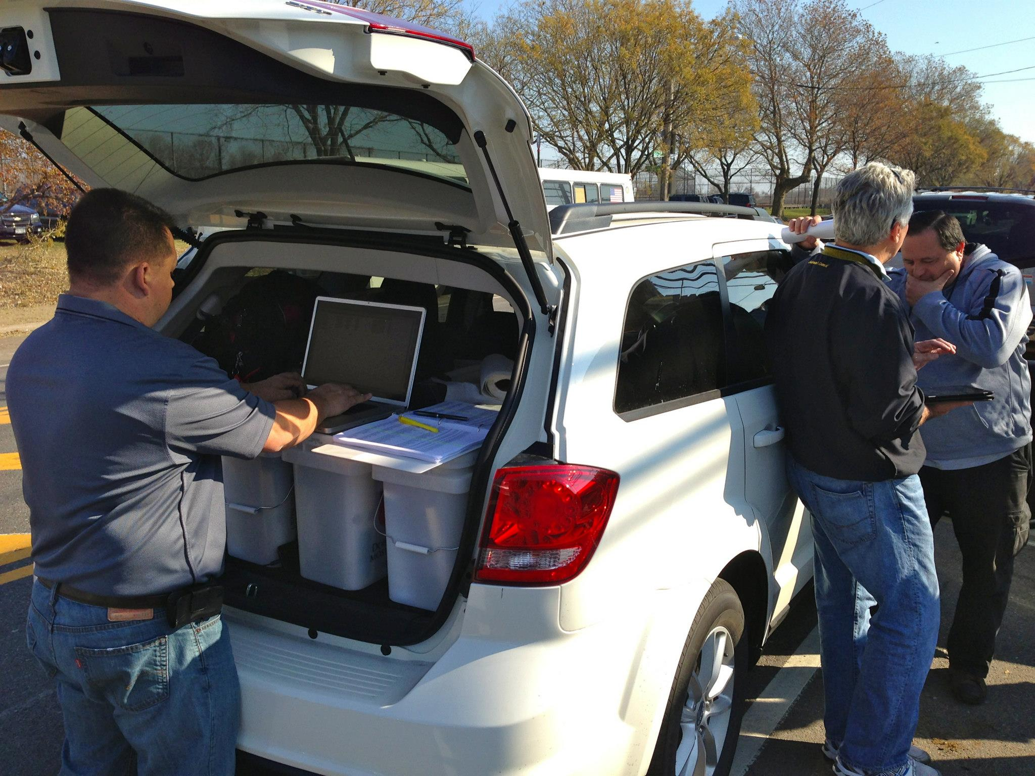
NEW YORK STATE PROFESSIONAL FIRE FIGHTERS ASSOCIATION
DISASTER RELIEF
IAFF Disaster Relief Fund Founded in 1993 After Hurricane Andrew.
The Disaster Relief Fund provides immediate financial assistance to help displaced IAFF members and their families while they continue to serve the surrounding communities.
IAFF Assistance comes in two categories:
Member Assistance
Operations Assistance

Slide 14
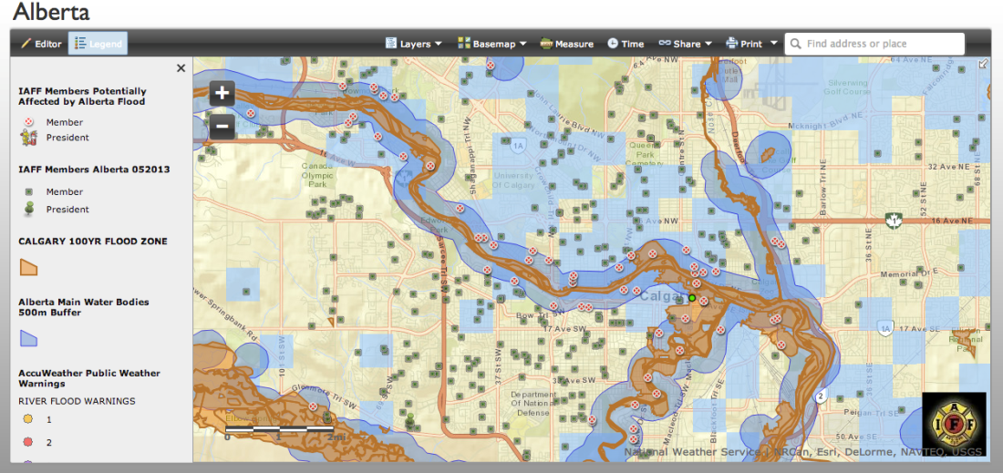
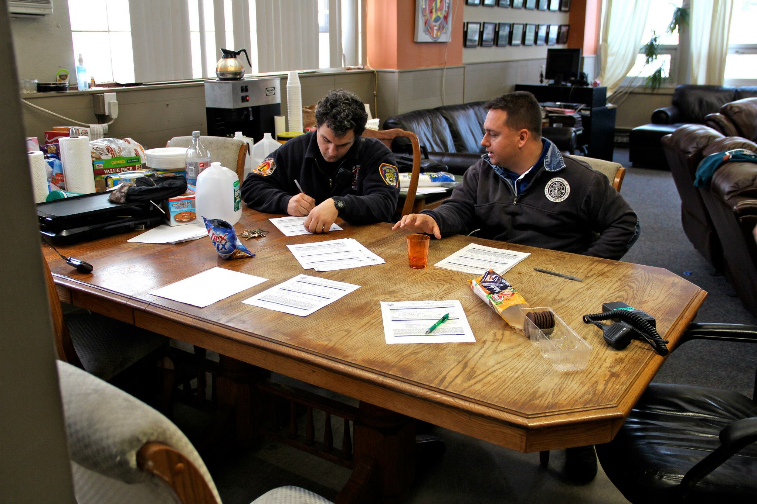
NEW YORK STATE PROFESSIONAL FIRE FIGHTERS ASSOCIATION
Disaster Relief Resources
IAFF Headquarters
GIS Map & Member List
Live Interactive Weather Map
Communication Systems
Social Media
Membership database
IAFF Disaster Relief Fund
Immediate Financial Help for Members
Chainsaws and Generators for Members
Home Repair Crews Activated
Mental Health – CISM, Peers, Professionals
Local Affiliates and Our Membership – IAFF Staff on the ground establishing a relief center.

Slide 15
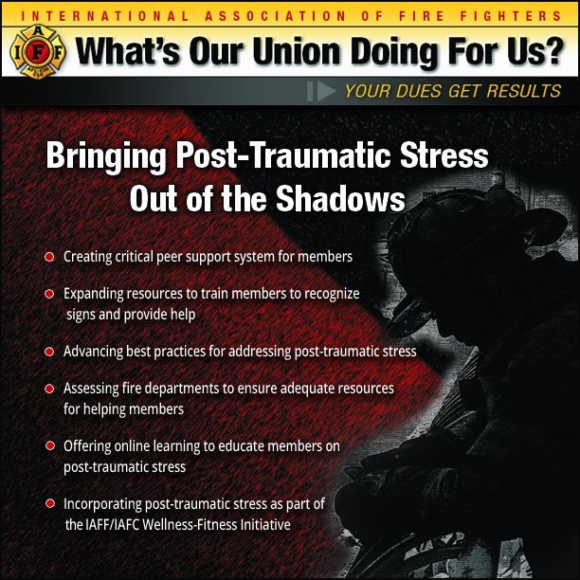
NEW YORK STATE PROFESSIONAL FIRE FIGHTERS ASSOCIATION
POST TRAUMATIC STRESS
Post Traumatic Stress is among a long list of behavioral health issues facing first responders and is an ever growing problem in all ranks of the fire service.
The IAFF is a leader in working to reduce the stigma and raising awareness to better recognize the signs and symptoms of PTSD and providing the necessary tools to help address it.
PTSD In The Fire Service: https://www.youtube.com/watch?v=WkzztWPuto8
Live Workshop- Behavioral Wellness: https://www.youtube.com/watch?v=AB-MOUNPOfg
IAFF Dispatch- Out of the Shadows: https://www.youtube.com/watch?v=2A-ESKDs4xM

Slide 16
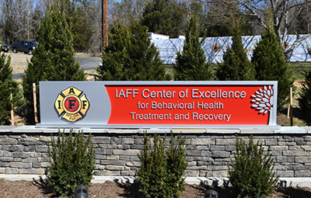
NEW YORK STATE PROFESSIONAL FIRE FIGHTERS ASSOCIATION
POST TRAUMATIC STRESS
IAFF CENTER OF EXCELLENCE
MARCH 2017- The IAFF opened the Center of Excellence, a facility for IAFF members to battle addictions and deal with the effects of Post Traumatic Stress.
64 bed facility located just outside of Washington D.C.
Over 200 members in 1st year.
Opening of the Center of Excellence: https://www.youtube.com/watch?v=x-Md5DmqyD8&t=48s

Slide 17
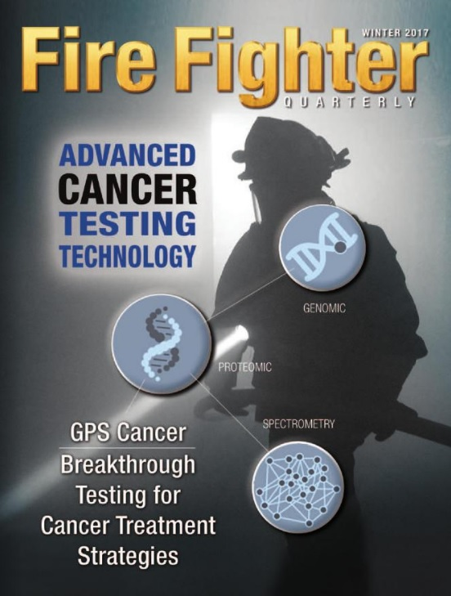
NEW YORK STATE PROFESSIONAL FIRE FIGHTERS ASSOCIATION
CANCER AWARENESS
Cancer is an occupational disease of the fire service.
The IAFF has conducted training via live internet feeds and offers safety tips to help prevent cancer and resources for fire fighters with cancer.
New GPS Cancer initiative using 21st Century technology to fight cancer.
Live Workshop- Cancer In The Fire Service- https://www.youtube.com/watch?v=pilKO1HYeXA
Live Workshop- Cancer Awareness- https://www.youtube.com/watch?v=s4pzeww4T74

Slide 18
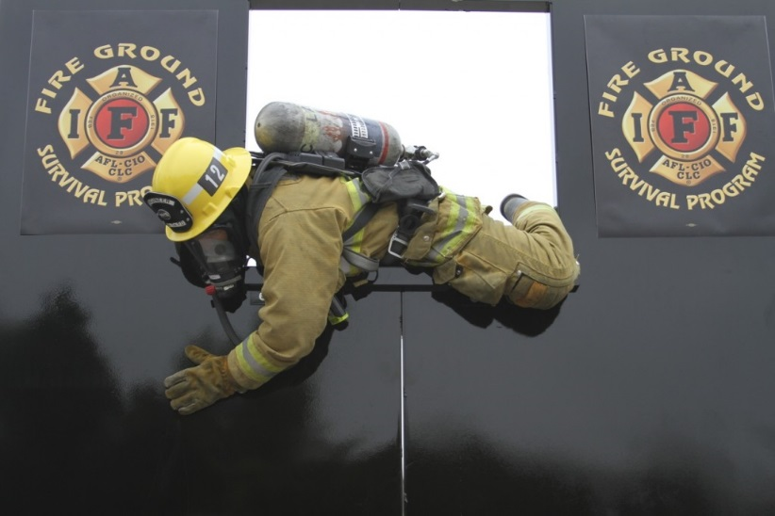
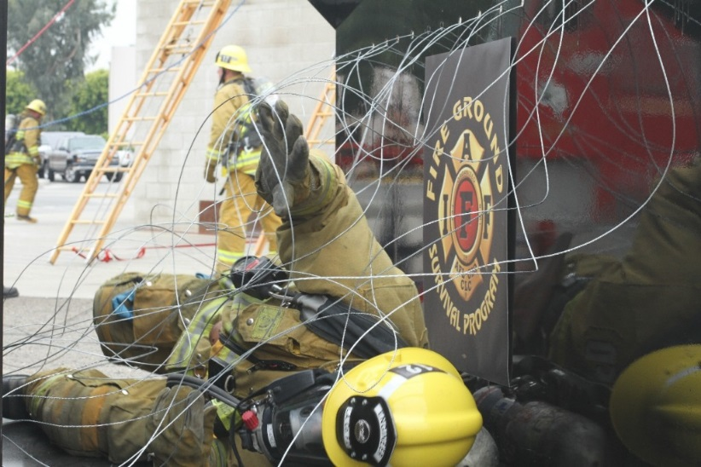
NEW YORK STATE PROFESSIONAL FIRE FIGHTERS ASSOCIATION
TRAINING- IAFF FIREGROUND SURVIVAL
IAFF offers training that ensures Mayday operations are consistent between fire fighters, company officers, and chief officers.
Funded by the IAFF and assisted by a grant from the U.S. Department of Homeland Security through the Assistance to Firefighters (FIRE Act) grant program.

Slide 19
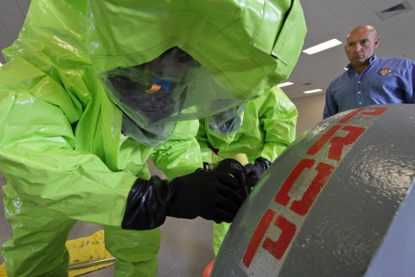
NEW YORK STATE PROFESSIONAL FIRE FIGHTERS ASSOCIATION
TRAINING- HAZARDOUS MATERIALS
Hazardous Material/WMD Training
Offered to all fire departments/first responders.
Quality, grant funded training program developed by fire fighters for our first response community.

Slide 20
NEW YORK STATE PROFESSIONAL FIRE FIGHTERS ASSOCIATION
GRANTS ADMINISTRATION
TOTAL 2015 NY SAFER awards: $7,959,527
*City of Newburgh Fire Department L0589 $2,061,516
*Newburgh L0589: The IAFF provided technical assistance in the drafting and review of the application prior to submission.
City of Syracuse L0280 $1,991,532
Troy Fire Department L0086 $ 972,377
City of Lockport Fire Department L0963 $ 848,368
*Lockport L0963: The IAFF provided technical assistance in the drafting and review of the application prior to submission.
Johnson City Fire Department L0921 $ 797,990
*Johnson L0921: The IAFF provided technical assistance in the drafting and review of the application prior to submission.
Fishers Fire District L4907 $ 653,728
*Fishers L4907: The IAFF provided technical assistance in the drafting and review of the application prior to submission.
City of Ithaca Fire Department L0737 $ 634,016
TOTAL 2016 NY SAFER awards: $1,221,051
City of Kingston Fire Dept. L0461 $ 690,390
Village of Medina Fire Department L2161 $ 530,661

Slide 21
NEW YORK STATE PROFESSIONAL FIRE FIGHTERS ASSOCIATION
IAFF FINANCIAL CORPORATION
IAFF Owned and operated financial institution with over $8 billion in assets.
Provides members with access to deals on mortgages, personal loans, retirement funding, as well as home, auto and life insurance.
The Frontline 457 plan serves as an alternative to your employer’s plan for you to invest for your retirement.

Slide 22
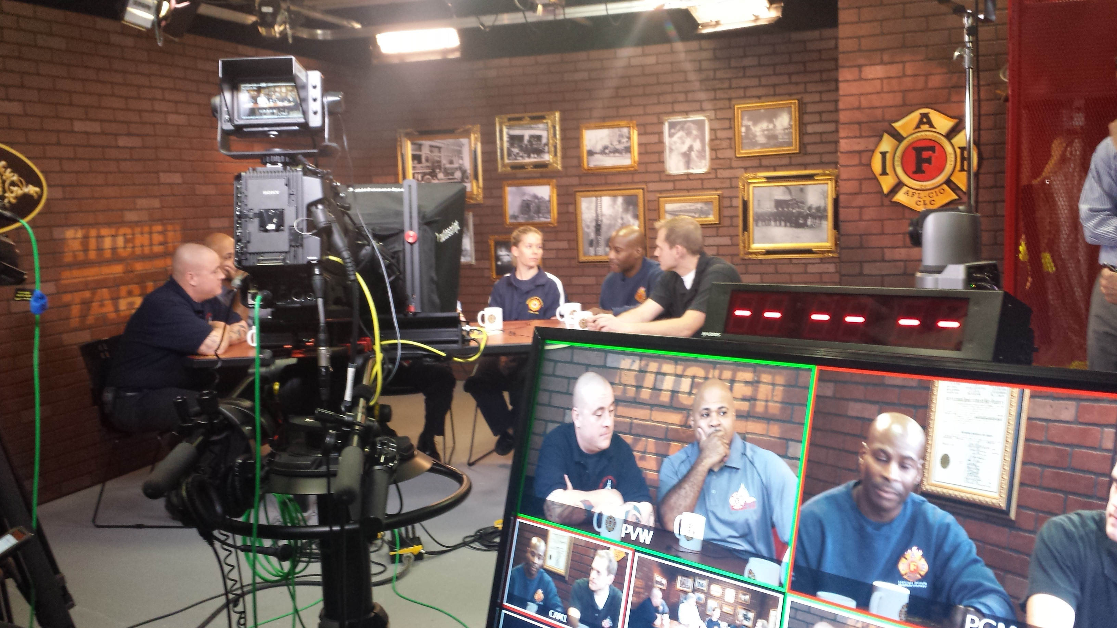
NEW YORK STATE PROFESSIONAL FIRE FIGHTERS ASSOCIATION
E-18 Media
Services Provided
Live feed capabilities to beam back to your local news affiliates if you need an expert interview.
Video production for your elected candidates.
Development of radio spots and online ads.
Edit the videos you shoot.
Also can buy media for your campaign, saving you thousands in commission costs.

Slide 23

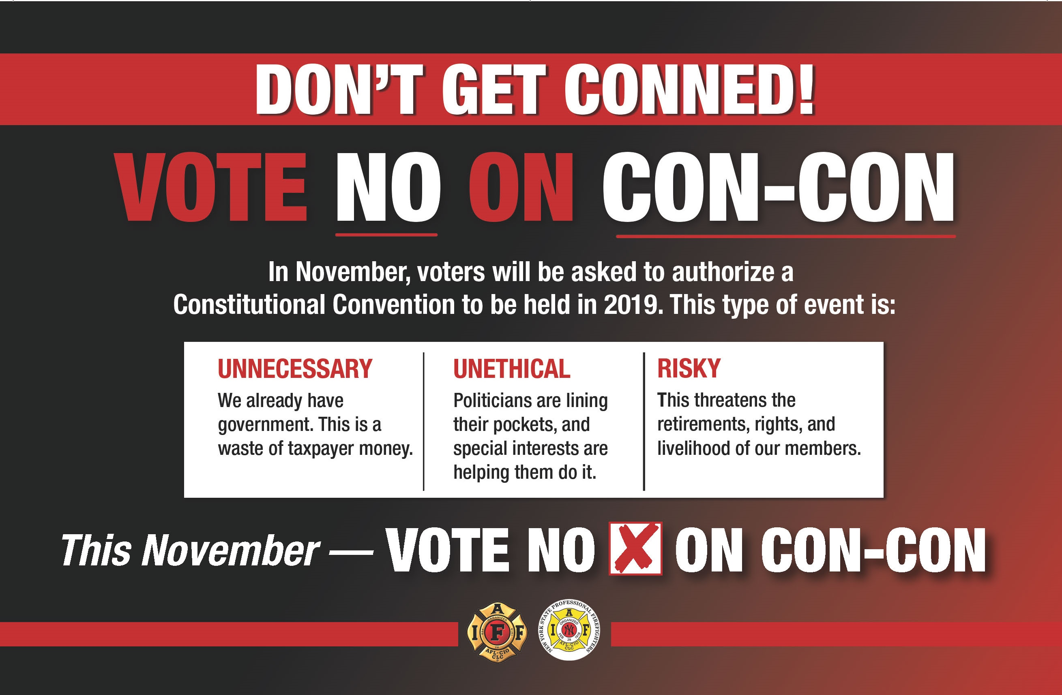
NEW YORK STATE PROFESSIONAL FIRE FIGHTERS ASSOCIATION
So… What Does Your IAFF Do For You?
Professional graphic design team on staff at IAFF HQ to assist with all of your design needs.

Slide 24
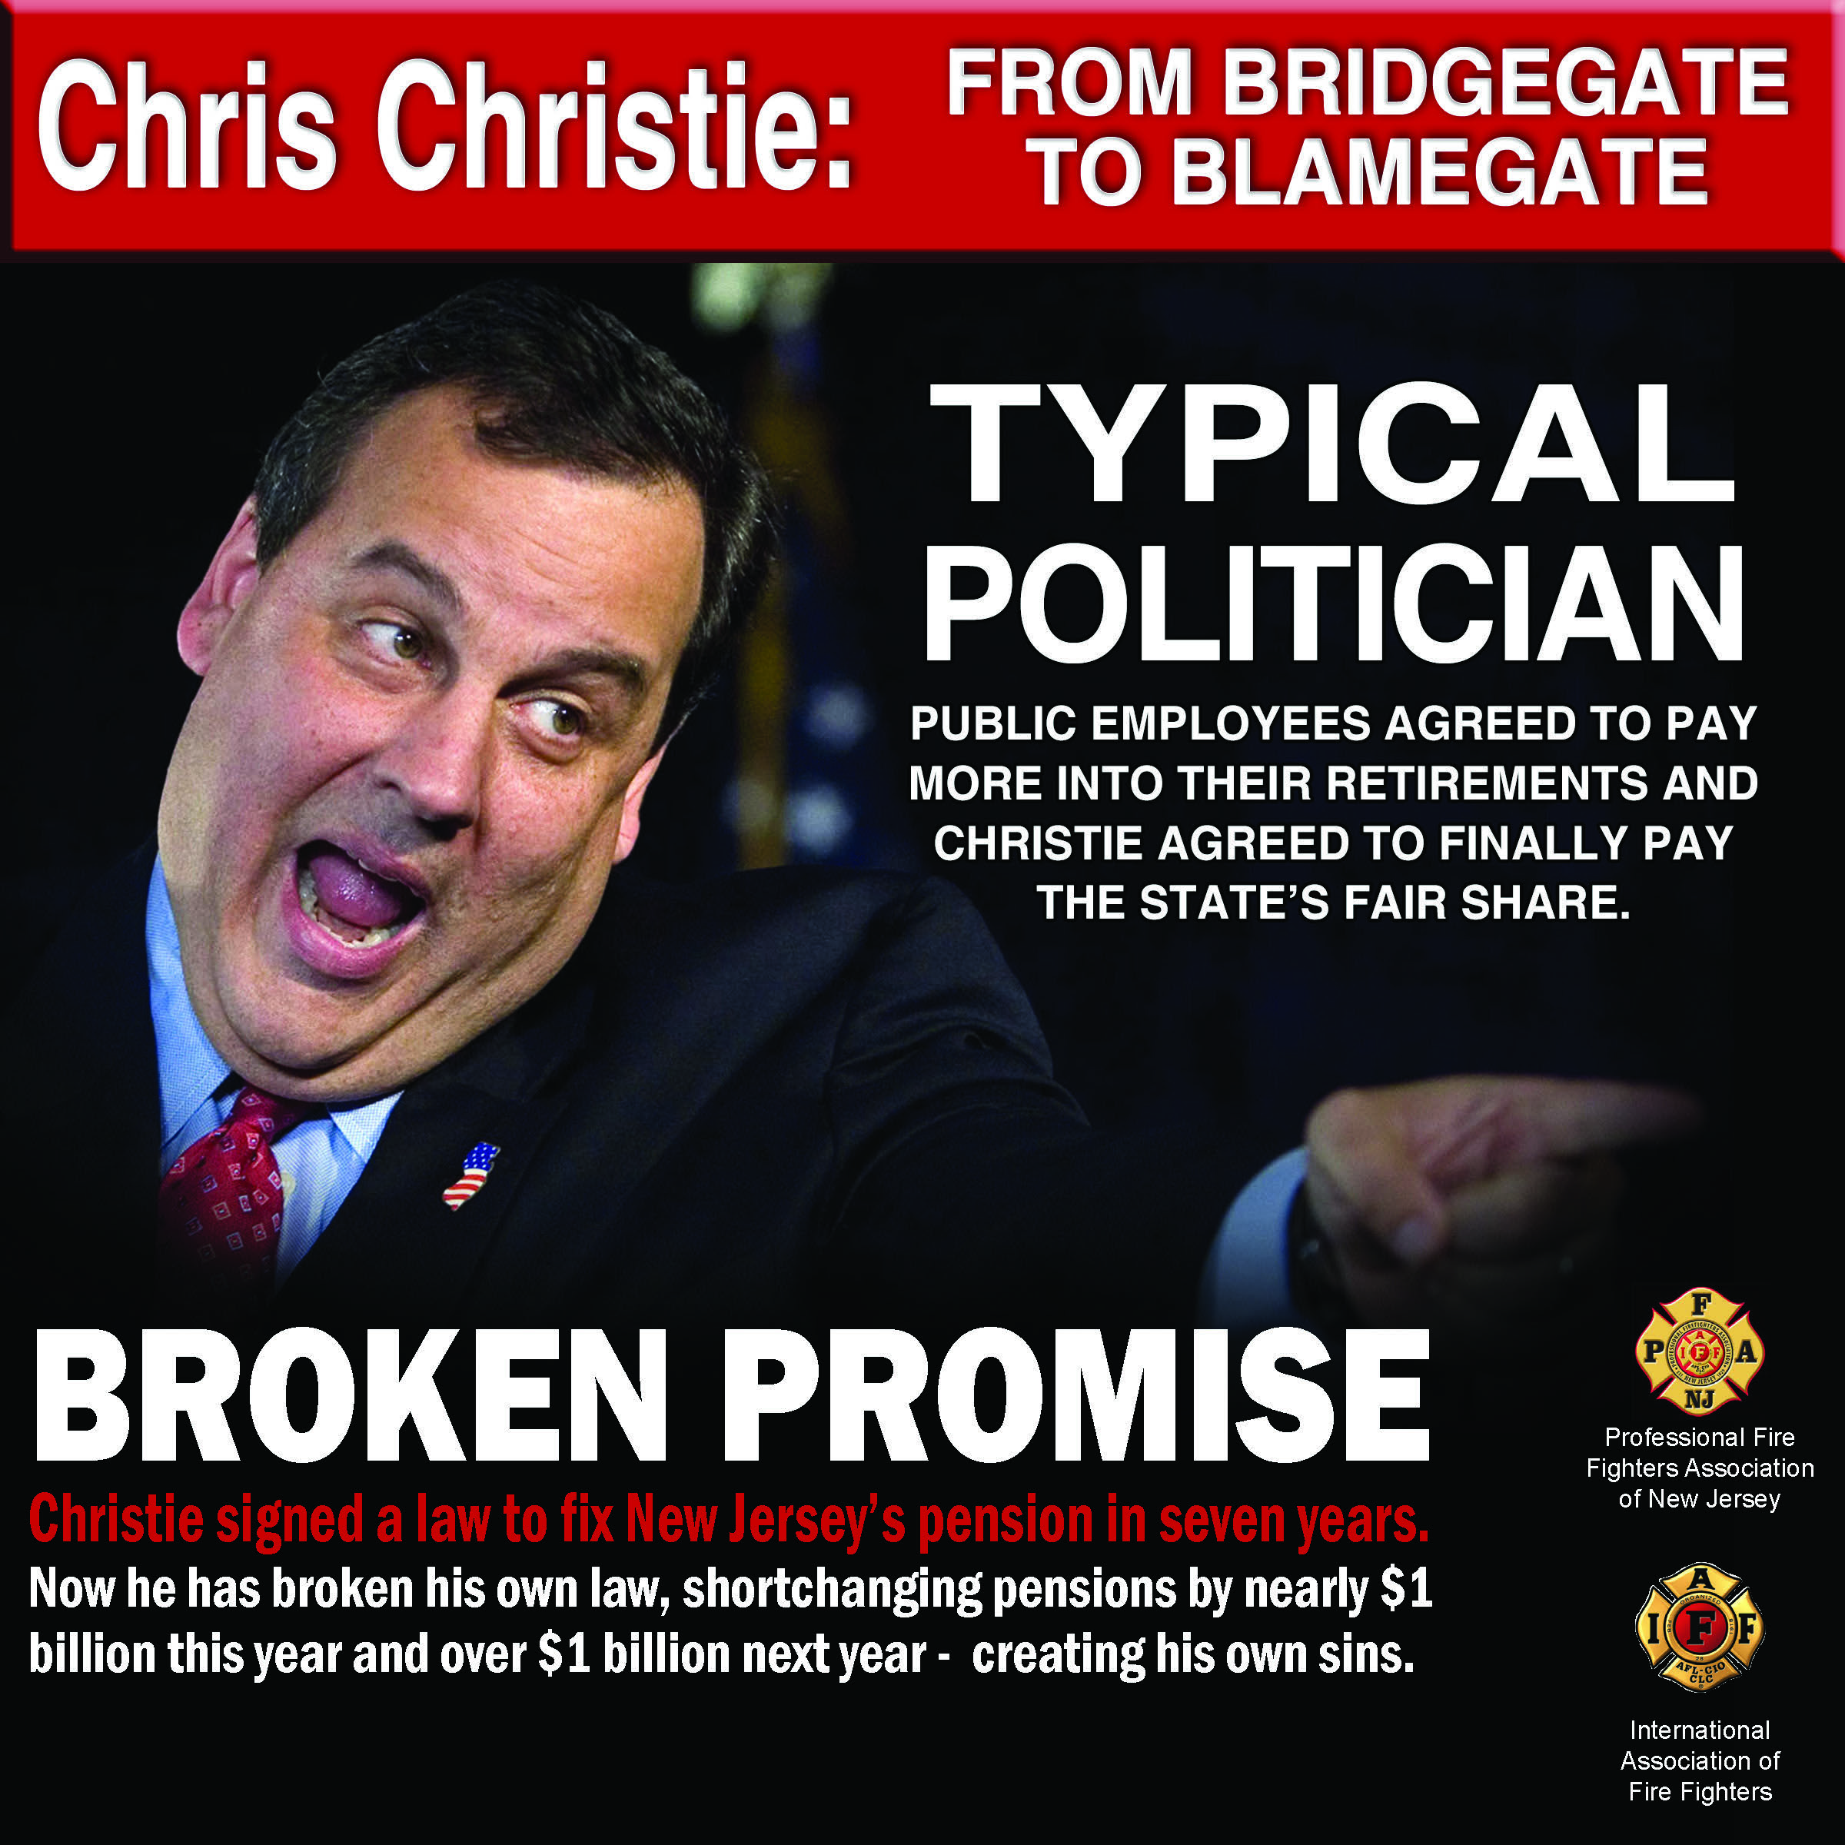
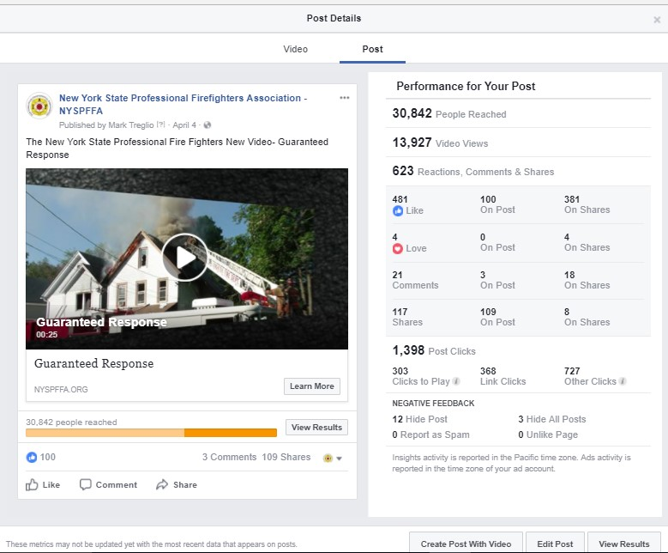
NEW YORK STATE PROFESSIONAL FIRE FIGHTERS ASSOCIATION
So… What Does Your IAFF Do For You?
Design of social media infographics and assistance with social media advertising.

Slide 25
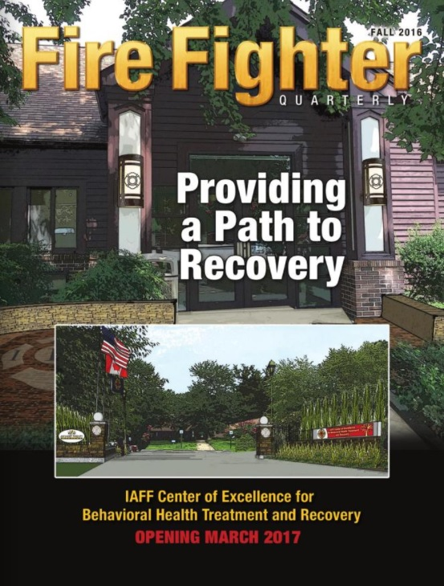
So… What Does Your IAFF Do For You?
GPS Cancer Initiative
IAFF Center of Excellence
The IAFF is on the frontline protecting members

Slide 26
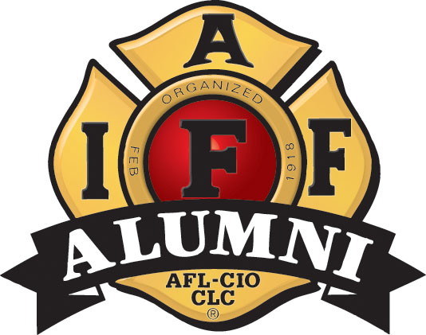
NEW YORK STATE PROFESSIONAL FIRE FIGHTERS ASSOCIATION
IAFF RETIREES- What Do I Get?
Inactive-Retired
Active-Retired
Free membership
Offered magazine at half price - $7.50 per year
Membership packet to include card and decals
must complete registration process first
Access to the IAFF website and Online store
Obtain discounts through Union Privilege
Access to insurance and financial services from the IAFF Financial Corporation
Automatic member
Must register to receive Alumni member packet
Pays half dues
Receives magazine
Half vote at convention for local
Access to the IAFF website and Online store
Obtain discounts through Union Privilege
Access to insurance and financial services from the IAFF Financial Corporation

Slide 27
NEW YORK STATE PROFESSIONAL FIRE FIGHTERS ASSOCIATION
RETIREES- IAFF ALUMNI
The IAFF Alumni became a reality following the adoption of resolution 40 at the 2002 convention in Las Vegas.
The idea of the IAFF Alumni began as a suggestion from delegates during the 2000 convention in Chicago to establish a retiree organization.
This program is designed to help retirees and former members maintain their relationship with the IAFF.
Currently serving 42,000 Active-Retired IAFF members

Slide 28
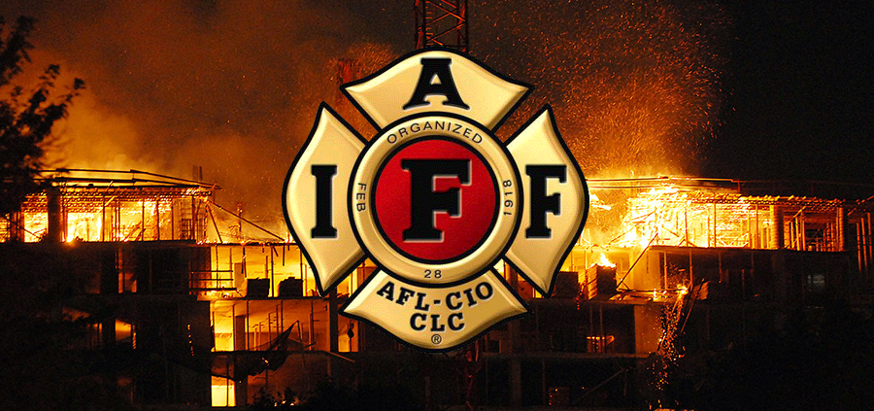
NEW YORK STATE PROFESSIONAL FIRE FIGHTERS ASSOCIATION
NEW YORK STATE PROFESSIONAL FIRE FIGHTERS ASSOCIATION (NYSPFFA)
State affiliate of the IAFF
Membership is voluntary
Dues are minimal
Benefits are provided largely through fundraising
Lobby at the state legislature to protect and advance the interests of New York’s career firefighters
On the job death and disability benefits
State-based financial, technical and legal resources

Slide 29
NEW YORK STATE PROFESSIONAL FIRE FIGHTERS ASSOCIATION
Consultation at No Cost to members
Arranged thru NYSPFFA office
- NFPA
- OSHA Standards and Regulations
- Fire Fighter related Legislative Updates
- Civil Service
- New York State Police and Fire Pensions
- Local Union Contracts (for comparison)
- Health & Safety Press Releases
- Fire Fighter and EMS
- Public Employment Relations Board Decisions
Access and Assistance from our PR Firm and
IAFF E18 for Local PR Campaigns
Full Time Registered Lobbyists
- Filing Accidental/Performance of
Duty Application
- Disability Retirement
- §207-a Questions/Cases
- Service Retirements
- 2% Foreign Insurance
- Negotiations
- Mediation
- Arbitrations/Hearings
- Attorney General Opinions
- Legal Updates
- Legislative Retrieval System

Slide 30
NEW YORK STATE PROFESSIONAL FIRE FIGHTERS ASSOCIATION
Lobbying Assistance
NYSPFFA has full time representation in the Capital with full time registered lobbyists
Communications
All locals have access to the NYSPFFA Communications team at Corning Place Communications
Legal Representation
- Host legal Conference
- Maintain legal library
- File Amicus briefs
- Free consultation on union issues
- Free consultation on disability issues
Continuous Representation
Represents members during career and into retirement

Slide 31
NEW YORK STATE PROFESSIONAL FIRE FIGHTERS ASSOCIATION
Representation on the Following Boards
NYS AFL-CIO
EMS State Board
EMS Regional Boards
NYS Civil Service Board
NYS Hazard Abatement Board
PERB Labor Management Board
NYS Comptroller’s Advisory Board
Fire Service Council of New York State

Slide 32
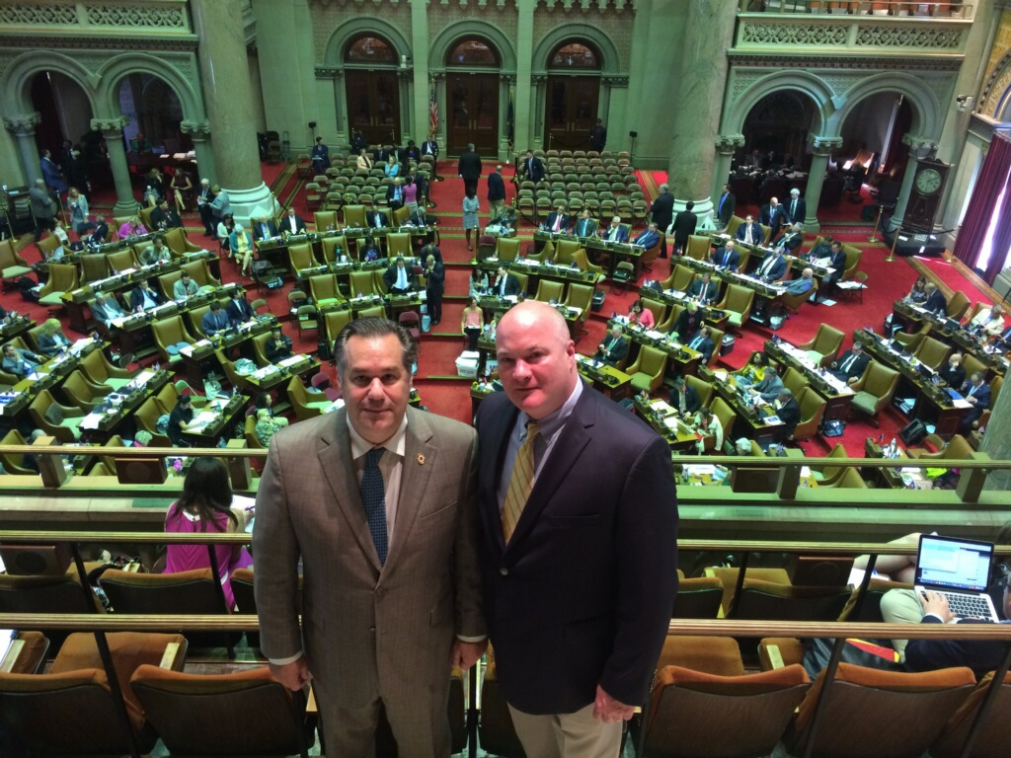
NEW YORK STATE PROFESSIONAL FIRE FIGHTERS ASSOCIATION
NYSPFFA in Albany
Political wins come by passing legislation that is beneficial to members and by killing potential legislation that can harm our members.
Binding Arbitration
General 207-a Disability-3/4 Disability
Cost of living adjustment (COLA). Additional COLA for widows.
Cancer Extension 2 year to 5 year
Presumptive Heart, Lung, Cancer, AIDS, TB, and HEP-C Bills
Military Service Time Buy Back (Up to three years) Peace or War.

Slide 33
NEW YORK STATE PROFESSIONAL FIRE FIGHTERS ASSOCIATION
Database/Library Information
Attorney General Reports
Audit & Control Reports
Comptroller’s Reports
Health & Safety Video Library
Incident Recording System
Local Union Contracts
NFPA & OSHA Regulations
PERB Cases (Interest and Grievance)
Train the Trainer Conferences
Health & Safety Database

Slide 34
NEW YORK STATE PROFESSIONAL FIRE FIGHTERS ASSOCIATION
Educational Opportunities
Labor Conference
Legislative Conference
NYSPFFA Convention
Public Relations/Media Conference
Health & Safety Training Conferences
(Statewide & Regional)

Slide 35
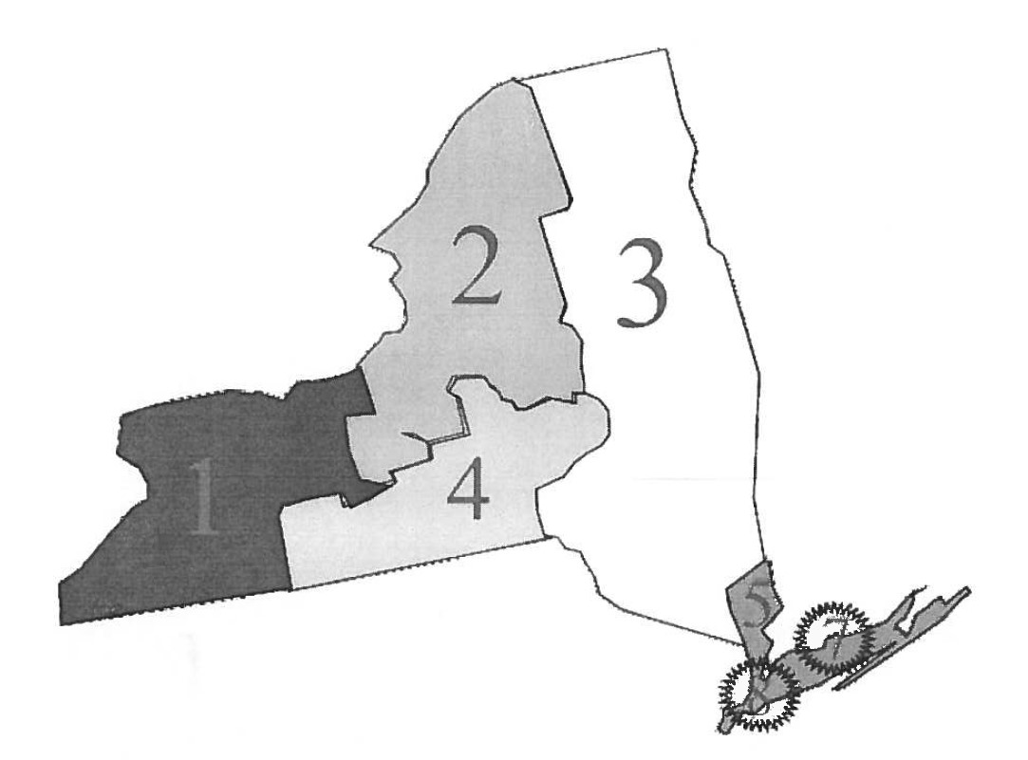
NEW YORK STATE PROFESSIONAL FIRE FIGHTERS ASSOCIATION
NYSPFFA STATEWIDE DISTRICTS
District 1:
Cattaraugus, Chautauqua, Erie, Genesee, Monroe, Niagara, Ontario and Orleans Counties
District 2:
Cayuga, Herkimer, Jefferson, Madison, Oneida, Onondaga, Oswego, St. Lawrence and Seneca Counties
District 3:
Albany, Clinton, Dutchess, Franklin, Fulton, Montgomery, Orange, Rensselaer, Rockland, Saratoga, Schenectady, Ulster, Warren and Washington Counties (With the exception of IAFF Local 589, Newburgh Professional Fire Fighters, Orange County which is in the 5th District)
District 4:
Broome, Chemung, Chenango, Cortland, Otsego, Steuben and Tompkins Counties
District 5:
Nassau, Putnam, Suffolk and Westchester Counties With the exception of IAFF Local 589, Newburgh Professional Fire Fighters, Orange County)
District 7:
Inclusive of all the members of IAFF Local 94, City of New York
District 8:
Inclusive of all the members of IAFF Local 854, City of New York

Slide 36
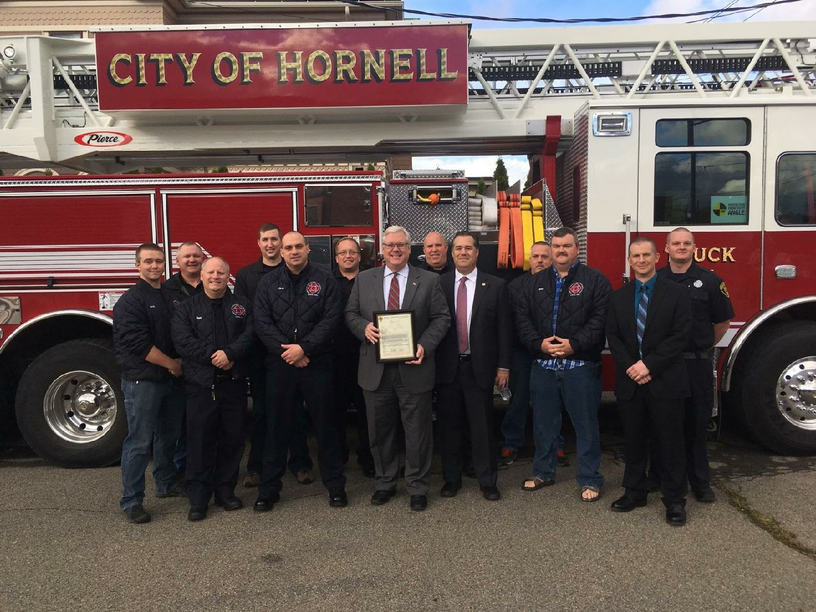
NEW YORK STATE PROFESSIONAL FIRE FIGHTERS ASSOCIATION
LOCAL REPRESENTATION
Local political Lobbyists
Co-ordinates all levels of representation, IAFF, NYSPFFA and Locally
Our IAFF local affiliates work at the municipal level to secure:
Fair, market-base compensation
Quality benefits
Secure and dignified retirement
Safe staffing and equipment
Equitable working conditions, including:
Fair promotional opportunities
Due process in disciplinary matters

Slide 37
NEW YORK STATE PROFESSIONAL FIRE FIGHTERS ASSOCIATION
MEMBER RESPONSIBILITIES
Be a member in good standing and pay your dues
Know your rights and stand up for each other
Represent the local in a professional manner
Bring your interests, talents and energy to your local

Slide 38
NEW YORK STATE PROFESSIONAL FIRE FIGHTERS ASSOCIATION
What happens if members drop out (free riders)
It will be a cancer that will spread as fast as traditional cancer
Once one members opts out it will be a down hill slide
All salary, wages and benefits that have been achieved over the last 100 years will begin to disappear
The IAFF will no longer have the financial resources to provide the same services and support on the national level that directly supports your Local
The NYSPFFA will no longer have the financial resources to provide the same services and support on the state level that directly supports your Local

Slide 39
NEW YORK STATE PROFESSIONAL FIRE FIGHTERS ASSOCIATION
What happens if members drop out (free riders)
Your Local will no longer be able to adequately provide all members the services and support it currently provides
It will no longer have the resources it needs to protect your pension, health care, salary, wages, health and safety and other benefits
Harmony in the fire station, were we live, will be in jeopardy

Slide 40
NEW YORK STATE PROFESSIONAL FIRE FIGHTERS ASSOCIATION
We need 100 percent Union membership
Is saving $20 in Union dues worth risking everything you and your family have and deserve??

Slide 41
NEW YORK STATE PROFESSIONAL FIRE FIGHTERS ASSOCIATION
In Conclusion
Union’s are under attack, need solidarity more now then ever
Strength in number’s
Everything we have has been fought for by the IAFF, NYSPFFA, and your Local. City, State and the Federal government have given us nothing with out a fight
Need all members to stay involved, need 100% percent membership

