Slide 1
Keeping Your Firefighters From Killing Themselves!
John Norman
Retired Chief of Special Operations, FDNY
Notes:
1

Slide 2
Hints for Class Participation
When asked to participate, do so.
  Take a stand on the question, right or wrong. No one will die here today as a result of your decisions.
Respect the opinions of others. They are taking a stand.
Have fun.
Don’t beat DEAD HORSES.
Help the instructor meet the goals of the class.

Slide 3
Start feeding your
“300 Year old mind.”

Slide 4
We have learned a great deal about Firefighter deaths.
Notes:
4

Slide 5
We have identified very few new phenomenon- for example, Extreme Wind Driven Fires
Notes:
5

Slide 6
But most deaths are not the result of new hazards …
Notes:
6

Slide 7
….Instead, They Are the Result of the Same Causes That We Have Been Dying From for Decades.
Notes:
7

Slide 8
Everyone Needs to Learn These Lessons, They’re Not Just a Big City Problem
60 Ff. Deaths In 2017
9 at Structure Fires*
*Source- NFPA
Notes:
8

Slide 9
9 Deaths Occurred While Responding or Returning
No Matter How Serious the Alarm is,
YOU DON’T DO ANY GOOD IF YOU DON’T GET THERE!!!
Notes:
9

Slide 10
Structure fires have three factors that play a role in FF Safety
The Structure
  Older “legacy” buildings
  Newer lightweight
The Contents
The Firefighters

Slide 11
The environment we are operating in HAS CHANGED dramatically in the last 48+ years

Slide 12
Dramatically larger plastics fire load
The average home or apartment contains over 3,500 lbs of plastic.
Faster fire growth
More toxic fire gases

Slide 13
Energy Efficient Windows
Hold heat and toxic gases in
Do not self vent until well into the fire
Require additional personnel and effort to thoroughly vent

Slide 14
Tight Building Syndrome
Hold in heat and toxic gases
Hastens flashover
Creates more toxic environment
Increases possibility of backdraft

Slide 15
The Impact
249 Deaths at Structure Fires 2000-2017*
99 Asphyxiation/Smoke
47 Burns
53 Heart Attack
49 Crushing/Trauma
*Excluding the 343 FF Deaths at the World Trade Center on 9/11/2001
Source: NFPA / USFA
Notes:
15

Slide 16
Reasons for Firefighter Deaths-
Lack of Understanding of
Smoke
Fire Behavior
Flashover
Backdraft
Notes:
16

Slide 17
What is Smoke?
Smoke is Unburned Fuel Gases & Solids Including Carbon Monoxide (CO), Cyanides & Carbon (Soot)
Notes:
17

Slide 18
Reasons for Firefighter Deaths
1970
Asphyxiation and Smoke Inhalation were leading causes of death.
Notes:
18

Slide 19
Today-Universal SCBA Use
3 Asphyxiation/Inhalation Deaths in 2016 !
Notes:
19
19

Slide 20
0f the 99 Asphyxiation Deaths
36Caught by Structural Collapse
31 Caught by Fire Growth, Flashover, or Backdraft
23 Lost/Disoriented in Structure
9 Fell Through Holes in Floor
96 out of 99 Were Wearing SCBA!
  Two that weren’t were fighting fires in their own homes.
Notes:
20
20

Slide 21
More Deadly Fire Gases
Since 1970 fires have tripled the BTU output, but…..
Smoke output can be as much as 20 times more toxic from synthetics
Energy Efficient Windows and insulation combine to trap all these gases inside with us
Notes:
21

Slide 22
Burning polyurethane foam releases dangerous chemicals such as hydrogen cyanide, and dioxin

Slide 23
Toxicity of today’s smoke is far worse than in the past.
They incapacitate first, making escape impossible, before killing.

Slide 24
Vent Thoroughly, Once Water On Fire
Conditions Change,
Masks Can Fail or
You Can Be
Entangled
Notes:
24

Slide 25
When Evaluating Smoke, Look at:
Color
Volume
Movement
Location
Notes:
25

Slide 26
Grey or Brown Smoke Indicates Burning Class A Materials
Notes:
26

Slide 27
“Velvety Smoke” or “Boiling” Movement, Is Smoke That Moves Rapidly Skyward, Is Highly Heated Smoke That Is About To Ignite
Notes:
27

Slide 28
Black Smoke=
Petroleum Products, Foam Rubber, Plastics
Notes:
28

Slide 29
Today that’s not still true
Notes:
29

Slide 30
Smoke Location is NOT always Fire Location
Notes:
30

Slide 31
Any Level With Smoke Must Be Checked Out!
AND The Floor Below !
Notes:
31

Slide 32
Beware of changing conditions !
Notes:
32

Slide 33
Have A Safe Haven
Notes:
33

Slide 34
Don’t Be Caught by Flashover
Notes:
34

Slide 35
Smoke Conditions May Be Your Last Warning Before Fire “Lights Up” BUT
Smoke Can Also Conceal Fire
Notes:
35

Slide 36
Of The 48 Burn Deaths
15 Caught by Structural Collapse
21 Caught or Trapped by Fire Growth, Flashover, or Backdraft
5 Lost/Disoriented in Structure
5 Fell Through Holes in Floor
2 Struck by Falling Debris
Notes:
36

Slide 37
Plastic’s Heat Release Rate & Volume
One pound of paper
  7,100 BTU’S
One pound of styrene plastic
  18,000 + BTU’S/lb.
  3,500 x 18,000=63,0000,000 BTUs (AKA a Whole Lot)
Notes:
37

Slide 38
Heat Release Rates & Volumes
BTUs
2’ diameter pool of Gasoline 380
Upholstered Cotton Chair 351 70 Lbs
Dry Christmas Tree 474
Uphlst’d Polyurethane Fm Chair 1990 62 lbs
Cotton/Jute Mattress 55 lbs 385
Polyurethane Foam Mattress 2493 32 lbs

Slide 39
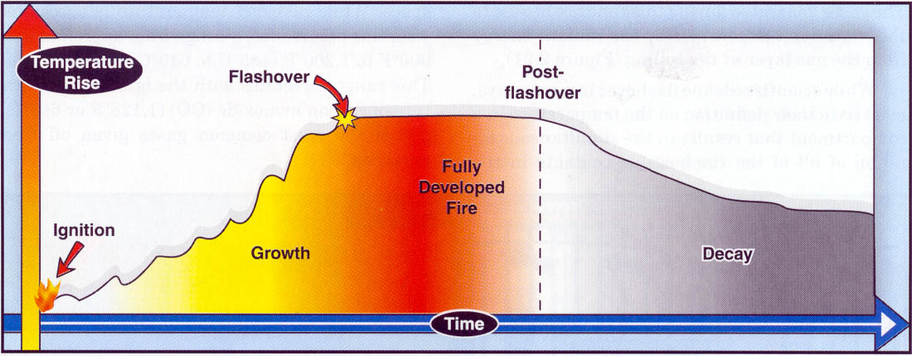
This Compresses The Stages of Fire Development
Notes:
39

Slide 40
Compressed Stages of Fire Development
At the same time, FD is arriving sooner due to improvements in alarm systems, cell phones etc.
Notes:
40

Slide 41
Impacts of Time
Fire doubles in size each minute*
Flashover occurs in 2 to 3 minutes.
Lightweight truss fails in 4 to 5 minutes.
Steel bar joists fail in 5 minutes.
Our average reflex time is 8-10 minutes.
Notes:
41

Slide 42
Flame Spread Rates
Some plastics exhibit a flame spread rate of 2 feet per second!!
That is 10 times faster than most wood surfaces

Slide 43
Flashover- Ignition of Entire Room
Usually gives warnings:
Rising heat levels
Rollover
PPE can delay detection of heat warning signs!!
Notes:
43

Slide 44
Rollover Is the Ignition of Fuel Gases (Smoke) at Ceiling Level Ahead of the Main Body of Fire.
Smoke Can Hide Rollover.
Notes:
44

Slide 45
Rollover is your last warning before flashover. You must either cool the area, or get out!
Notes:
45

Slide 46
Flash- over !
Notes:
46

Slide 47
Firefighters must understand this environment but more importantly, We Must Know How to React
Notes:
47

Slide 48
There are only 2 choices..1-adequately cool
Notes:
48

Slide 49
Or 2-
GET OUT
PPE can only protect you for about 2 seconds after flashover. You must cool the fire or, get out, or else you start burning
Notes:
49

Slide 50
How about ventilation?
19:35:31
Notes:
50

Slide 51
Ventilation will NOT prevent flashover
Notes:
51

Slide 52
Ventilation will hasten flashover in ventilation limited fires
Notes:
52

Slide 53
No matter what PPE you wear, or what you may have heard, Flashover is NOT a survivable event !
Notes:
53

Slide 54
Understand the changing environment
Temperature
Time

Slide 55
Understand the changing environment
Temperature
Time

Slide 56
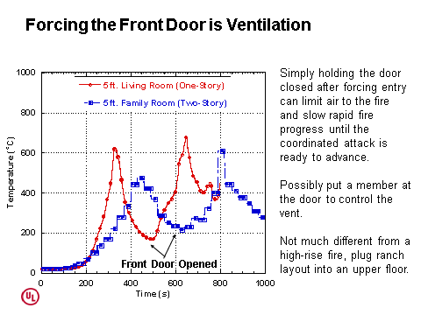
Notes:
56

Slide 57
Reasons for Firefighter Deaths
Unpredictable Fire Behavior
BACKDRAFT !
Notes:
57

Slide 58
What is a Backdraft?
A Backdraft is an instantaneous ignition of Fuel Gases (Smoke) that results in an explosion.
Notes:
58

Slide 59
What Causes A Backdraft ?
A Backdraft is caused by admitting air into a superheated, oxygen deficient atmosphere that is rich in fuel.
Notes:
59

Slide 60
What are the warning signs of potential backdraft?
Oxygen Deficient Smoke is Grey-Yellow in Color
Notes:
60

Slide 61
Backdrafts Can Be Extremely Powerful Explosions !
This one blew down a 12” brick wall burying 3 firefighters
Notes:
61

Slide 62
Most Backdrafts Occur in the Decay Phase
Notes:
62

Slide 63
How Do We Prevent A Backdraft?
This Backdraft blew the gate out of it’s track!
Notes:
63

Slide 64
Vertical Ventilation !
Notes:
64

Slide 65
What Good Will Vertical Venting Do Here?
Notes:
65

Slide 66
Every separate space is a different balloon!

Slide 67
Backdrafts Can Occur in Voids That Are in Proximity to the Fire, Even Where the Fire Is Free Burning

Slide 68
Building Construction Impacts on Firefighter Survival
Notes:
68

Slide 69
Q. What do these buildings have in common?
Notes:
69

Slide 70
A. They’re all the scene of at least one firefighters death where the building played a major role!!
Notes:
70

Slide 71
Cultivating a 300 year old mind.
Notes:
71

Slide 72
Make Friends with Brannigan & Dunn

Slide 73
KNOW the classes of construction and their hazards from fire
Notes:
73

Slide 74
Which Fires Are Related?
23rd St Fire, NYC 1966 -12 LODD
Vendome Hotel, Boston, 1972, 9 LODD
Waldbaum’s Supermarket, 1978 -6 LODD
Macy’s Dept Store, NYC 1979, 1 LODD
Hackensack Ford, NJ, 1988-5 LODD
Gift Shop, Orange Co Fla, 1989 2 LODD
Brackenridge Pa, 1991 – 4 LODD
Mary Pang Fire, Seattle 1995- 4 LODD
Houston Mc Donald's, 2000-2 LODD
Sofa Store, Charleston SC, 2007 9 LODD

Slide 75
Which Fires Are Related?
23rd St Fire, NYC 1966 -12 LODD
Vendome Hotel, Boston, 1972, 9 LODD
Waldbaum’s Supermarket, 1978 -6 LODD
Macy’s Dept Store, NYC 1979, 1 LODD
Hackensack Ford, NJ, 1988-5 LODD
Gift Shop, Orange Co Fla, 1989 2 LODD
Brackenridge Pa, 1991 – 4 LODD
Mary Pang Fire, Seattle 1995- 4 LODD
Houston Mc Donald's, 2000-2 LODD
Sofa Store, Charleston SC, 2007 9 LODD

Slide 76
Building Construction Impacts
Flame Spread and Smoke Production
Notes:
76

Slide 77
Building Construction Impacts
Exit Travel Distances
Notes:
77

Slide 78
Building Construction Impacts
Airflow Characteristics-IN
Notes:
78

Slide 79
Airflow Out- Tight Building Syndrome

Slide 80
Airflow Characteristics
Notes:
80

Slide 81
Acetylene –1200 Degrees
Notes:
81

Slide 82
Oxy-Acetylene – 5,500 Degrees
Notes:
82

Slide 83
A Closed Door Is the Difference Between Life and Death
Notes:
83

Slide 84
SOP’s only work at “Standard” Fires
Notes:
84

Slide 85
Houston, 2009- 2 LODDs
1 Story PD

Slide 86
Fire Officers must maintain “State of the Art” knowledge, and use appropriate tactics

Slide 87
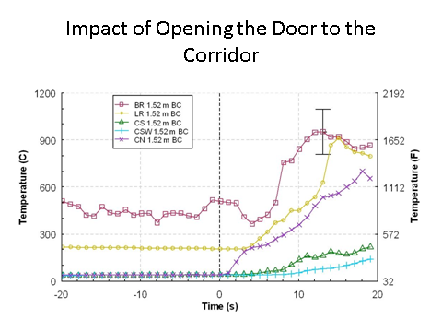
Notes:
87

Slide 88
Building Construction Impacts
Building Geometry

Slide 89
A Key Difference Between Stores And Residential Fires...
...Ceiling Height !!
9 Ft of FUEL GAS
6 Ft
Notes:
89

Slide 90
Building Construction Impacts
Building Geometry
Notes:
90

Slide 91
Building Construction Impacts
Presence of Hidden Voids
Notes:
91

Slide 92
What Happens When Ceilings Collapse?

Slide 93
You Must Get The Ceilings Open !

Slide 94
Building Construction Impacts
Collapse Potential
Notes:
94

Slide 95
249 FF Deaths at Structure Fires
2000-2017*
75 Were Caught in Structural Collapses and were asphyxiated (40), burned (18), or crushed (17).
Source:NFPA / USFA
Notes:
95

Slide 96
Fire Related
Causes of Collapse
Notes:
96

Slide 97
Fire Related Causes of Collapse
Heating of Unprotected Steel
Notes:
97

Slide 98
Fire Related Causes of Collapse
Failure of Highly Heated Cast Iron
Notes:
98

Slide 99
Fire Related Causes of Collapse
Fire Damage to Wooden Structural Elements
Notes:
99

Slide 100
Fire Related Causes of Collapse
Explosions Fuels, Explosives, Backdrafts
Notes:
100

Slide 101
Fire Related Causes of Collapse
Expansion of Water Absorbent Materials
Notes:
101

Slide 102
Fire Related Causes of Collapse
Overloading of Floors or Roof
Notes:
102

Slide 103
Fire Related Causes of Collapse
Cutting or Removing Structural Elements During Overhaul
Notes:
103

Slide 104
Fire Related Causes of Collapse
High Winds, Old Age
Notes:
104

Slide 105
Fire Related Causes of Collapse
Faulty Construction
Shoddy Renovations
Notes:
105

Slide 106
Fire Related Causes of Collapse
Flooding, Stream Impact,
Notes:
106

Slide 107
Fire Related Causes of Collapse
Vibrations, Impact Loads
Notes:
107

Slide 108
Indicators of Potential Collapse
Notes:
108

Slide 109
Indicators of Potential Collapse
Construction
Notes:
109

Slide 110
At least 14 FF Deaths involved lightweight wood construction
Notes:
110

Slide 111
Explosions

Slide 112
Indicators of Potential Collapse
Problem Occupancy
Notes:
112

Slide 113
Indicators of Potential Collapse
Heavy fire for 20 minutes or more
Accelerants
Notes:
113

Slide 114
Pay attention to the elapsed time of burn.
Notes:
114

Slide 115
Multiple Fires
Notes:
115

Slide 116
Indicators of Potential Collapse
Cracks or Bulges in Walls
Notes:
116

Slide 117
Indicators of Potential Collapse
Overloaded Floors
Columns or Walls out of Plumb
Notes:
117

Slide 118
Indicators of Potential Collapse
Not enough runoff
Notes:
118

Slide 119
Indicators of Potential Collapse
Smoke or Water Through a Wall
Notes:
119

Slide 120
Indicators of Potential Collapse
Roofs sagging, or abnormally spongy, pulling away from wall
Notes:
120

Slide 121
Indicators of Potential Collapse
Notes:
121

Slide 122
Indicators of Potential Collapse
Building Leaning
Notes:
122

Slide 123
Indicators of Potential Collapse
Obvious Movement, Plaster Sliding Off, Doors Swinging, Windows Breaking, Creaking, Cracking, Groaning Noises
Notes:
123

Slide 124
Resistance To Collapse
1-Type 1 Fire Resistive
2-Type 4 Heavy Timber
3-Type 3 Ordinary
4-Type 5 Wood Frame
5-Type 2 Non Combustible
Notes:
124

Slide 125
Class 1
Fire Resistive*
Notes:
125

Slide 126
Class 1 Heavyweight
Notes:
126

Slide 127
Class 1 Lightweight
Notes:
127

Slide 128
What Types of Collapse Are Possible in a Poured Concrete Bldg?
Notes:
128

Slide 129
Class 4
Heavy Timber
Notes:
129

Slide 130
Why Are Heavy Timber Buildings Unlikely to Collapse on Firefighters?
Because the tremendous fire drives us out of the building and out of the collapse zone before collapse is likely.
Notes:
130

Slide 131
What is the Life Hazard Then From Collapse of a Heavy Timber Building?
Personnel Operating In Exposures
Notes:
131

Slide 132
Class 3- Ordinary
(Brick & Wood Joist)
Notes:
132

Slide 133
Parapet Wall Collapse
Notes:
133

Slide 134
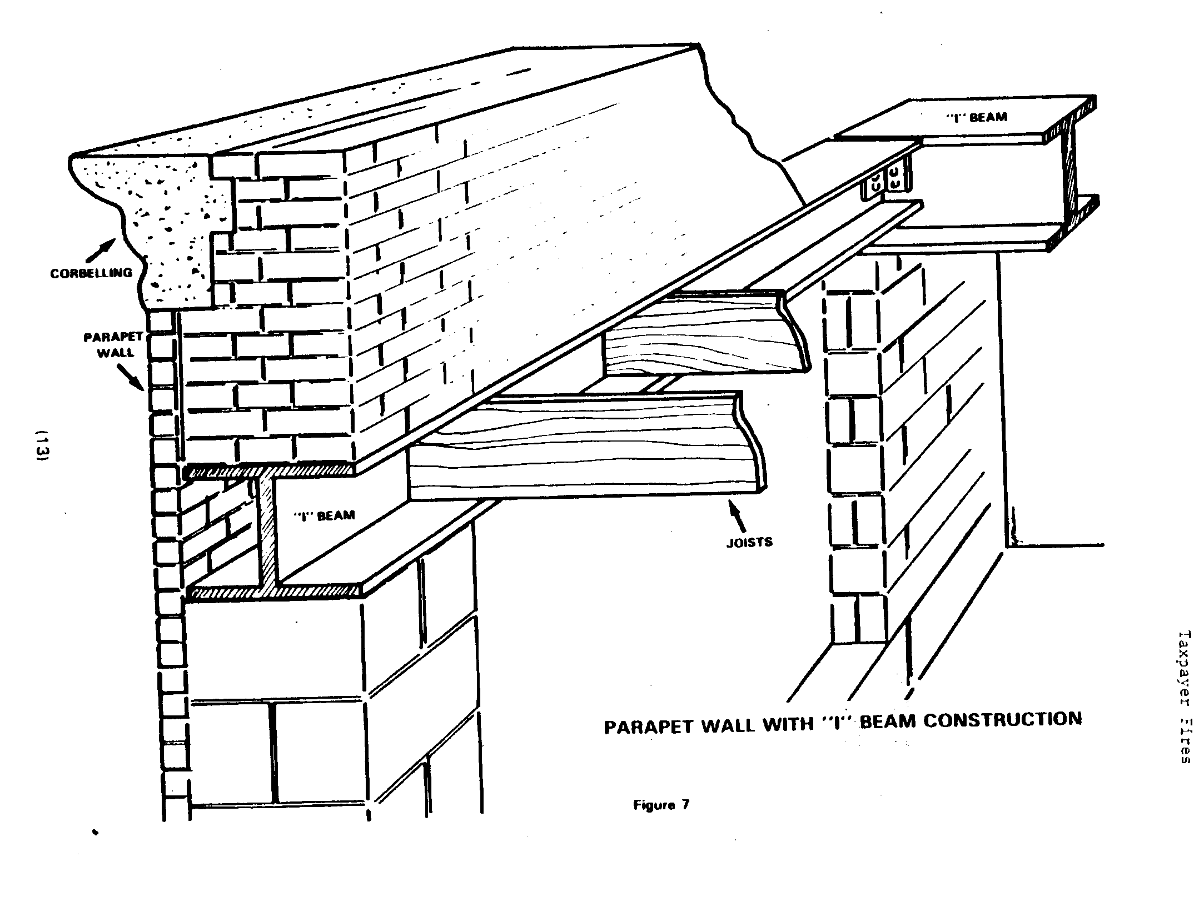
1 Ft
= 250 Lbs
2 Ft
1 Ft
Brick Weighs 125 Lbs / Cu. Ft.
Notes:
134

Slide 135
Will Collapse of This Parapet Kill Firemen?
No ! They’re Outside The Collapse Zone !
Notes:
135

Slide 136
Now This Is Where Guys Die!
Notes:
136

Slide 137
This Beam is the problem
Notes:
137

Slide 138
A 100 Ft. Steel Beam Heated 1000 Degrees Expands 9-1/2”
Notes:
138

Slide 139
The Sidewalk Is Always In The Collapse Zone !
Notes:
139

Slide 140
How Wide Should The Collapse Zone Be?
Notes:
140

Slide 141
Collapse Zone Extends The Entire Length Of the Parapet
Notes:
141

Slide 142
Exterior collapse deaths are preventable.
Establish collapse zones.
Notes:
142

Slide 143
The collapse zone includes buildings and apparatus

Slide 144
Problems With Steel
Notes:
144

Slide 145
Steel “Lally Columns” can explode when heated to 800 degrees

Slide 146
Class 5 - Wood Frame
Notes:
146

Slide 147
Class 5 needs 2 categories:
Legacy &
Lightweight

Slide 148
20 Minutes is not guaranteed !
You Must Look For Other Indicators !
Notes:
148

Slide 149
Of the 49 Crushing/Trauma Deaths
18 Caught in Structural Collapse
9 Fell/Jumped from windows
3 Fell on Debris
18 Struck by explosion debris (backdraft) (9 in ’13)
1 Stuck between a moving part and the building
Notes:
149

Slide 150
Ways To Cut The Fireground Death Toll
Notes:
150
150

Slide 151
Tactics for the Modern Environment
Provide water flows adequate for plastics heat release rates
Stage at areas that are not going to be overrun by rapidly advancing flame
Understand fire gas dynamics

Slide 152
Reasons for Firefighter Deaths
Faulty Fireground Decision Making
2011-2016
50 % of structure fire deaths in Stores, Factories, Public Assembly, Storage, & Vacant Buildings
Notes:
152

Slide 153
Risk A Lot To
Save A Lot
Notes:
153

Slide 154
Risk Little To Save Little
Notes:
154

Slide 155
Risk Nothing To Save Nothing
Notes:
155

Slide 156
Firefighter Deaths per 100,000 fires 2011-2016 Source-NFPA
Notes:
156

Slide 157
Reasons for Firefighter Deaths Faulty Fireground Decision Making
4 Deaths in Vacant Buildings !
Notes:
157

Slide 158
Vacant Buildings Identified
& Hazards Marked
Notes:
158

Slide 159
Normal stability when marked,
Hazards, Interior Ops only after exam & with extreme caution
Exterior Ops. Enter only after exam, w/ OK of IC for short time, min. staff
Notes:
159

Slide 160
Take Action On Hazards!!!
Notes:
160

Slide 161
Reasons for Firefighter Deaths
Attitude!
Notes:
161
161

Slide 162
Firefighter Survival
Rule #1
  Never put yourself in a position where you are depending on someone else to get you out!

Slide 163
Firefighter Survival
Rule #2
  ALWAYS know where your escape route is.

Slide 164
Firefighter Survival
Rule #3
  Always know where your second escape route is.

Slide 165
Give All Firefighters High Quality, Live Fire Training
Notes:
165
165

Slide 166
Establish Mandatory Minimum Standards for Officer Training
Notes:
166
166

Slide 167
Provide Adequate Staffing
Too few people slows completion of vital tasks, hoselines are stretched later, ladders don’t get raised on time, ventilation doesn’t get done.
Increases stress on members, 26 Heart Attacks & Strokes in 2016
Notes:
167
167

Slide 168
It takes people to do this job !!
Notes:
168
168

Slide 169
Effective Fireground Supervision Promotes Firefighter Safety Through Proper Risk Management
Notes:
169
169

Slide 170
Forward Deployment Of Chief Officers Puts Them In Position To Make Correct Decisions
Notes:
170

Slide 171
Employ Safety Officers
Reports Directly To The Incident Commander
Has The Authority To Stop or Modify Dangerous Operations
Shall Monitor Overall Scene Safety & Specific Concerns of IC
Is Not To Get Involved In Tactical Operations
Notes:
171

Slide 172
Use and Enforce an
Accountability System
That means more than just hanging tags on a helmet!!
Notes:
172

Slide 173
Invest in Your Firefighter’s Safety. The fireground is no place for ‘good enough’
Notes:
173
173

Slide 174
In spite of our best efforts however, the unexpected, unpredictable event can still happen on the fireground
Notes:
174

Slide 175
Train & Use
Rapid Intervention Teams
Notes:
175
175

Slide 176
They Have Saved Firefighters Lives!!
But They Must Be Properly Staffed, Trained, Equipped, and
Motivated
Notes:
176
176

Slide 177
Solve The Most Life Threatening Problems First !!
FIRE
AIR
Medical
Removal
Notes:
177
177

Slide 178
Get Them AIR !
Notes:
178

Slide 179
Bring A RIT PAK or Spare Mask for Each Downed FF
Notes:
179

Slide 180
Make Thermal Imagers Available At Every Operating Location.
They are especially critical to
Rapid Intervention Teams
Notes:
180
180

Slide 181
Promote Firefighter Survival Training
Notes:
181

Slide 182
It’s a Whole Lot Easier to Bailout in a Hurry If Need Be When You Have Done It Before in Practice!
Notes:
182

Slide 183
Firefighter Survival Techniques
Maintain control of the door to the fire area
Control ventilation
Have a safe haven before committing to above the fire
Notes:
183

Slide 184
When The Search is Complete, Get to a Safe Area
Notes:
184

Slide 185
Firefighter Survival Techniques
If cut off by FIRE….
Close doors between you & fire
Call for help, use radio & PASS
Locate ANY exit-
Breach a partition- TOOLS
Emergency window bailout
Notes:
185

Slide 186
Make sure you always have two ways out.
Notes:
186

Slide 187
Your Dept can spend thousands to buy you ropes and harnesses, and train you in its use, but it ain’t worth a damn if you don’t carry it and prepare yourself mentally for its use!
Notes:
187

Slide 188
When Water Problems Occur,
Get People To Safe Areas
Notes:
188

Slide 189
Promote Wellness & Rehab Programs
Enforce Mandatory Fireground Retirement Age of 65
Notes:
189

Slide 190
Be Alert For Building Alterations And Unusual Conditions
STOP IF SOMETHING DOES’NT FEEL RIGHT!

Slide 191
Steel Plating Adds Weight
Holds Heat, Accelerates Flashover
Delays or Prevents Ventilation
Accelerates Collapse
Altered Buildings Kill Firefighters!

Slide 192
Take Action On Hazards ! !

Slide 193
Get Out and Pre-plan Your Area

Slide 194
Everyone Can Have A 3 - Ring Binder
G.I./G.O.
Notes:
194

Slide 195
Learn your buildings, before..
Notes:
195

Slide 196
…NOT after the fire!
Notes:
196

Slide 197
Because After the Fire Is Way Too Late!
Notes:
197

Slide 198
How Do We Motivate Our People To Take Their Responsibility Seriously?
Notes:
198

Slide 199
If That’s Your Kid In That Box, And You Could Have Prevented It, How Could You Look At Yourself In The Mirror?
Notes:
199

Slide 200
Bring All Your People Home Safely !
Notes:
200

Slide 201
And finally, the Number 1 proven way to keep your firefighters from killing themselves in structural fires……

Slide 202
Advocate, Mandate, and Install automatic sprinklers in every structure….
Including your own homes!!!

Slide 203
99 Firefighters committed suicide in 2016!
We must support suicide prevention efforts.
Source NFPA and Firefighter Behavioral Health Alliance

Slide 204
Please pray for our troops
Notes:
204

Slide 205
Thanks to NIST and UL for their research and continuing efforts to make firefighters safer. ww.nist.gov/fire ww.ul.com/global/eng/pages/ newscience/firesafety
Thanks to NYSPFF and NYSDOL
for sponsoring this opportunity to share with fellow firefighters
Notes:
205

Slide 206
For comments, copies of this presentation, or further info:
www.chiefnorman.com
Stay Safe. BE Careful!
Notes:
206

Slide 207
Be CAREFUL !
Stay Safe.
Thanks to all the Fire Photographers who share their pictures so that others may learn.
R.I.P. Harvey
Notes:
207

