Slide 1
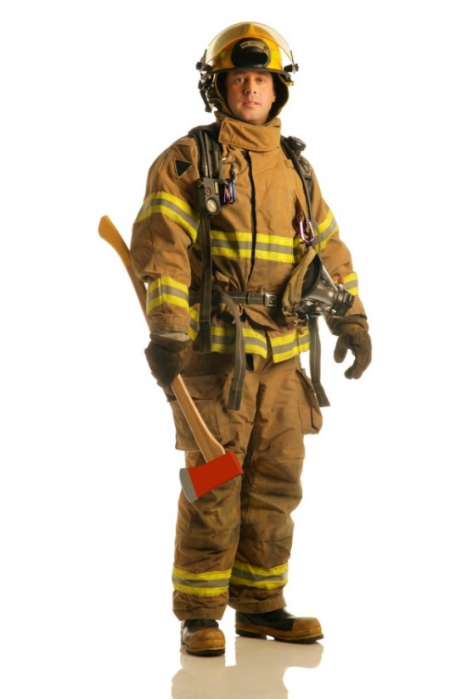
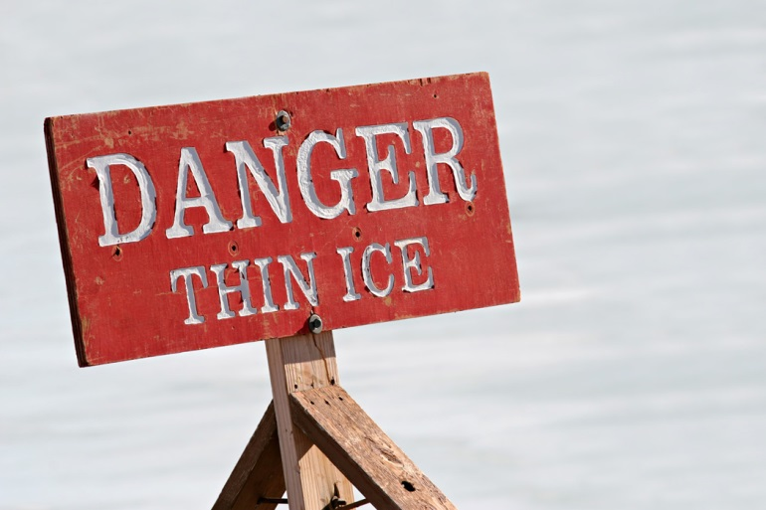
Safety Leadership
The Firehouse to the Fire Ground
Welcome
Safe Operations
Attitude
Fire Ground
Excellence
Timing
Yielding

Slide 2
Safety Leadership
What is your idea of safety?
What should your goals be?
When and where is it applicable?
Where are we now, and where are we going?

Slide 3

Being a Safety Advocate
Building a foundation of culture
Big changes in attitude and behaviors
Paradigm shift
“The definition of insanity is doing the same thing over and over and expecting different results”
--Albert Einstein

Slide 4
Being a Safety Advocate
Coaching starts with your good behaviors;
Setting the example
Setting the tone
Leading by example
Walk the talk
At all levels and at all times

Slide 5
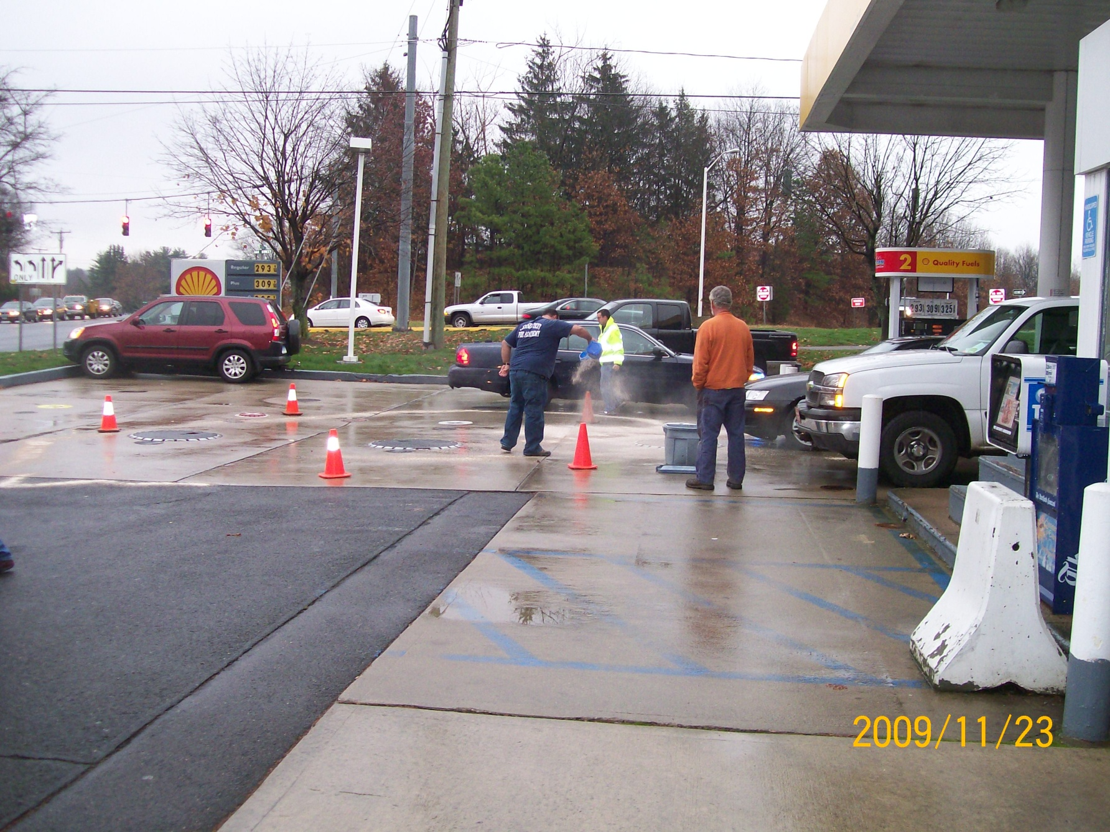

Slide 6
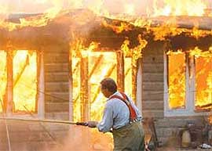
Being a Safety Advocate
“What you allow to happen without your intervention, becomes your standard”
--Chief Peter Lamb, MA

Slide 7
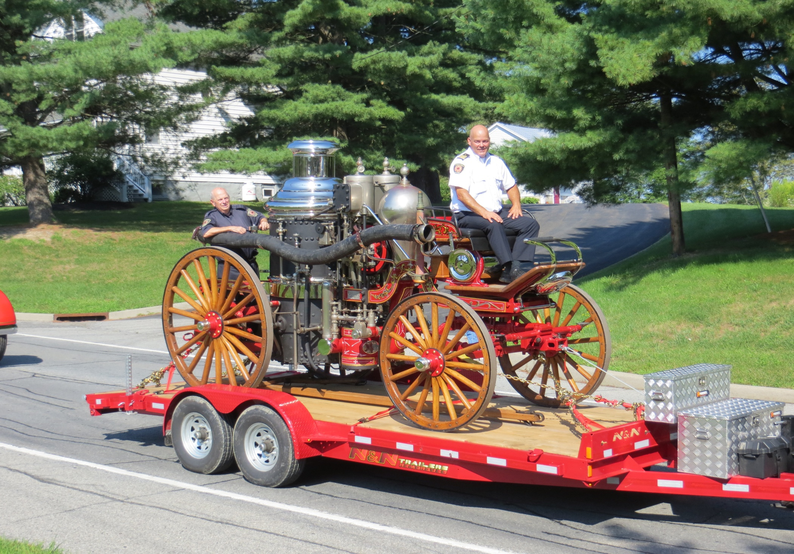

Slide 8
Being a Safety Advocate
The NFFF 16 Life Safety Initiatives:
Courage to be Safe/Everyone Goes Home
LSI#1; “Define and advocate the need for a cultural change within the fire service relating to safety; incorporating leadership, management, supervision, accountability, and personal responsibility.”
Let’s discuss.

Slide 9
Being a Safety Advocate
The NFFF 16 Life Safety Initiatives:
Courage to be Safe/Everyone Goes Home
LSI#2; “Enhance the personal and organizational accountability for health and safety throughout the fire service.”
Let’s discuss.

Slide 10
Being a Safety Advocate
The NFFF 16 Life Safety Initiatives:
Courage to be Safe/Everyone Goes Home
LSI#3; “Focus greater attention on the integration of risk management with incident management at all levels, including strategic, tactical, and planning responsibilities.”
Let’s discuss.

Slide 11
Being a Safety Advocate
Rules of Engagement for FF Survival
Size-up your tactical area of operation.
Determine occupant survival profile.
Do not risk your life for lives or property that cannot be saved.
Extend limited risk to protect savable property.
Extend vigilant and measured risk to protect and rescue savable lives.
International Association of Fire Chiefs

Slide 12
Being a Safety Advocate
Rules of Engagement for FF Survival
Go in together, stay together, come out together.
Maintain awareness of air supply, situation, location and fire conditions.
Monitor radio for critical fire ground communications.
Report unsafe practices or conditions that can harm you or others. Stop, Evaluate, Decide.

Slide 13
Being a Safety Advocate
Rules of Engagement for FF Survival
Abandon your position before deteriorating conditions can harm you.
Declare a mayday as soon as you think you’re in trouble.
Do these make sense?

Slide 14
Being a Safety Advocate
IC Rules of Engagement for FF Safety
Rapidly conduct a 360 situational size-up.
Determine occupant survival profile.
Conduct initial risk assessment.
If you don’t have the resources to safely support and protect firefighters, consider going defensive.
Do not risk firefighter’s lives for lives or property that cannot be saved. Consider going defensive.

Slide 15
Being a Safety Advocate
IC Rules of Engagement for FF Safety
Extend limited risk to protect savable property.
Extend vigilant and measured risk to protect and rescue savable lives.
Act upon unsafe practices reported to you.
Maintain two-way communications and keep all informed on fire conditions.

Slide 16
Being a Safety Advocate
IC Rules of Engagement for FF Safety
Obtain/give progress reports and adjust the plan accordingly.
Ensure accurate accountability of people on the fire ground, location & status.
If after the primary search, little or no progress is made on the fire, consider going defensive.

Slide 17
Being a Safety Advocate
IC Rules of Engagement for FF Safety
Always have a RIT/RIC/FAST on the scene.
Always have a rehab set up for personnel at the scene.
Do these make sense?

Slide 18
Being a Safety Advocate
NFPA 1500
“The acceptable level of risk is directly related to the potential to save lives or property.
Where there is no ability to save lives or property, there is no justification to expose fire department members to any avoidable risk and defensive operations are the appropriate strategy.”
DOES THIS MAKE SENSE?

Slide 19
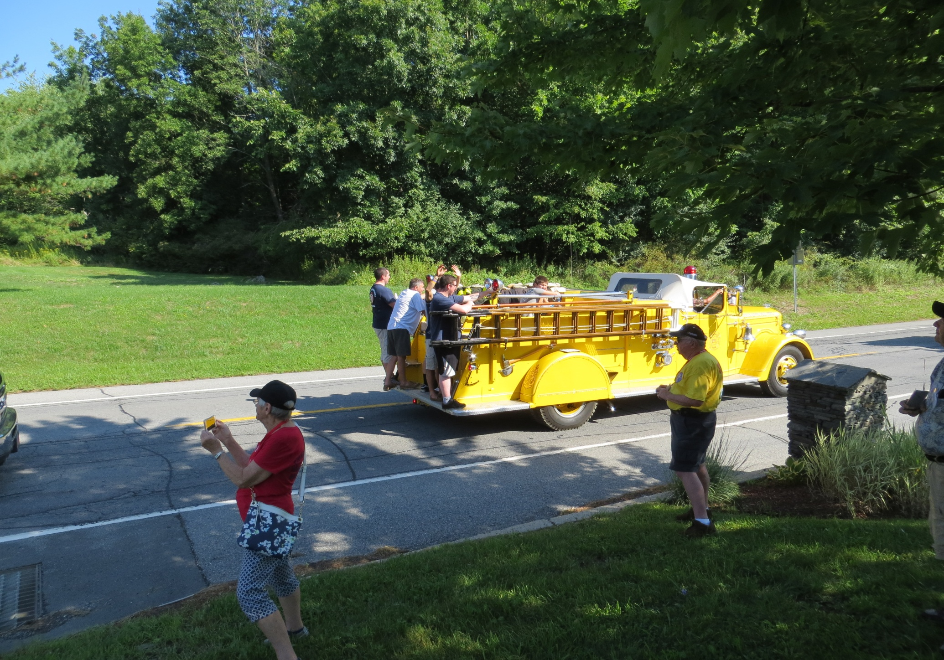

Slide 20
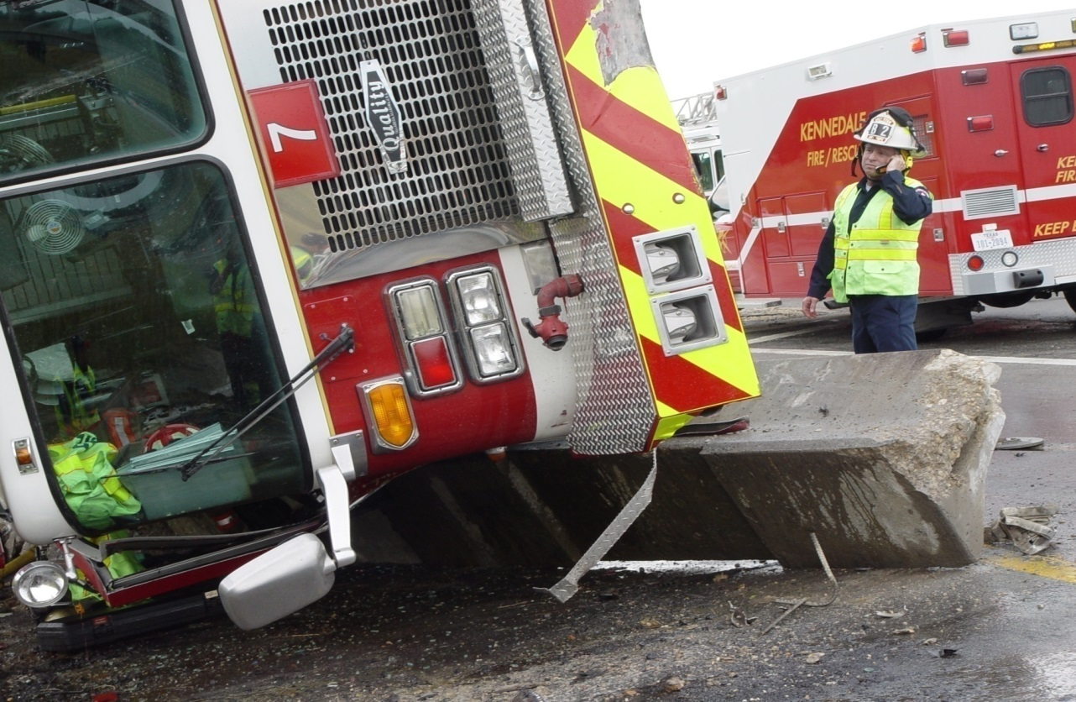
Foundations of
Safety

Slide 21
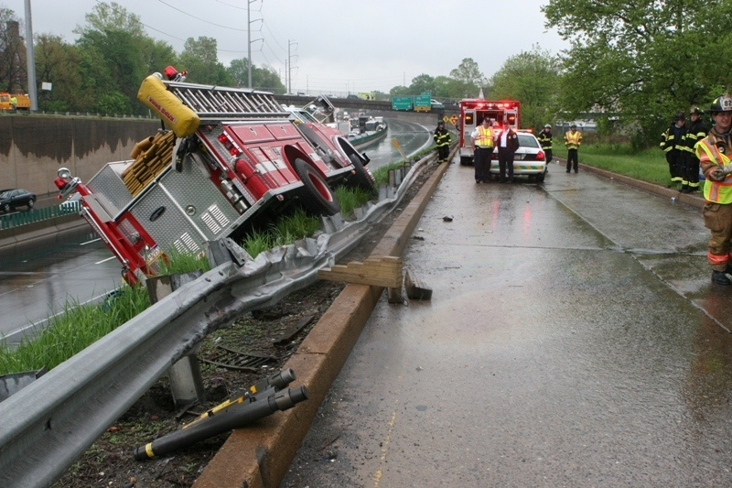
Foundations of Safety
Safety injects;
All the time
Verbal/Non-verbal; Your actions
Table-top drills
Hands-on drills
Light discussions

Slide 22
Foundations of Safety
Training Program;
Train every day for peak performance
Work as you train, train as you work
Train like you fight, fight like you train
Train for lack of fire ground operational experience (if you’re slow, you need more)
Skill drills; builds muscle memory
Train for life………………….
“Let no man’s ghost come back to say his training let him down” –FDNY Fire Academy

Slide 23

Foundations of Safety
Standard Operating Procedures and Standard Operating Guidelines
The very foundation of safety
Common goals & strategies
One blue print for operations
Singing off the same song sheet:
Jingle bells, jingle bells, jingle all the way!

Slide 24
What You Want to Hear in Your Firehouse
“We operate safely for the right reasons, not just to comply with rules and regs.”
“If we can’t do it safely, let’s figure out how to, or maybe not do it at all.”
“We want to understand the job hazards before we go in to the field.”
“Everyone on the fire ground should be empowered to stop a hazardous operation.”

Slide 25
What You Want to Hear in Your Firehouse
“We need consistent, predictable behaviors to help us survive the fire ground.”
“We need to constantly check each other for knowledge of procedures/operations.”
“We should strive for a zero accident and injury rate.”
“It’s easy to talk safety but we all need to do something about it.”

Slide 26
“Do something to make nothing happen.”
….Author Unknown

Slide 27
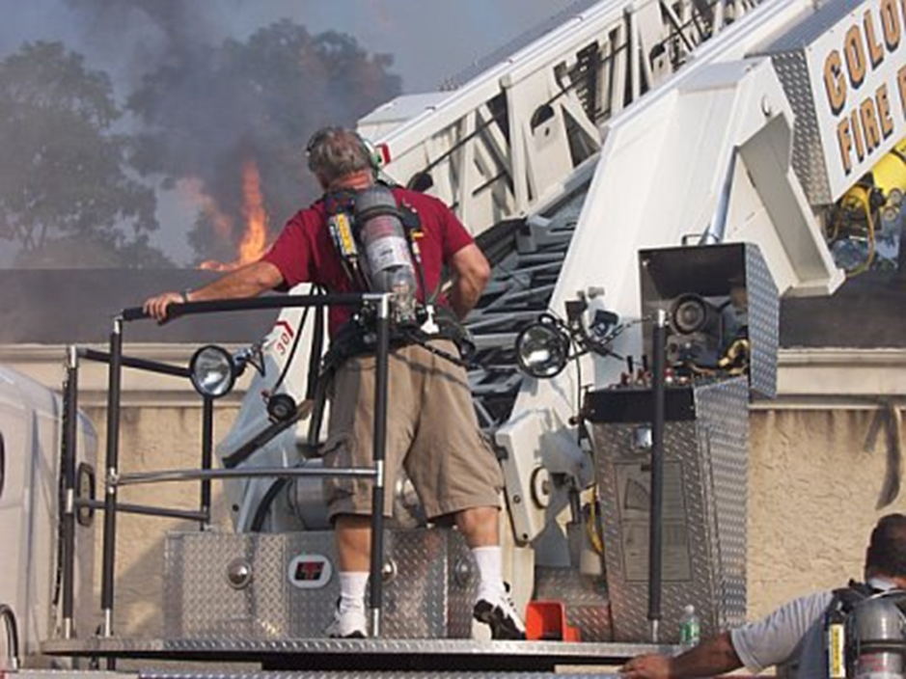
Situational
Awareness

Slide 28
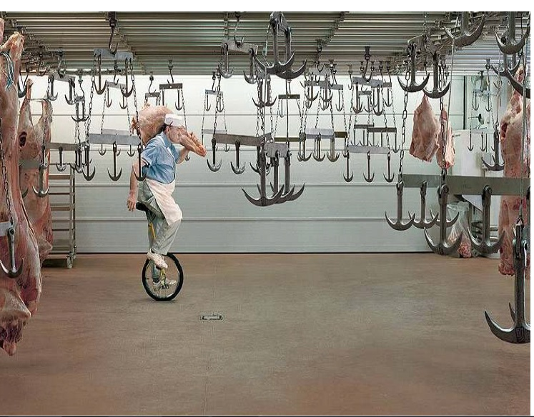

Slide 29
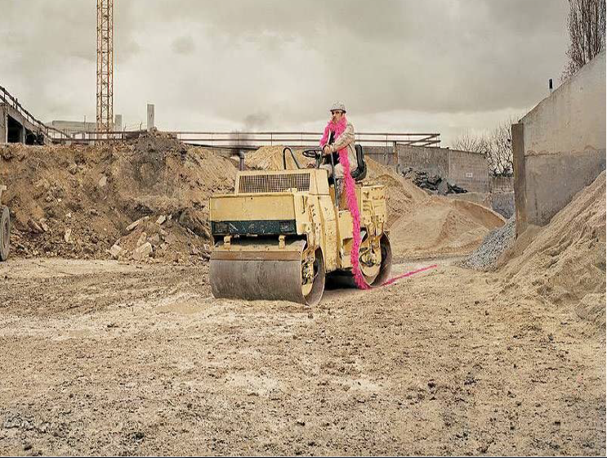

Slide 30
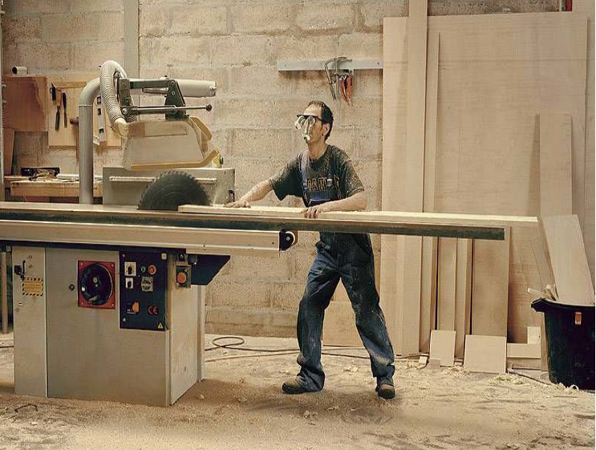

Slide 31
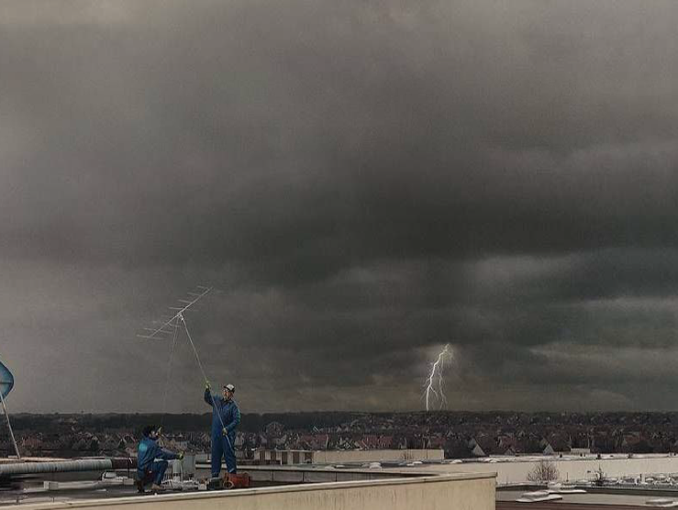

Slide 32
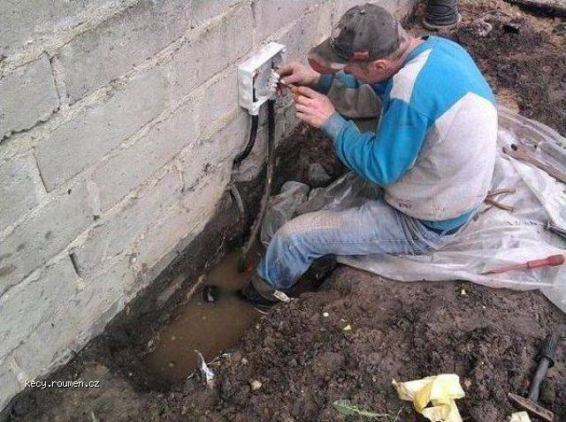

Slide 33
Situational Awareness
Starts when the tones drop
Responding to the floor-pole
Mental size-up re: alarm information
Driving to the scene
Seatbelts-Speed-Intersections
Size-up at the scene
Tactical decisions based upon;
Risk vs. Benefit
Survivability Profiling (S. Marsar)

Slide 34
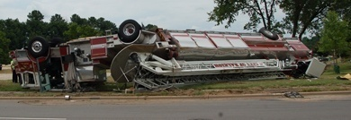
We need to get there.

Slide 35
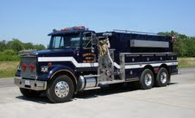
Nice rig!

Slide 36
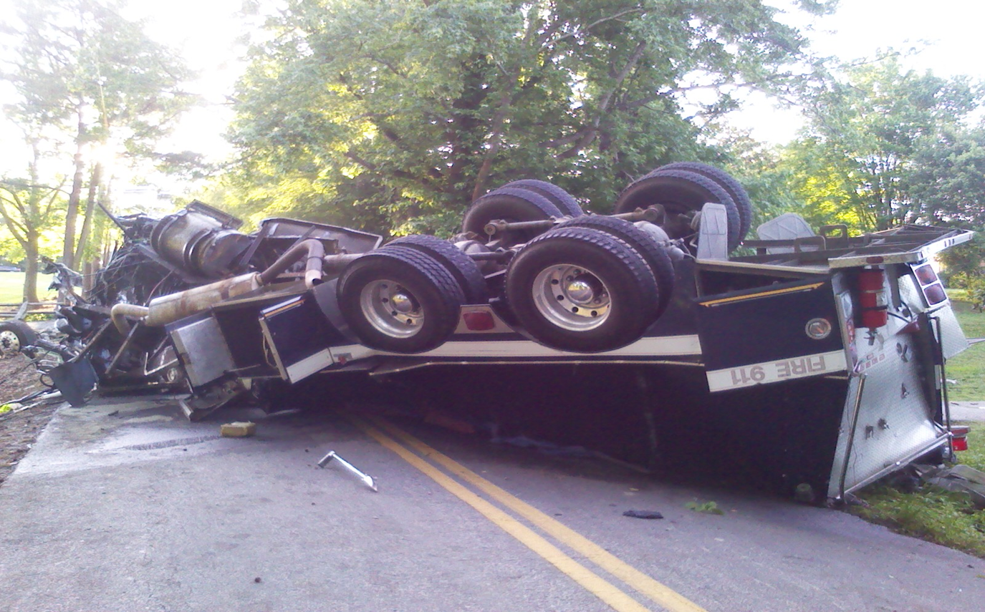
Not so nice. Same rig.

Slide 37
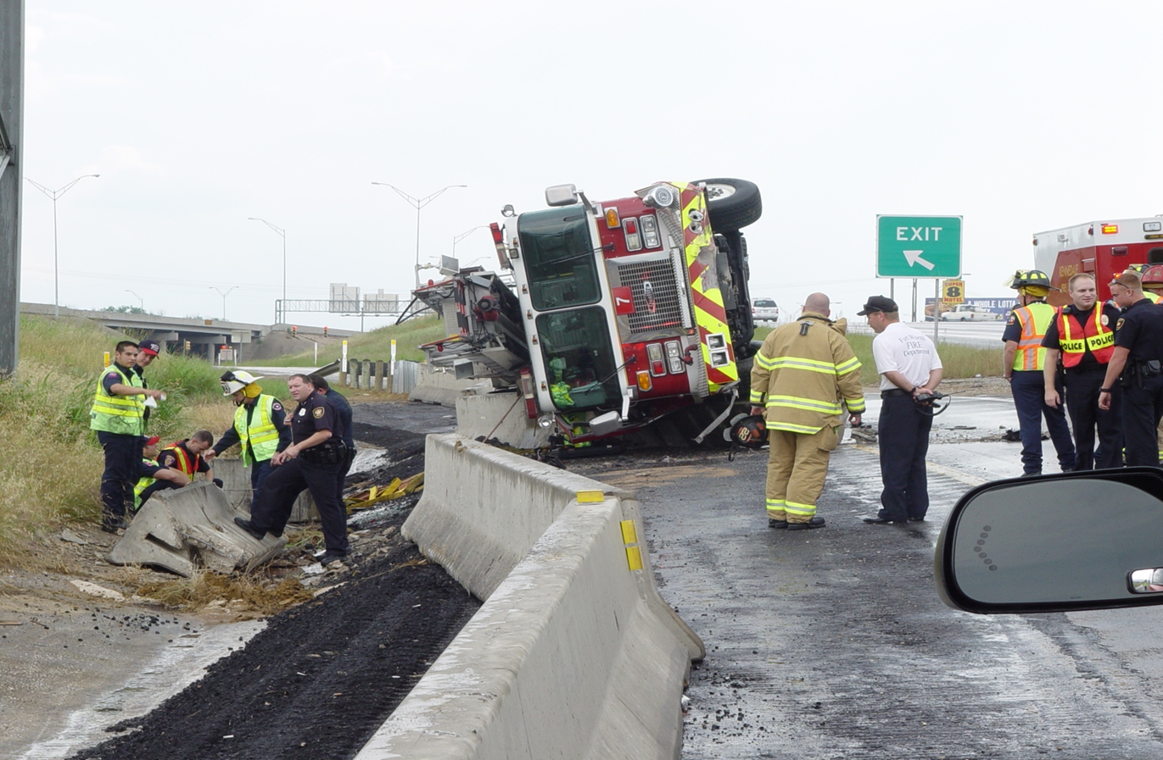
We need to stay upright!

Slide 38
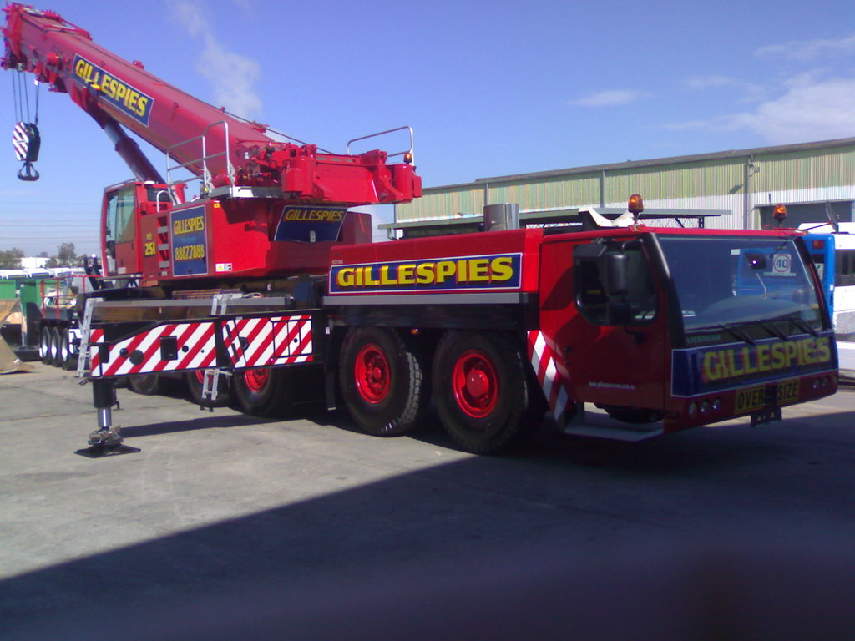
Situational Awareness

Slide 39
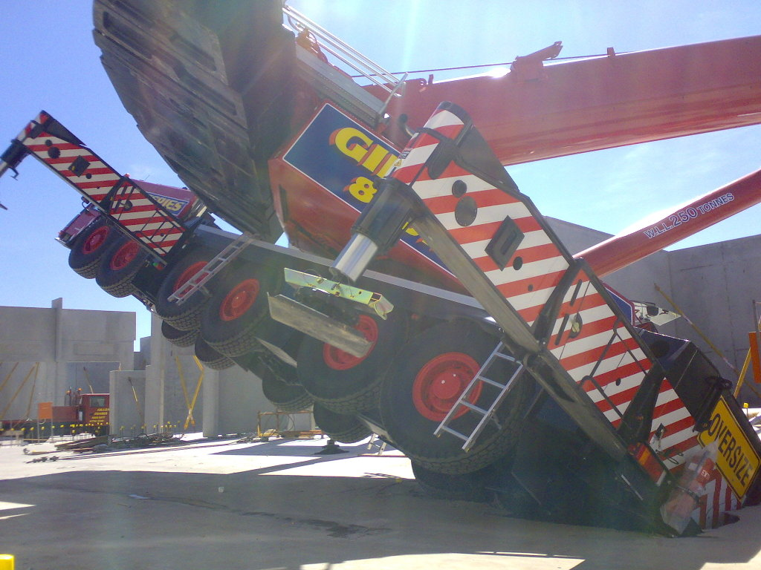

Slide 40
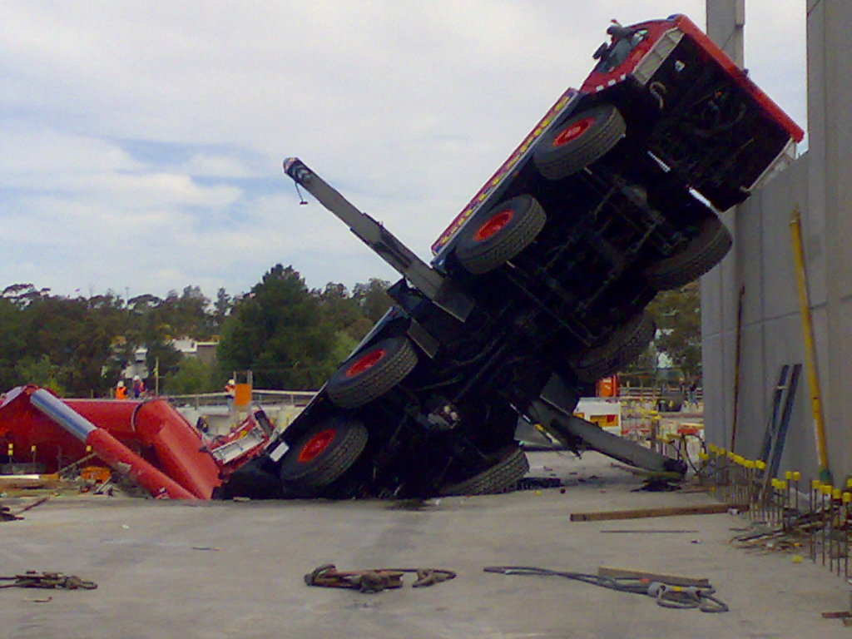

Slide 41
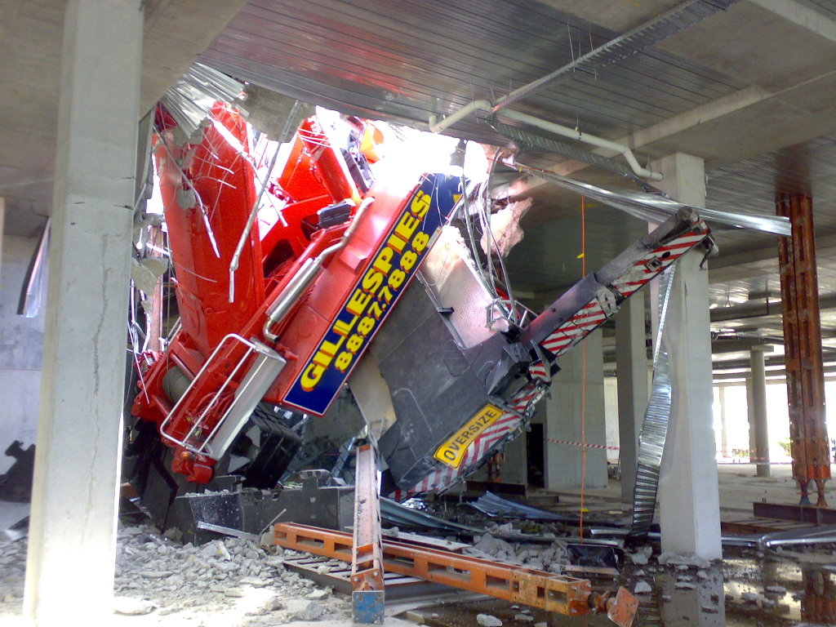

Slide 42
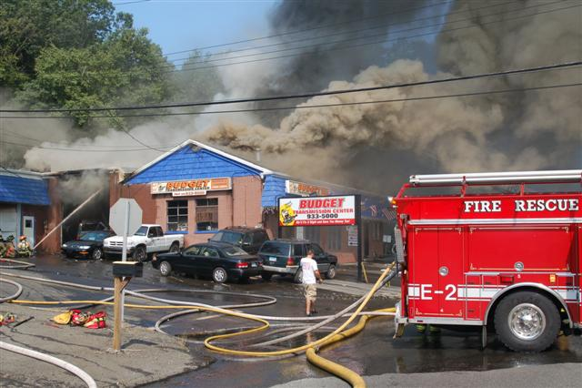
Situational Awareness

Slide 43
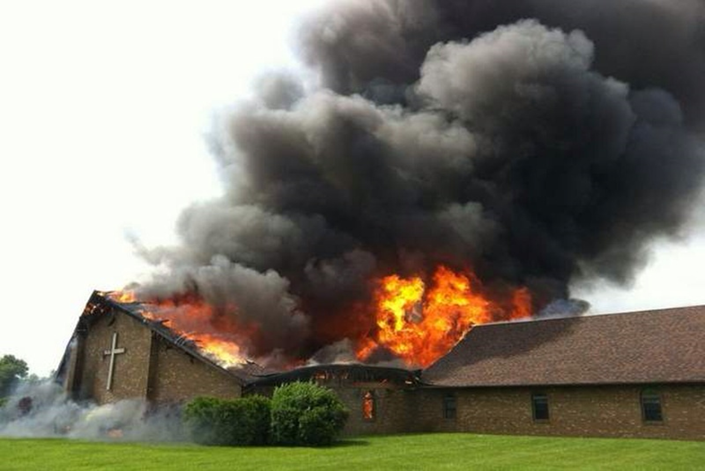
Situational Awareness

Slide 44
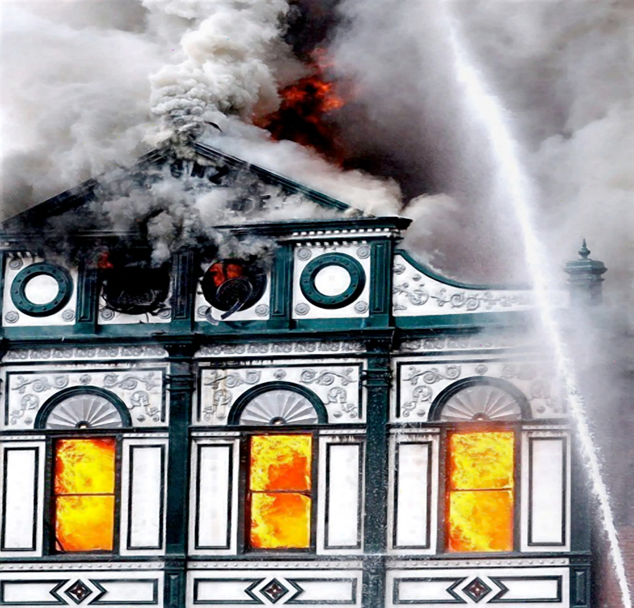
Situational Awareness

Slide 45
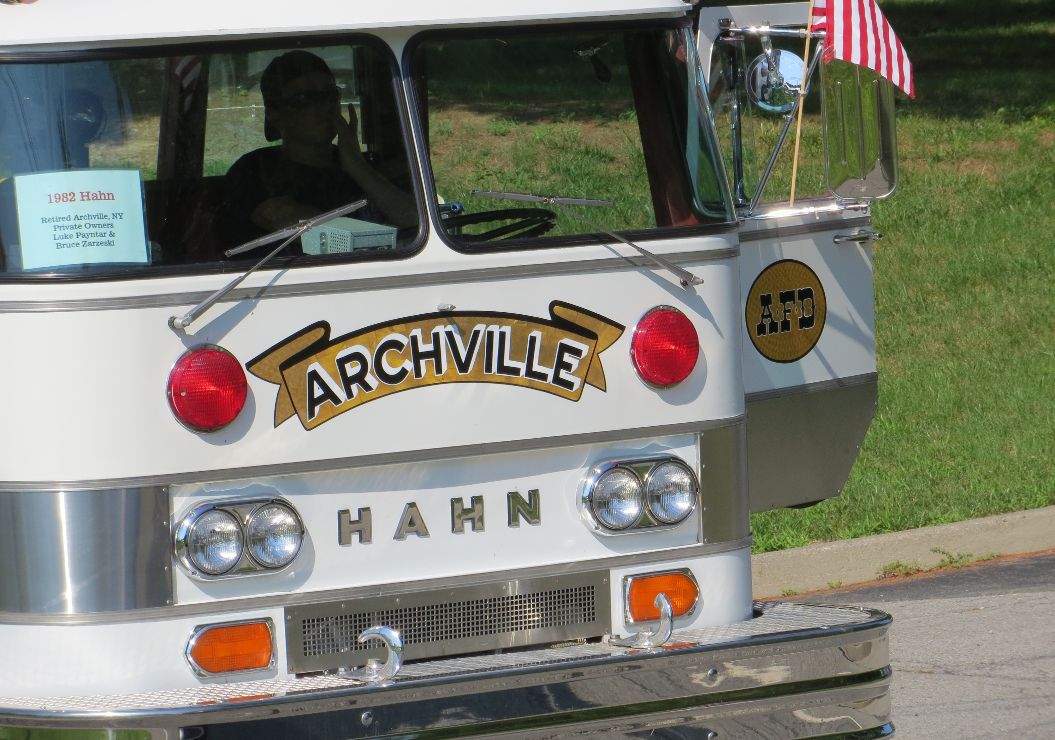

Slide 46
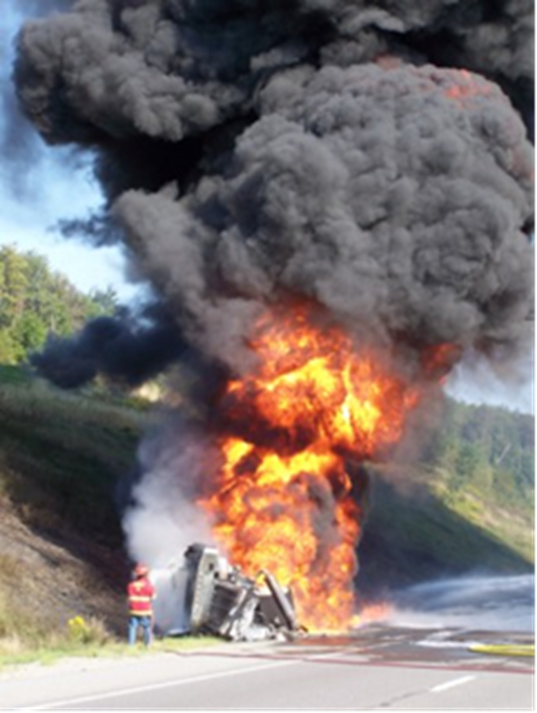
Situational Awareness

Slide 47
Situational Awareness What the brainiacs say………
Loss of situational awareness increases human error.
Human error is the most common cause of accidental death.
Improvements in situational awareness can reduce the number of firefighter injuries, near misses and deaths.

Slide 48
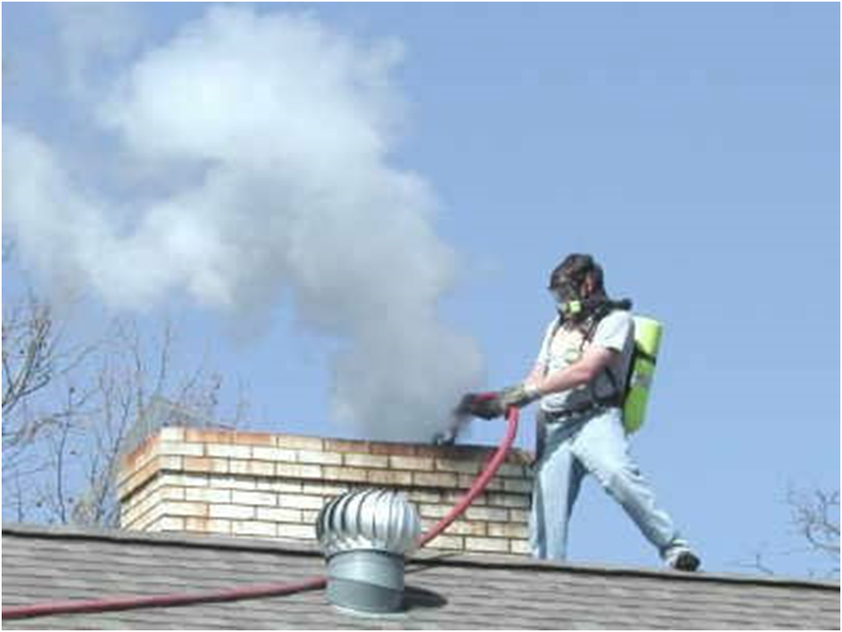
Loss of Situational Awareness

Slide 49
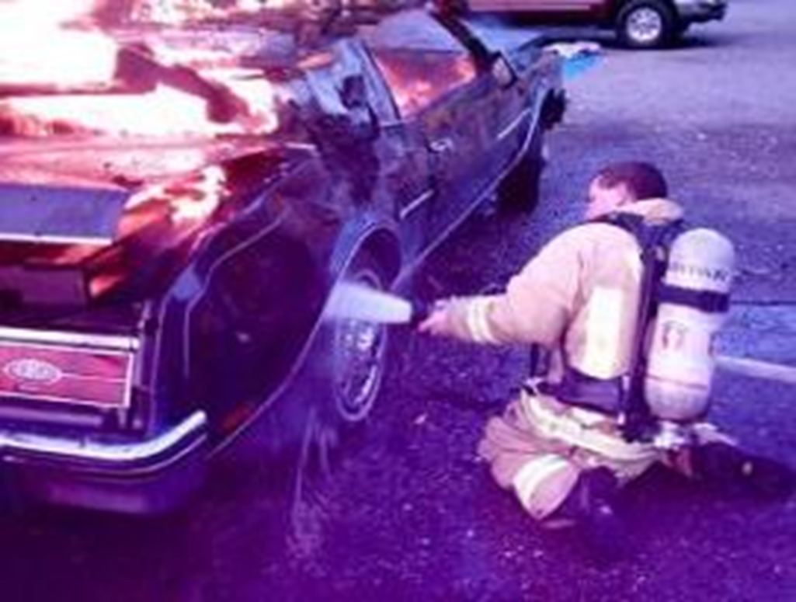
Loss of Situational Awareness

Slide 50

Loss of Situational Awareness

Slide 51

Loss of Situational Awareness

Slide 52
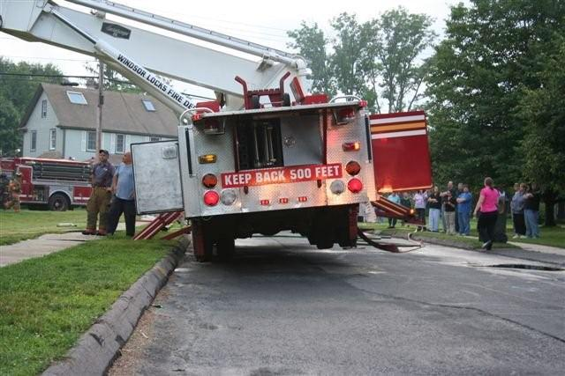
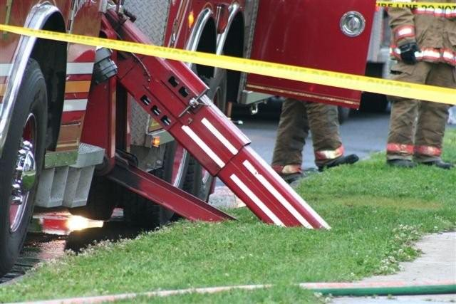
Take a few extra seconds…..

Slide 53
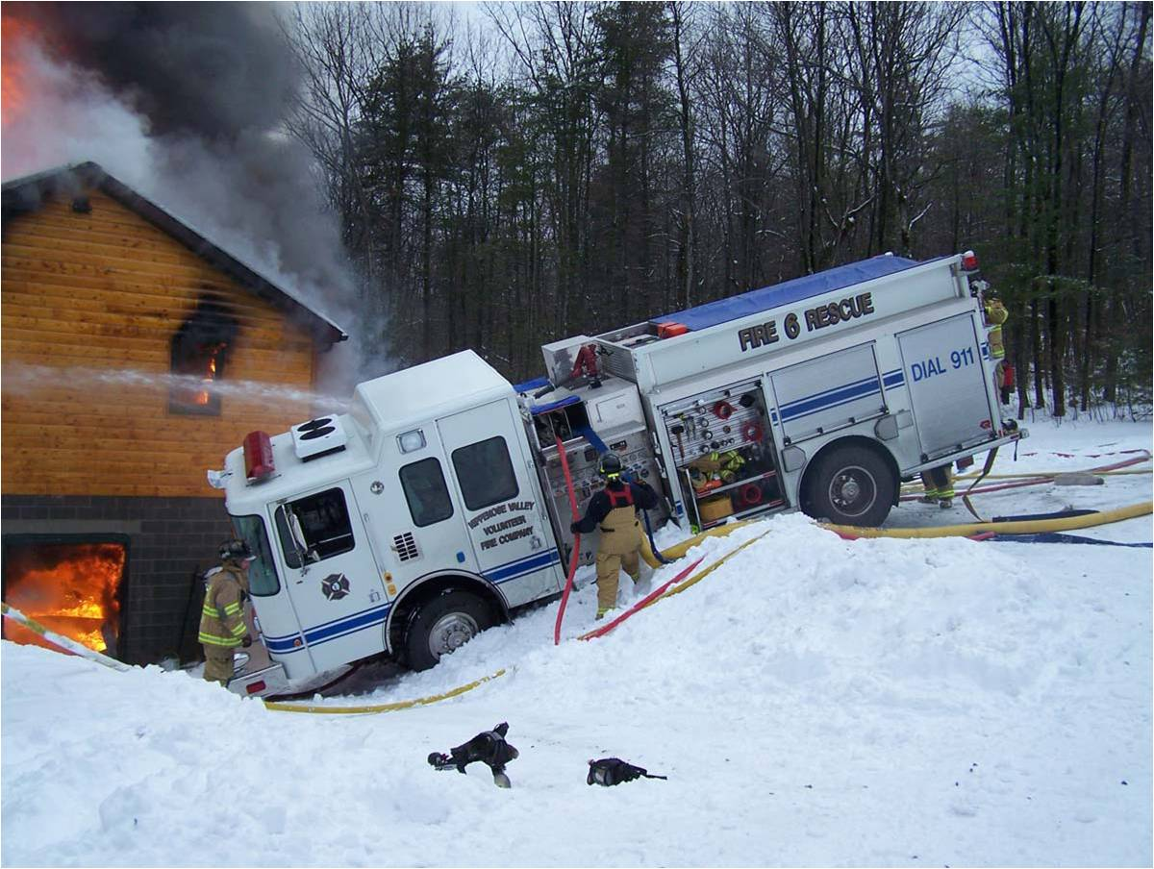
Loss of Situational Awareness

Slide 54
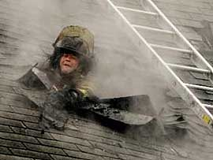
Because no one thinks it will happen to them.

Slide 55
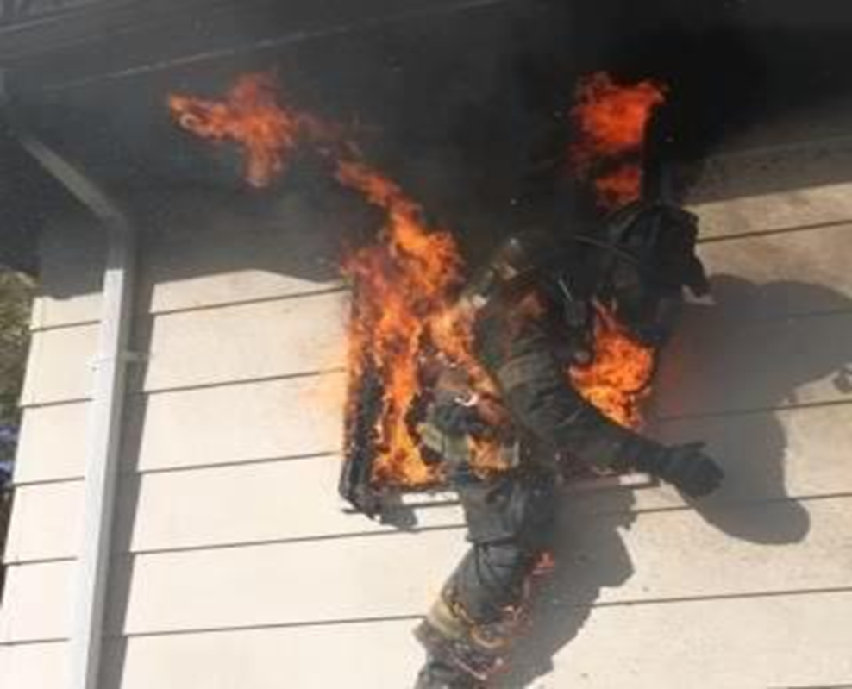
Situational Awareness
Because no one thinks it will happen to them.

Slide 56
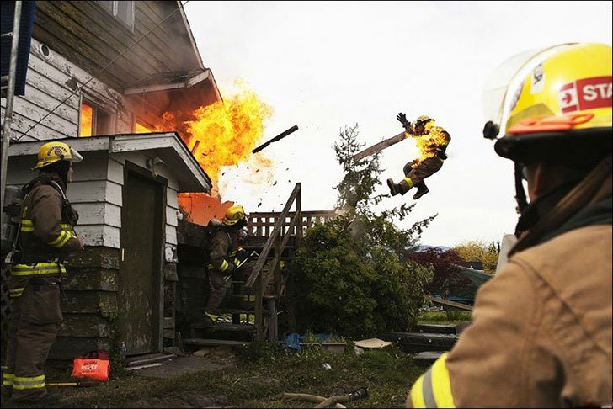
This couldn’t happen to me

Slide 57
Situational Awareness
Tools for LODD Prevention
Pre-planning
Building reconnaissance
Inspections
Familiarization tours
Training
SOP’s/SOG’s
Know your district like your own home!

Slide 58
Facts About Errors
Everyone makes errors-even experienced professional people
We work in high risk situations that increases the chance for error
We can avoid most errors by practicing low risk behaviors
Culture effects how we behave and our behaviors determine outcomes
Most near misses (near hits) are due to system or process problems (HPI, LLC)

Slide 59
Sentara Error Prevention Tool Box
Pay attention to detail
Clear communications
Have a questioning attitude
Hand-off effectively
Never leave your crew

Slide 60
Using STAR for Attention to Detail
Stop-Pause a few seconds and focus
Think-Consider your actions
Act-Concentrate and carry out the task
Review-Check to make sure you got the right results

Slide 61
Situational Awareness
Case Histories
&
Exercises

Slide 62
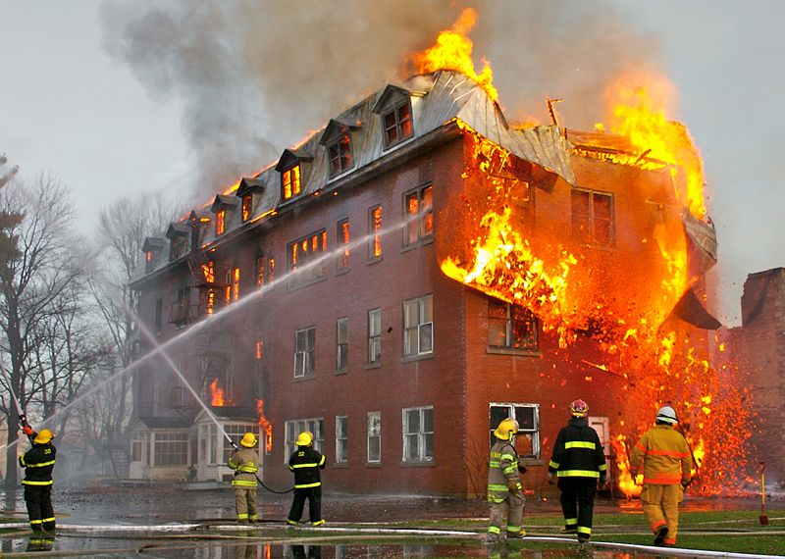

Slide 63
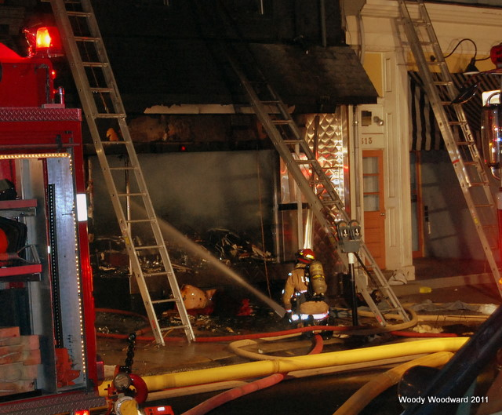

Slide 64
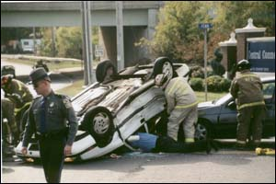

Slide 65
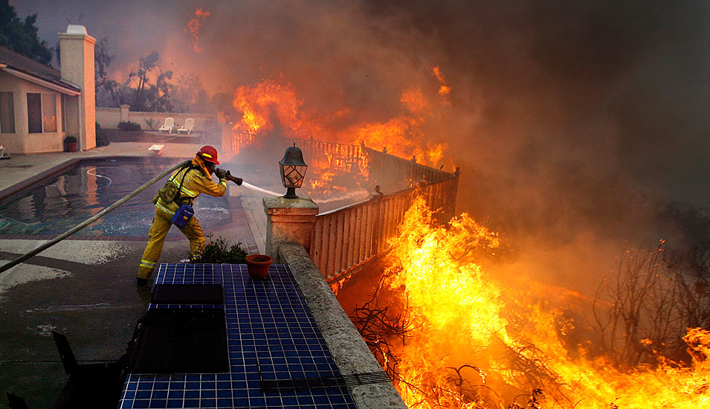

Slide 66
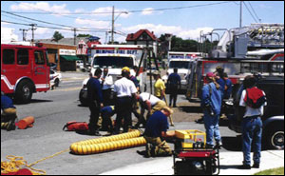

Slide 67
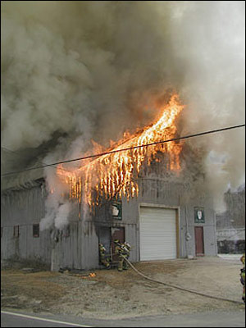

Slide 68
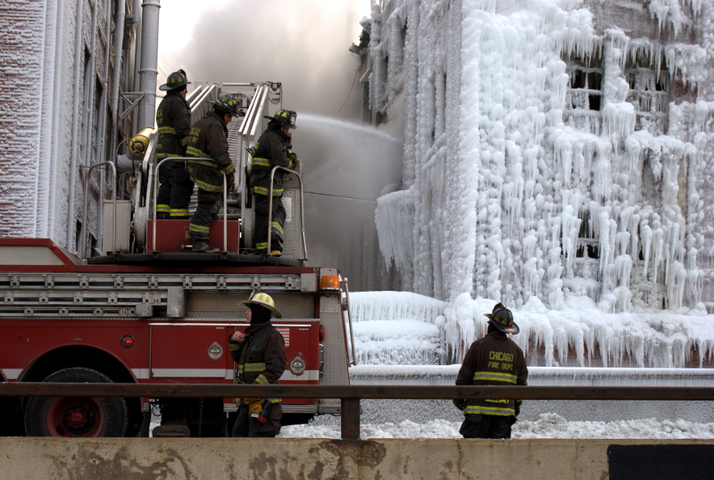

Slide 69
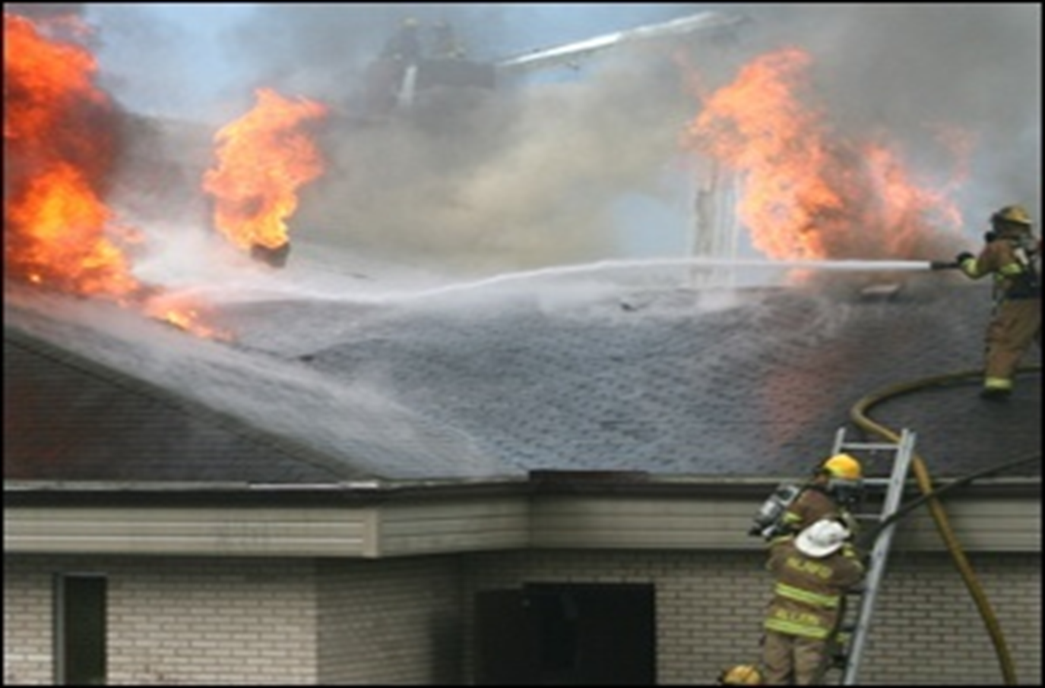

Slide 70
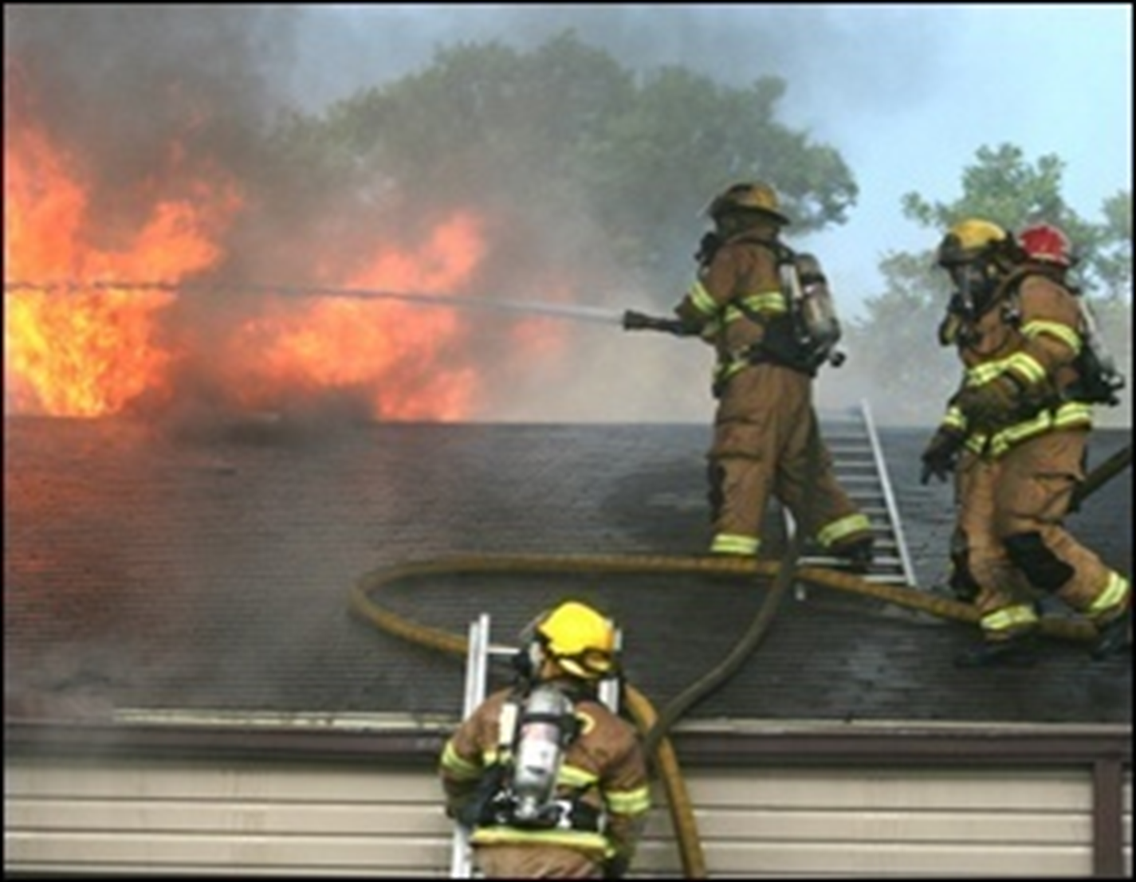

Slide 71
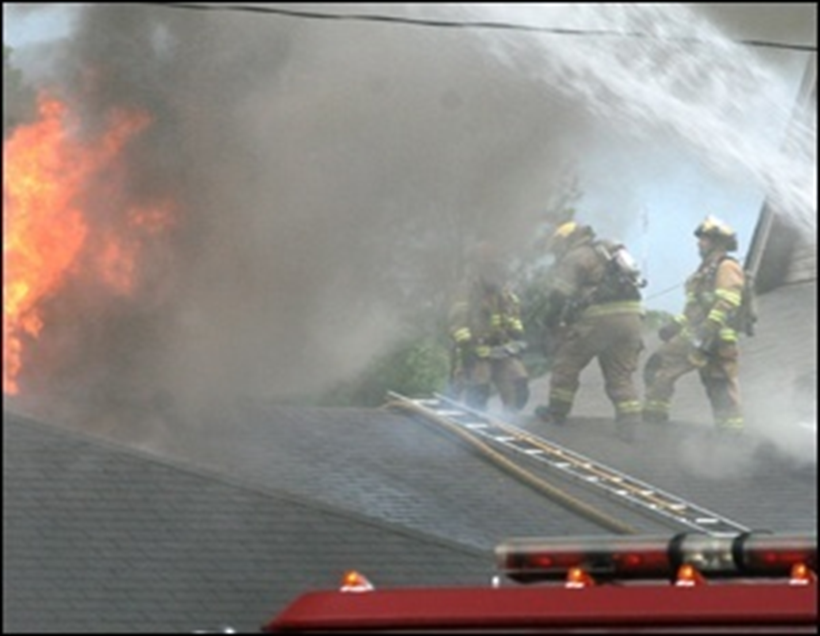

Slide 72
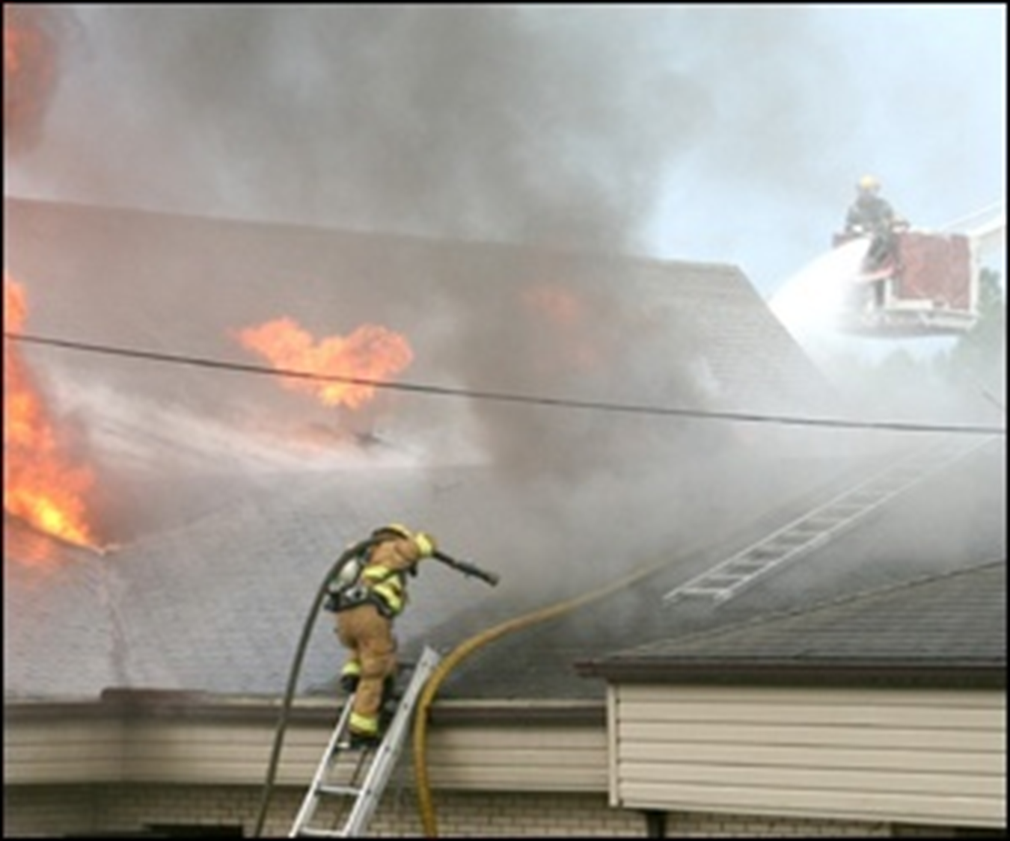

Slide 73
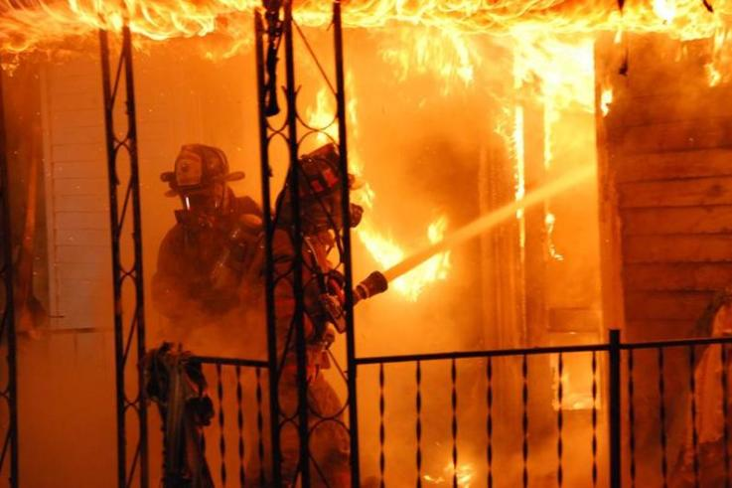

Slide 74
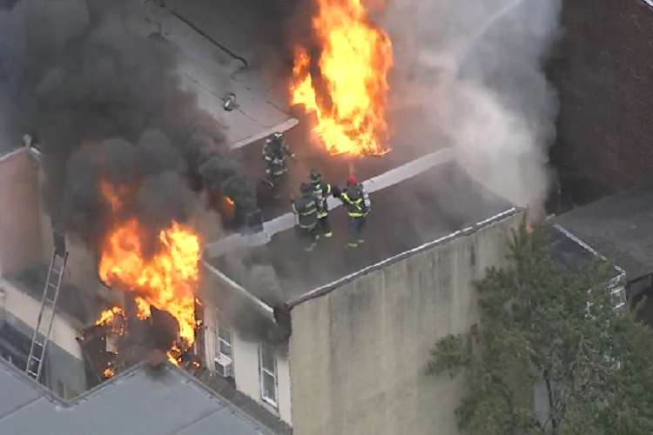

Slide 75
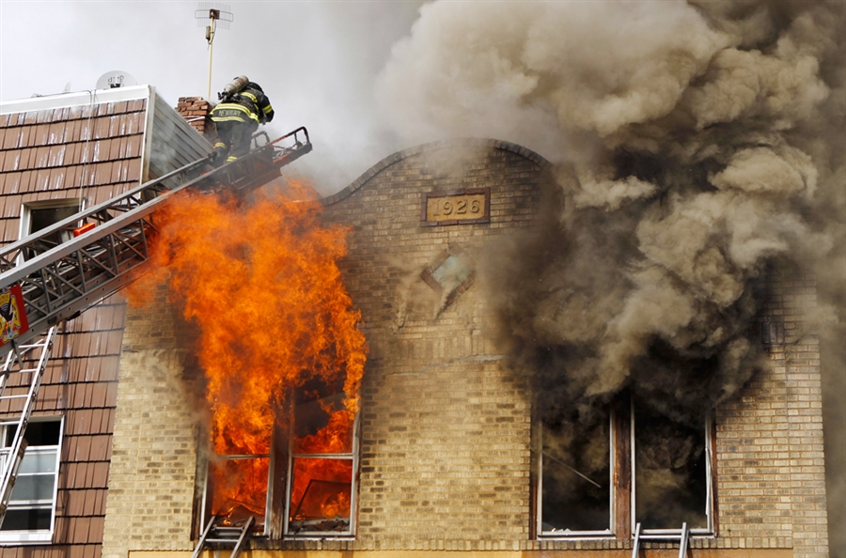

Slide 76
Safety Leadership
Let’s go to the videos!

Slide 77
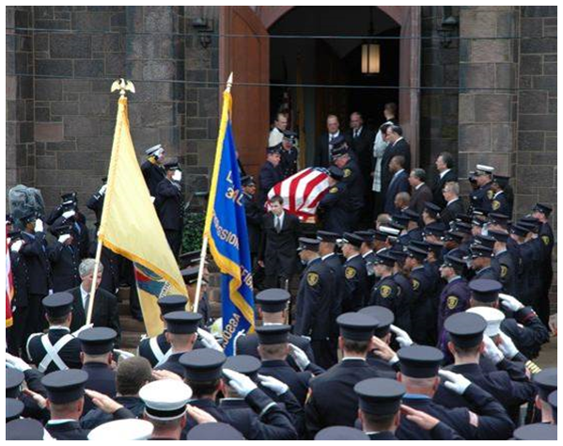
Consequences

Slide 78

Health & Safety
Champion

Slide 79
Health & Safety Champion
Global Approach
Firehouse & Physical plant
Quarters
Apparatus & equipment/tools
PPE-cleaning program
Living & sleeping areas
Decontamination-EMS/PPE
Slip, trip & fall hazards
Lighting, stairs, walkways, basements
Hazmats-use & storage

Slide 80
Health & Safety Champion
Global Approach
Wellness & fitness
Meals & cooking-going “light”
Work-outs & gym time
Stairs vs. elevators
Group exercise-walk, run, B-ball
Safety Committee-best practices

Slide 81

Crack kills.

Slide 82
Health & Safety Champion
Global Approach
Nutrition
Medical evaluations
Illness prevention-screenings
Accident prevention-cause & effect
Injury case management-long term follow up and assistance to members

Slide 83
Be a Safety CHAMP
C-Communicate clearly
H-Hand off effectively
A-Attention to detail
M-Mentorship
P-Practice and accept the “questioning attitude”

Slide 84

2014-66% LODD’s-Heart & Stroke

Slide 85
CANCER
Skin Absorption-Permeability
Dr. S. Baxter-January 2009
Groin 300
Jaw 93
Forehead 43
Scalp 25
Back 12
Palm 6
Foot Arch 1

Slide 86
CANCER
Dr. Susan Shaw
For every 5 degree rise in skin temperature, there is a 400% increase in skin absorption.

Slide 87
CANCER MITIGATION MEASURES
Separate the fire fighters from the contaminants:
Put SCBA’s is separate compartment than the cab
Specify vinyl seats and rubber matted floors in apparatus
Direct exhaust piping away from the pump panel
No turn out gear in clean areas of the firehouse (day room kitchen, offices)
Provide storage for contaminated turnouts/equipment
Use diesel exhaust systems all of the time

Slide 88
CANCER MITIGATION MEASURES
Conduct risk benefit analysis & limit personnel on-scene time:
SCBA shall be worn from initial attack throughout overhaul (structures, car fires and dumpster fires, etc.)
Units should stage uphill and upwind when possible
Windows closed, air conditioner and heater off
Turn off apparatus not integrally involved in operations
Crews can be available and staged but not within the smoke envelope

Slide 89
CANCER MITIGATION MEASURES
Gross decontamination at structure fires:
50’ of booster/forestry/trash line or garden hose with a small adjustable nozzle. According to recent studies, water flushing is 85% effective.
Put a cone 40 to 50 feet away from the engine in the direct path of the entry team’s exit to guide personnel towards the decon station.
Crews decon each other – don’t expose engineer/driver/pump operator to contaminants.
When you come out after one bottle, wipe your neck, change your hood and go back in.

Slide 90
CANCER MITIGATION MEASURES
Gross decontamination at structure fires:
Wash hands, face and neck before eating or drinking.
Ensure personnel are hydrated and monitored for heat/cold stress.
All personnel in hazard zone, including pump operators should also cycle through rehab.
Remove contaminated turn out gear, bag and stow on the hose bad or a compartment. (tests show turn out gear off-gases for 45 minutes after exposure to toxins)

Slide 91
CANCER MITIGATION MEASURES
Need warm water at the scene?
Washing with soap and water removes contaminants:
Fire mechanics can take a 3/8” line off the heat exchanger (engine cooler) and run it out to the pump panel. In 2 minutes, they can get 98 degree water.
For approximately $70 in parts, and a couple hours of labor, every fire engine can be equipped with a warm water wash station.
Beth Gallup & Bob Dirham, Washington State Firefighters: “Healthy In, Healthy Out” Program
Cancer Symposium, Phoenix, AZ (9/2017)

Slide 92


Slide 93
Sudden Cardiac Events
From 2005-2014-485 LODD’s
Averages 50% of all LODD’s
Crosses all disciplines-career, volunteer, wild land, etc.
Median age-53. Career-48
Vast majority of SCD events occur in FF’s with excess of CVD risk factors (high BP, high LDL cholesterol, obesity, pre-diabetic, smoking

Slide 94





Resources

Slide 95
Resources
Everyone Goes Home-Courage to be Safe
16 Life Safety Initiatives-3 to 4 hour program
#1-Culture change
#2-Personal & organizational accountability
#3-Risk management integration
www.lifesafetyinitiatives.com
www.everyonegoeshome.com
www.firehero.org

Slide 96

Resources
Accidents and incidents
Near miss (near hit!) reports
Injuries and LODD’s
Fire/EMS/Rescue
Fire news and up-dates

Slide 97

Resources
Safety Training programs
National Fire & EMS Safety Week Campaigns
Critical injury reports
LODD reports and information
Section membership news

Slide 98
Resources
LODD Reports
Lessons learned
Full investigations
Good training tool
Drives the safety points home

Slide 99

Resources
International Assn.
of Fire Chiefs;
Fire ground reports
Testimonials
Case studies
Training opportunities
Partnership with the IAFF

Slide 100

Resources
Books and manuals
NFA Courses-on/off campus
FF Fatality & injury reports
Health, wellness & fitness initiatives

Slide 101
Resources
FF Cancer Studies
Seatbelt Pledge
Stress First Aid
L.A.S.T.
Chief to Chief
Taking Care of Our Own
www.firehero.org

Slide 102

Resources
1250-Risk Management
1407-Rapid Intervention Companies
1500-Occupational Safety & Health
1521-Safety Officer

Slide 103

Resources
1581-Infection Control
1582-FD Medical Programs
1583-Health Related Fitness
1584-Rehab at Incidents

Slide 104
Resources
On-line interactive training program
Tactical Fire Ground Safety
May Day Training
Case Histories
Graphics, photos and narration

Slide 105

Resources
IAFF/IAFC
Wellness & Fitness Initiative
Peer Fitness Trainer
American Council on Exercise
Individual Assessment
Program Design
Program Implementation
Program Administration

Slide 106


Slide 107
Safety Leadership
Questions, Comments, Concerns
Disagreements, Thoughts, Conflicts
Does anyone have anything nice to say?
Take care of yourselves, take care of each other, be well, stay well, stay fit, eat right, get rest, slow down and buckle up.
Thanks, be safe and good luck,
Chief Ron Kanterman
mfdcar1@comcast.net
www.goldhornassociates.com

Slide 108


