Slide 1

Understanding and Developing: SAFER Grants: Staffing for Adequate Fire and Emergency Response AFG Grants: Assistance to Firefighter Grants
Elizabeth M. Del Re, Assistant to the General President
June 29, 2021

Slide 2
Assistance to Firefighters Grant
AFG Offers Three Grant Programs
Assistance to Firefighters Grants
Staffing for Adequate Fire & Emergency Response
Fire Prevention and Safety Grants

Slide 3
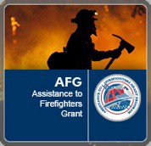
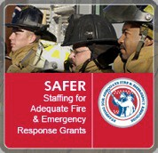

FY21 and ARPA Application Schedule
Application period – December 2021
Application period – Early 2022
Application period – Early 2022

Slide 4
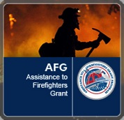


Total FY 2021 Appropriations including ARPA
$ 414,000,000
$ 560,000,000
$ 46,000,000

Slide 5

SAFER Allocation of Funds
20%
80%

Slide 6
SAFER Summaries by Quantity 2020 through 2018
Department Types
 | 2020 |  | 2019 |  | 2018
Total No. of Applications Submitted | 1354 |  | 1206 |  | 909
Department Type | Submitted | Awarded | Submitted | Awarded | Submitted | Awarded
All Paid/Career | 404 | TBD | 322 | 67 | 194 | 144
All Volunteer | 237 | TBD | 260 | 105 | 205 | 66
Combination (Majority Paid/Career) | 241 | TBD | 204 | 41 | 165 | 50
Combination (Majority Volunteer) | 448 | TBD | 397 | 69 | 326 | 102
Interest Organization | 24 | TBD | 23 | 6 | 19 | 12

Slide 7
SAFER Summaries by Federal Dollars 2020 through 2018
Department Types
 | 2020 |  | 2019 |  | 2018
Amount of Applications Awarded | TBD |  | $350,000,000 |  | $350,000,000
Department Type | Submitted | Awarded | Submitted | Awarded | Submitted | Awarded
All Paid/Career | $1,166,394,914 | TBD | $497,592,668 | $218,465,693 | $288,505,096 | $214,524,477
All Volunteer | $84,350,138 | TBD | $72,209,266 | $20,407,323 | $51,405,508 | $13,491,762
Combination (Majority Paid/Career) | $363,209,110 | TBD | $185,309,528 | $58,113,865 | $138,136,852 | $53,002,926
Combination (Majority Volunteer) | $388,393,140 | TBD | $207,209,334 | $45,797,747 | $171,593,691 | $59,432,036
Interest Organization | $23,612,846 | TBD | $61,461,098 | $7,206,042 | $26,334,054 | $9,548,798

Slide 8
AFG Allocation of Funds

Slide 9
AFG Summaries by Quantity
2020 through 2018
Service Areas and Department Types
 | 2020 |  | 2019 |  | 2018
Total No. of Applications Submitted | 8130* |  | 8340* |  | 8406*
Service Area | Submitted | Awarded | Submitted | Awarded | Submitted | Awarded
Rural | 5525 | TBD | 5762 | 1111 | 5,851 | 1175
Suburban | 1788 | TBD | 1806 | 423 | 1,807 | 402
Urban | 817 | TBD | 772 | 211 | 748 | 209
No. of Applications Awarded | TBD |  | 1774 |  | 1786
Department Type | Submitted | Awarded | Submitted | Awarded | Submitted | Awarded
All Paid/Career | 1500 | TBD | 1483 | 423 | 1,538 | 418
All Volunteer | 3792 | TBD | 4276 | 771 | 3,835 | 819
Combination | 2838 | TBD | 2581 | 551 | 2,443 | 463
Paid On-Call / Stipend | Included with Combo | Included with Combo | Included with Combo | Included with Combo | 590 | 86
(*) Does not include State Fire Training Academy applicants
Information as of 06/21/2021

Slide 10
AFG Summaries by Federal Dollars
2020 through 2018
Service Areas and Department Types
 | 2020 |  | 2019 |  | 2018
Amount of Applications Submitted | $1,996,583,107.03‬ |  | $1,964,558,387.08 |  | $1,832,932,404.00
Service Area | Submitted | Awarded | Submitted | Awarded | Submitted | Awarded
Rural | $1,181,464,274.25 | TBD | $1,175,577,063.00 | $156,423,451.69 | $1,119,997,491.00 | $162,277,681.49
Suburban | $485,970,543.53 | TBD | $477,047,857.00 | $85,184,597.69 | $446,845,258.00 | $71,153,906.74
Urban | $329,148,289.25 | TBD | $299,623,073.60 | $62,634,538.29 | $266,089,655.00 | $69,734,859.16
Amount of Applications Awarded | TBD |  | $314,513,114.56 |  | $303,166,447.39
Department Type | Submitted | Awarded | Submitted | Awarded | Submitted | Awarded
All Paid/Career | $518,244,532.04 | TBD | $493,033,164.10 | $106,233,109.20 | $470,869,211.00 | $104,188,859.28
All Volunteer | $712,633,873.26 | TBD | $770,611,504.50 | $96,627,284.56 | $645,340,845.00 | $96,292,895.31
Combination | $765,704,701.73 | TBD | $688,603,325.40 | $101,382,193.91 | $607,231,570.00 | $90,589,680.38
Paid On-Call / Stipend | Included with Combo | Included with Combo | Included with Combo | Included with Combo | $109,490,778.00 | $12,095,012.42
(*) Does not include State Fire Training Academy applicants
Information as of 06/21/2021

Slide 11
Application Evaluation Criteria Development
Each year, FEMA convenes a panel of fire service professionals to develop funding priorities for the SAFER grant program.
The panel makes recommendations about funding priorities as well as about developing criteria for awarding grants.
The content of the NOFO reflects implementation of this Criteria Development Panel’s (CDP) recommendations with respect to the priorities, direction, and criteria for awards.

Slide 12

Criteria Development Panel
International Association of Fire Fighters
International Association of Fire Chiefs
National Volunteer Fire Council
National Fire Protection Association
National Association of State Fire Marshals
International Association of Arson Investigators
International Society of Fire Service Instructors
North American Fire Training Directors
Congressional Fire Service Institute

Slide 13
What Is the Purpose of SAFER?
The purpose of SAFER is to provide funding directly to fire departments and volunteer fire fighter interest organizations to assist in increasing the number of fire fighters to help communities meet industry minimum standards and attain
24-hour staffing to provide adequate protection from fire and fire-related hazards, and to fulfill traditional missions of fire departments.

Slide 14
SAFER Activities
SAFER is composed of two activities.
Hiring of Fire Fighters
Career, combination, and volunteer fire departments are eligible to apply (interest organizations cannot apply).
Recruitment and Retention (R&R) of Volunteer Fire Fighters
Combination fire departments, volunteer fire departments, and national, state, local, or tribal organizations that represent the interests of volunteer fire fighters are eligible to apply.
If you want to apply for both activities, you will need to submit two separate applications. Career departments cannot apply for R&R.

Slide 15
Hiring of Firefighters Activity
Grants provide financial assistance to help fire departments hire new fire fighters or change the status of part-time or paid-on-call firefighters to full-time firefighters.
The goal is to assist departments to improve staffing levels to ensure they have adequate personnel to respond and safely perform at incident scenes, providing protection from fire and fire-related hazards in their communities.

Slide 16
Hiring of Firefighters Activity
This activity provides three-year grants to assist fire departments by paying a portion of the salaries and benefits of the SAFER-funded positions.

Slide 17
SAFER Hiring Cost Share
Usually required to contribute a cost share toward the actual cost of hiring fire fighters under this program. The Federal portion of the costs of hiring fire fighters under this grant may not exceed:
75% of the actual costs incurred in the first year
75% in year two
35% in year three

Slide 18
SAFER Priorities
FEMA prioritizes bringing non‐compliant (NFPA® 1710 or 1720) departments into compliance in the most cost‐effective manner.
Applications resulting in the largest percentage increases in compliance with NFPA® 1710 or 1720 receive higher consideration.

Slide 19
Understanding the Application Process
Notice of Funding Opportunity (NOFO)
Application Period (~30 Days)
Electronic Pre-Score
Peer Panel Review
Post Panel Review
Awards

Slide 20
The Process of Applying
Plan and preparation
Application content
Developing the narrative
Review and submittal
Scoring and selection

Slide 21
Planning and Preparation
SAM Registration
Is the System for Award Management.
http://www.sam.gov/ – free service – do not pay!
Is valid for one year, but must renew and ensure status is active.
Online registration followed by certified letter.
Allow 5-6 weeks to complete.
SAM registration is held by the jurisdiction.
Registration is linked to new FEMA Go System.

Slide 22
Planning and Preparation
DUNS Number
Is the Data Universal Numbering System.
A DUNS number is a unique nine-character number used to identify your organization.
The federal government uses the DUNS number to track how federal money is allocated.
DUNS numbers need to be renewed every three (3) years.
Allow 2-3 days to complete.
Number is typically held jurisdiction.

Slide 23
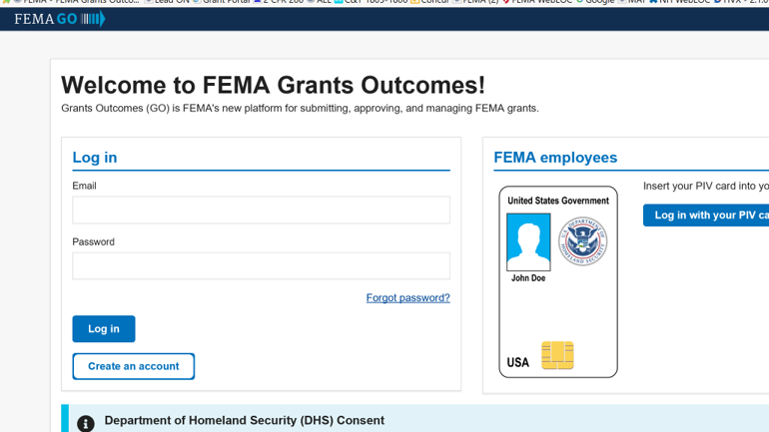
Planning and Preparation

Slide 24
Planning and Preparation
Approval from fire chief, city manager, or council
Cost match required in many cases
May have to be formally passed at council or other budget hearing

Slide 25
Planning and Preparation
Gather all your data ahead of time.
Call volume (by 100 series)
Population
Apparatus
Staffing levels
Training levels
FF and civilian injury/death data
Equipment inventory
Financial information

Slide 26



Planning and Preparation
The program guidance format is known as the Notice of Funding Opportunity (NOFO).
It contains the rules and tools for putting together a successful application.
Funding priorities are igh, edium, or ow.
Your focus should be on items identified in the NOFO as high priority!

Slide 27
Self Evaluation Sheets
The Self Evaluation Sheet is designed to help you understand the four narrative questions.
It will also help you to understand what the panelist are asked to look for in your answer.
Lastly, it will allow you to see the actual scoring criteria used by the panelist.
Can be found on the FEMA AFG/SAFER website.

Slide 28
SAFER FAQs
What are eligible expenses in the hiring of firefighters activity?
Only the salary and associated benefits (actual payroll expenses) are eligible.
Costs are reimbursable, if they are included as part of the standard package, available to all operational firefighter positions, and contractually obligated.

Slide 29
SAFER FAQs
Will the SAFER hiring of fire fighters' activity pay for raises or increases to firefighter pay or benefits in years two and three?
No. The federal portion of grant funds for years one, two, and three is based on the usual annual cost of a first-year (i.e., entry-level) fire fighter in your department at the time the grant application was submitted.

Slide 30
SAFER FAQs
What are some ineligible expenses in the hiring of fire fighters' activity?
The salaries and benefits of full-time fire fighters who are employees at the time of grant award are ineligible to be funded under this grant.
Pre-application costs, such as grant writer fees, administrative costs (e.g., physicals/medical exams, background checks, etc.), and indirect costs associated with hiring of fire fighters.

Slide 31
SAFER FAQs
What are some ineligible expenses in the hiring of fire fighters' activity?
Costs to train and equip fire fighters (e.g., personal protective equipment (PPE)/turnout gear). However, the salaries and benefits of fire fighters hired with SAFER grant funding – while engaged in training – are eligible.
Overtime costs except overtime costs that are routinely paid as a part of the fire fighter’s regularly scheduled and contracted shift hours in order to comply with the Fair Labor Standards Act (FLSA).

Slide 32
SAFER FAQs
What type of fire fighter positions will be funded?
Only new, additional full-time positions or to change the status of part-time or paid-on-call fire fighters to full-time fire fighters will be funded.
Full-time positions are those that are scheduled for at least 2,080 hours per year (e.g., 40 hours per week, 52 weeks per year).
All applicants must certify that the primary assignment (more than 50 percent of time) of all SAFER-funded positions will be on an operational fire suppression vehicle, regardless of collateral duties.
Fire Staffing Grant not EMS Staffing Grant

Slide 33
SAFER FAQs
Is there a waiver that would allow us to retain fire fighters facing layoff?
Sometimes, the SAFER grant may only be used to hire new, additional firefighters or to change the status of part-time or paid-on-call fire fighters to full-time fire fighters. Sometimes, there is a waiver for this option.
This can change year to year – see the NOFO.

Slide 34
SAFER FAQs
Not required to keep SAFER Personnel after 3-year POP.
Usually, must be new positions not on the payroll.
You have six months post award to hire before POP starts.
Again – these can change year to year – see the NOFO.

Slide 35
AFG Application Types
Operations and safety
Training, equipment, personal protective equipment (PPE) wellness/fitness, modifications to facilities
Micro grants
Vehicles
Regional operations and vehicles
Non-affiliated EMS
State fire training academies

Slide 36
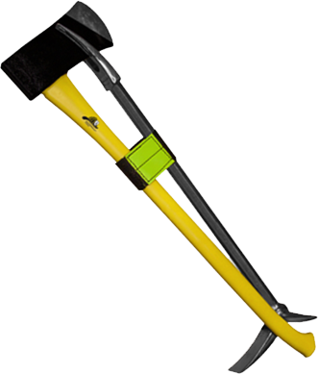
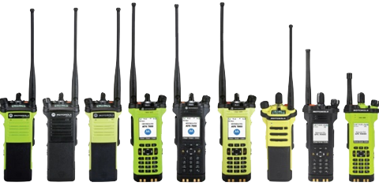
Equipment
Basic equipment
Communications – P25 compliant
EMS/rescue
Extrication
Avoid HazMat, specialized and investigation equipment.

Slide 37
Equipment – Application Choices
The following are examples of project priorities.
Training evaluated using national or state standards
Obtain equipment to achieve minimum operational and deployment standards for existing missions.
Replace unusable/unrepairable equipment to meet current standard
Replace non-compliant equipment to current standard

Slide 38
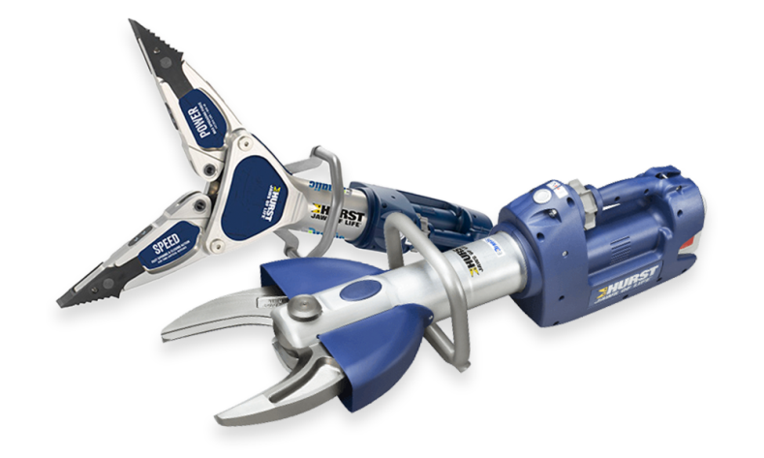
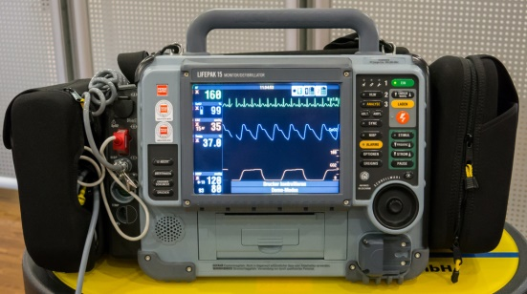
Equipment
Extended warranties and service agreements, when offered, are eligible on all items.
Personnel must be trained or get training to use equipment.
Request training for specific equipment by adding training costs to additional funding.

Slide 39
Personal Protective Equipment
The following are examples of project priorities.
Replace damaged/ broken/ inoperable equipment to current standard. (OOS)
Increase supply for new hires and/or existing firefighters that do not have one set of Turnout Gear (PPE).
Replace non-compliant PPE to current standard. (Replace old, eligible PPE)
For SCBA, justify the number of units you request.
Notes:
-Must be Broken and not in service
-Need more for those that don’t have
-Medium priority that will be funded – this is the one you want if you need new PPE

Slide 40
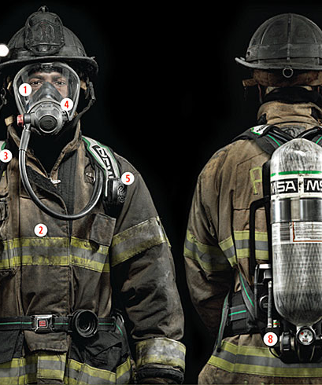
Personal Protective Equipment
PPE being replaced must be 10 years old or older.
SCBA must be 10 years old or older and compliant with the 2007 Edition of NFPA® 1981 or older.
FEMA will not fund second set of gear.
If you wear it – it is considered PPE and applied for under PPE.

Slide 41
Wellness and Fitness Priority 1
Must offer, or plan to offer, all five of the following Priority 1 activities:
Periodic health screenings
Entry physical examinations
Immunizations
Behavioral health programs
Cancer Screenings
Eligible for Micro Grant option.

Slide 42
Wellness and Fitness Priority II
Candidate Physical Ability Evaluation (CPAT)
Formal fitness and injury prevention program/equipment
Injury/illness rehab program(s)
IAFF or IAFC Peer Fitness Trainer programs
NFPA® 1583 compliant
Simultaneous requests for Priority 1 and 2 activities will be a lower priority than requests for the five Priority 1 activities.

Slide 43
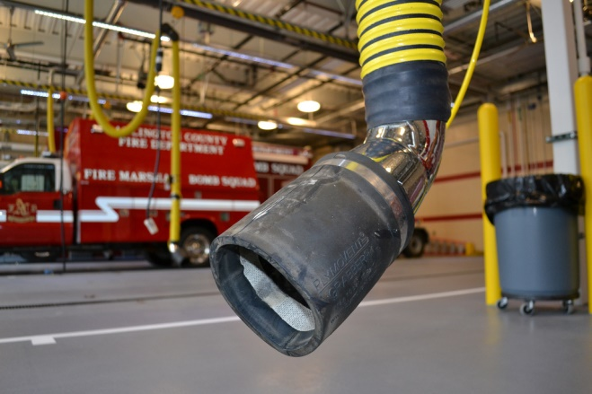
Modification to Facilities
Program priorities
Requests for direct source-capture exhaust systems, sprinkler and smoke/fire alarm systems
Stations with sleeping quarters and occupied 24/7
Additional considerations
$100,000 maximum per station
No construction

Slide 44
Modification to Facilities
No modification may involve changing the footprint or profile of a structure.
Grants will not be provided to modify buildings constructed after 2003.

Slide 45
AFG Training
Can include training instruction costs, training equipment costs, and costs to pay/backfill members to attend training.
Training projects must benefit the highest percentage of personnel within a fire department and be open to other departments in the region = high priority.
Training for PPE or equipment must be requested with PPE or equipment as additional funding.

Slide 46
AFG Training Priorities
Instructor-led training programs
Training programs that will result in attendees receiving a national or state certification
Training that brings department into compliance with NFPA® or other national standards
Training projects that benefit the highest percentage of personnel within a fire department and are open to other departments in the region
Training priorities MAY change between:
Urban – Suburban – Rural

Slide 47
Training
Some of the training projects that are eligible for AFG funding include:
Firefighter I/II
Fire officer
Safety officer
Fire instructor
RIT
EVOC
Tech / Vehicle Rescue training
EMS
(ALS level = highest priority)

Slide 48

IAFF Programs You Can Apply For in AFG
Peer Support Training
Fire Ground Survival Training
Peer Fitness Training
Responding to the Interface
New classes coming soon…
IAFF Resiliency

Slide 49
AFG Micro-Grants
Grants of $50,000 or less (Federal Share)
Overmatching is not allowed.
All five of the operations and safety activities are eligible.
Equipment
PPE
Training
Wellness and fitness Priority 1 only
Modifications to facilities
Those that score in the competitive range for panel review may receive additional consideration at panels, or post-panel review.

Slide 50
AFG Vehicle Priorities
Replacing unsafe vehicles.
Replacing vehicles converted from vehicles not intended for the fire service.
Replacing fire fighting vehicles that were built prior to 1992.
Note:
Refurbished/used vehicles are no longer eligible.

Slide 51
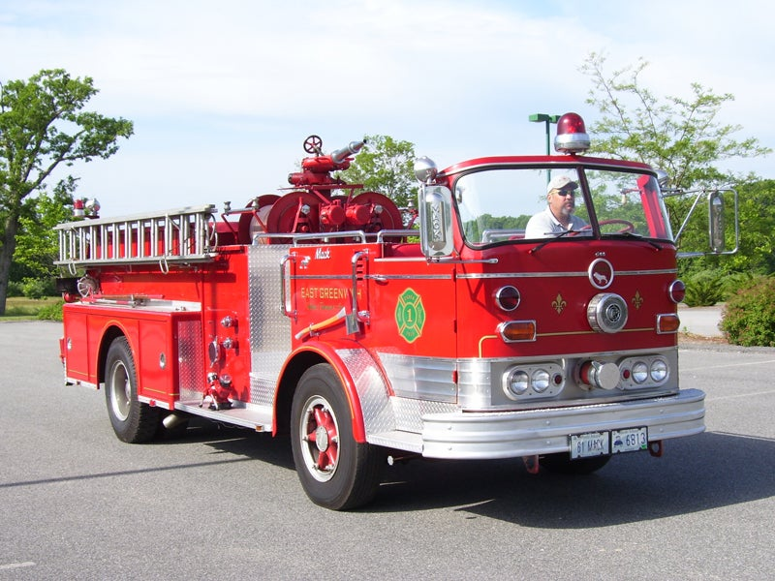
AFG Vehicle Applications
Vehicle applications are scored based on a variety of factors including, but not limited to:
Age of the vehicle being replaced
Existing fleet, including like vehicles
Open cab or converted
Call volume
Population
Mutual aid usage

Slide 52
AFG Activities Analysis – Vehicle Acquisition
AFG implemented preliminary review of vehicles to panel after applications had been pre-scored starting FY17, including:
Data validation
Preliminary technical review
The average age seeking replacement:
Urban – 22 years old
Suburban – 26 years old
Rural – 31 years old
The average mileage seeking replacement:
Urban – 93,390
Suburban – 65,795
Rural – 100,893
Notes:
723 over 30 years old
FD>Urban>High Priority
50
1966 aerial ladder truck.
FD>Suburban>High Priority
49
1967 International/Sutphen (Pumper/Engine 750 gpm)
FD>Rural>High Priority
64
1952 Lafrance Pumper open canopy cab (Pumper/Engine 750 gpm)
Regional (FD and EMS)>Urban or Suburban or Rural>High Priority
54
1962 American LaFrance 100ft aerial with open rear jumpseats and no pump or water

Slide 53
AFG Regional Applications
Multiple organizations serving more than one local jurisdiction benefit directly from the activities implemented with the grant funds.
Counts against your jurisdictional funding cap.
Eligible projects:
Operations and safety
Training
Equipment
PPE
Vehicle acquisition
An eligible department must act as host.
All partners listed in application
Include stats of all involved
MOU requirement

Slide 54
Application Basics
Applications are made up of several sections.
Statistical information
Request
Narratives

Slide 55
Application Basics
Applications are made up of several sections.
Statistical information
Request
Narratives

Slide 56
Unscored Questions
Community Description
Does your organization protect critical infrastructure?
Please provide details on the department's existing staffing model (i.e., number of shifts, number of positions per shift, etc.)
Briefly describe the department’s hiring practices and timelines
Is your request for hiring fire fighters based on a risk analysis and/or a staffing needs analysis?
Does your department currently have a policy in place to recruit and hire veterans?
Is it your department’s intent to sustain the positions filled under this grant after the completion of the period of performance?

Slide 57
The Narratives
There are 4 scored narrative sections in the SAFER application:
Financial Need
Project Description
Cost/Benefit
Impact on Operations

Slide 58
How Peer Review Works
Each application is read by three people seated together.
Each application must be scored.
SAFER - Strongly Agree, Agree, Neither Agree or Disagree, Disagree or Strongly Disagree
Every score must have comments.
Reviewers do not read any applications from their own state.

Slide 59
How Peer Review Works
There is a cross-section of reviewers at each table.
Might be FF, chief, fire marshal, from the NFPA® etc.
All reviewers have some background in the fire service.
The application you print at home is exactly what the reviewer sees at the table – same formatting.
Please fix formatting!

Slide 60

After Peer Review
Technical Evaluation Process (TEP)
The SAFER Program Office will then perform a Technical Review of applications that are in the fundable range prior to recommending awards.
The SAFER Program Office will assess the requests with respect to costs, quantities, feasibility, eligibility, and recipient responsibility prior to recommending any application for an award.

Slide 61
If You Get a Turndown Letter
You can contact FEMA regional contacts and ask.
They will look into the reviewer feedback.
Applications are very competitive, scoring is very tight.
Good projects are left on the table – even excellent applications aren’t funded.
There are always applications right on the edge of being funded, but FEMA simply runs out of money.

Slide 62
Best Practices
Read the NOFO!

Slide 63
Best Practices
Align your department’s risk assessment with the AFG funding priorities.
Tell your department’s story – avoid vendor/template narratives.
Read each question carefully, and then answer it.
Have your entire application/narrative reviewed by someone else before submitting.

Slide 64
Best Practices
Gather and include all eligible costs as part of your application.
Ensure you have support from your local government leaders.

Slide 65
Best Practices
Use the FEMA Self‐Evaluation Sheets.
These parallel the peer review score sheets!
Be very careful using place holders in sections
Make sure you go back and fill in
xxxx

Slide 66

Best Practices
Use MS Word to write your narratives.
Otherwise, the grants portal may time out and you will loose all of your work!

Slide 67

Best Practices
Before You Submit
Print application
Read every line again.
Not just the narratives
Check and fix narrative formatting.
Leave no placeholders.
Recheck all your numbers.
Fix any errors and reprint to check again.

Slide 68
Biggest Pitfalls
Starting Late
Statistics show that applications that are started and completed during the last week of the application period have a high chance of not being awarded.

Slide 69
Biggest Pitfalls
Not explaining financial need
No budget breakdown
Not explaining what you are doing (project) or why you need it

Slide 70
Biggest Pitfalls
Not doing a cost/benefit breakdown
Not explaining how the grant will effect your daily operations
Place holders or missing sections

Slide 71
Overall Biggest Pitfall
Not answering the questions!

Slide 72
IAFF Grant Resources
Grants Department at IAFF
FireGrants@iaff.org
Will review your grant prior to submission and critique it and make suggestions.
Provides guidance on the IAFF website.

Slide 73

FEMA Grant Resources
AFG Program Office
AFG Help Desk Phone Number : 1-866-274-0960
AFG Help Desk E-mail: firegrants@dhs.gov
AFG Web site: http: www.fema.gov/firegrants

Slide 74
Questions?
firegrants@iaff.org

