Slide 1
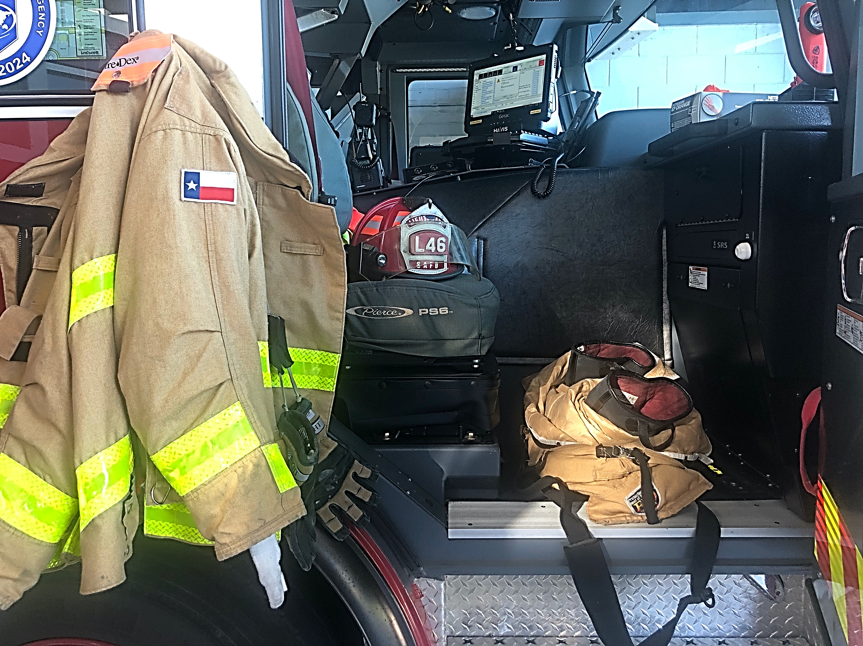
Selection of Firefighter Protective Clothing from Risk Assessment to Distribution
FDIC 2022
Jim Reidy (Lt SAFD-ret)
with contributions from:
Amanda Newsom – UL
LT Dennis Chavez-SAFD
Capt Pat Woods – FDNY ret

Slide 2
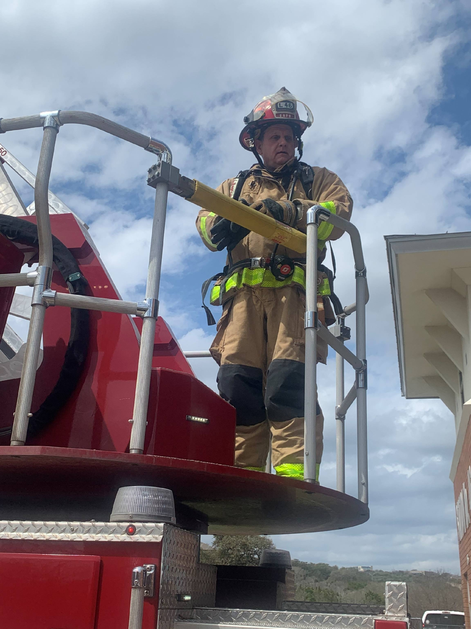
Lieutenant Jim Reidy
SAFD 33 Years-Ladder 46 (retired)
SAFD Firefighting PPE Committee Co-Chair
NFPA 1971 & 1851 Principal member –Representing the Texas State Association of Firefighters
Texas Commission on Fire Protection – Firefighter Advisory Committee
SAFD Quartermaster 2018

Slide 3
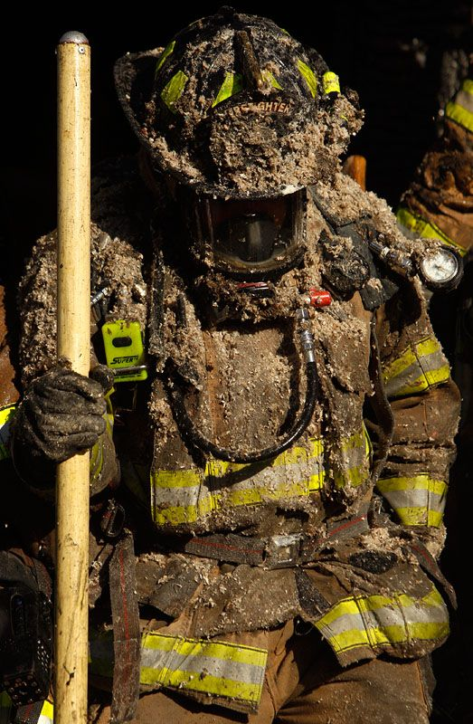
Purpose
Communicate some successful practices from evaluation and selection by a metropolitan fire department
Couple the selection/ evaluation process with testing and certification process
Based on interactions and experience gained over many years
These are recommendations only and all comments and opinions are my own.

Slide 4
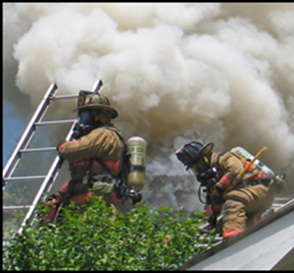
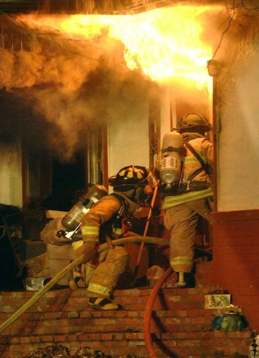
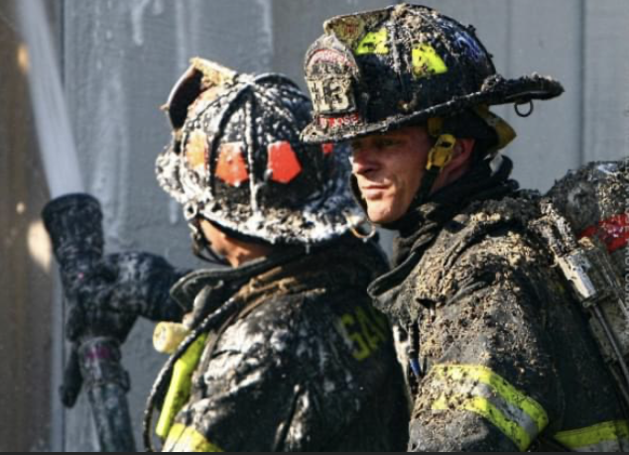
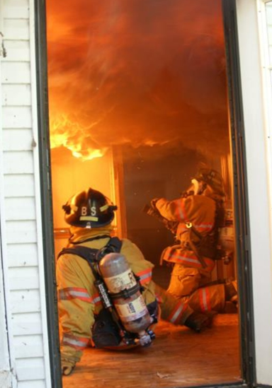
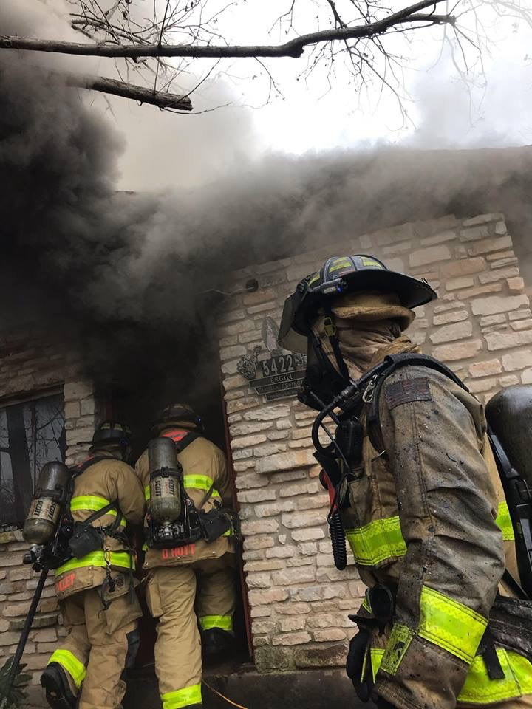
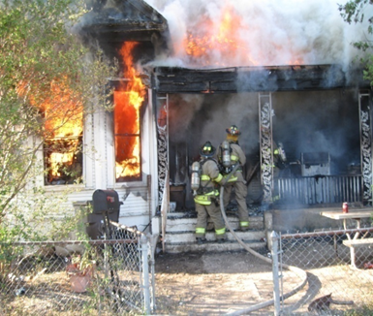
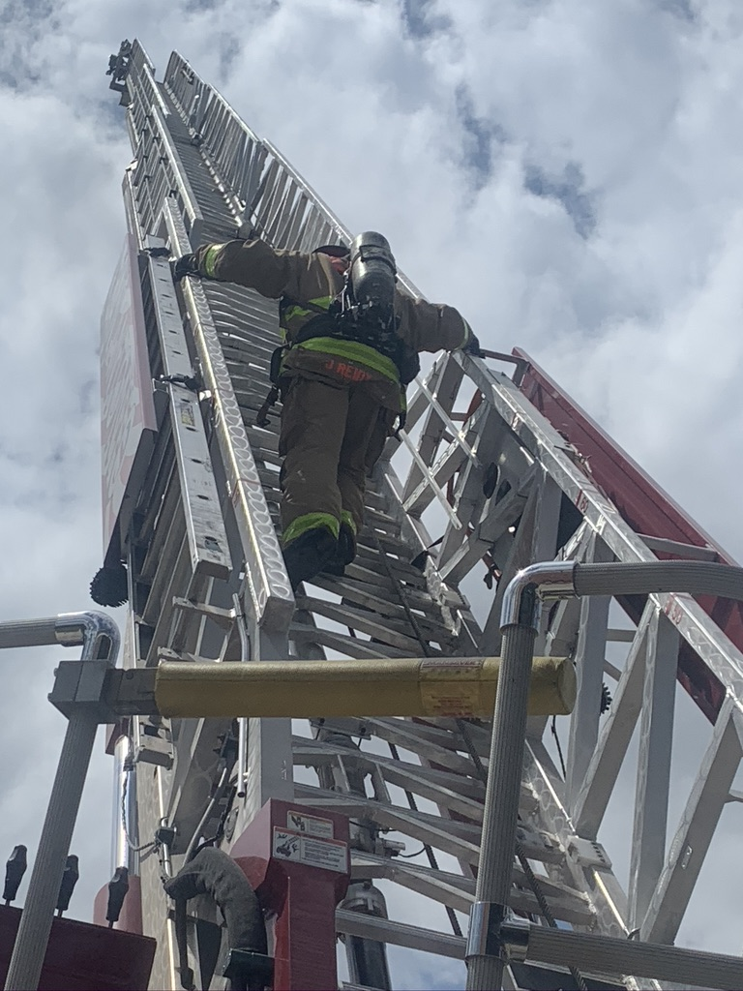
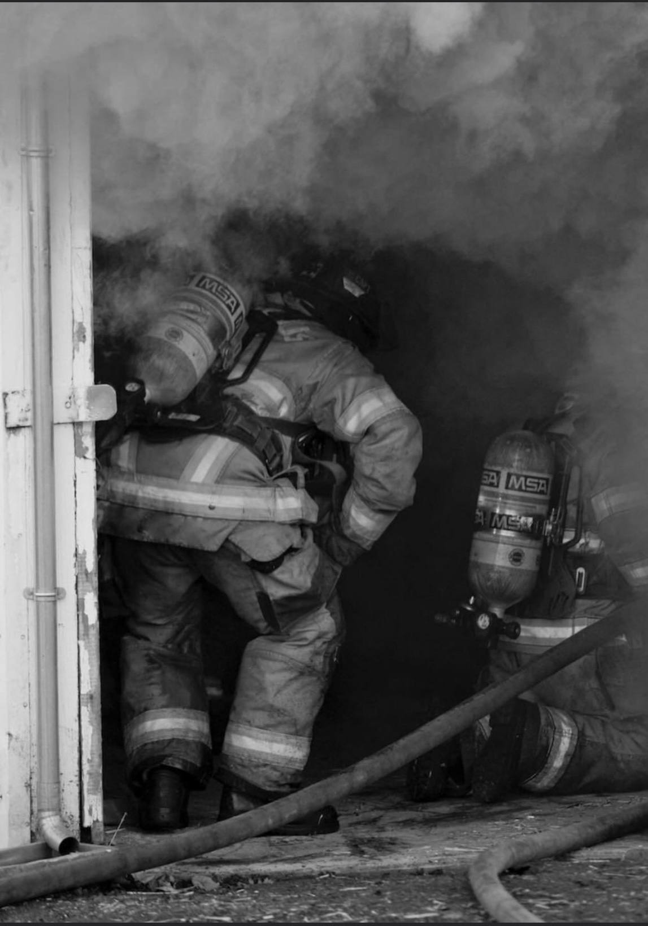
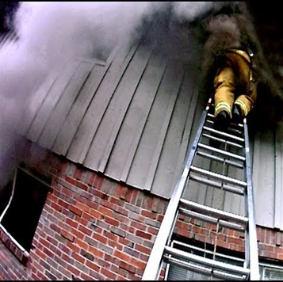
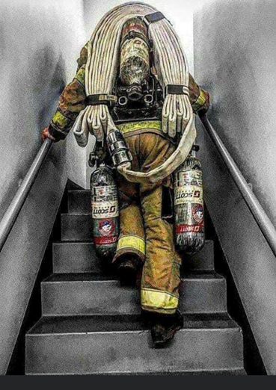
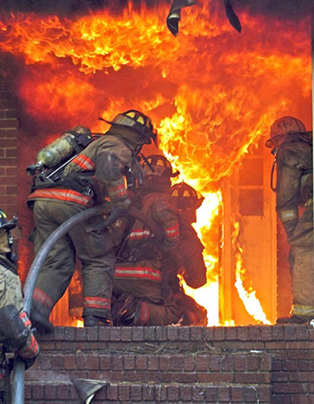
We still do firefighting!

Slide 5
NFPA 1971-History of the Standard
1975
First issue of NFPA 1971
2007
NFPA 1976 standard for proximity was combined into NFPA 1971
Added optional CBRN requirements for ensembles
2018
Removed the optional CBRN requirements
New barrier hood option added
Revised glove sizing system added
1986
Added more performance requirements
Less specification
1997
Combined helmet (NFPA 1972), glove (NFPA 1973), footwear (NFPA 1974) standards into NFPA 1971
1981
Second issue
Complete editorial reworking
1991
Added 3rd party certification
Added chapter on interface items
Added appendix on cleaning and how materials impact heat stress
2000
Added THL
Added CCHR
Increased preconditioning requirements for added durability
Added glove dexterity test
2013
Revised and added many new test methods notably:
Stored energy test
Glove torque test
Glove tool test
Fastener tape tests
2024
Open for public input now

Slide 6
Committee Make-Up NFPA 1971-1851
Manufacturer
Representative of a maker or marketer of a product, assembly, or system, or portion thereof, that is affected by the standard
User
Representative of an entity that is subject to the provisions of the standard or that voluntarily uses the standard
Installer/Maintainer
Representative of an entity that is in the business of installing or maintaining a product, assembly, or system affected by the standard
Labor
A labor representative or employee concerned with the safety in the workplace
Applied Research/Testing Laboratory
Representative of an independent testing laboratory or independent applied research organization that promulgates and/or enforces standards
Enforcing Authority
A representative of an agency or an organization that promulgates and/or enforces the standard
Insurance
Representative of an insurance company, broker, agent, bureau, or inspection agency
Consumer
A person who is or represents the ultimate purchaser of a product, system, or service affected by the standard, but who is not a user
Special Expert
A person not representing any other category and who has special expertise in the scope of the standard
No single interest may exceed 1/3 of the committee membership
Each member has one vote
Voting members and their interest can be found in the front of every standard

Slide 7
Why Do We Need New Gear/item ?
Needs Assessment
Issues with current gear (product failure/serious injury)
Complaints from the field
Problems with Vendor/Manufacturer
“Finally,” getting that second set/pair
Significant upgrade materials and technology
Replacement Cycle (NFPA 1851 – 10 Year)
Emerging issue – PFAS/PFOA
Notes:
Often if there has been a serious injury or repetitive service issues with gear, members will begin to loose the confidence of the protection their gear is supposed to afford them.
If there is a ground swell of complaints generating from the field, often it is a good idea o start the process to see if there is a superior product available.
As all busineess’s go, sometimes there are economic or corporate changes made at a high level that change the service or the expected service from manufacturers.
When approval for a second set of gear is anticipated, it may be a good time to initiate a new possibly ‘better” product search.
As technology changes on a daily basis, it important to always be on the lookout to find an upgrade to PPE hat may increase safety or at least comfort.
Since all gear now has a limited shelf life, the process of upgrading to better gear is always a possibility.

Slide 8
Selection Process Begins With?
Pilot Programs
Focus Groups
Risk Assessment
Needs Assessment
How much time do you have?

Slide 9
FOCUS GROUPS
Staged or informal
Firehouse kitchen *Training sessions *Formal group setting
What’s important to the firefighter and what priority do they give to those items or issues
meet in person with a cross section of field personnel to establish the priorities
2) anonymous survey online
3) personnel range in age, seniority, rank, assignment, and geographic area
4) New recruit or different department bias

Slide 10
PILOT PROGRAMS
Making a change to something “Different” or “New”
Test drive – no official or legal commitment
Trying something comparable in protection but different in materials
Having several members try it and/or wear it for a time frame
Continuous usage allows members to not only see it, but to acquire additional information as to if it may be advantageous
Probably best to initiate prior to process

Slide 11
Education
Research (Internet)
Presentations by Fabric Manufacturers / Mills
Presentations by Moisture Barrier Manufacturers
Presentations by Bunker Gear Manufacturers
Manufacturer/Mill Visits (if feasible)
Decision making member(s) need to learn about the materials, the manufacturing process, and network
Trade shows and conferences
Capitalize on their expertise but Ask tough questions
Notes:
There is an infinite amount of research that can be ascertained from the world wide web.
Although most likely a bit difficult for smaller departments, an effort should be made to push local vendors to make available represenitives that can fully explain the materials and testing that are mandated by NFPA standards

Slide 12
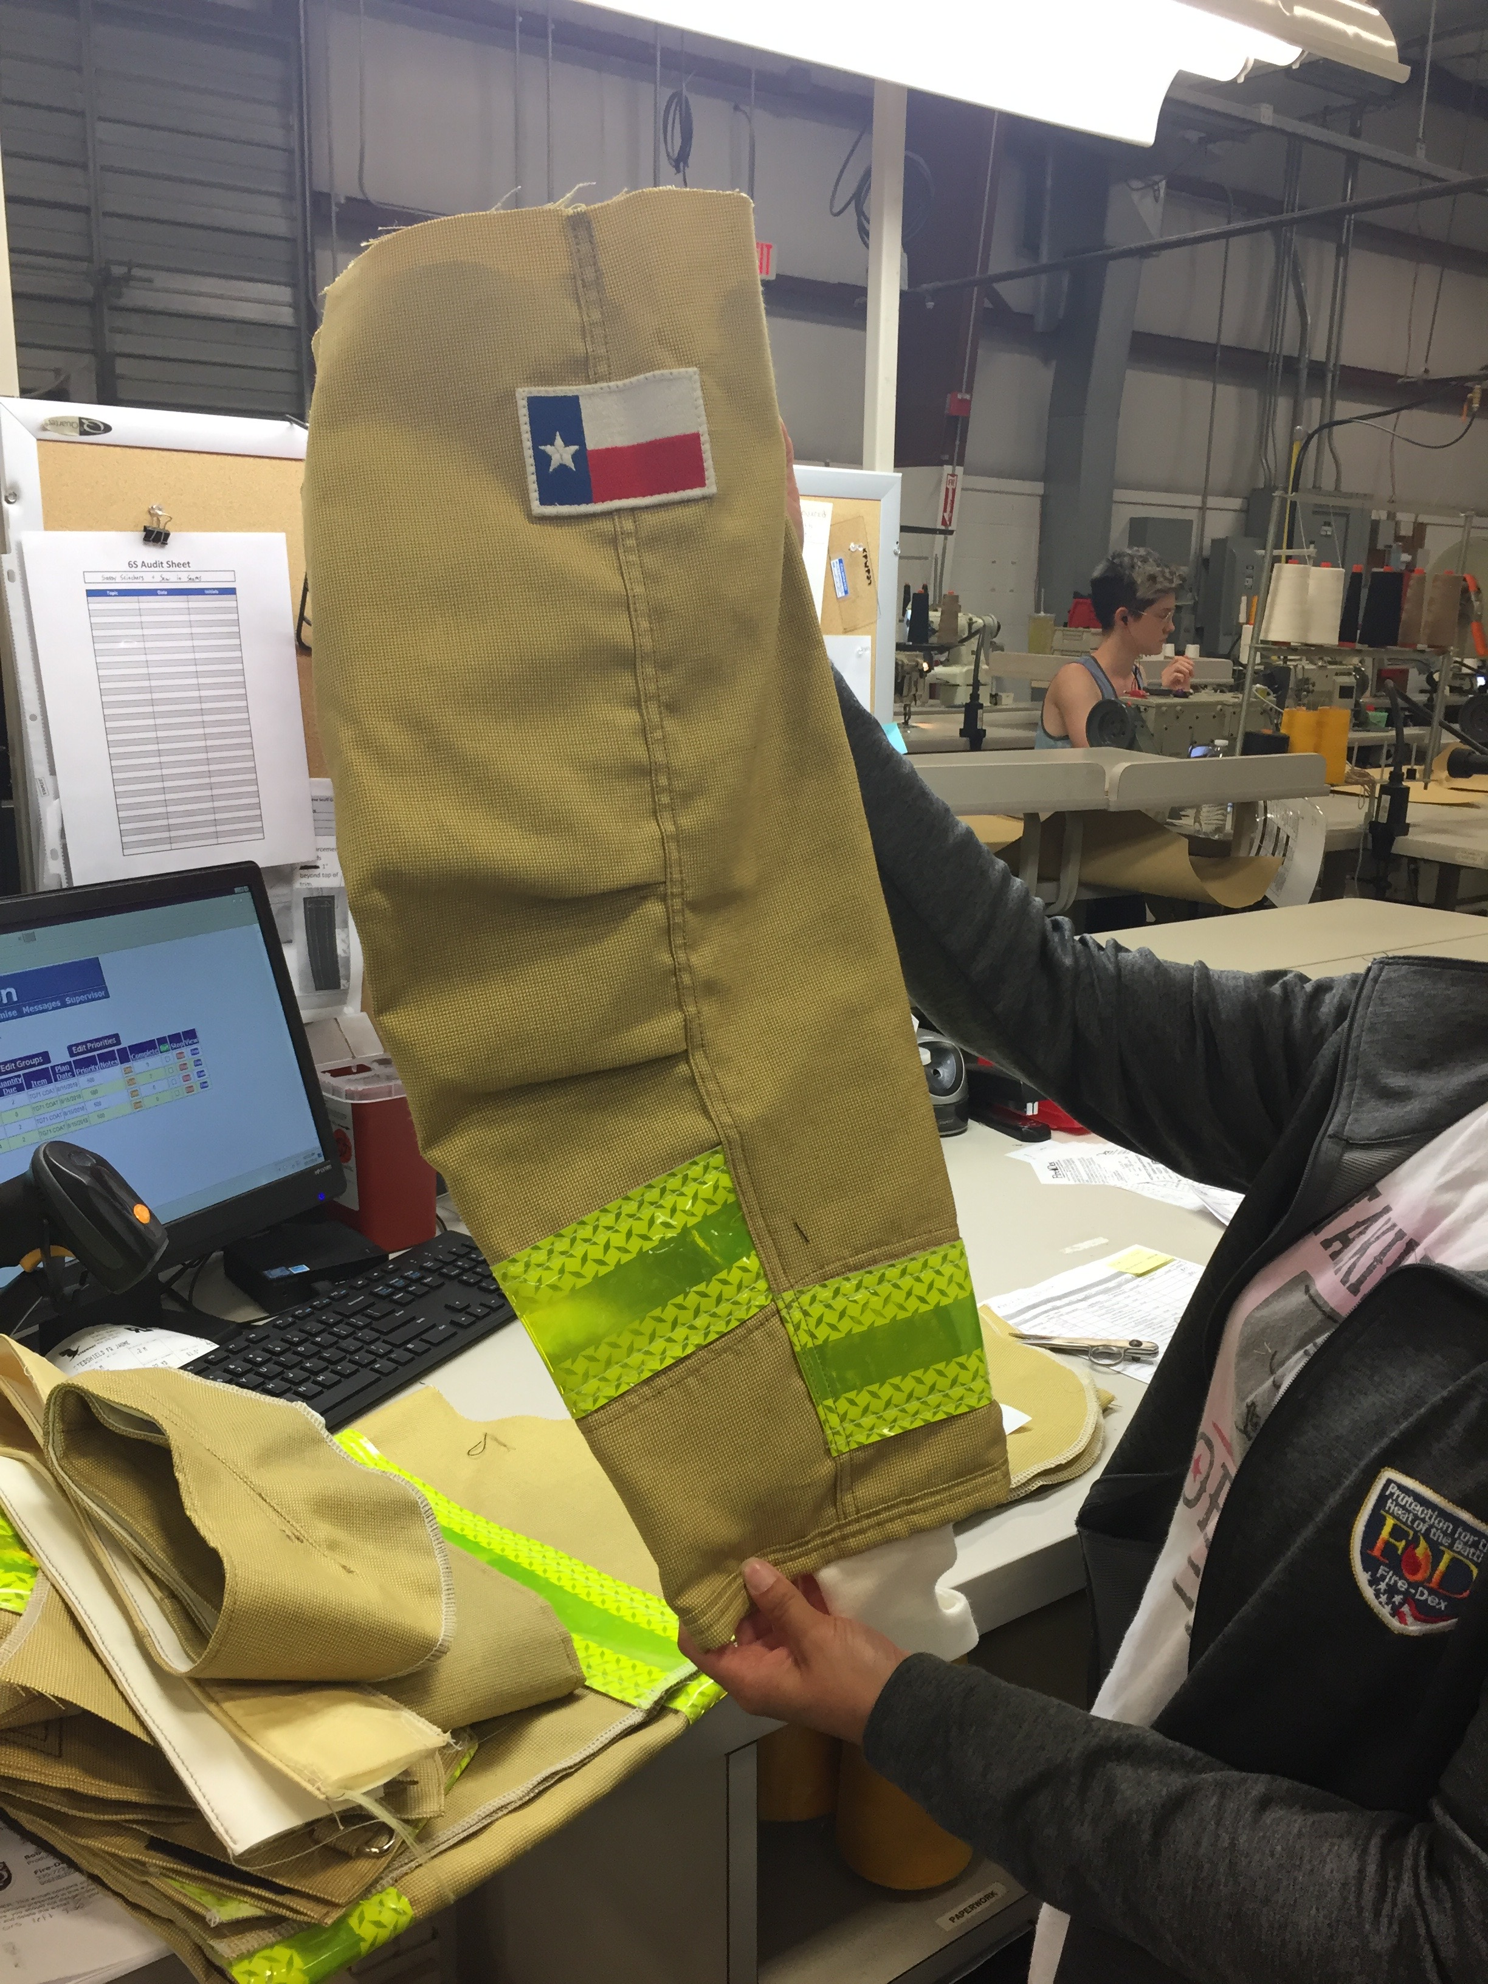
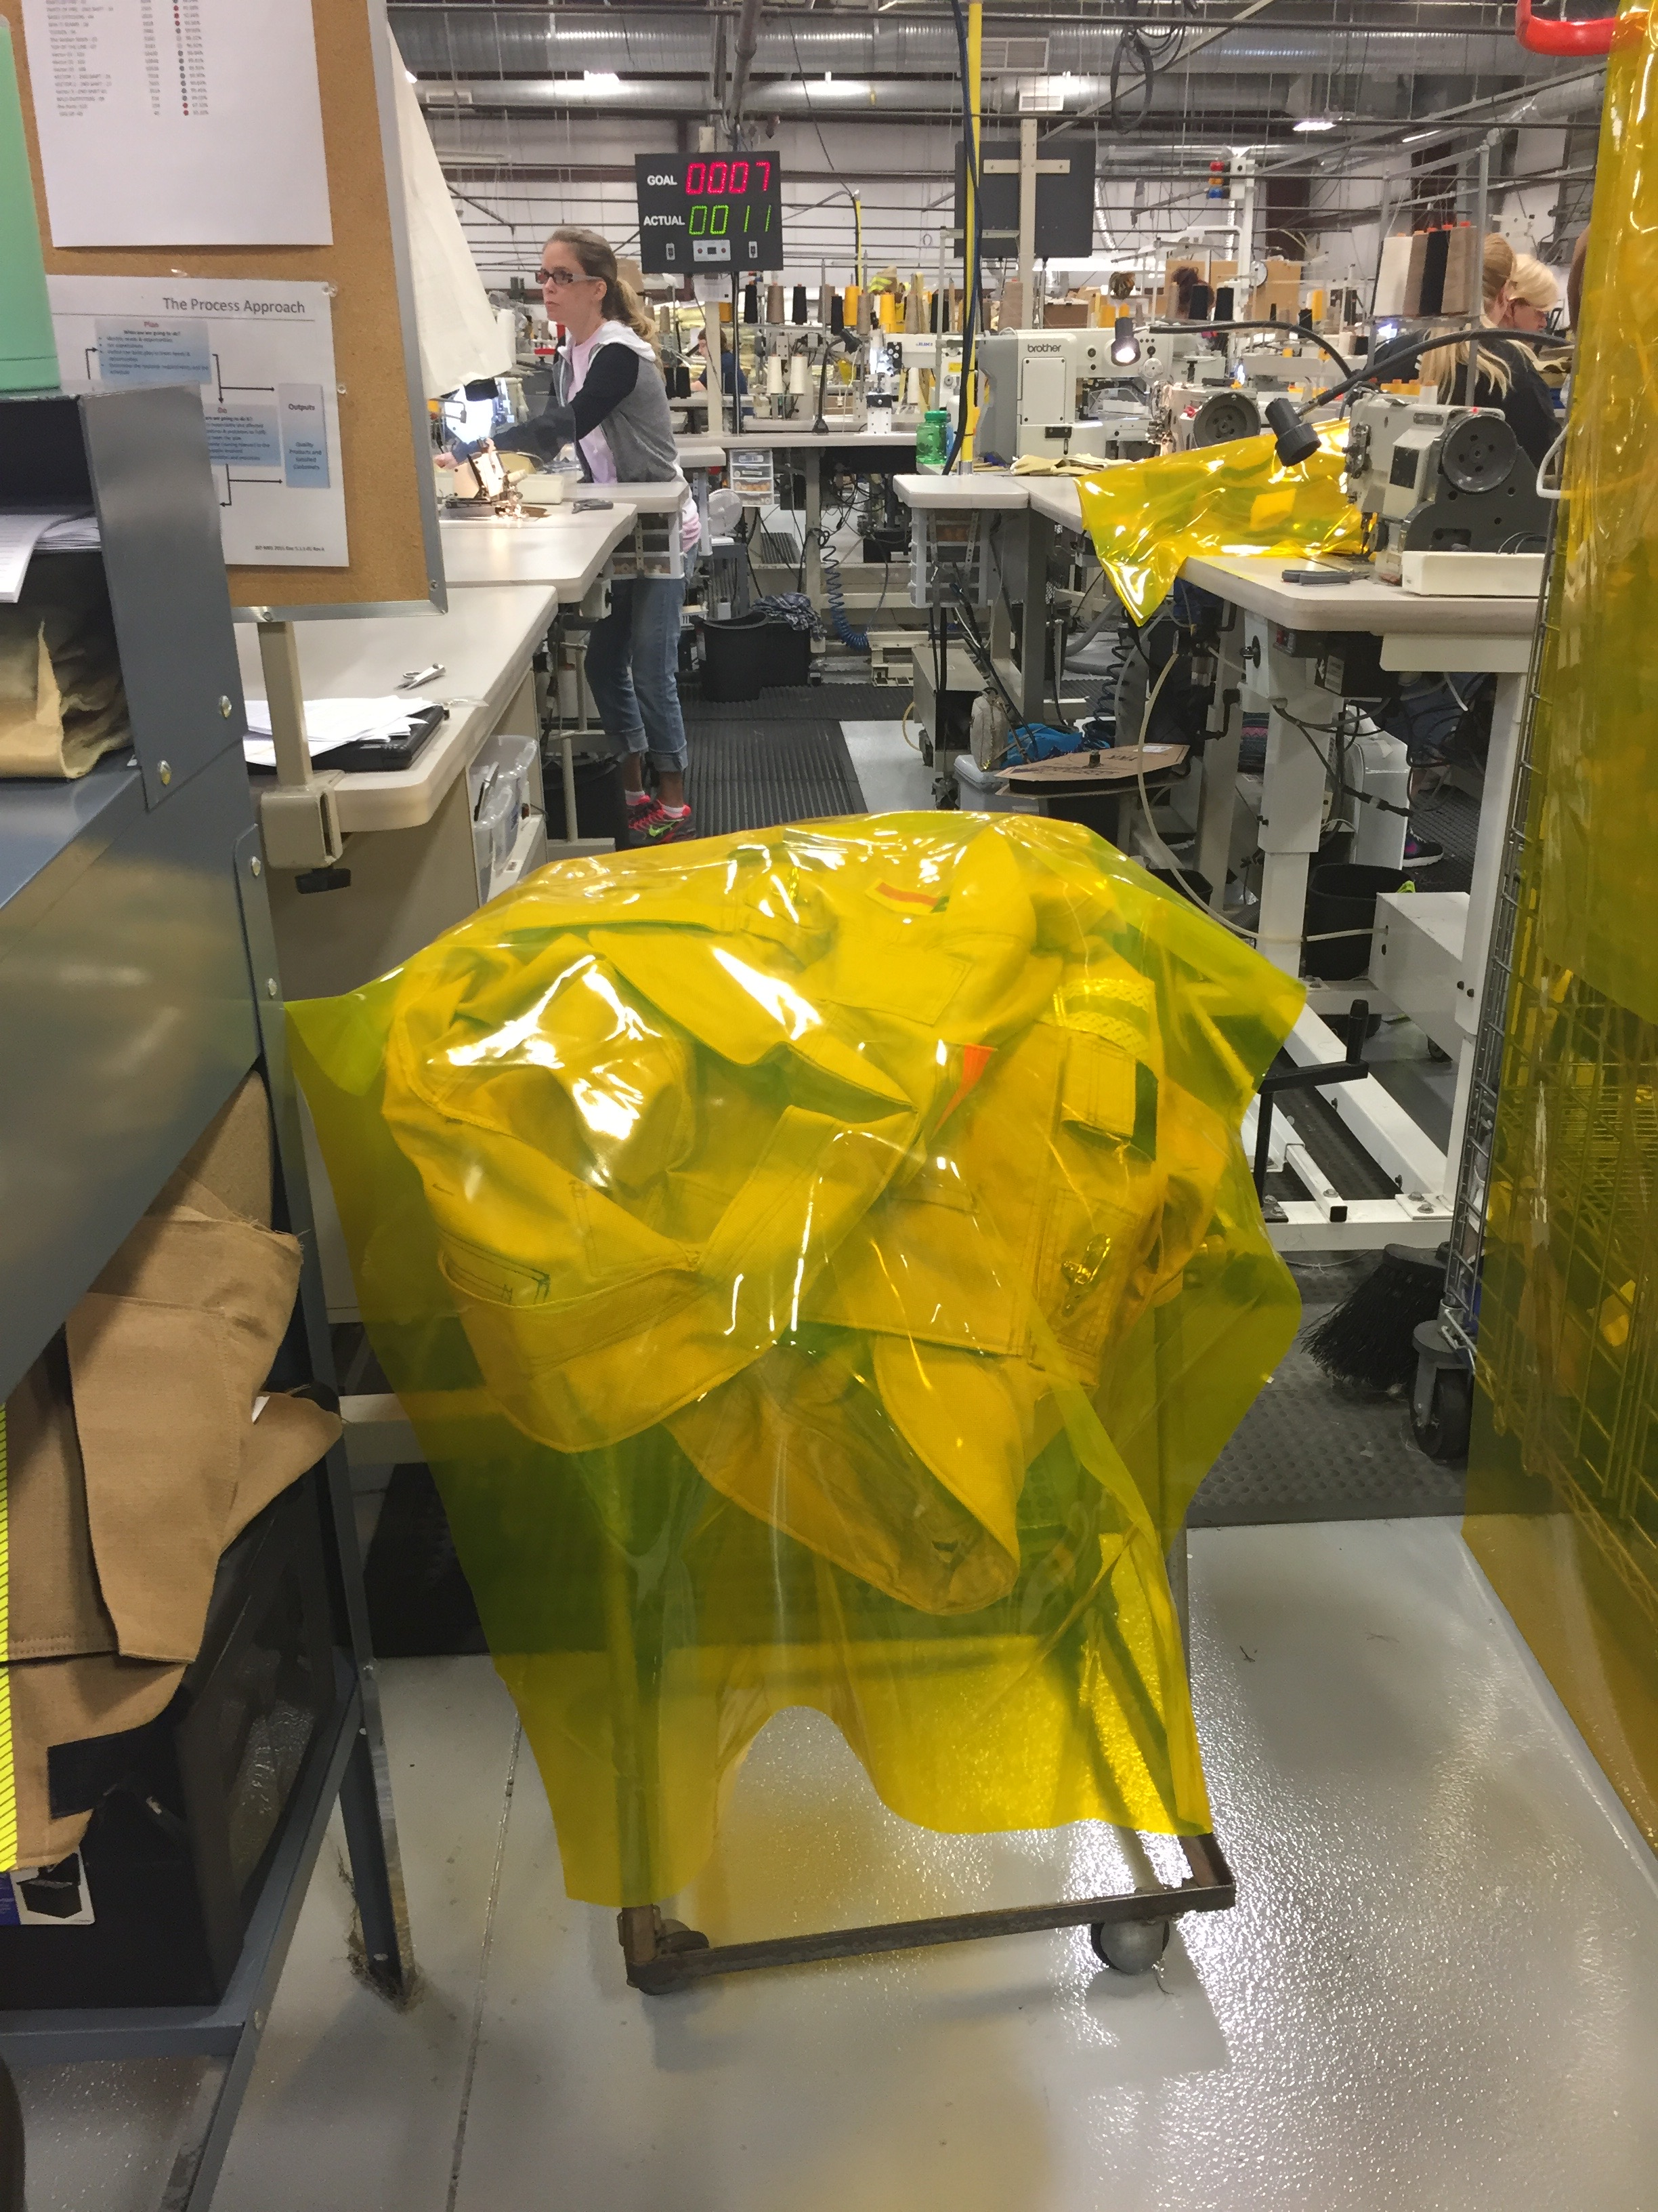
Visit a mill or manufacturer

Slide 13
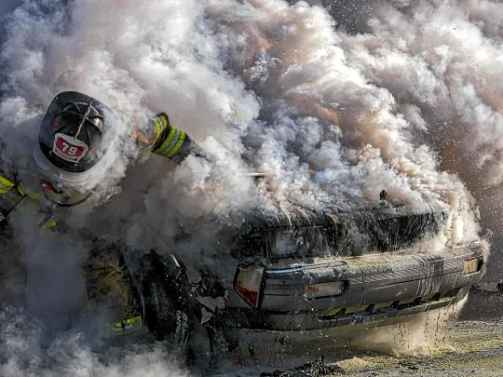
Risk Assessment
NFPA1851 (2020)
Chapter 5 Section 5.1.2 states:
“The risk assessment shall include , but not be limited to the hazards that can be encountered by structural or proximity based on …”
Types of duties
Response activities for different potential incidents
Organization’s experiences
Incident operations
Geographic location and climate
Specific area of operation
Likelihood of/or response to CBRN terrorism incident
Need for 2 sets or spare ensemble elements

Slide 14
Risk Assessment
Process required that identifies the hazards members may encounter and dictates the “proper” level of protection
For Bunker Gear – one of most important is TPP &THL and now PFAS-PFOA
Ultimately this will lead towards the “Composite” for any of the elements.
Notes:
There are hundreds of varieties of different layer of compostes available to today’s firefighters. Those charged with making the decision should be sure that all required research has been done to ensure that all aspects of safety have been considered

Slide 15
Risk Assessment – Firefighter Priorities
Thermal Protection
Movement
Weight
Breathability
Design
Features
Customer Service
All Intermingled
Maintain, higher, lower?
= Tradeoffs?
Firefighter awareness
Driven by manufactures and firefighters

Slide 16
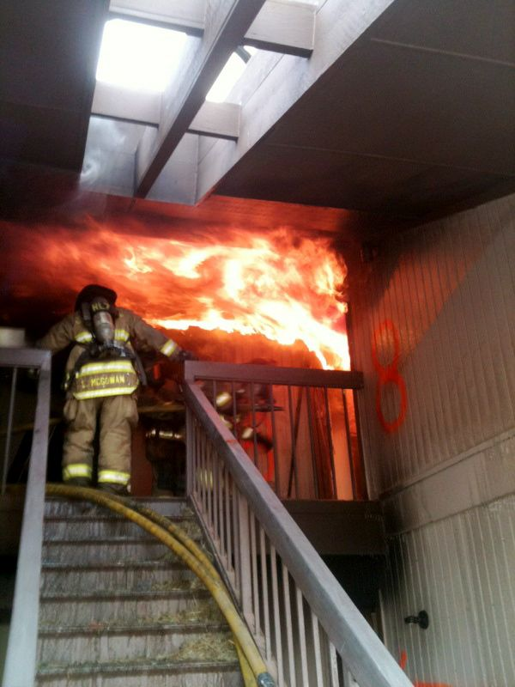
Temperature
º F Response
98.6 Normal human oral/body temperature
111 Human skin begins to feel pain
118 Human skin receives a first degree burn injury
131 Human skin receives a second degree burn injury
140 A phase where burned human tissue becomes numb
162 Human skin is instantly destroyed
212 Water boils and produces steam
284 Glass transition temperature of polycarbonate
446 Melting temperature of polycarbonate
482 Charring of natural cotton begins
>572 Charring of modern protective clothing fabrics begins
>1112 Temperatures inside a post-flashover room fire

Slide 17
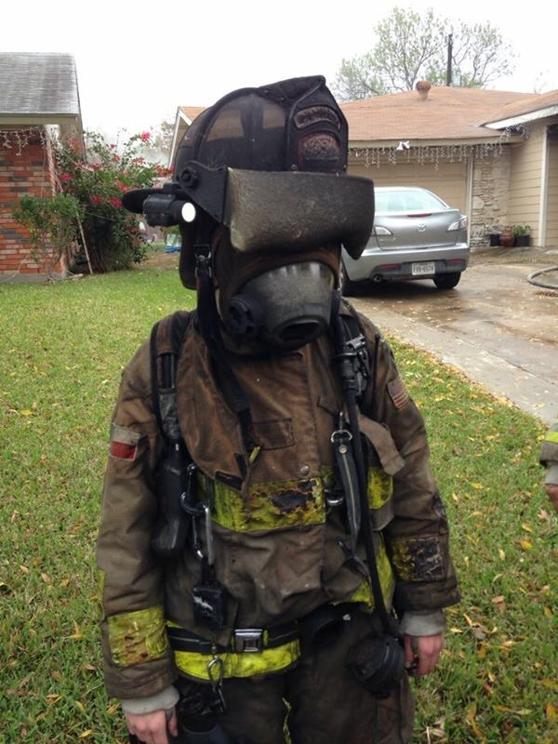
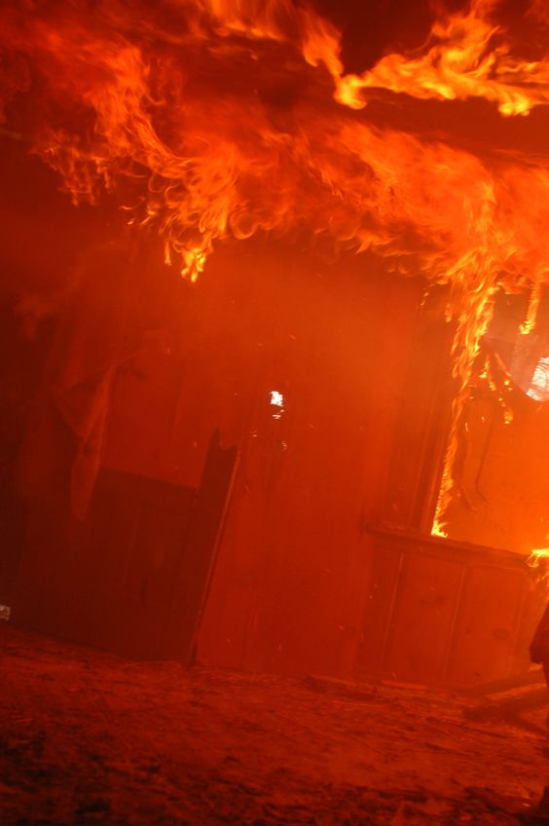

Slide 18
Firefighting PPE Element Values TPP – Thermal Protective Performance / THL – Total Heat Loss Thermal Breathability
Element | Minimum TPP | Minimum THL
Helmet | None | None
Ear Flaps | 20.0 | None
Hoods | 20.0 | None
Coat | 35.0 | 205
Pant | 35.0 | 205
Gloves | 35.0 | None
Boots | None | None
*R_{et} is not currently a requirement in NFPA 1971

Slide 19
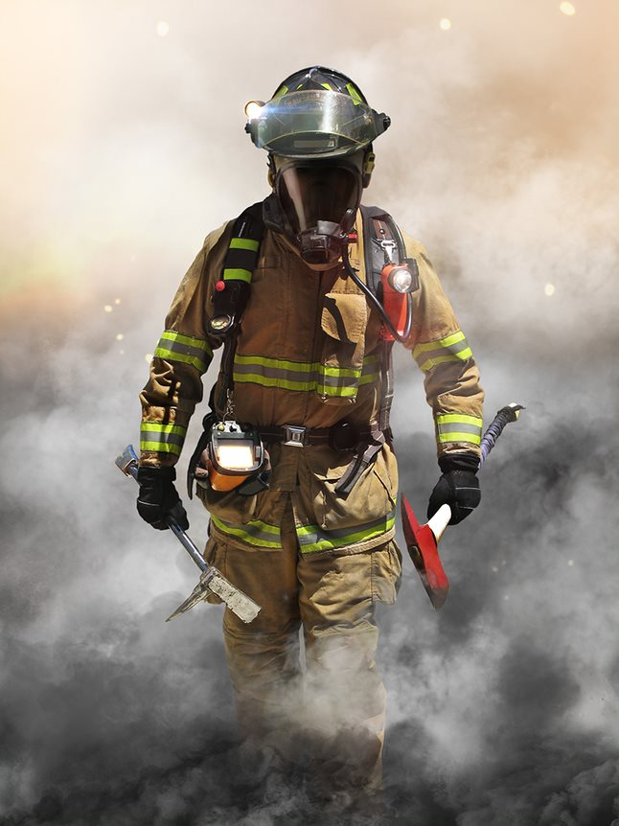
Item | TPP Value*
Shoulder | <120
Trim | 54
Inside Label | 71
Pocket Flap | 69
Pocket | 53
Coat & Pant Overlap | 101
Knee | >120
Boot Overlap | 160
Boot | 75
Item | THL Value*
Shoulder | 50
Trim | 117
Inside Label | 68
Pocket Flap | 172
Pocket | 205
Coat & Pant Overlap | 133
Knee | 50
Boot Overlap | 88
Boot | 147
Composite values will not match the actual TPP and THL values for the actual worn garment
*https://www.fireengineering.com/leadership/the-cost-of-a-pocket-the-impact-of-reinforcements-on-the-tpp-and-thl/#gref

Slide 20
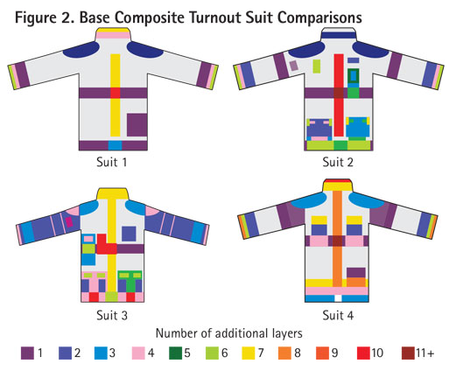
Breathability
Adding layers will decrease THL values and reduce breathability

Slide 21

Coat and Pant
MOISTURE BARRIER
OUTER SHELL
THERMAL BARRIER
COMPOSITE LAYERS
Heat
Wearer’s Body
Vapor
Metabolic Heat
Station Uniform

Slide 22
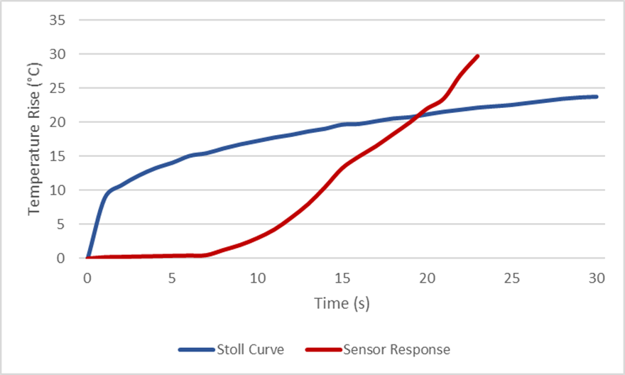
Thermal Protective Performance (TPP)
The Stoll Curve
Alice Stoll and Maria Chianta conducted burn injury research on “sailors, pigs and rats” in the late 1950s and early 1960s at the Aerospace Medical Research Department, Naval Air Development Center.
Sailors of the U.S. Navy volunteered to be burned on their forearms for a weekend pass.
Stoll and Chianta used heat exposures on human and animal skin to determine the level of heat energy that would create a second-degree burn.
For their work, they defined a second-degree burn as the point at which a blister forms.
It became the Stoll Curve, which quantifies the level of heat and the duration of time required for a second-degree burn.
2nd Degree Burn

Slide 23
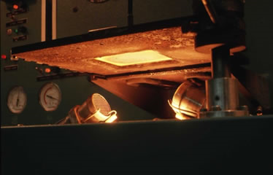
TPP
This testing is done with swatches of fabric to measure the rate at which convective and radiant heat penetrate through the composite system - outer shell, thermal liner, and moisture barrier - to cause a second degree burn to the human skin.

Slide 24
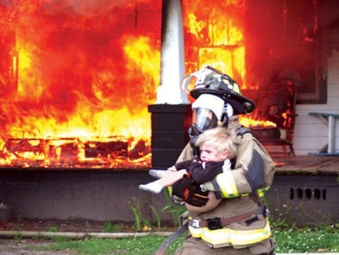
TPP – Thermal Protective Performance Coat/Pant
Minimum = 35 / no maximum
Not measured above 60
35=17.5 seconds to pain/2nd degree burn in a flashover temp situation
60 = 30 seconds
120 = 60 seconds
150 = 75 seconds

Slide 25
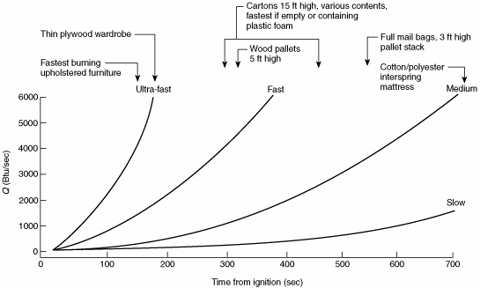
Fire growth rates are classified as ultra fast, fast, medium or moderate, and slow. The fire growth curves classifications are defined on the basis of the time required for the fire to grow to a heat release rate of 1050 kW (1000 Btu/sec).
TO
AR
AT

Slide 26
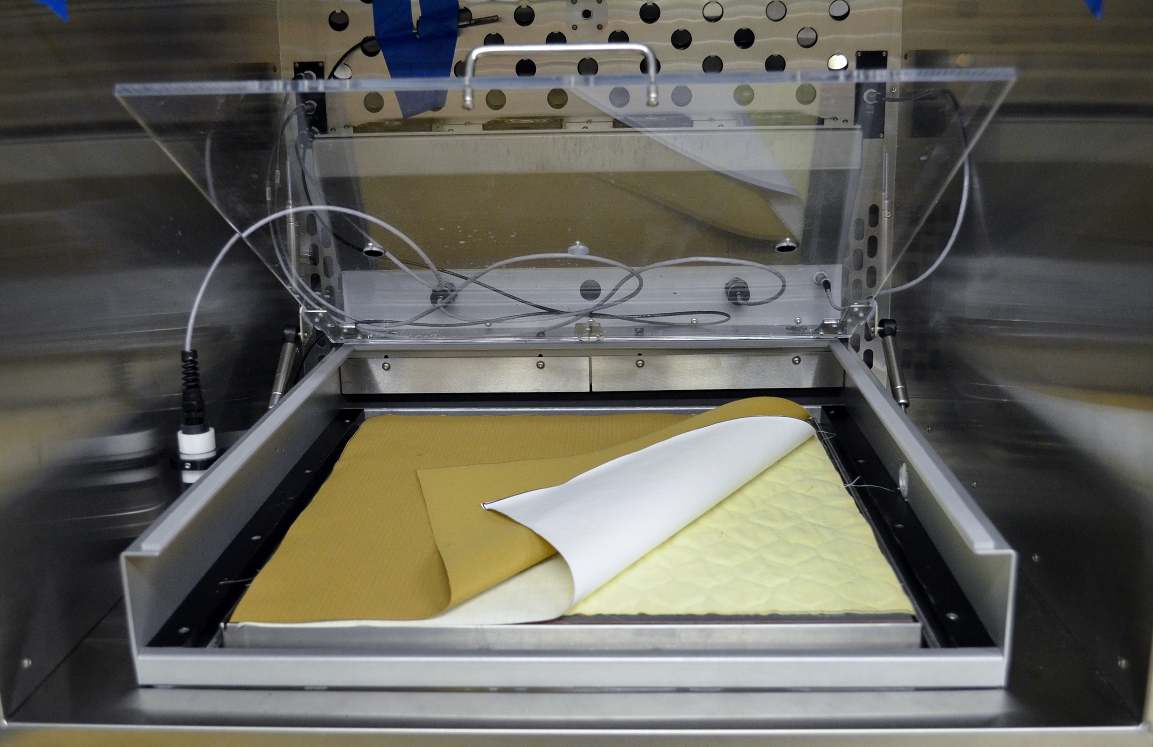
Total Heat Loss (THL)
Every available composite is tested for total heat loss (THL) which consists of:
Thermal resistance (R_{ct}) recorded by testing on dry plate
Ability of the composite to transfer heat away from the wearer
Evaporative resistance (R_{et}) recorded by testing on wet plate
Ability of the composite to transfer moisture away from the wearer
The THL Value (Q_{t}) is calculated using the Thermal Resistance and the Evaporative Resistance
Notes:
Thermal resistance measures the ability of a material to allow air to pass through the material in a dry condition. This measurement is like evaluating a lightweight t-shirt vs. a heavy weight t-shirt in the summer. The lighterweight material will likely allow more air to pass through it, making the wearer feel cooler.
The evaporative resistance is the ability of the material to allow moisture through it. So when the person is sweating, will the material allow that moisture inside the garment pass through it to the outside.
The THL value is calculated using both of those measurements.

Slide 27
Coat and Pant Composite TPP & THL
THL
Measures breathability, or the ability of the total composite system to allow heat and moisture to evaporate. Breathability is a key factor in reducing heat stress. 205
TPP
From the U.S. Department of Homeland Security and FEMA, Thermal Protective Performance (TPP) “measures how well a fabric protects the wearer against second-degree burns in a flash fire. The higher the TPP value, the more thermal protection the fabric provides relative to other fabrics.”35
Roughly approximates flashover conditions

Slide 28

Weighing THL and TPP
Firefighting Coat and Pant
Thermal Protective Performance (TPP)
Higher TPP reduces the ability to sense the heat in the environment
Should you be in the environment?
Savable lives?
Savable property?

Slide 29
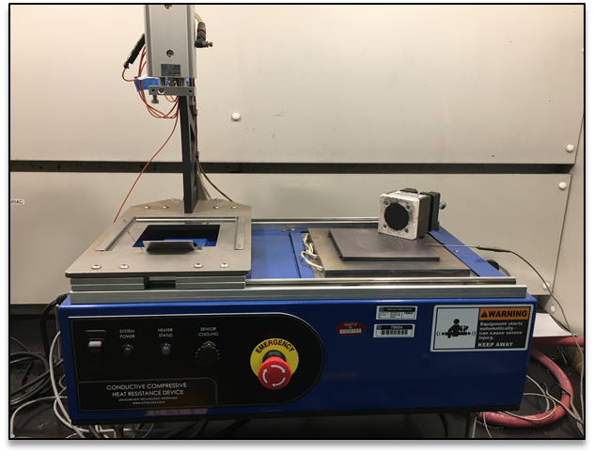
Conductive and Compressive Heat Resistance (CCHR)
Limited Composites are Tested for CCHR which consists of:
Weight assembly (2 psi or 8 psi) with imbedded sensor
Hot plate at 280°C
Time to 2nd degree burn determined by comparison to Stoll Criterion
Conducted wet and dry
Composites tested are selected based on their weight and historical performance:
Lightest weight materials are known to perform poorly
New materials are selected until historical data is generated
Based on engineering judgement
Notes:
The next test that I will talk about is the CCHR test. This test is performed on a limited number of composites, which I will explain in detail in a minute.
The test consists of a weight assembly with an imbedded sensor. There are two different pressure requirements, 2 psi and 8 psi. The 2 psi pressure is used to test shoulder composites and the 8 psi pressure is used to test knee composites. The knee requires higher compression since it is meant to replicate kneeling or crawling on a hot surface. The shoulder compression is intended to replicate the compression of the firefighter gear when standing in a hot environment and then donning an SCBA.
The hot plate is set and calibrated to 280 degrees C. The sample is placed in a shutter device that moves the sample over to the hot plate. Then, the weight assembly is lowered on to the sample, which then presses it against the hot plate. In the same manner as TPP, the heat flux calorimeter reads the thermal energy transferred through the composite specimen and then calculates the time to burn injury. The minimum requirement for this test is no burn injury can occur before 25 seconds of exposure.
Additionally, this test is performed wet and dry. During normal wear, the gear rarely stays dry. Not necessarily due to the outside environment, but the inner layer is usually damp or even wet from the sweat from the wearer. The transfer of thermal energy, as you probably know, occurs much faster through water. This means that a wet fabric, would also transfer the energy through the material faster when it is wet than when it is dry. For this reason, this test is performed so that the inner layer – usually the thermal barrier – is made damp prior to testing. This wet condition usually provides the lower time to burn injury.
As I mentioned earlier, this test is only performed on a limited number of composites and the composites selected for testing are based on their weight and historical performance. For example, some materials are known to perform more poorly on this test due to their material make-up or construction. New materials are generally selected since we do not have any historical data to support how they would perform on this test. In both cases, engineering judgement is made by our experienced project handlers and textile experts.

Slide 30
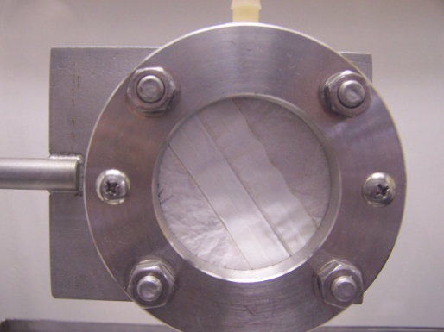
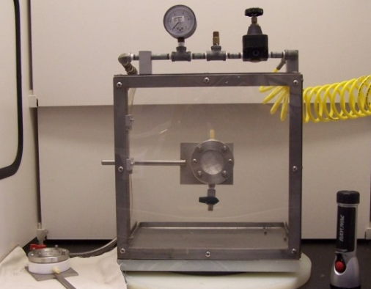
Moisture Barrier Requirements
Liquid Penetration Resistance
2 psi for 1 minute, 0 psi for remaining hour
Test chemicals
Fuel H
37 % Sulfuric acid
FR Hydraulic Fluid
AFFF
Chlorinated water
Antifreeze

Slide 31
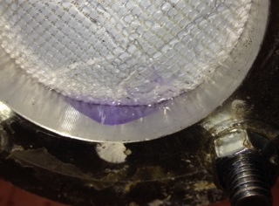
Moisture Barrier Requirements
Liquid Penetration Resistance
Hydraulic fluids (Skydrol and Hyjet) cause this moisture barrier film to break down over the one-hour period and result in a failure.
Onset of leakage during the test, which occurs after about 30 minutes.

Slide 32
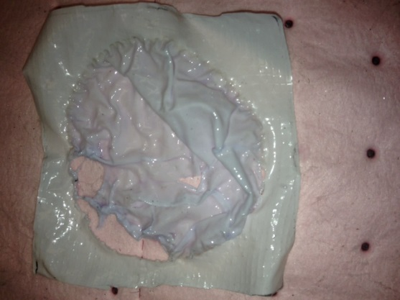
Liquid penetration tests for chemical resistance Barrier is interior to the glove Integrity cannot be confirmed without destructive testing

Slide 33
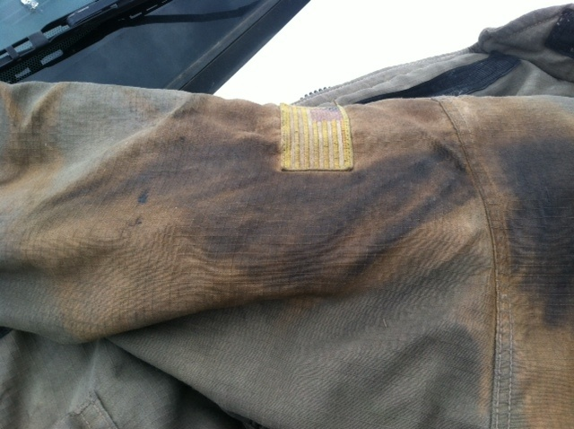
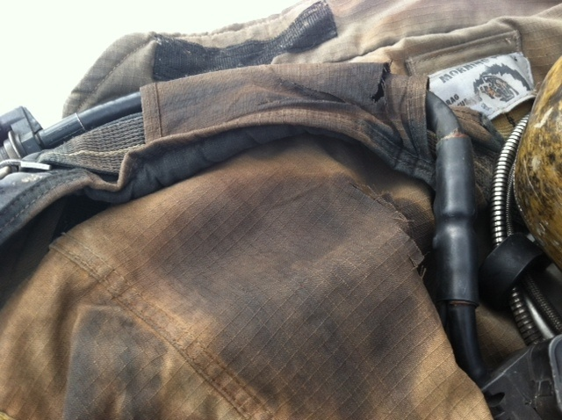
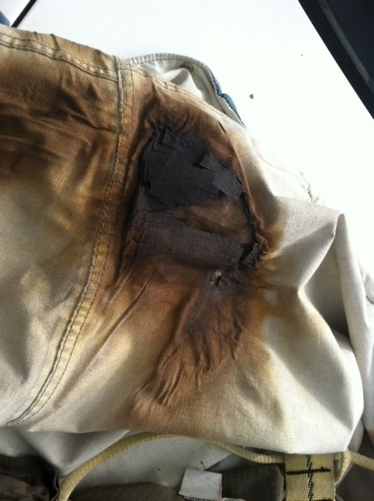
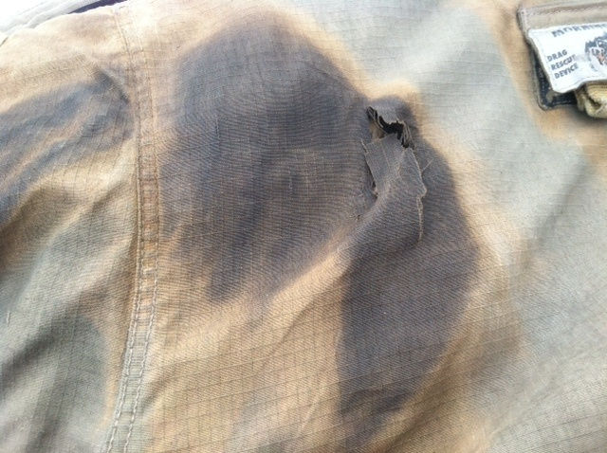
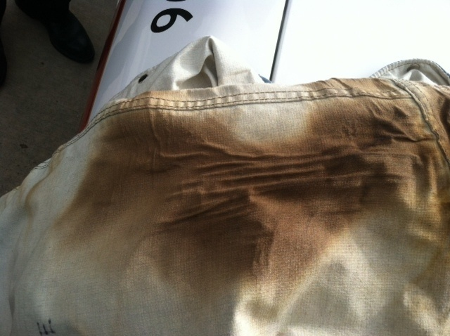
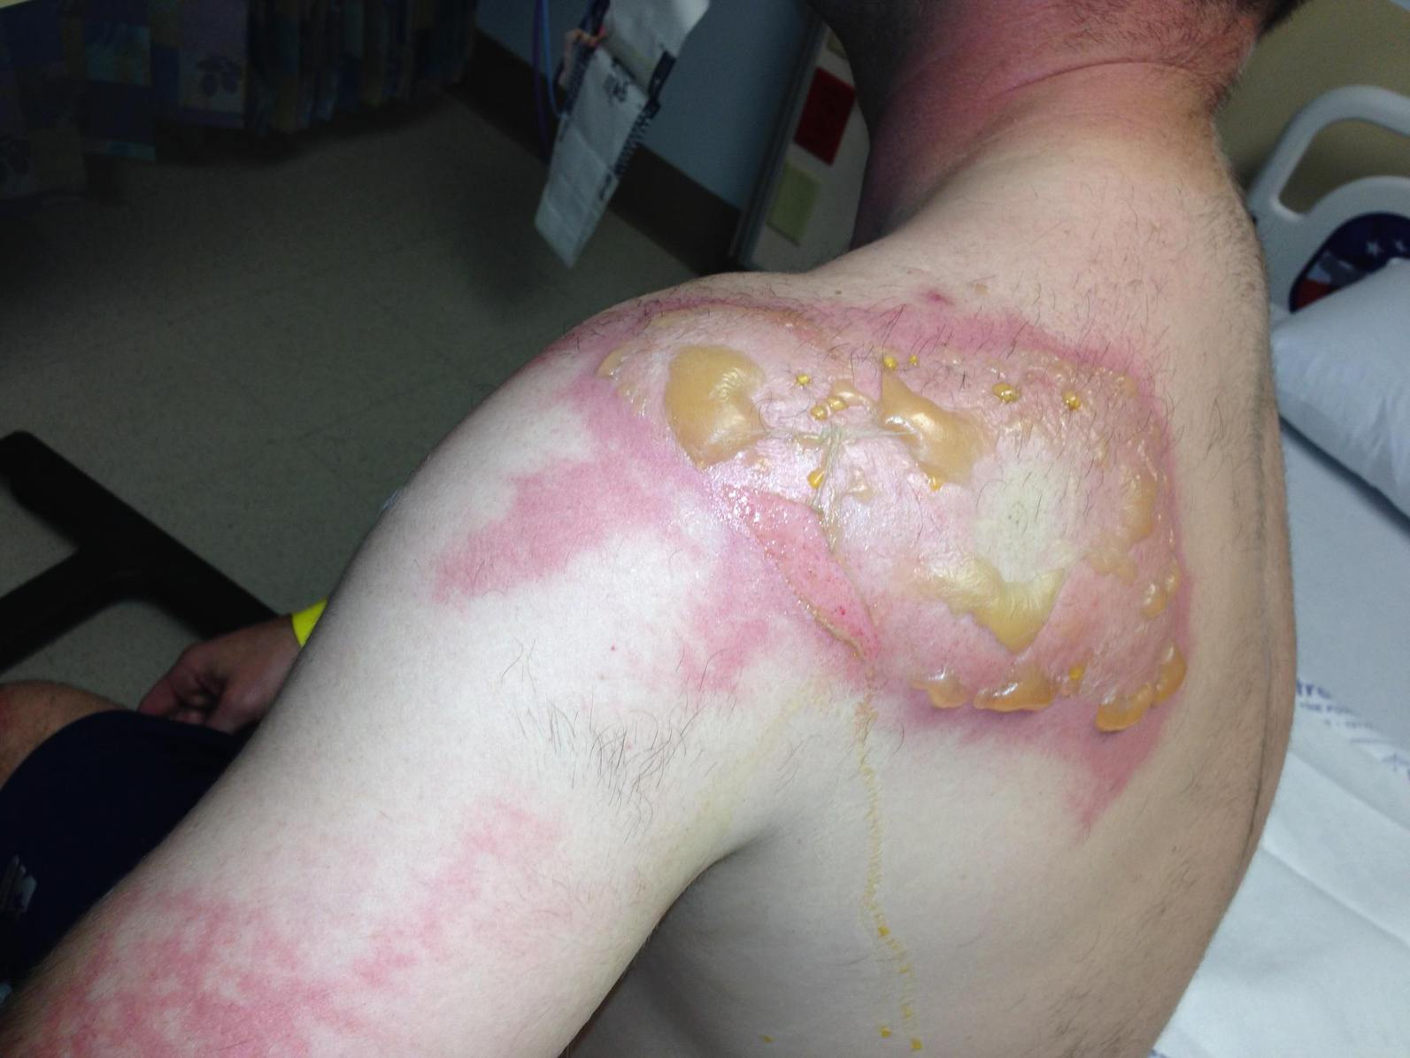
Contamination Burn ?
Tablecloth Not A Tabletop

Slide 34
PFOA – PFAS - PFOS
PFOA has been used in many manufacturing processes including non-stick coatings on cookware, food packaging materials, and as durable water repellents (DWR) in consumer clothing, upholstery and carpets. PFOA is one of a family of chemicals that contain fluorine (perfluorinated chemicals). It has a long half-life (time to decrease by half in the body) of 2-3 years in humans. (IAFF 2017)
The ammonium salt of PFOA degrades at 350-400C (752F), similar to the melting temperature of the fluorinated polymers it is used in.
• PerFluoroOctaneSulfonate • One specific type of PFAS
• Chemical Industry used PFOS as: key ingredient in 3M ScotchGard.
3M replaced PFOS (C8) with PFBS (C4) around 2003.
What is PTFE? PolyTetraFluoroEthylene Another specific type of PFAS

Slide 35
Hazard Assessment of Fluorochemicals Present on Firefighter Gear Cody Patrick Zane (2020)
“Ultimately, it was determined that firefighters have minimal risk of exposure to PFCs from their gear. Quantification of the 20-year range of turnout gear determined the highest level of perfluorooctanoic acid (PFOA) to be at 14.83 ng/cm2. With dermal exposure being the most likely pathway to exposure from PFCs on gear, this concentration is 1,000 times lower than the lowest concentration tested for dermal studies of PFCs. The study found no detectable limits of perfluorooctane sulfonate (PFOS).”

Slide 36
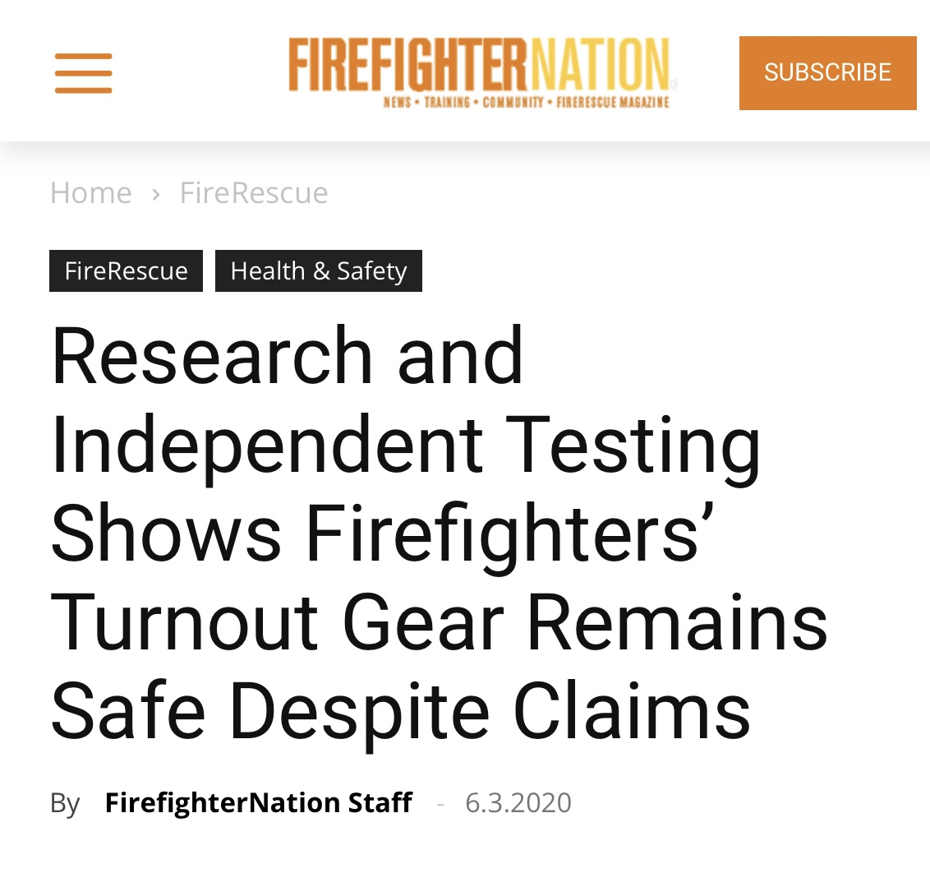
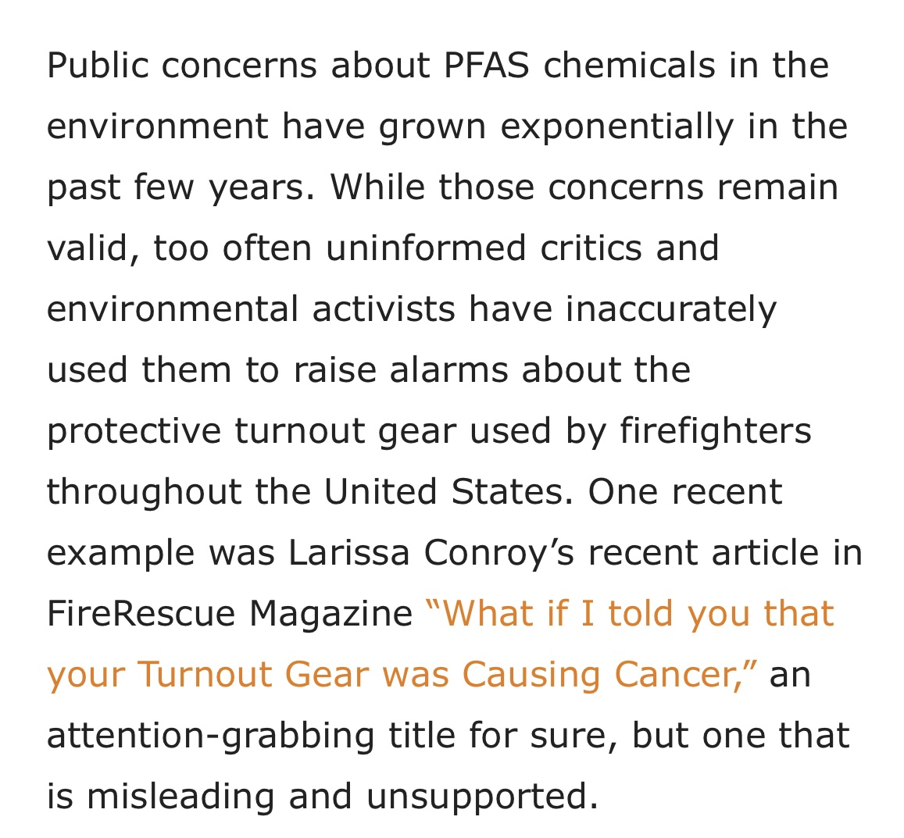
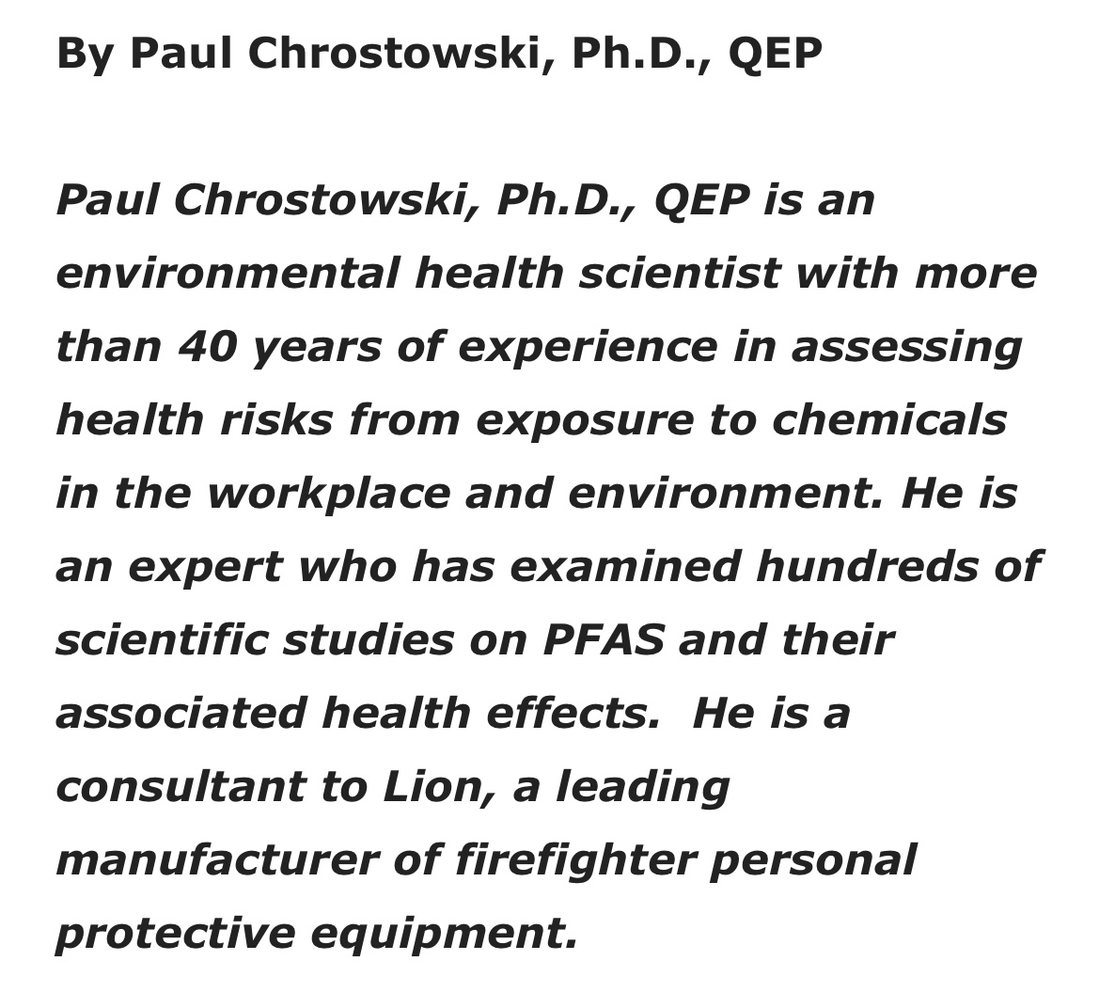

Slide 37
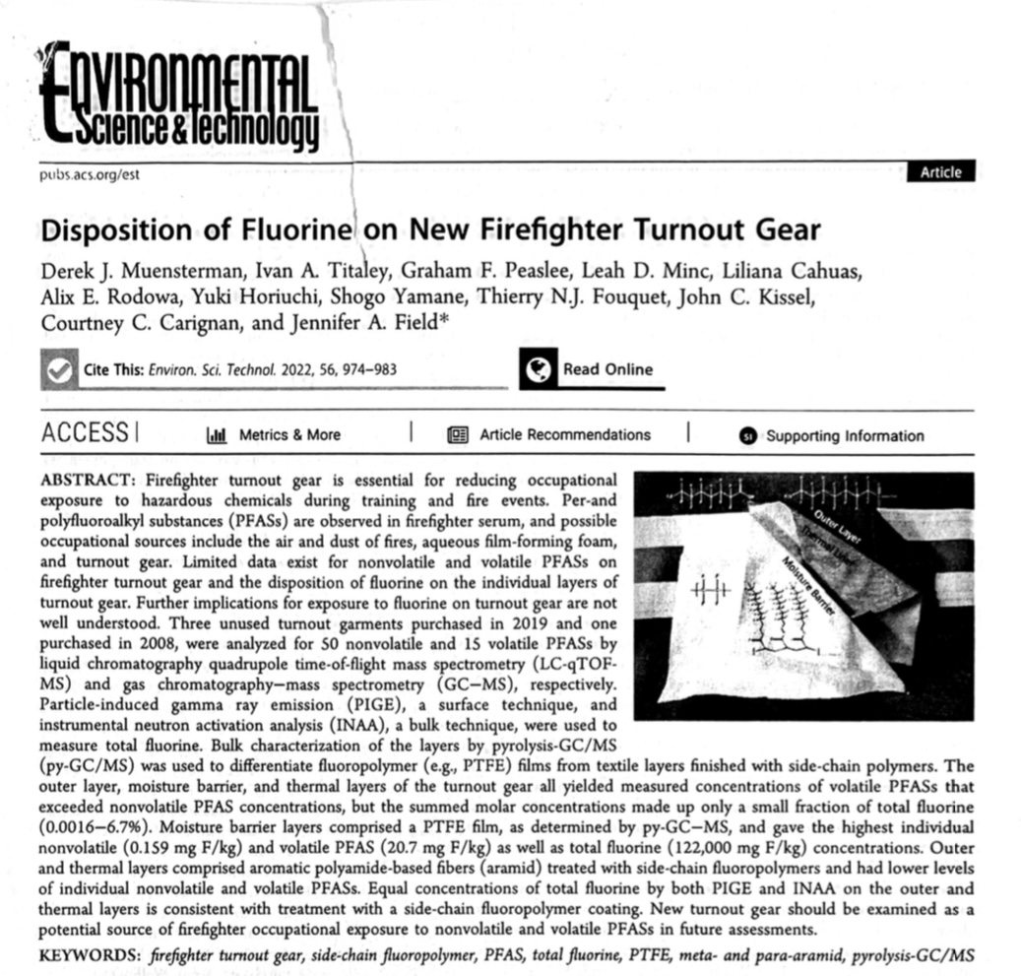

Slide 38
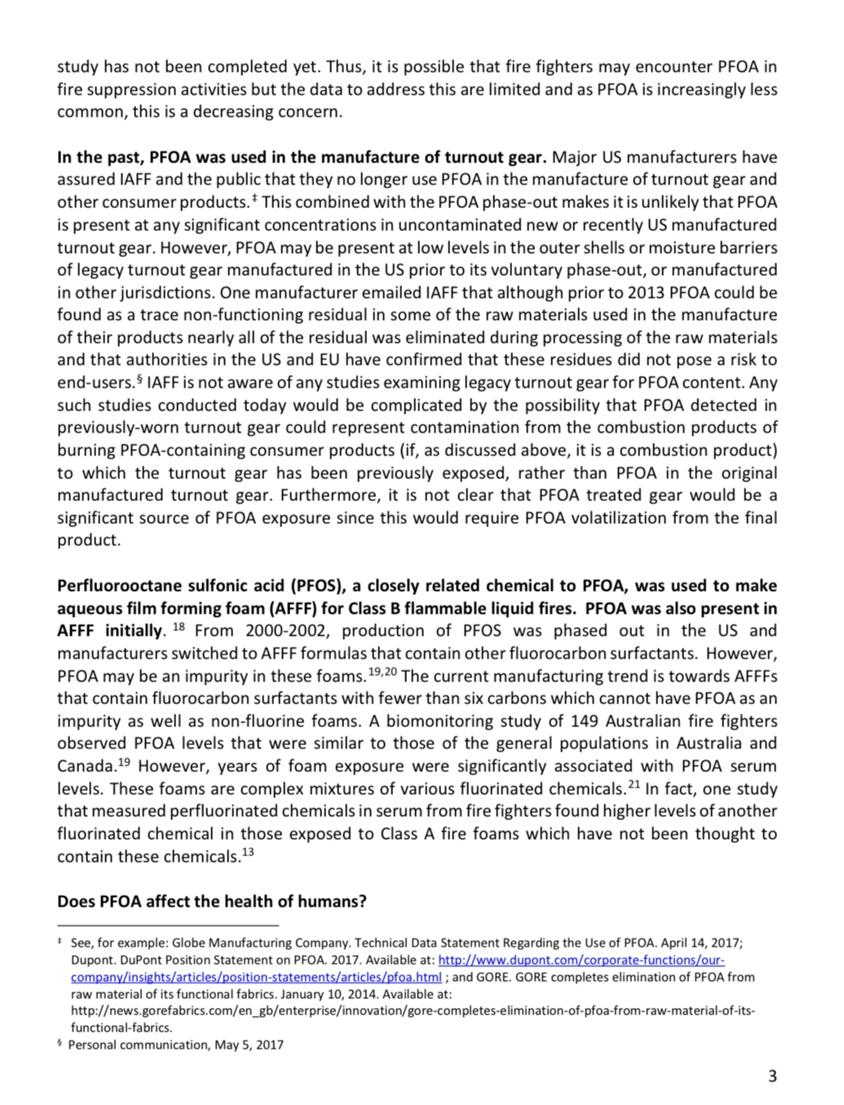
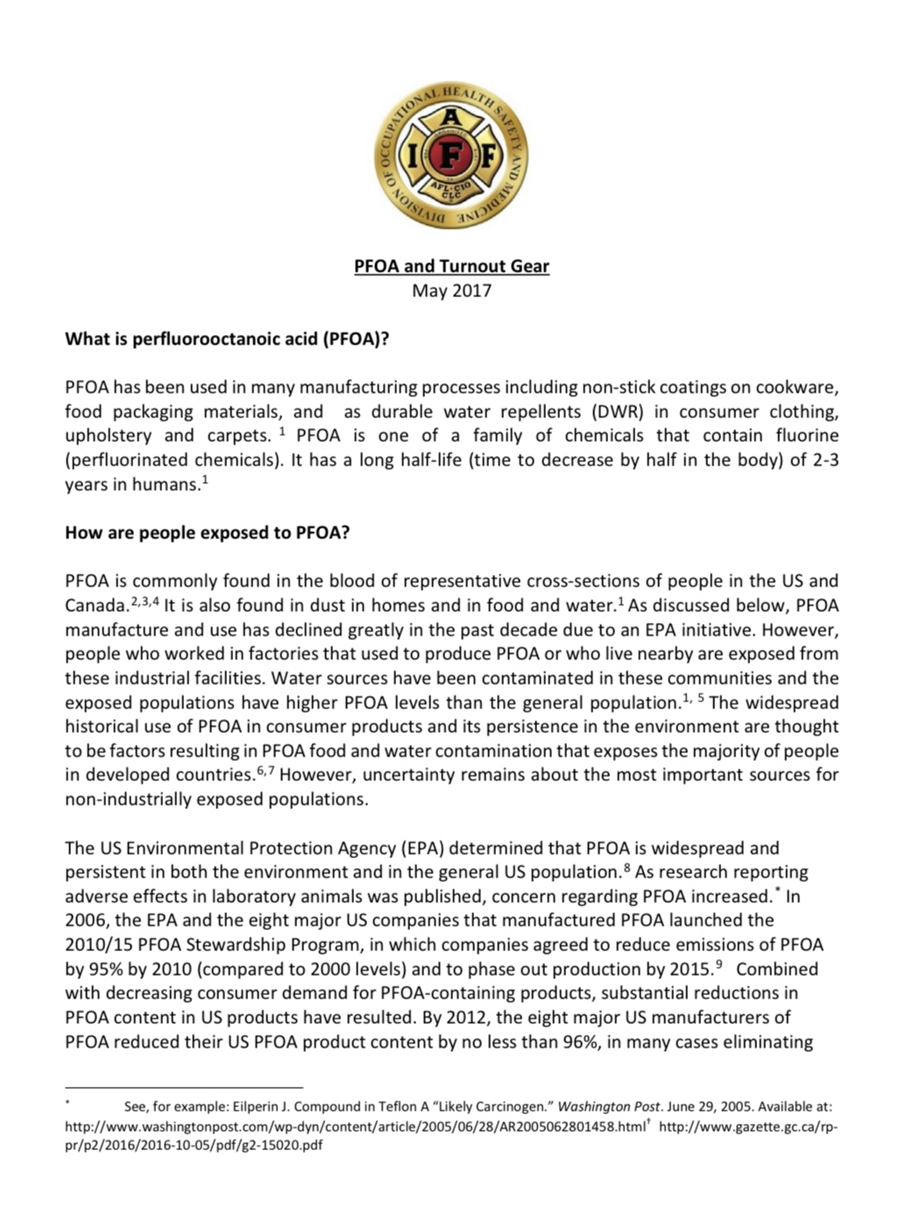
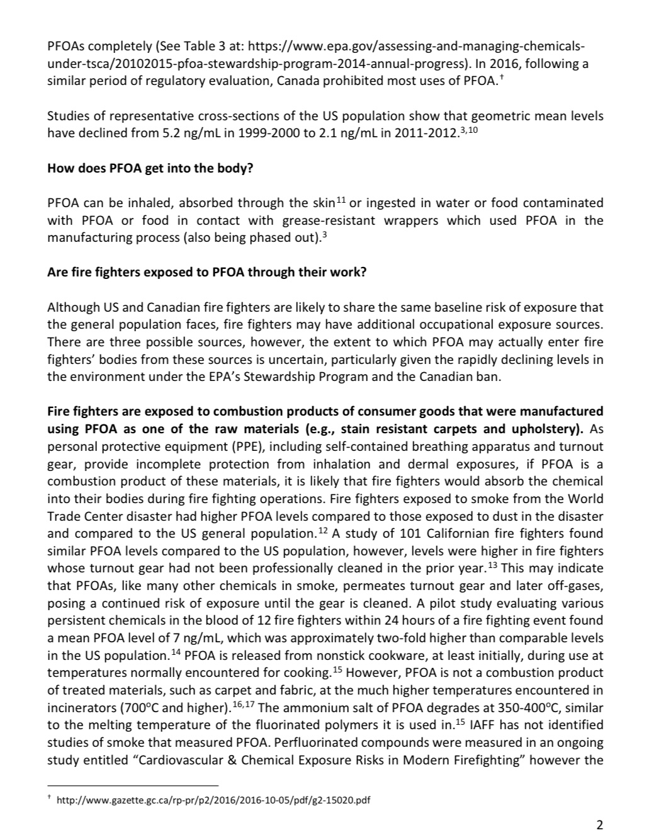
IAFF, Turnout gear, and PFOA 2017
(3 pages of 7)

Slide 39
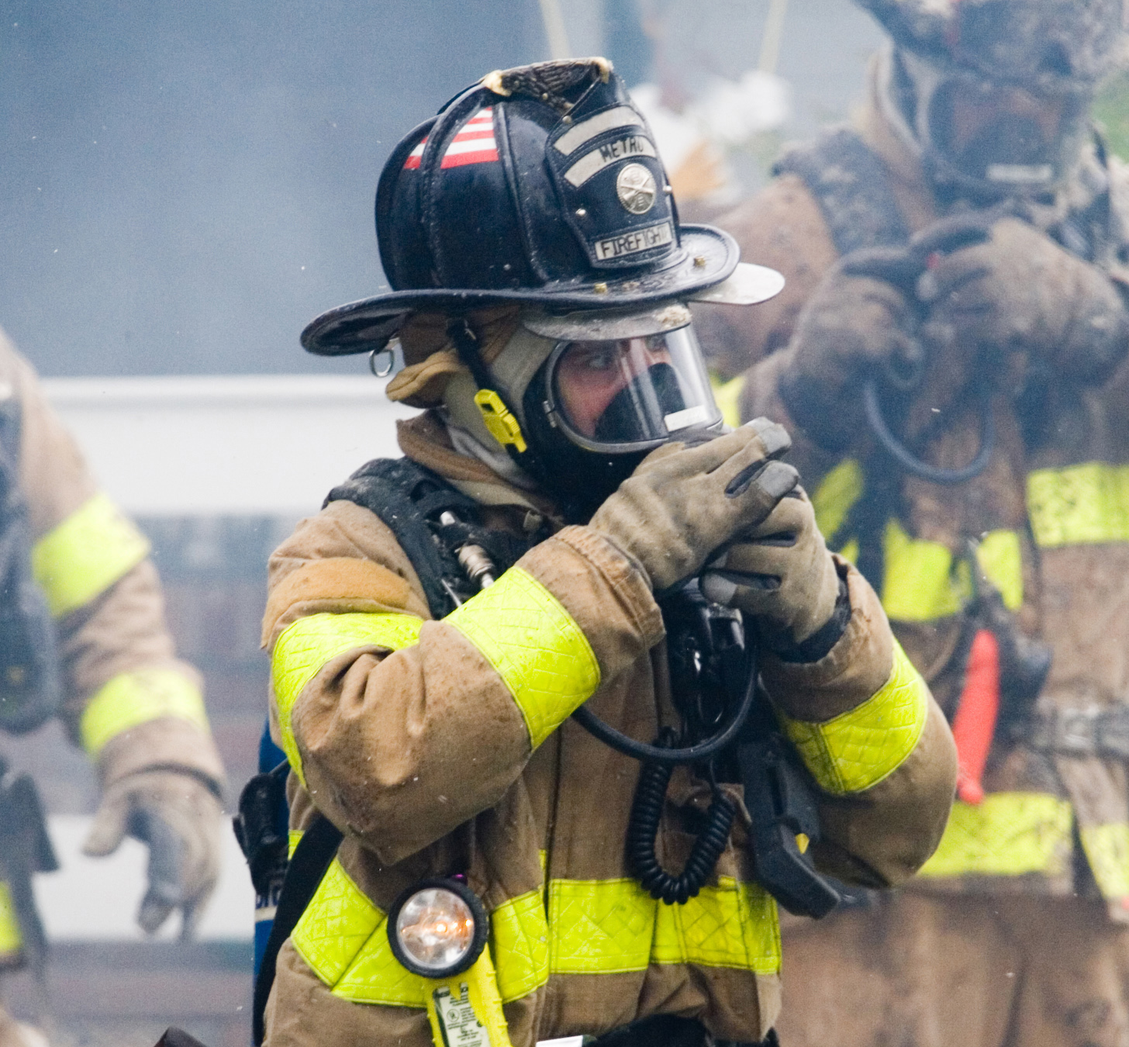
The Head Protection System
Helmets, ear flaps and hoods are a system
Designed to protect from:
Impact
Heat
Fluids
Thermal protection comes from ear flaps and hood
Helmet is not tested for TPP or internal temperature
Ear flaps and hoods are tested for a minimum 20 TPP
Hoods do not offer protection against fluids
Proper use and placement = Reduced burns

Slide 40
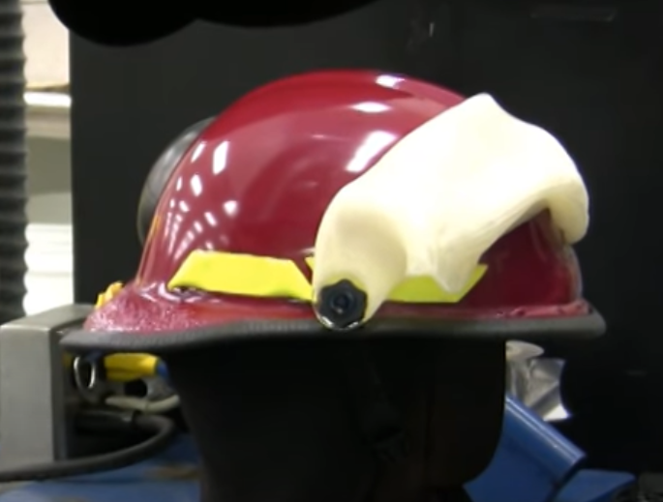
500 Degree Helmet Test

Slide 41
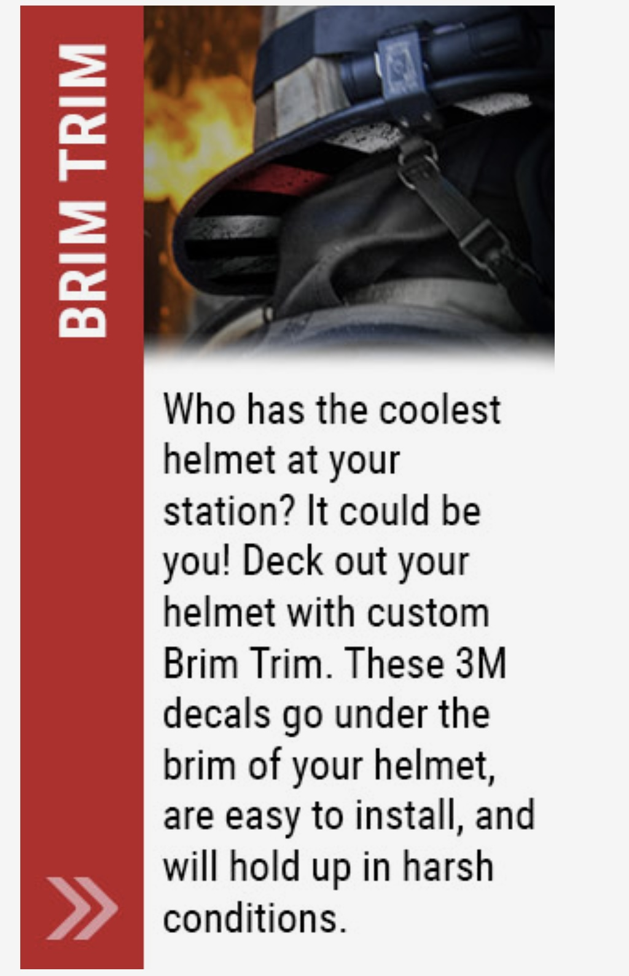
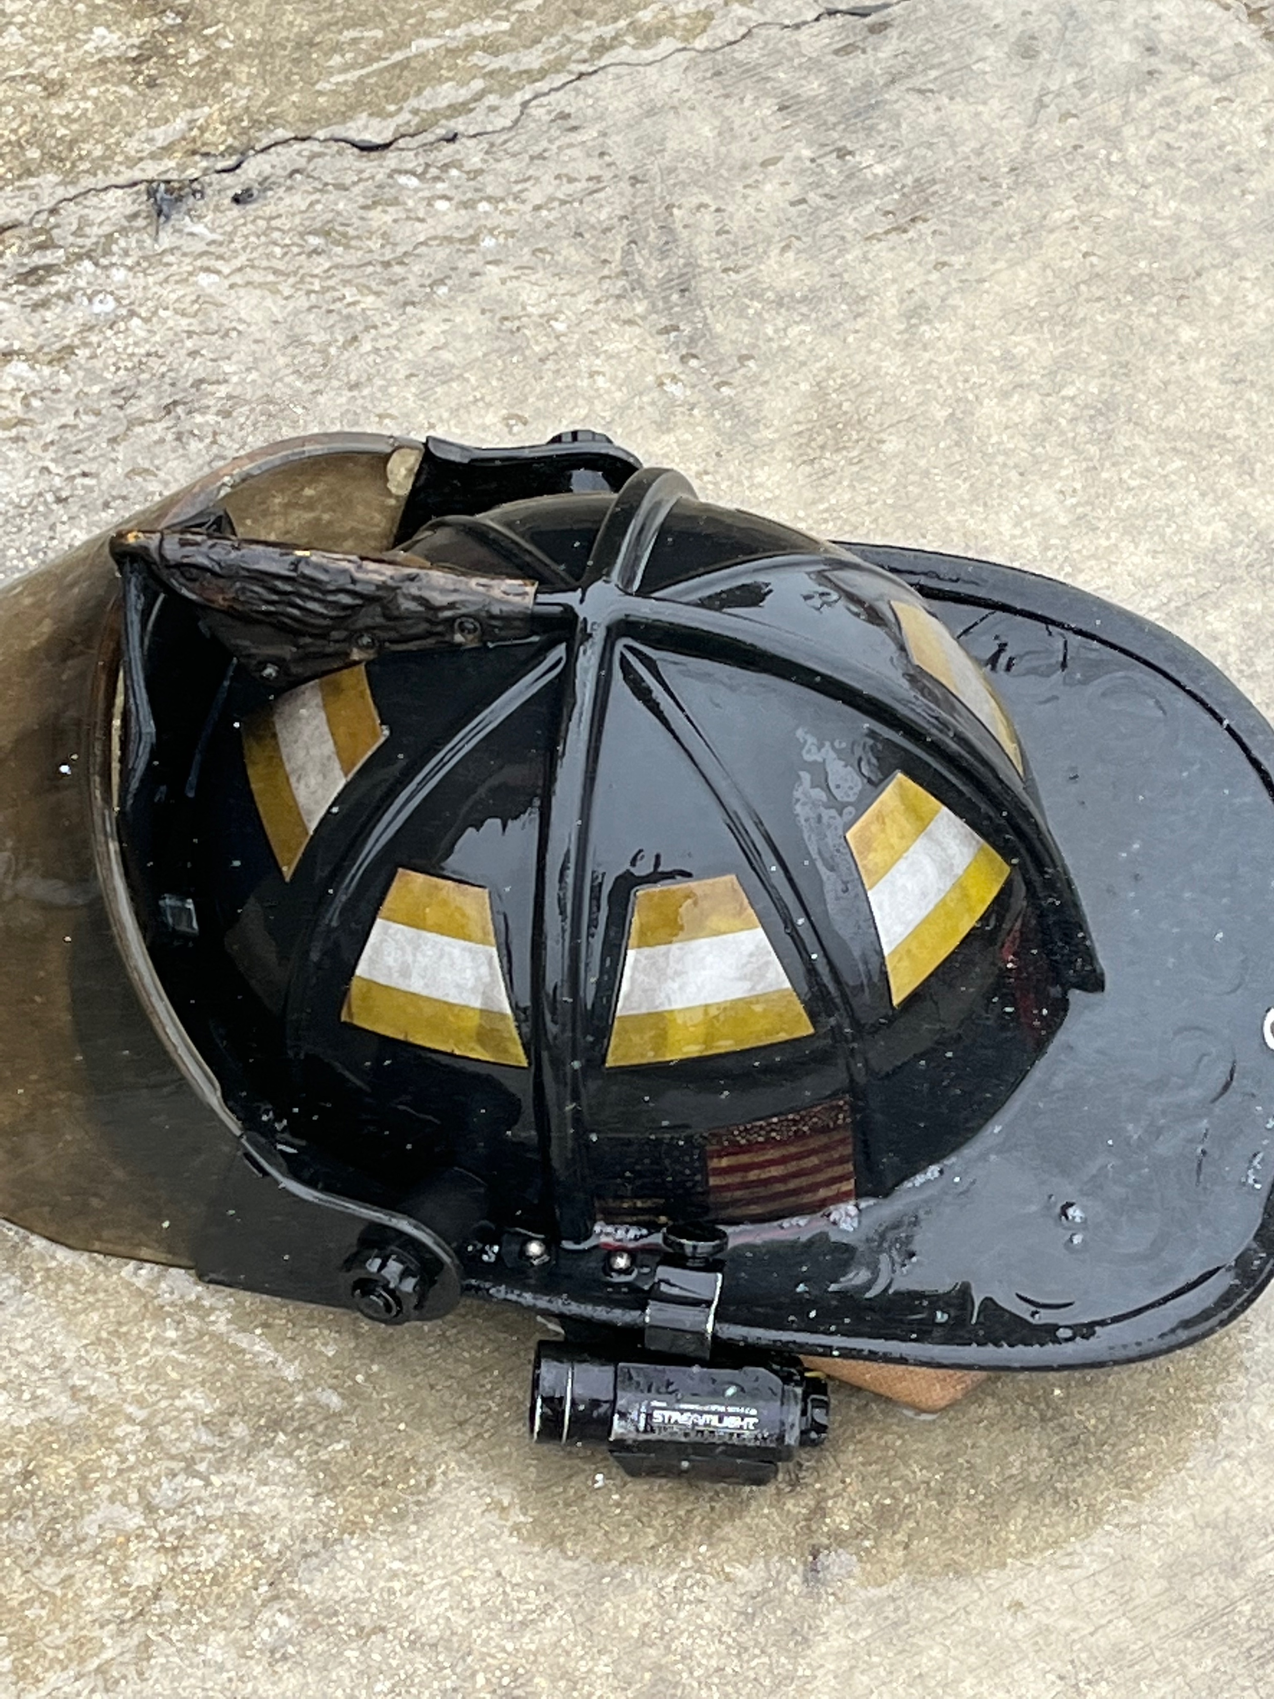
Our helmets are not showpieces. They are an extremely important piece of equipment

Slide 42
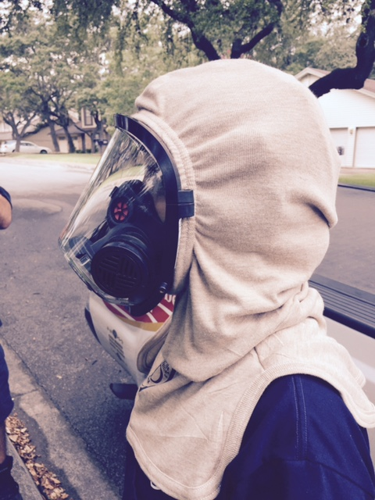
hoods
Weighing Hood Features
Heat
Breathability
Particulates
Comfort
Function
Acoustic distortion
Coat interface
Overall fit
Blocking ability
Breathability
Air transfer
Moisture transfer
Situational awareness
Thermal protective performance

Slide 43



The need for a barrier inside the hood
Below the angle of the jaw - 2nd most absorbent area

Slide 44

Particulate Blocking Test
Performed on hood composite, not finished hood
Measures the particles from 0.1 µm to 1.0 µm that pass through the composite
Must block 90% of the particles from passing through the composite
https://www.firehouse.com/sponsored-content/article/20998944/five-tips-for-choosing-the-right-particulate-hood-wl-gore-associates

Slide 45

Hoods
Hood Face Opening
Tests were designed to allow hood face openings to be large enough for staging, but small enough to seal to the facemask
Device created for visual observation of compliance
Must “freely” fit around upper cylinder
Must fit “snug” around bottom cylinder
Top cylinder
Bottom cylinder

Slide 46
Particulate Blocking Hoods
Evaluation suggestions
How does it feel?
Is it comfortable?
Perform a static test in a class A fire
Does it fit from top to bottom?
How does it lay on your shoulders and chest?
Does it feel breathable?
Will heat pass from inside to outside?
Does air pass through it?
Wipe necks before they enter and then immediately after they exit.
Evaluate thermal recognition, time to alarm, hearing and particle blocking
Field trial the hood
Wear it, use it, stow it, store it, wash it
Expose to conditions normal for your use

Slide 47


Boots
Footwear | Requirement
Upper | 60 N (13lbf)
Sole | 1200 N (270 lbf)
Puncture resistance test 272 lbf
(a nontechnical unit of force equal to the mass of 1 pound with an acceleration of free fall equal to 32 feet/sec/sec.)
Images copyright of ASTM International

Slide 48


Boots
Performance and reality – a personal story
No TPP is Required
Conductive Heat Resistance (CHR) is required for footwear soles
Minimum 44°C (111°F) after 20 minutes
Radiant Heat Resistance (RHR) is required for footwear uppers
Minimum 44°C (111°F) after 5 minutes
RHR
CHR

Slide 49



Gloves
Grip Test
Test subject performs the test bare handed
Then dons gloves to perform tests again
Performed with wet gloves
No more than 30% drop between bare-hand and gloved-hand
Image copyright of NFPA

Slide 50


Gloves
Torque Test
Tool Test
No more than 20% drop between bare-hand and gloved-hand
Bare-handed result can not exceed 175% of gloved result

Slide 51

Gloves
Hand Function
Bare-hand result cannot exceed 220% of gloved-hand

Slide 52

Considerations for selecting Evaluation Products

Slide 53
Needs Assessment Process
Know and understand what is required
Hone in on your specific needs (TPP, THL, etc.)
Review current gear/elements
Is it doing its job?
Does it satisfy the element’s new risk assessment?
Can/how do we make it better?
Notes:
Understanding most of the requirements is no easy task.
Keep in mind that once specific TPP and THL minimums are picked, composite choices may become limited.
Having a full knowledge of your current gear will provide you a better understanding of other gear you may be looking at.

Slide 54

NFPA 1851 Risk Assessment

Slide 55



Slide 57
Selection Process
Seek Education
Research (Internet)
Presentations by fabric manufacturers/mills
Presentations by moisture barrier manufacturers
Presentations by bunker gear manufacturers
Manufacturer/mill visits (if feasible)
Decision making member(s) need to learn about the materials, the manufacturing process, and network
Trade shows and conferences
Capitalize on their expertise but ask tough questions
Notes:
There is an infinite amount of research that can be ascertained from the world wide web.
Although most likely a bit difficult for smaller departments, an effort should be made to push local vendors to make available represenitives that can fully explain the materials and testing that are mandated by NFPA standards

Slide 58

Selection Options
Composite
Leather
Particulate Protection
Laminated
Sewn
Floating
2 or 3 Layer
Outer Shell
Moisture Barrier
Thermal Barrier
2D
3D
Specific Barrier
Leather
Rubber
Hybrid
Helmets
Hoods
Coat and Pant
Gloves
Boots
Notes:
Tabletop vs tablecloth

Slide 59

Selection Process
Vendor Day
Schedule day(s) when manufacturers, fabric mills, barrier companies can visit
Your location
A regional location
Plan separate days for materials and product manufacturers
Plan for materials first
Plan for product manufacturers second
More relevant for bunker gear
Notes:
Materials – determine what you want
Manufacturers – find out if they offer what you want (proprietary products)

Slide 60
Evaluation-Selection process

Slide 61
Request and Acquire Information
Letter of Interest
Request for Information (RFI)
Identify what (products) you are looking for
Specify all pertinent requirements (TPP, THL, Composites, Color, Style, Made in USA, etc.)
A description of the selection and purchasing process from start to finish
Notes:
Getting the proper information out to the vendors is important. No sense utilizing a lot of time and effort being sold on gear that in the end will most likely not satisfy your needs

Slide 62

New York City Durable Goods And Services Solicitation
Notes:
In large departments, the solicitation process must be sent out to the public.

Slide 63


Selection Process
Solicit Manufacturers

Slide 64
Selection Process
Solicit Manufacturers

Slide 65

Selection Process
Solicit Manufacturers

Slide 66
Selection Process
Solicit Manufacturers

Slide 67
Selection Process
Solicit Manufacturers

Slide 68


Product Submission Review
Possible destructive assessment
Does it meet the guidelines of the specification in the invitation?
Does it interface with other current and future PPE items?
Sleeve/glove
Leg/boot
Review the technical data package
Cut them up!
Particulate blocking layer
Right-handed zippers
Extra material
Nail repelling footplate
Glove barrier
Helmet identification labels

Slide 69

You don’t want the gear to show up a different color.

Slide 70
Selection of Evaluators
6 sets of gear
6 manufacturers
2 composites
All shifts at a station
Entire crews
Able to compare between evaluators on different shifts
Single and double companies
Evaluate gear in different types of work environment
Different geographic areas
More exposure to test gear to non-evaluators
Reduce criticism of favoritism
Allows for discussion

Slide 71


Willing Enthusiastic Participants

Slide 72


Evaluation Considerations
Include female firefighters
Include your very large or small if possible
Provides an extra set for them
This shows that the manufacturer can make non standards sizes in all elements
Consider that new personnel that will have little experience in gear and may not provide a valuable feedback due to the lack of a baseline
Consider that experienced personnel may have a pre-existing bias to previous gear
Having the same person test different sets or items on a rotating basis has pros and cons.
Pro: provides a consistent evaluation among all gear options
Con: may not provide consistent exposure to all gear options (# of calls, extrications, type of fire, climate)

Slide 73
Live fire is a must to evaluate materials, design, and manufacturing under “real world heat/conditions
Field trials to evaluate normal day to day usage, storage, and conditions are a necessary reality.
Evaluate during your range of seasons/temperatures.
Post fire ”decon”, extractor, advanced cleaning is a part of the gear/element’s journey.
Practice like you play

Slide 74
Set up Static Live Burns
Tasks
Gas
Class A
Gas and Class A
Job tasks
Accelerate wear in a short field trial.
Provide equal conditions for all sets.
Compare to current gear in the same environment
Perform like evolutions and functions
Gas Fire

Slide 75



Differentiate “test” sets
Cover manufacturer info to lessen brand bias

Slide 76
Recommendations
Have a complete written plan
Make sure the evaluation questions cover the objective (goal)
Ensure there is a way to capture member comments
Try to choose members dedicated to job, open minded, and willing to learn and work
Have a “safety” system in place to continually monitor progress
Engage the line firefighters of all ranks and experience in the as many aspects of the process as possible (they’re the ones that use it!)
Differentiate the “trial gear” from current gear so that even non-evaluators can see it and ask questions and/or give input

Slide 77



Fit & Function
8 members sized and outfitted
Each had one set of each qualifying vendor (3)
Each had to get fully dressed in all PPE and go through a series of fire and emergency related activities
Top Scores Advance
Notes:
The “Fit & Function” section of the bunker gear evaluation is important. This provides an opportunity to ensure that all parts of the new bunker gear will not present any issues that might present a danger to a firefighter when the bunker gear makes it to the field.

Slide 78






Slide 79



Field Trial
members sized and outfitted
Each member had a complete set from each manufacturer (3)
Bunker Gear sets were rotated monthly
A three season period was completed
All members completed on line eval
Notes:
The Wear Trial by far is the most tricky part of the process. During this phase we often lose direct contact with the members involved and the new gear. It is difficult to ensure it is being worn properly and there is always a significant difference in the experience (actual use) the trial gear is being exposed to. Any eval is by nature a comparison to something else; often in these cases the member’s current PPE. The difficulty is trying to keep the playing field similar. Temperatures change by day and season. Firefighters have some busy days and some not so busy. Ideally, longer wear trials with as many participants as feasible would always be advantageous.

Slide 80





Post Evaluation

Slide 81


Scoring Meeting
Evaluators and committee members came together for a meeting to decide which composite material and manufacturer trial gear will be selected
The FD allowed for evaluators not on duty to come in on overtime to attend the meeting
Of the 36 evaluators, 24 attended and 2 submitted comments via email
Only the evaluators were allowed to "vote"
The members of the PPE Committee assisted in facilitating the process
The composite material was chosen unanimously
Then the discussion of the 5 remaining manufacturers gear proceeded.
1 was eliminated initially for design deficiencies, poor service, and non-compliance with requested specs
The 2nd was eliminated for poor design features and some construction deficiencies
The 3rd was eliminated for non-compliance with requested specs
The evaluators then went seam by seam, stitch by stitch, through the entire composite garment; coat and pant
After much discussion and examination, their decision was unanimous. (Polling of the evaluators not able to attend was consistent with the decisions made.)

Slide 82


Scoring meeting

Slide 83








Slide 84
Distribution through attrition.
Can be touchy if your numbers are different (TPP/THL)
Mixing of coat and pant?
Complete replacement. Even if its your 2nd set favoritism can apply.
If protection is different then extra training or total phase out.
New / Replacement Gear / Items Considerations.

Slide 85





SAFD 2nd set of gear distribution
Picked up new gear and dropped off old gear to be cleaned inspected and stored as 2nd set
6 days for 3 shifts (July)
Dispatch managed the flow along with on site officer
Keep track on site of flow and delays

Slide 86
Recommendations
Pre-laundering of gloves and gear may be useful
Make sure the manufacturer is able to provide correct sizing/fit. Special sizing are the responsibility of the manufacturer.
Include the same language in your bid spec and contract
Don’t ignore really good/popular/useful features or designs on an item not selected
Non-proprietary features from one manufacturer can be placed into your spec

Slide 87
Recommendations
Automatic discounts for late delivery or non-compliance with the contract. Late = 10%, +30 =25%, etc..
Secondary substitution if necessary.
Delivery of Items with a DOM within 6 months (or less) of PO.
Start your warranty from day of delivery
Individualized/Personalized Sizing for any gear or element.

Slide 88


Slide 89



