Slide 1
New York State Professional Firefighters Association
Behavioral Health Programs in the Fire Service
Lt. Drew Kane LMSW
FDNY Counseling Services Unit
Deputy Director

Slide 2
Standards, such as NFPA 1500, recommend that all fire fighters have access to behavioral health programs and that such services are available when needed.

Slide 3
Benefits of a Behavioral Health Program
Fire fighters experience elevated rates of psychiatric disorders and symptoms that include:
Sleep disturbances
Substance Abuse
Post Traumatic Stress Disorder
                PTSD; Carey et al., 2011; Cornell et al.,1989; Murphy et al., 1999

Slide 4
Sleep Disturbances
In a national sample of 7,000 fire fighters, participants were assessed for common sleep disorders
Almost 40% were found to suffer from at least one sleep disorder such as obstructive sleep apnea, insomnia and restless leg syndrome
Of those fire fighters who screened positive for a common sleep disorder, more than 80% were undiagnosed and untreated
                Journal of Clinical Sleep Medicine, November 2014

Slide 5
Substance Abuse
Emergency service workers are exposed to a high degree of trauma, which poses a greater risk for the development of substance abuse
May use drugs and alcohol as an escape to cope with the daily stressors of the job
When it becomes a problem, they not only jeopardize their own safety, but those of their co-workers and the community at large

Slide 6
Substance Abuse
Career fire fighters drank approximately 10 days per month
58% of firefighters reported binge drinking on the days they consumed alcohol
9% who drank self-reported driving while intoxicated in the previous 30 days.
Conclusions: Prevention and interventions are critically needed in the fire service
C. K. Haddock, S. A. Jahnke, W. S. C. Poston, N. Jitnarin, C. M. Kaipust, B. Tuley, and M. L. Hyder 2012

Slide 7
Substance Abuse
Emergency service workers are exposed to a high degree of trauma, which poses a greater risk for the development of substance abuse
May use drugs and alcohol as an escape to cope with the daily stressors of the job
When it becomes a problem, they not only jeopardize their own safety, but those of their co-workers and the community at large

Slide 8
Post Traumatic Stress Disorder
Post traumatic stress disorder (PTSD) is a Trauma Related Disorder that can develop following a traumatic event and or experience or witnessing of an event.

Slide 9
Stress
Stress is the body's method of reacting to a challenge
Stress is not the event but our reaction to it

Slide 10
Acute Stress v. Chronic Stress
Acute Stress
Chronic Stress
Is short-lived
Type of stress you feel after a fatal fire or other difficult call
Once situation is resolved, stress diminishes
Long-term stress
Might be the result of a eventually traumatic event or other ongoing situation
Feelings may not have been dealt with and chronic stress remains

Slide 11
Stress related Disorders
Acute Stress Disorder (ASD)
  Symptoms experienced during or immediately after the trauma
  Last for at least two days and resolve within four weeks

Slide 12
Stress related Disorders
Post Traumatic Stress Disorder
  Reliving the event
  Emotional anesthesia
  Persistent anxiety
Symptoms begin within the first three months after the event, may last months to years

Slide 13
Post Traumatic Stress Disorder (PTSD)
30% of Vietnam War Veterans suffer from PTSD
Gulf War Veterans range as high as 10% (Hamblen, 2010)
Afghanistan 6-11%, Iraq range from 12-20% (Hamblen, 2010)
Fire fighters range from 18 to 30% (Mitani, 2008 and Haslam & Mallon, 2003)

Slide 14
Suicide
Even at general population rates, a fire department is three times more likely to experience a suicide in any given year than a line-of-duty death.
                The National Fallen Firefighters Foundation, Confronting Suicide in the Fire Service, 2014

Slide 15
Suicide
In a recent study titled ‘Suicidal Thoughts and Behaviors Among Fire fighters,’ a group of 1,027 current and retired fire fighters were surveyed.
Journal of Affective Disorders, 2015; I.Stanley, M. Hom, C. Hagan, T. Joiner

Slide 16
Suicide
Career prevalence estimates:
Suicide ideation: 46.8%
Plans: 19.2%
Attempts: 15.5%
Non-suicidal self-injury: 16.4%
    Journal of Affective Disorders, 2015; I.Stanley, M. Hom, C. Hagan, T. Joiner

Slide 17
Suicide
The study concluded fire fighters report an alarmingly high career prevalence of suicidal thoughts and behaviors.
              Journal of Affective Disorders, 2015; I.Stanley, M. Hom, C. Hagan, T. Joiner

Slide 18
Typical Behavioral Health Program in the
Fire Service

Slide 19
Typical Behavioral Health Program
Twenty four departments and local unions were surveyed on behavioral health.

Slide 20
Typical Behavioral Health Program
Does your department employ regular mental health or behavioral health education?

Slide 21
Typical Behavioral Health Program
Does your department have an Employee Assistance Program (EAP)?

Slide 22
Typical Behavioral Health Program
If you answered “yes” to the previous question, please answer the following: Do members of your department trust that the EAP will provide effective treatment and will protect confidentiality?

Slide 23
Typical Behavioral Health Program
Is access to counseling services paid for by the department, local union or the individual’s health plan?

Slide 24
Typical Behavioral Health Program
Does your department have a formal mental health “fitness for duty” examination?

Slide 25
Typical Behavioral Health Program
In your opinion, is there any perception in your department, among management or rank and file, that accessing mental or behavioral health services could bring negative attention among the employee accessing the services?

Slide 26
Typical Behavioral Health Program
Does your department employ “critical incident stress debriefings?”

Slide 27
Typical Behavioral Health Program
Limited or no peer counseling
Limited education about behavioral health
Stigma associated with any behavioral health
Lack of trust with EAP (if one exists at all)
Lack of understanding of behavioral health benefits (e.g. insurance)
Critical Incident Stress Management (CISM) response

Slide 28
Critical Incident Stress Management (CISM)
Critical Incident Stress Management (CISM) was created by Jeff Mitchell at UMB in the 1980’s
Became the de-facto to response to “critical incidents”
Premised on preventing emergency responder attrition from stress
Minimal research on its effectiveness

Slide 29
The Cochrane Collaboration
A worldwide network of centers based out of England
Definitive source for evidence based practice
Publish quarterly publications, several separate databases, position papers define best practices

Slide 30
Cochrane Collaboration Conclusion on CISM
Value neutral to negative
Some evidence of harm to certain individuals

Slide 31
CISM
May add trauma
May complicate recovery
Now banned in most countries
US institute of Mental Health and World Health Organization both recommend AGAINST it
Removed from NFPA1500 for the Fire Service

Slide 32
What is the alternative to CISM?
Psychological First Aid

Slide 33
Psychological First Aid
Psychological First Aid refers to a set of skills identified to limit the distress and negative behaviors that can increase fear and arousal
Premise derived from military “buddy care”
Evidence connects physiological arousal with later PTSD development

Slide 34
Psychological First Aid
Three basics of psychological resilience hardwired into our biological makeup:
  Recreate a sense of safety
  Establish meaningful social connections
  Re-establish a sense of efficacy

Slide 35
Psychological First Aid
Psychological first aid is designed to:
  Reduce the risk for stress reactions
  Continuously monitor stress levels
  Recognize quickly those who are reacting to a wide range of stressors
  Offer a spectrum of interventions
  Monitor progress of recovery
  Bridge individuals to higher levels of care when needed

Slide 36
Psychological First Aid
Psychological first aid for fire fighters represents an adaption of the Combat and Operational Stress First Aid (COFSA) from the Navy
NFFF adapted Stress First Aid to the fire service
Principal authors:
  Patricia Watson, PhD, National Century for PTSD
  Vickie Taylor, Prince William Community Services
  Richard Gist, PhD, Kansas City (MO) Fire Department

Slide 37
Building a
Behavioral Health Program

Slide 38
Behavioral Health Program Development
  Identify an advocate with authority to implement change
  Tailor a strategy that fits your Departments needs
  Work with labor and management on identifying policies that may be an obstacle for members seeking support

Slide 39
Behavioral Health Development
Education
Direct Services
Outside Resources
Outreach/ Peer Program

Slide 40
Education
Trainings
Pamphlets
Website
Other material (e.g. Posters)

Slide 41
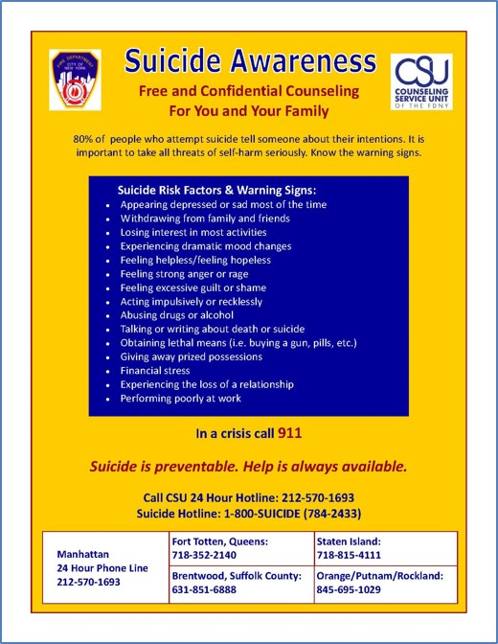
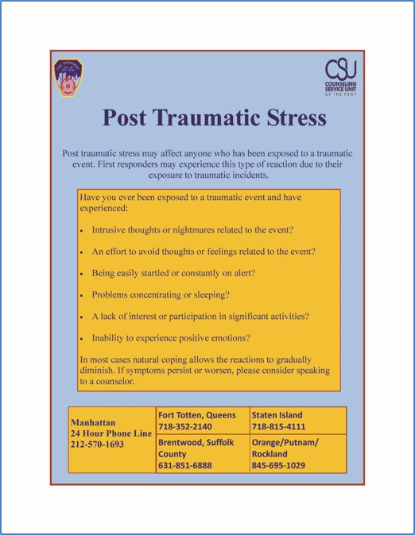
Education

Slide 42
Direct Services
Effective EAP/ MAP Program
  Proactively educate about behavioral health programs and treatment
  Have relationships with sufficient
    Treatment providers
    Impatient and outpatient services
    With established means of getting FF to care QUICKLY
  Solid connections to Peer Support Programs
  Working understand of addiction and addiction treatment
  Up-to-date understanding of all benefit structures for firefighters in that city
  Prepare for large or unexpected incidents and support peer and professional providers when critical incidents occur
Internal Counselors

Slide 43
Outside Resources
Referrals
Hospitals
Rehab facilities

Slide 44
Outside Resources
Inform members
Reduces stigma
Identifies members in need

Slide 45
Peer Support Program
The purpose of the Peer Support Program is to prevent and/or lessen the potential negative impact of stress upon a member by providing emotional support, information and assistance
The Peers also work in conjunction with designated mental health professionals

Slide 46
Definition of Peer Support
Peer support is the process of giving and receiving non-clinical assistance to achieve long-term recovery from behavioral health challenges. This support is provided by peer supporters, people who have “lived experience” and/or have been trained to assist others in initiating and maintain long-term recovery and enhancing the quality of life for individuals and their families.
  International Association of Peer Supporters (iNAPS)

Slide 47
The Foundation of a Peer Program
Create a Peer Program Mission Statement
Identify a Peer Support Coordinator
Partner with Departmental administration, officers and union officials
Select Peers
Coordinate peer support specialist training, supervision and continuing education
Develop procedure for mental health consultation and training
Create confidentiality policies and procedures

Slide 48
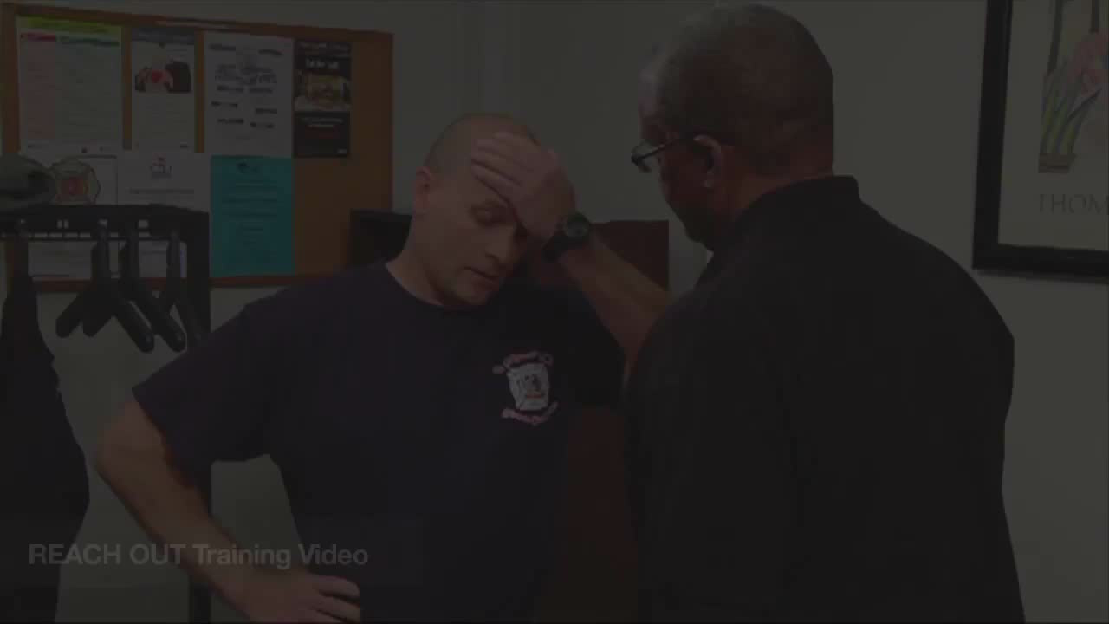

Slide 49
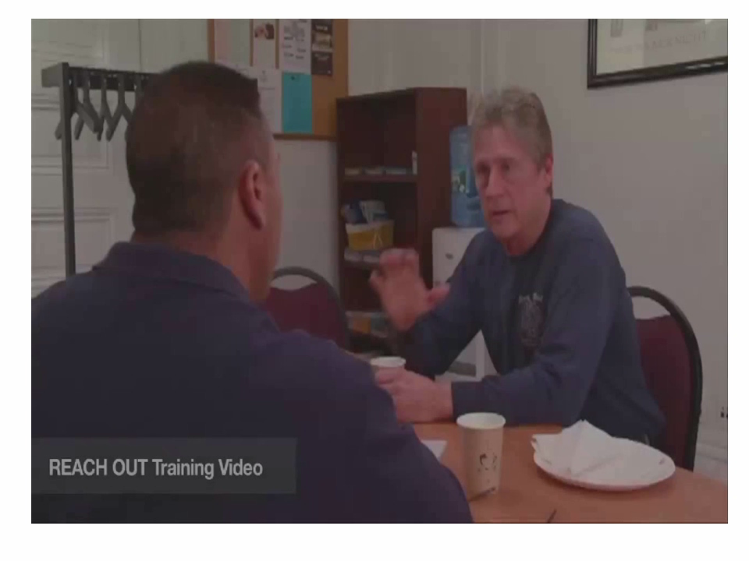

Slide 50
Peer Support Evidence
Peer support has resulted in significant gains in the areas of:
Self esteem/ empowerment/ confidence
Decision making skills
Social and overall functioning
Reduced psychiatric symptoms
Reduced isolation
Larger social networks and increased support seeking
Greater pursuit of educational goals and employment
Greater capacity to deal with adverse life events
        Resnick & Rosenhack,2008; Norris & Stevens, 2007; Davidson et.al; 1999
        Froland, Brodsky, Olson & Stewart

Slide 51
IAFF Behavioral Health Training Program
On-line Awareness Course

Slide 52
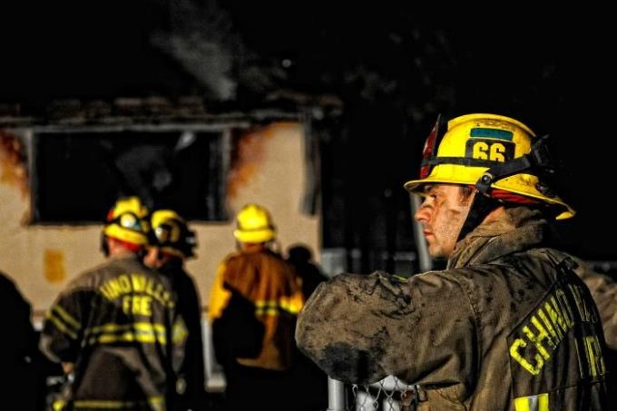
Overview of Behavioral Health for Fire Fighters

Slide 53
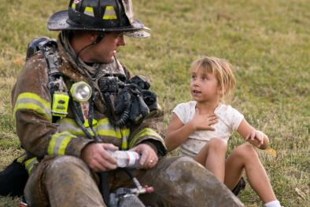
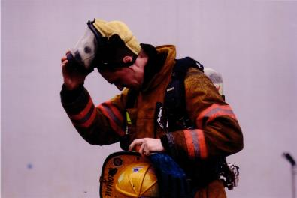
Behavioral Health Awareness
Module 1:
Overview of Behavioral Health for Fire Fighters
Module 2:
Recognition of Behavioral Health Disorders
Module 3:
Fighting Back:
Maintaining Behavioral Health
Notes:
Behavioral Health Awareness has 3 Modules:
Overview of Behavioral Health for Fire Fighters—introduces behavioral health issues in the fire service
Recognition of Behavioral Health Disorders—identifies the signs and symptoms to watch for
Fighting Back: Maintaining Behavioral Health—covers resilience, overcoming stigma, and access to resources
Now let's get started with Module 1.

Slide 54
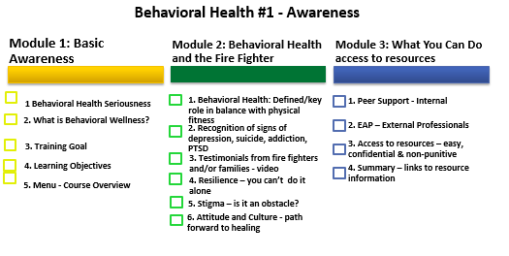

Slide 57
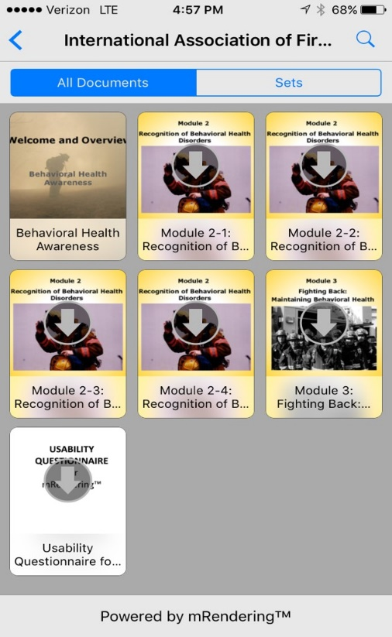
Behavioral Health Awareness

Slide 58
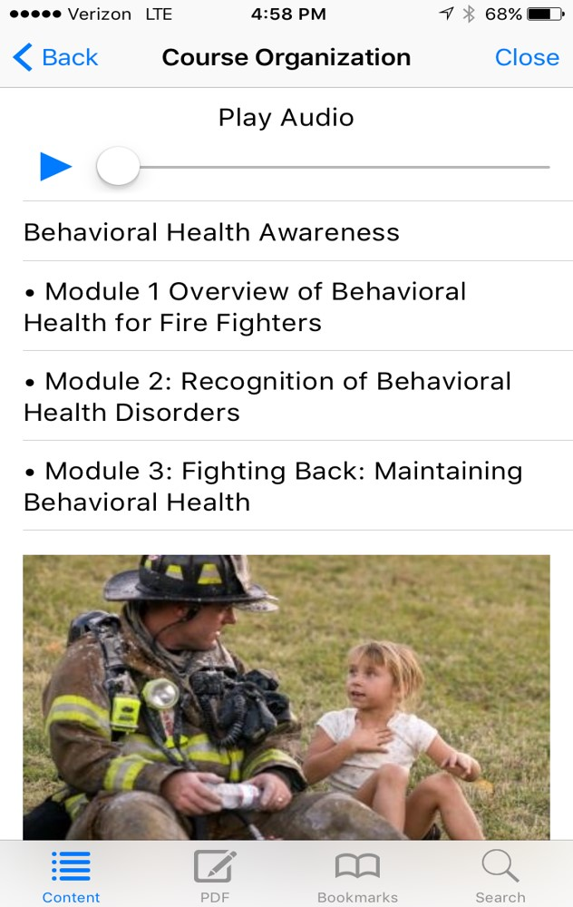
Behavioral Health Awareness

Slide 59
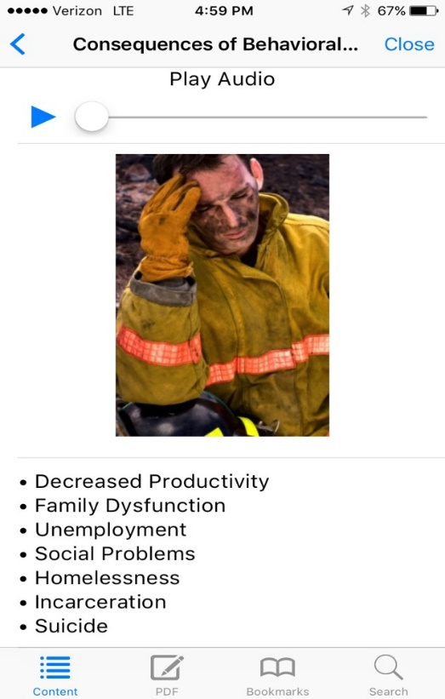
Behavioral Health Awareness

Slide 60
Fire Department Assessment Report
Behavioral Health Program Readiness Assessment:

Slide 61
Please answer the following questions:
How many members are in the department? ___________
Number of sworn members _____
Number of civilian members________
Number of volunteers _____
Which of the following are in place?
CISM Team/Peer Team ⃝Utilized ⃝Underutilized ⃝Not in place ⃝Unsure
Fire Department EAP ⃝Utilized ⃝Underutilized ⃝Not in place ⃝Unsure
City EAP ⃝Utilized ⃝Underutilized ⃝Not in place ⃝Unsure
Union EAP ⃝Utilized ⃝Underutilized ⃝Not in place ⃝Unsure
Combined union/management EAP ⃝Utilized ⃝Underutilized ⃝Not in place ⃝Unsure
Staff Psychologist, Social Worker, Counselor ⃝Utilized ⃝Underutilized ⃝Not in place ⃝Unsure
Department Physician ⃝Utilized ⃝Underutilized ⃝Not in place ⃝Unsure
Chaplains ⃝Utilized ⃝Underutilized ⃝Not in place ⃝Unsure

Slide 62
Roster of Fire Culture Aware Health Care Providers ⃝Utilized ⃝Underutilized ⃝Not in place ⃝Unsure
Roster of Inpatient Resources ⃝Utilized ⃝Underutilized ⃝Not in place ⃝Unsure
Roster of Outpatient Resources ⃝Utilized ⃝Underutilized ⃝Not in place ⃝Unsure
Peer Support Program ⃝Utilized ⃝Underutilized ⃝Not in place ⃝Unsure
Roster of 12-Step Resources ⃝Utilized ⃝Underutilized ⃝Not in place ⃝Unsure
Behavioral Health Education Program ⃝Utilized ⃝Underutilized ⃝Not in place ⃝Unsure
Family Programs ⃝Utilized ⃝Underutilized ⃝Not in place ⃝Unsure
Retiree Programs ⃝Utilized ⃝Underutilized ⃝Not in place

Slide 63
Does your department have funding allocated for behavioral health or member services? _______________
Does your local union have funding allocated for behavioral health or member services? ____________
Does your department have a section or offices for staff or peers to use for their behavioral health or member services organizations? ________________
Does your local union have a section or offices for staff or peers to use for their behavioral health or member services organizations? _________________

Slide 64
Peer Support Train the Trainer Course
Two day Peer Training Program
24 IAFF Behavioral Peer Trainers
Curricula is completed
Video role playing incorporated into the course
Three beta classes scheduled
Cost estimate at $6-8k
Kickoff after Convention

Slide 65
Benefits of a Behavioral Health Program
Builds trust
Healthier workforce
Less absenteeism
Break-down barriers, reduce counseling stigma, normalizing, dispel myths
Well-educated workforce
Emotionally prepare workforce and families for individual and large-scale crises

Slide 66
Behavioral health program development is essential for every department in order to ensure the mental health of all members and their families.

Slide 67
Thank You
Drew Kane
Phone: 212-570-1693
Email: Andrew.Kane@fdny.nyc.gov

